Slide 1
Electrical Machines

Slide 2
Synchronous Motor
Synchronous motor and induction motor are the most widely used types of AC motor. Construction of a synchronous motor is similar to an alternator (AC generator). A same synchronous machine can be used as a synchronous motor or as an alternator. Synchronous motors are available in a wide range, generally rated between 150kW to 15MW with speeds ranging from 150 to 1800 rpm.
This motor is called synchronous motor because its rotor runs in synchronism with the synchronously rotating stator field.

Slide 3
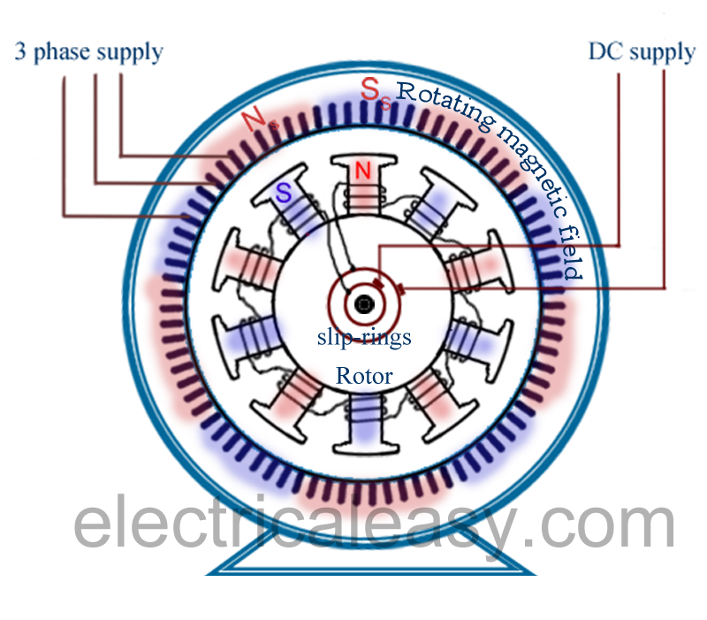
Synchronous Motor
Construction Of Synchronous Motor
Just like any other motor, it consists of a stator and a rotor. The stator core is constructed with thin silicon lamination and insulated by a surface coating, to minimize the eddy current and hysteresis losses. The stator has axial slots inside, in which three phase stator winding is placed. The stator is wound with a three phase winding for a specific number of poles equal to the rotor poles.
The rotor in synchronous motors is mostly of salient pole type. DC supply is given to the rotor winding via slip-rings. The direct current excites the rotor winding and creates electromagnetic poles. In some cases permanent magnets can also be used.

Slide 4
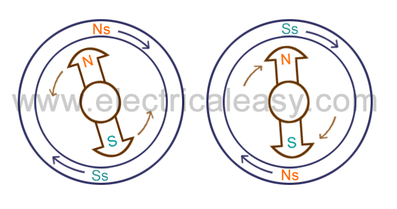
Synchronous Motor
Working Of Synchronous Motor
The stator is wound for the similar number of poles as that of rotor, and fed with three phase AC supply. The 3 phase AC supply produces rotating magnetic filed in stator. The rotor winding is fed with DC supply which magnetizes the rotor. Consider a two pole synchronous machine as shown in figure below.

Slide 5
Now, the stator poles are revolving with synchronous speed (lets say clockwise). If the rotor position is such that, N pole of the rotor is near the N pole of the stator (as shown in first schematic of above figure), then the poles of the stator and rotor will repel each other, and the torque produced will be anticlockwise.
The stator poles are rotating with synchronous speed, and they rotate around very fast and interchange their position. But at this very soon, rotor can not rotate with the same angle (due to inertia), and the next position will be likely the second schematic in above figure. In this case, poles of the stator will attract the poles of rotor, and the torque produced will be clockwise.
Hence, the rotor will undergo to a rapidly reversing torque, and the motor will not start.
But, if the rotor is rotated upto the synchronous speed of the stator by means of an external force (in the direction of revolving field of the stator), and the rotor field is excited near the synchronous speed, the poles of stator will keep attracting the opposite poles of the rotor (as the rotor is also, now, rotating with it and the position of the poles will be similar throughout the cycle). Now, the rotor will undergo unidirectional torque. The opposite poles of the stator and rotor will get locked with each other, and the rotor will rotate at the synchronous speed.

Slide 6
Types of Synchronous Motor
Synchronous motors can be classified into two types based on how the rotor is magnetized.
Non-Excited Synchronous Motors
Direct Current (DC) Excited Synchronous Motors
Non Excited Synchronous Motor
The rotor is made up of steel. At synchronous speed, it rotates with the rotating magnetic field of the stator, so it has an almost-constant magnetic field through it. The rotor is made of high-retentively steel such as cobalt steel.
Non-Excited Synchronous Motors are available in three designs:
Hysteresis Synchronous Motors
Reluctance Synchronous Motors
Permanent Magnet Synchronous Motors
Direct Current (DC) Excited Synchronous Motor
Direct Current (DC) Excited Synchronous Motor requires DC supply to the rotor to generate a magnetic field. It has both stator winding as well as rotor winding. The direct current can be supplied from a separate DC source or from a DC generator connected to the motor shaft.

