Slide 1

Basic Electrical Engineering (BEEE101L)
Presented By
Dr. Maddela Chinna Obaiah
Assistant Professor (Sr)
School of Electrical Engineering

Slide 2
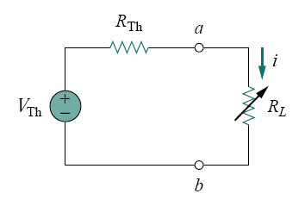
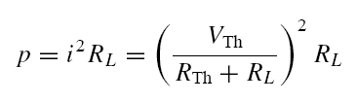
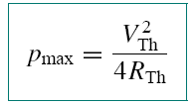
Maximum power transfer Theorem
The Thevenin equivalent is useful in finding the maximum power a linear circuit can deliver to a load. the power delivered to the load is
Maximum power is transferred to the load when the load resistance equals the Thevenin resistance as seen from the load (R_{L} = R_{Th}).
The maximum power transferred is obtained as

Slide 3
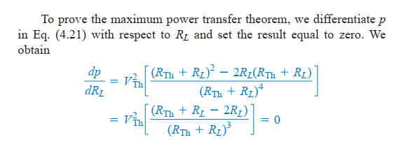
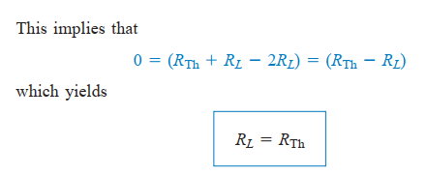
Proof

Slide 4
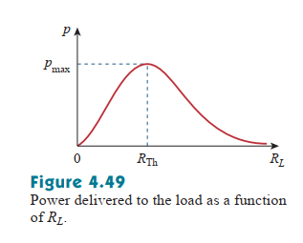

Proof (contd.,)

Slide 5
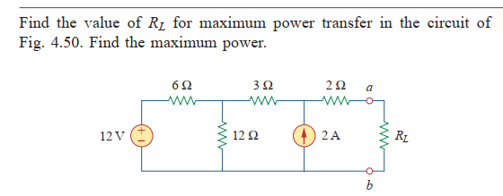
Problem

Slide 6
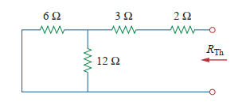

Solution

Slide 7
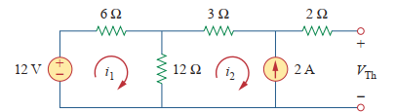
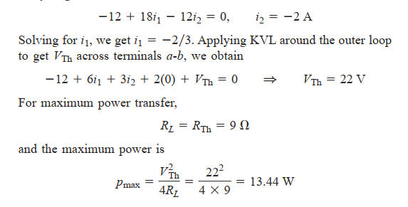

Slide 8
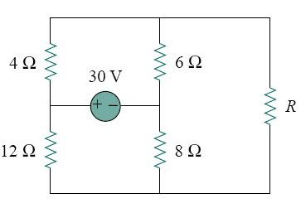
Problem. For what value of R is the power dissipated in R maximum? Calculate that power.

Slide 11
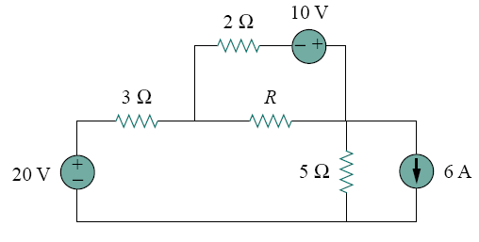
Problem. Find the maximum power that can be delivered to the resistor R in the circuit in Fig.

Slide 12
Problem. Find the current in 5 Ω resistor for the circuit shown in fig using nodal method.
Ans:
V₃ = -8.42V
I_{5Ω}= -3.68 A
Problem. Find the currents in all branches using nodal method and verify with mesh analysis.
Ans:
I_{1Ω}= -0.92 A
I_{2Ω}= 0.615 A
I_{2Ω}= 1.075 A
I_{4Ω}= 1.69 A

