Slide 1
Predicate Logic
Topic #3 – Predicate Logic
Predicate logic is an extension of propositional logic that permits concisely reasoning about whole classes of entities.
Propositional logic (recall) treats simple propositions (sentences) as atomic entities.
In contrast, predicate logic distinguishes the subject of a sentence from its predicate.

Slide 2
Subjects and Predicates
Topic #3 – Predicate Logic
In the sentence “The dog is sleeping”:
The phrase “the dog” denotes the subject - the object or entity that the sentence is about.
The phrase “is sleeping” denotes the predicate- a property that is true of the subject.
In predicate logic, a predicate is modeled as a function P(·) from objects to propositions.
P(x) = “x is sleeping” (where x is any object).

Slide 3
More About Predicates
Topic #3 – Predicate Logic
Convention: Lowercase variables x, y, z... denote objects/entities; uppercase variables P, Q, R… denote propositional functions (predicates).
Keep in mind that the result of applying a predicate P to an object x is the proposition P(x). But the predicate P itself (e.g. P=“is sleeping”) is not a proposition (not a complete sentence).
E.g. if P(x) = “x is a prime number”, P(3) is the proposition “3 is a prime number.”

Slide 4
Propositional Functions
Topic #3 – Predicate Logic
Predicate logic generalizes the grammatical notion of a predicate to also include propositional functions of any number of arguments, each of which may take any grammatical role that a noun can take.
E.g. let P(x,y,z) = “x gave y the grade z”, then if x=“Kaushik”, y=“Ankit”, z=“A”, then P(x,y,z) = “Kaushik gave Ankit the grade A.”

Slide 5
Universes of Discourse (U.D.s)
Topic #3 – Predicate Logic
The power of distinguishing objects from predicates is that it lets you state things about many objects at once.
E.g., let P(x)=“x+1>x”. We can then say, “For any number x, P(x) is true” instead of (0+1>0) ∧ (1+1>1) ∧ (2+1>2) ∧ ...
The collection of values that a variable x can take is called x’s universe of discourse.

Slide 6
Quantifier Expressions
Topic #3 – Predicate Logic
Quantifiers provide a notation that allows us to quantify (count) how many objects in the univ. of disc. satisfy a given predicate.
“∀” is the FOR∀LL or universal quantifier. ∀x P(x) means for all x in the U.D., P holds.
“∃” is the ∃XISTS or existential quantifier. ∃x P(x) means there exists an x in the U.D. (that is, 1 or more) such that P(x) is true.

Slide 7
The Existential Quantifier ∃
Topic #3 – Predicate Logic
Example: Let the U.D. of x be parking spaces at ASV. Let P(x) be the predicate P(x): “x is full.” Then the existential quantification of P(x), ∃x P(x), is the proposition:
“Some parking space at ASV is full.”
“There is a parking space at ASV that is full.”
“At least one parking space at ASV is full.”

Slide 8
The Universal Quantifier ∀
Topic #3 – Predicate Logic
Example: Let the U.D. of x be parking spaces at ASV. Let P(x) be the predicate “x is full.” Then the universal quantification of P(x), ∀x P(x), is the proposition:
“All parking spaces at ASV are full.”
i.e., “Every parking space at ASV is full.”
i.e., “For each parking space at ASV, that space is full.”

Slide 9
Free and Bound Variables
Topic #3 – Predicate Logic
An expression like P(x) is said to have a free variable x (meaning, x is undefined).
A quantifier (either ∀ or ∃) operates on an expression having one or more free variables, and binds one or more of those variables, to produce an expression having one or more bound variables.

Slide 10
Example of Binding
Topic #3 – Predicate Logic
P(x,y) has 2 free variables, x and y.
∀x P(x,y) has 1 free variable, and one bound variable. [Which is which?]
“P(x), where x=3” is another way to bind x.
An expression with zero free variables is a bona-fide (actual) proposition.
An expression with one or more free variables is still only a predicate: e.g. let Q(y) = ∀x P(x,y)
y
x

Slide 11
Applications of Predicate Logic
Topic #3 – Predicate Logic
It is the formal notation for writing perfectly clear, concise, and unambiguous mathematical definitions, axioms, and theorems or any branch of mathematics.

Slide 12
Nesting of Quantifiers
Topic #3 – Predicate Logic
Example: Let the U.D. of x & y be people.
Let L(x,y)=“x likes y” (a predicate w. 2 f.v.’s)
Then ∃y L(x,y) = “There is someone whom x likes.” (A predicate w. 1 free variable, x)
Then ∀x (∃y L(x,y)) = “Everyone has someone whom they like.”
A __________ will have ___ free variables.
0
Proposition

Slide 13
Review: Predicate Logic
Objects x, y, z, …
Predicates P, Q, R, … are functions mapping objects x to propositions P(x).
Multi-argument predicates P(x, y).
Quantifiers: [∀x P(x)] :≡ “For all x’s, P(x).” [∃x P(x)] :≡ “There is an x such that P(x).”
Universes of discourse, bound & free vars.

Slide 14
Quantifier Exercise
Topic #3 – Predicate Logic
If R(x,y)=“x relies upon y,” express the following in unambiguous English:
∀x(∃y R(x,y))=
∃y(∀x R(x,y))=
∃x(∀y R(x,y))=
∀y(∃x R(x,y))=
∀x(∀y R(x,y))=
Everyone has someone to rely on.
There’s a poor overburdened soul whom everyone relies upon (including himself)!
There’s some needy person who relies upon everybody (including himself).
Everyone has someone who relies upon them.
Everyone relies upon everybody, (including themselves)!

Slide 15
Example:
Let P(x): x is a person,
F(x,y): x is the father of y
M(x,y): x is the mother of y
Write the predicate “ x is the father of the mother of y”
∃z (P(z) ∧ F(x,z) ∧ M(z,y))

Slide 16
Symbolize the expression
“All cats are animals”
C(x): x is a cat
A(x): x is an animal.
∀x (C(x) → A(x)) “All cats are animals”
“Some cats are black”
B(x): x is black
∃x (C(x) ∧ B(x))

Slide 17
Quantifier Equivalence Laws
Topic #3 – Predicate Logic
Definitions of quantifiers: If U.D.=a,b,c,… ∀x P(x) ⇔ P(a) ∧ P(b) ∧ P(c) ∧ … ∃x P(x) ⇔ P(a) ∨ P(b) ∨ P(c) ∨ …
From those, we can prove the laws: ∀x P(x) ⇔ ¬∃x ¬P(x) ∃x P(x) ⇔ ¬∀x ¬P(x)
Which propositional equivalence laws can be used to prove this?

Slide 18
DeMorgan laws for quantifiers
¬∀x P(x) ⇔ ∃x ¬P(x)
¬∃x P(x) ⇔ ∀x ¬P(x)

Slide 19
Exercise Write the following using quantifiers
1. Everyone likes everyone
2. Everyone likes someone
3. Someone likes everyone
4. Someone likes someone

Slide 20
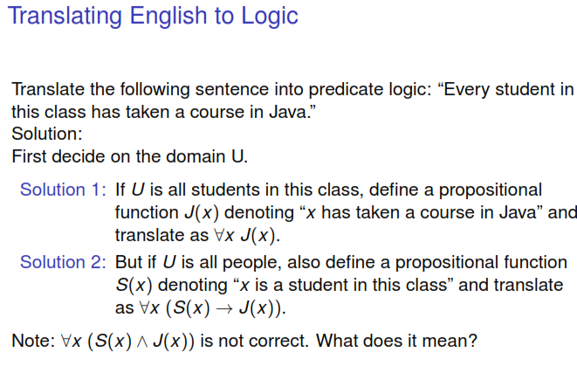

Slide 21
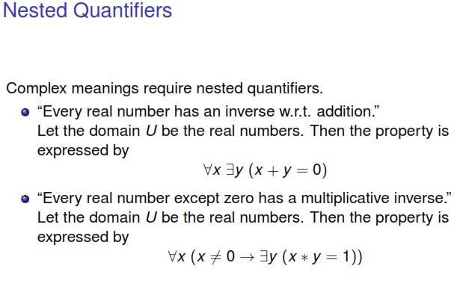

Slide 22
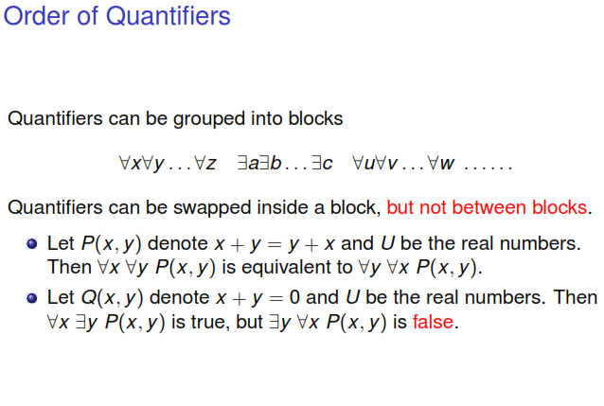

Slide 23
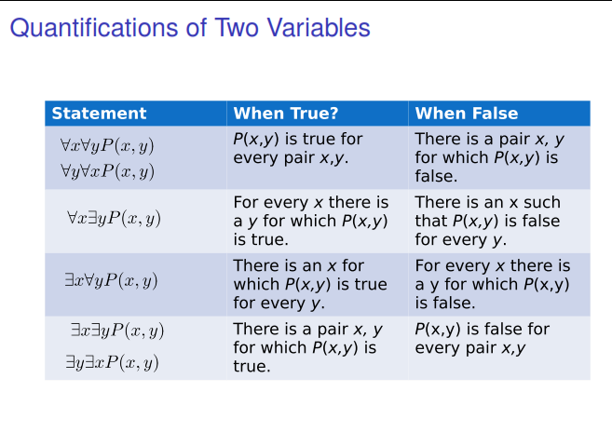

Slide 24
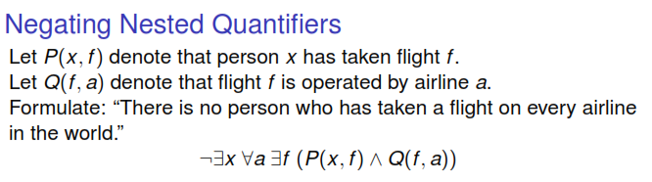

Slide 25
PROBLEM
Negate the following statements:
Every city in Canada is clean
All humans are good

Slide 26
EXAMPLE
Rewrite the following expression, pushing negation inward:
¬ ∀x (∃ y ∀z P(x,y,z) ∧ ∃ z ∀y P(x,y,z))
Answer:
∃x (∀y ∃z ¬P(x,y,z) ∨ ∀z ∃y ¬P(x,y,z))

Slide 27
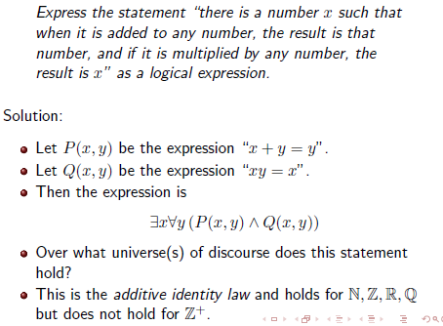

Slide 28
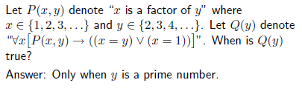

Slide 29
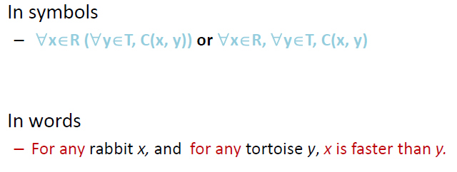
Symbolise the expression “All rabbits are faster than all tortoises”
Solution:

Slide 30

Symbolise and negate the following statement

Slide 31
Rule US (Universal Specification)
From ∀x P(x) one can conclude P(y) where y is a free variable

Slide 32
Rule ES (Existential Specification)
From ∃xP(x), one can conclude P(y) provided that y is not free in any given premise and also not free in any prior step of the derivation. These requirements can easily be met by choosing a new variable each time ES is used.

Slide 33
Rule UG (Universal Generalization)
From P(y) one can conclude that ∀x P(x) provided that y is not free in any of the given premises and provided that if y is free in a prior step which resulted from use of ES, then no variables introduced by that use of ES appear free in P(y).

Slide 34
Rule EG (Existential Generalization
From P(y) one can conclude ∃xP(x)

Slide 35
Example
“All men are mortal, Socrates is a man. Therefore Socrates is a mortal”
H(x): x is a man
M(x): x is mortal
U.D.: ??
P1: ∀x (H(x) → M(x))
P2: H(s) where s:= socrates
C : M(s)

Slide 36
Example
For example the statement “If everyone is happy then someone is happy" can be proven correct using this existential generalization rule. To prove it, first let the universe be the set of all people and let H(x) mean that x is happy. The proof is 1. (x) H(x) Hypothesis
2. H(c) Universal specification
3. (϶x) H(x) Existential generalization.

Slide 37
Practice Problems
1. ∀x(P(x)→ Q(x))∧∀x(Q(x)→ R(x)) ⇒
∀x(P(x) → R(x))
2. Show that (∃x)M(x) follows logically from the premises ∀x(H(x)→ M(x)) and (∃x)H(x)
3. Prove that (∀x)(P(x)∨Q(x)) ⇒ (∀x)P(x)∨(∃x)Q(x) {Hint: Use Indirect proof}

Slide 38
Example (more than one variable)
Show that ¬P(a,b) follows logically from (x)(y)(P(x,y)→W(x,y)) and ¬W(a,b)
Derivation:
(y) (P(a,y)→W(a,y))
P(a,b)→W(a,b)
¬W(a,b)
¬P(a,b)

Slide 39
More Equivalence Laws
Topic #3 – Predicate Logic
∀x ∀y P(x,y) ⇔ ∀y ∀x P(x,y) ∃x ∃y P(x,y) ⇔ ∃y ∃x P(x,y)
∀x (P(x) ∧ Q(x)) ⇔ (∀x P(x)) ∧ (∀x Q(x)) ∃x (P(x) ∨ Q(x)) ⇔ (∃x P(x)) ∨ (∃x Q(x))

Slide 40
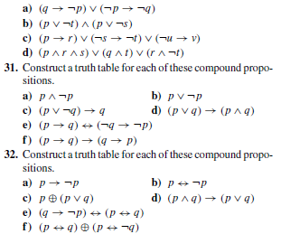

Slide 41
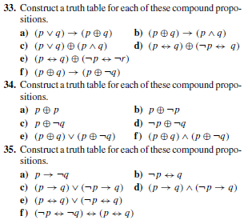

Slide 42
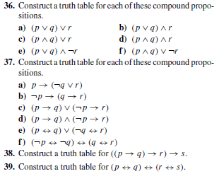

Slide 43


Slide 44


Slide 45
Problems
Show that the premises “Everyone in the Computer Science branch has studied Discrete Mathematics” and “Ram is in Computer Science branch” imply that “Ram has studied Discrete Mathematics’
Negate the statement “Every student in this class is intelligent” in two different ways.

