Slide 1
Outline
Relations
Inverse Relation
Composition
Reflexive
Symmetric
Transitive
Antisymmetric
Equivalence
Poset [Partially ordered set]
Hasse Diagram

Slide 2

Relations

Slide 3
Representing Relations
Set – ordered pairs
Set definition – membership values
Arrow Diagram

Slide 4
Relations
Arrow Diagram
Write the elements of A in one column
Write the elements B in another column
Draw an arrow from an element, a, of A to an element, b, of B, if (a ,b) ∈ R
Here, A = {2,3,5} and B = {7,10,12,30} and R from A into B is defined as follows: For all a ∈ A and b ∈ B, a R b if and only if a divides b
The symbol → (called an arrow) represents the relation R

Slide 5
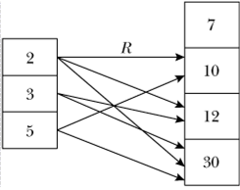
Relations

Slide 6
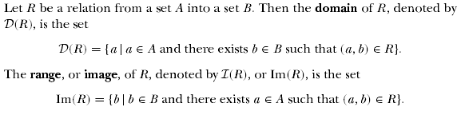
Relations

Slide 7
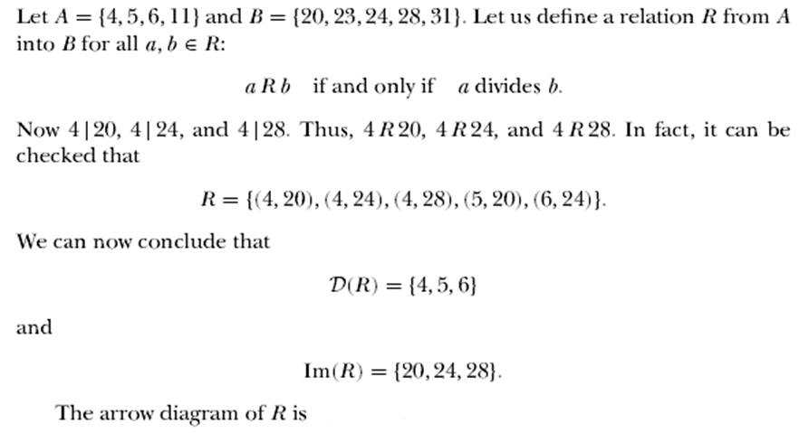
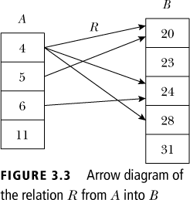
Relations

Slide 8

Inverse of Relations
Let A = {1, 2, 3, 4} and B = {p, q, r}. Let R = {(1, q), (2, r ), (3, q), (4, p)}. Then R⁻¹ = {(q, 1), (r , 2), (q, 3), (p, 4)}
To find R⁻¹, just reverse the directions of the arrows
D(R) = {1, 2, 3, 4} = Im(R⁻¹), Im(R) = {p, q, r} = D(R⁻¹)

Slide 9
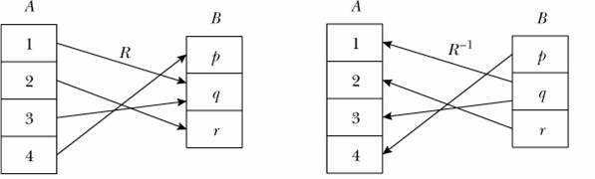
Inverse of Relations

Slide 10
Composition of Relations
Le R be a relations whose domain is A and whose image is B. Let S be a relation whose domain contains B and whose range is C. The composition of S and R is a subset of AXC. It is defined by:
Composition is Associative

Slide 11
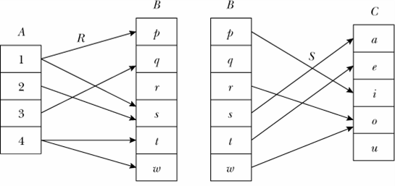
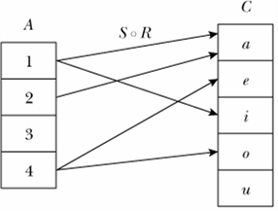
Composition of Relations
Example:
Consider the relations R and S as given above
The composition S ◦ R is shown on the right

Slide 12
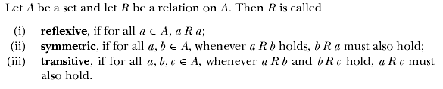
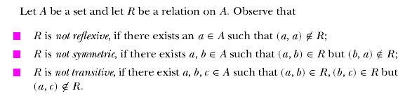
Properties of Relations

Slide 13


Slide 14
Example: R = {<x,y>| xRy = x is a friend of y}
Example: R = {<x,y>| xRy = x is the father of y}
R is Reflexive
R is Symmetric
R is transitive?
R is Not Reflexive
R is Not Symmetric
R is Not transitive

Slide 15

Equivalence Relations

Slide 16
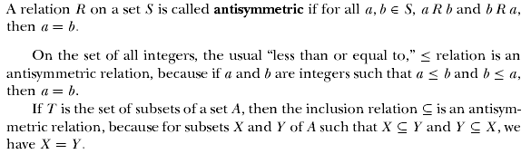
Antisymmetric

Slide 17
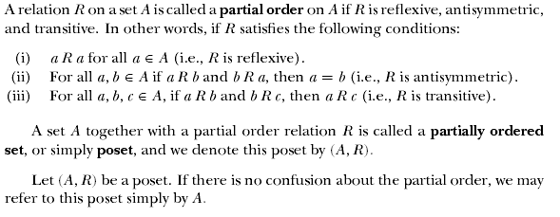

Partially Ordered Sets

Slide 18


Partially Ordered Sets

Slide 19
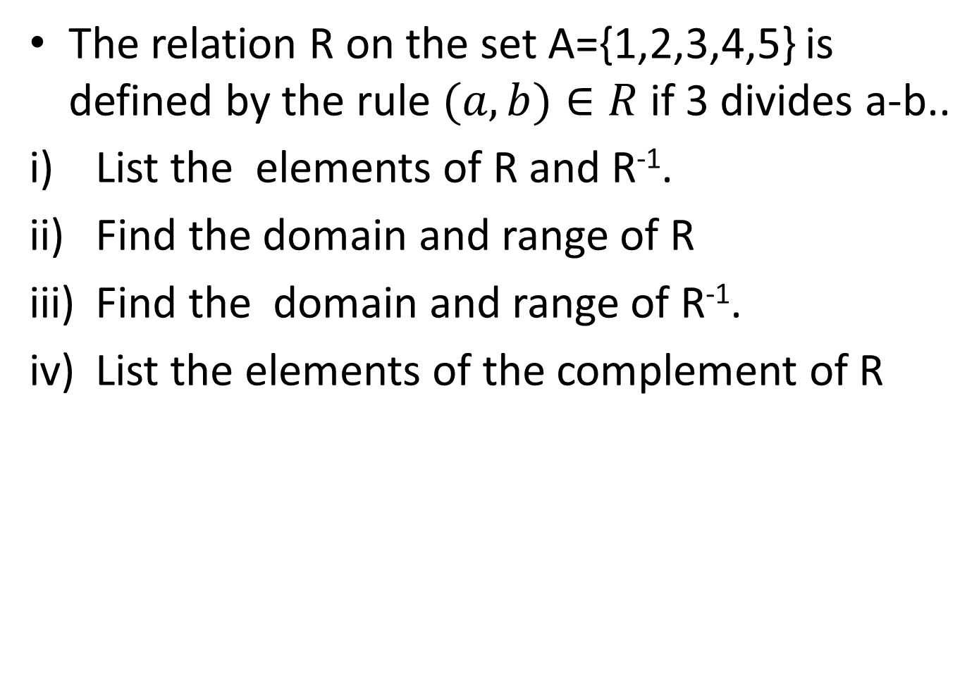

Slide 20
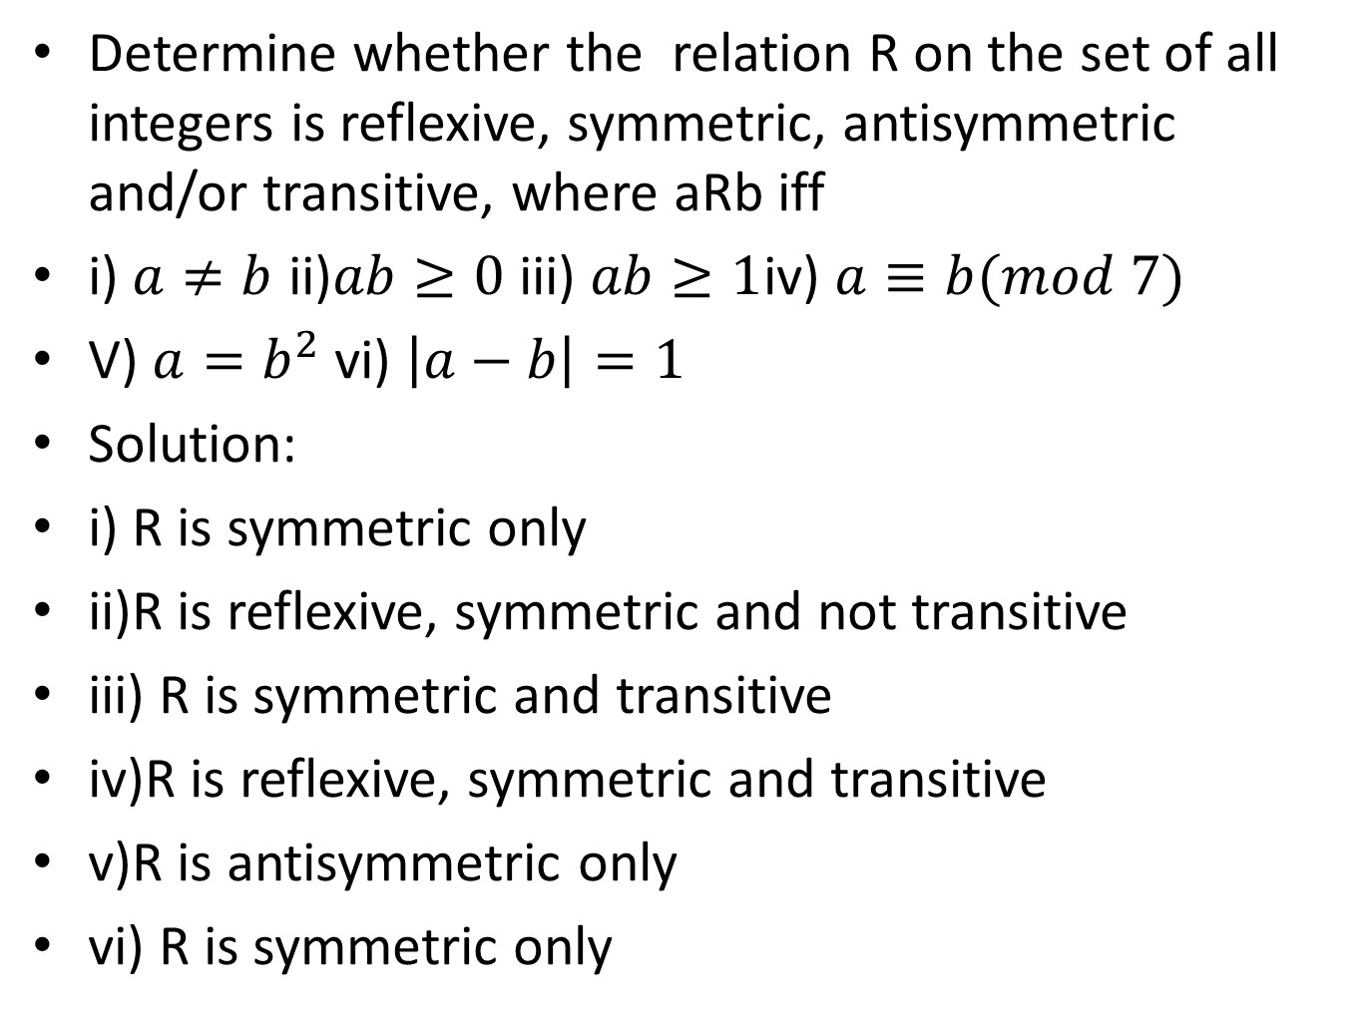

Slide 21
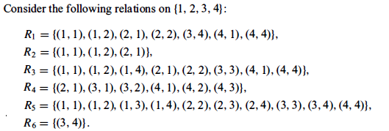
Example problems
1. Which of the following relations are symmetric and which are anti-symmetric?
R2,R3 symmetric
R4,R5,R6 are anti-symmetric

Slide 22
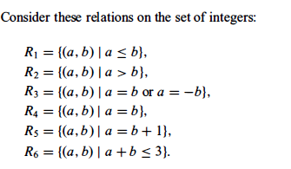
2. Which of the following relations are symmetric and which are anti-symmetric?
R3,R4,R6 symmetric
R1,R2,R4,R5 anti symmetric

Slide 23
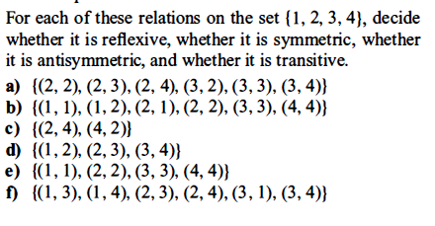
Ex. Problem 3 from Kenneth (8.1)

Slide 24
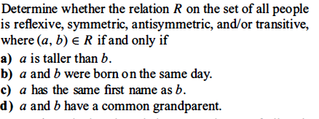
Ex. Problem 4 from Kenneth (8.1)

Slide 25

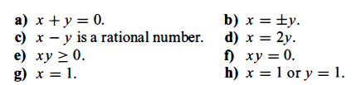
Ex. Problem 6 from Kenneth (8.1)

Slide 26
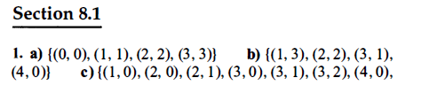
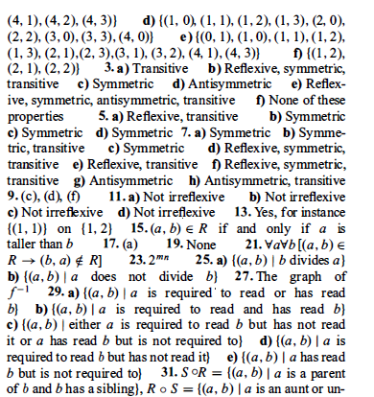

Slide 27
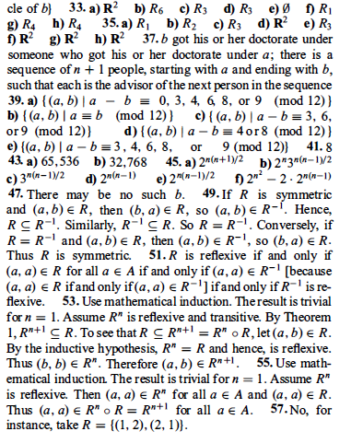

Slide 28
Hasse Diagrams
Let S={1,2,3,4}, consider the graph for a finite poset (S,≤)
When we KNOW it’s a poset, we can simplify the graph
4
3
2
1
4
3
2
1
4
3
2
1
4
3
2
1
Called the
Hasse
diagram

Slide 29
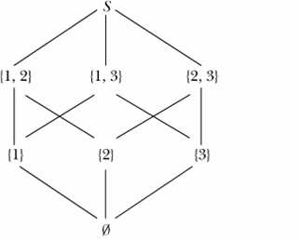
Partially Ordered Sets
Hasse Diagram
Let S = {1, 2, 3}. Then P(S) = {∅, {1}, {2}, {3}, {1, 2}, {2, 3}, {1, 3}, S}
Now (P(S),≤) is a poset, where ≤ denotes the set subset relation. The poset diagram of (P(S),≤) is shown

Slide 31
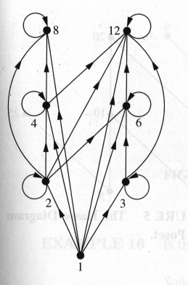
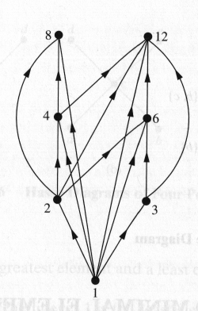
Hasse Diagram
Let S = {1,2,3,4,6,8,12},
≤ = | (Divisibility)
For the poset (S, ≤) Draw the Hasse Diagram

Slide 32
PROBLEMS
1. The relation R on the set A={1,2,3,4,5} id defined by aRb if 3 divides a-b.
i) List the elements of R and R⁻¹.
(ii)Find the domain and range of R.
(iii) Find the domain and range of R⁻¹.
2. Determine whether the relation R on the set of all integers is reflexive,symetric,antisymmetricand/or transitive aRb id defined iff
(i)a≠b (ii)ab≥0 (iii)ab≥1 (iv) a is a multiple of b
(v)a≡b(mod 7)

Slide 35
contd
3. Which of the following relations on {0,1,2,3} are equivalence relations? Find the properties of an equivalence relation that the others lack
R1={(0,0),(1,1),(2,2),(3,3)}
R2={(0,0),(0,2),(2,0),(2,2),(2,3),(3,2),(3,3)}
R3={(0,0),(1,1),(1,2),(2,1),(2,2),(3,3)}
4. If R is the relation on the set of ordered pairs of positive integers such that (a,b),(c,d) in R whenever ad=bc, show that R is an equivalence relation

Slide 37
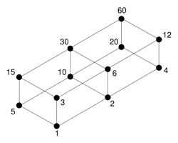
Draw the Hasse diagram for the set of all divisors of 60 using the relation aRb iff a divides b
60
12
20
30
4
6
10
15
2
3
5
1

Slide 41
An relation on binary digits.
Each source has one less ‘1’ digit than its target.

Slide 42
Ordered relation “partition order”
A partition of a positive integer m is a set whose sum is m. A partition P1 precedes a partition P2 if the integers in P1 can be added to obtain the partition P2. Let m=5 then we have: 5,3+2,2+2+1,1+1+1+1+1, 4+1, 3+1+1, 2+1+1+1.
5
3+2
4+1
1
3+1+1
2+2 +1
2+1+1+1 P2
1+1+1+1+1 P1
Notes:
A partition P1 precedes a partition P2 if the integers in P1 can be added to obtain the partition P2.

Slide 43
Ordered relation “divides”
Let A = {1,2,3,4,6,9,12,18,24}
24
8
12
18
4
6
1
9
2
3
1
For two natural numbers m and n the divisibility relation (|) can be written n|m if n divides m without remainder. (reads “n divides m." e.g. 2 divides 4)
Notes:
From Schaum’s Discrete Mathematics.
For two natural numbers m and n the divisibility relation (|) can be written n|m if n divides m without remainder.

Slide 44
Total Order
A total ordering is a partial ordering in which every element is related to every other element. (This forces a linear order or chain.)
Examples:
1
2
3
4
5
R: ≤ on {1, 2, 3, 4, 5} is total.
Pick any two; they’re related one way or the other with respect to ≤.
R: ⊇ on {{a, b}, {a}, {b}, ∅} is not total.
We can find a pair not related one way or the other with respect to ⊇.
{a} & {b}: neither {a} ⊇ {b} nor {b} ⊇ {a}
{a,b}
{a}
{b}
∅

Slide 46

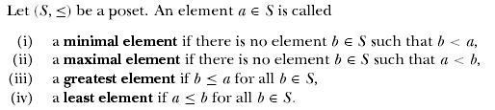
Partially Ordered Sets

Slide 47
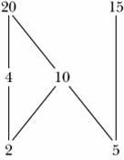
Partially Ordered Sets
Hasse Diagram
Consider the poset (S,≤), where S = {2, 4, 5, 10, 15, 20} and the partial order ≤ is the divisibility relation.
2 and 5 are the only minimal elements of this poset.
This poset has no least element.
20 and 15 are the only maximal elements of this poset.
This poset has no greatest element.

Slide 48
Extremal Elements: Example 1
c
d
a
b
What are the minimal, maximal, minimum, maximum elements?
Minimal: {a,b}
Maximal: {c,d}
There are no unique minimal or maximal elements, thus no minimum or maximum

Slide 49
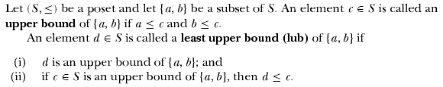
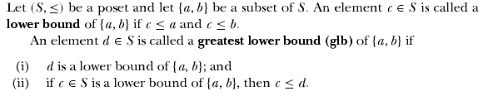
Partially Ordered Sets

Slide 50
Extremal Elements: Example 1
c
d
a
b
What are the minimal, maximal, minimum, maximum elements?
Minimal: {a,b}
Maximal: {c,d}
There are no unique minimal or maximal elements, thus no minimum or maximum

Slide 51
Extremal Elements: Example 2
Give lower/upper bounds & glb/lub of the sets:
{d,e,f}, {a,c} and {b,d}
{d,e,f}
Lower bounds: ∅, thus no glb
Upper bounds: ∅, thus no lub
{a,c}
g
h
i
Lower bounds: ∅, thus no glb
Upper bounds: {h}, lub: h
d
e
f
{b,d}
Lower bounds: {b}, glb: b
a
b
c
Upper bounds: {d,g}, lub: d because dpg

Slide 52
Extremal Elements: Example 3
Minimal/Maximal elements?
i
j
Minimal & Minimum element: a
Maximal elements: b,d,i,j
f
g
h
Bounds, glb, lub of {c,e}?
Lower bounds: {a,c}, thus glb is c
Upper bounds: {e,f,g,h,i,j}, thus lub is e
e
b
c
d
Bounds, glb, lub of {b,i}?
Lower bounds: {a}, thus glb is a
Upper bounds: ∅, thus lub DNE
a

Slide 53

Lattices

Slide 54
Extremal Elements: Example 2
Give lower/upper bounds & glb/lub of the sets:
{d,e,f}, {a,c} and {b,d}
{d,e,f}
Lower bounds: ∅, thus no glb
Upper bounds: ∅, thus no lub
{a,c}
g
h
i
Lower bounds: ∅, thus no glb
Upper bounds: {h}, lub: h
d
e
f
{b,d}
Lower bounds: {b}, glb: b
a
b
c
Upper bounds: {d,g}, lub: d because dpg

Slide 55
Extremal Elements: Example 3
Minimal/Maximal elements?
i
j
Minimal & Minimum element: a
Maximal elements: b,d,i,j
f
g
h
Bounds, glb, lub of {c,e}?
Lower bounds: {a,c}, thus glb is c
Upper bounds: {e,f,g,h,i,j}, thus lub is e
e
b
c
d
Bounds, glb, lub of {b,i}?
Lower bounds: {a}, thus glb is a
Upper bounds: ∅, thus lub DNE
a

Slide 56
Lattices: Example 1
Check the following is a lattice?
i
j
f
g
h
No, because the pair {b,c} does not have a least upper bound
e
b
c
d
a

Slide 57
Lattices: Example 2
What if we modified it as shown here?
j
i
f
g
h
Yes, because for any pair, there is an lub & a glb
e
b
c
d
a

Slide 58
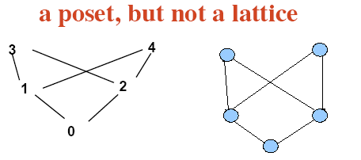

Slide 59
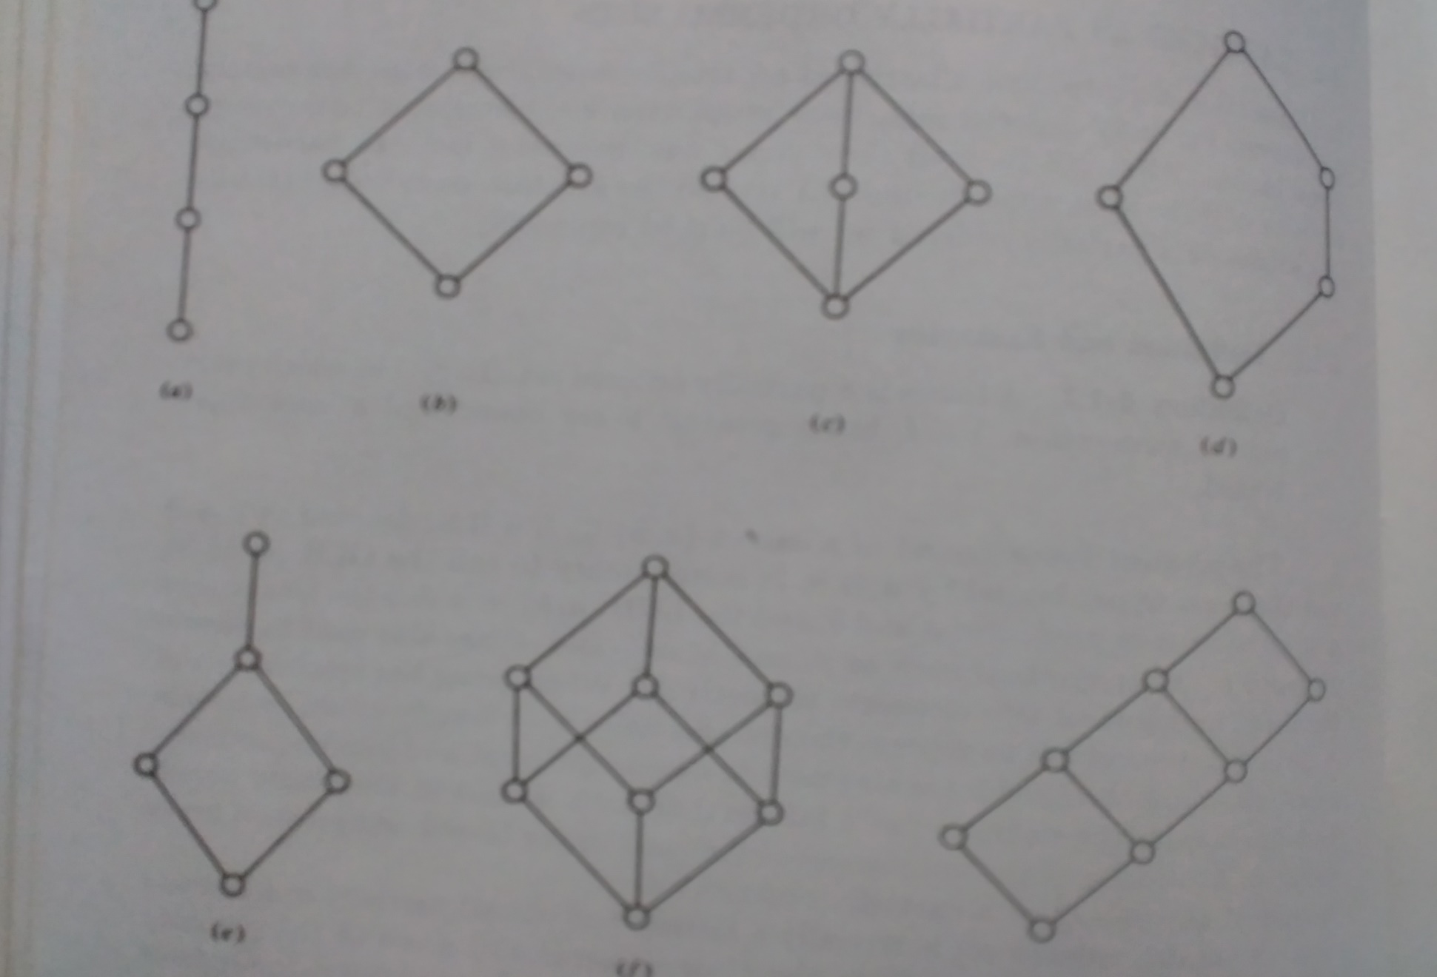
EXAMPLE FOR LATTICES

Slide 60

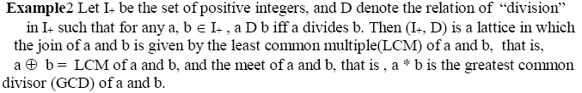

Slide 63
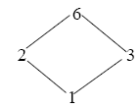

Slide 64
