Slide 1
GRAPH COLOURING, COVERING AND PARTITIONING

Slide 2
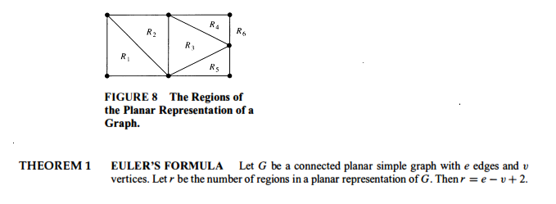

Slide 3
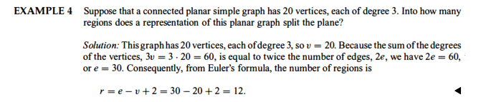

Slide 4

GRAPH COLORING

Slide 5
CHROMATIC NUMBER
Painting all vertices of a graph with colors such that no two adjacent vertices have the same color is called proper coloring of a graph. A graph in which every vertex has been assigned a color according to a proper coloring is called properly colored graph.

Slide 6
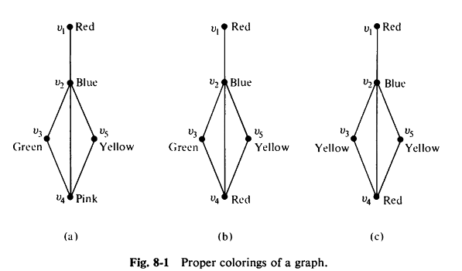
PROPER COLORINGS OF A GRAPH

Slide 7
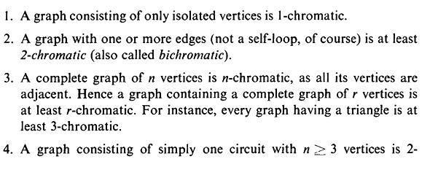
A graph that requires k different colors for proper coloring is called k-chromatic graph.
K is called the chromatic number of G. In the above example the chromatic number is 3 .
Note:

Slide 8

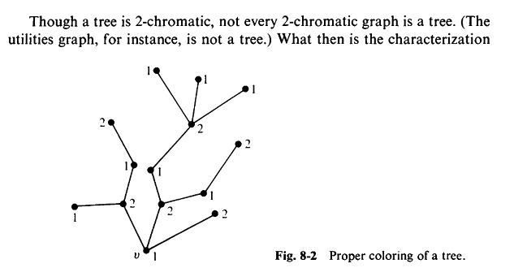

Slide 9

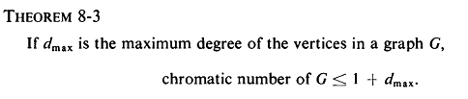

A

Slide 10
A graph G is called bipartite if its vertex set V can be partitioned into two disjoint subsets V₁ and V₂ such that every edge in V joins an edge in V₁ with a vertex in V₂. Thus every tree is a bipartite graph. Clearly, every 2-chromatic graph is bipartite.

Slide 11
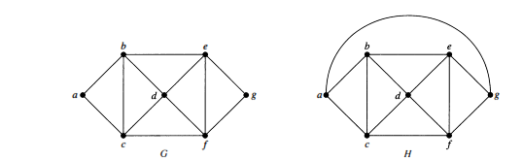
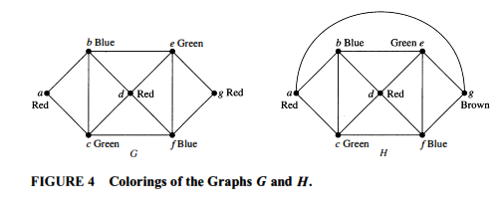

Slide 12
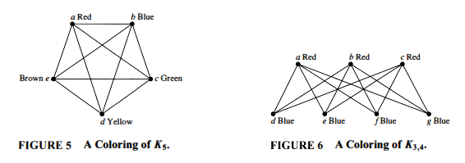

Slide 13
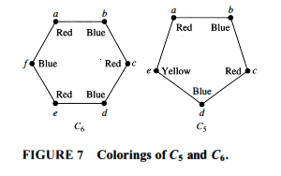

Slide 14
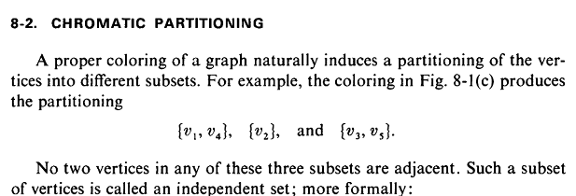
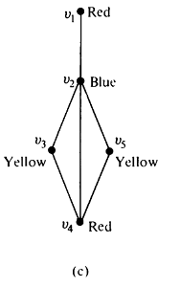

Slide 15
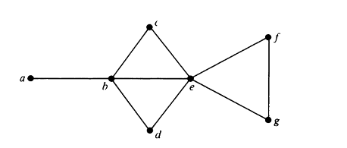
EXAMPLE

Slide 16
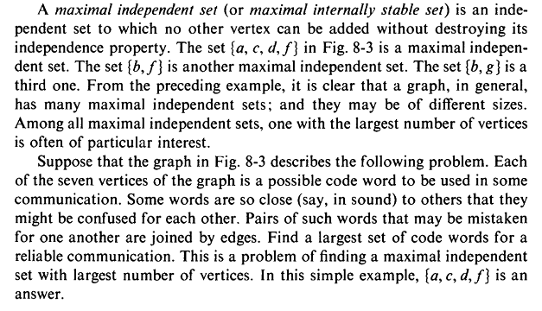

Slide 17

A given graph of n vertices can be colored in many different colours using sufficiently large number of colours. This property of graph can be expressed elegantly by using a polynomial called the chromatic polynomial of G.

Slide 18
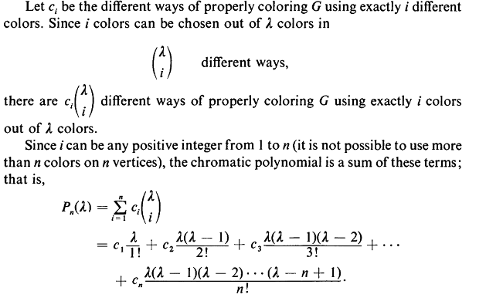

Slide 19
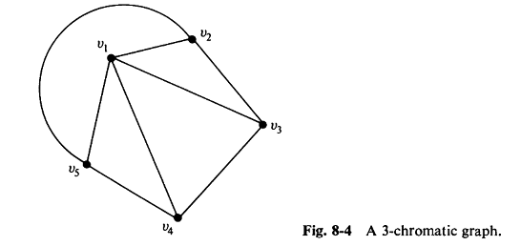

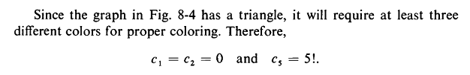
EXAMPLE- FINDING THE CHROMATIC POLYNOMIAL OF THE FOLLOWING GRAPH

Slide 20
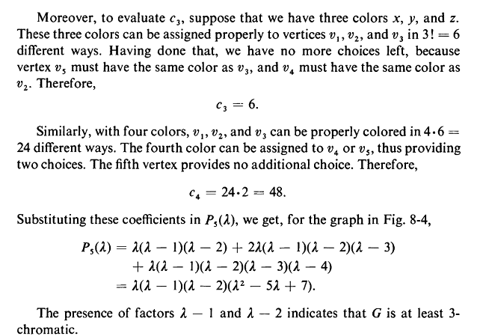

Slide 21

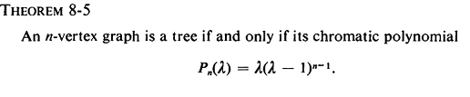

Slide 22
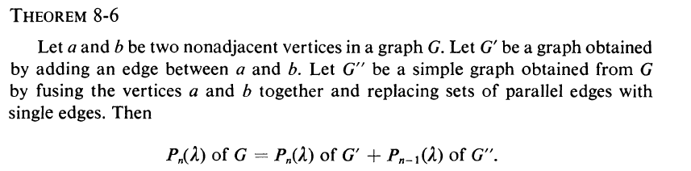
Using the above theorem we can find the chromatic polynomial of the following graph

Slide 23
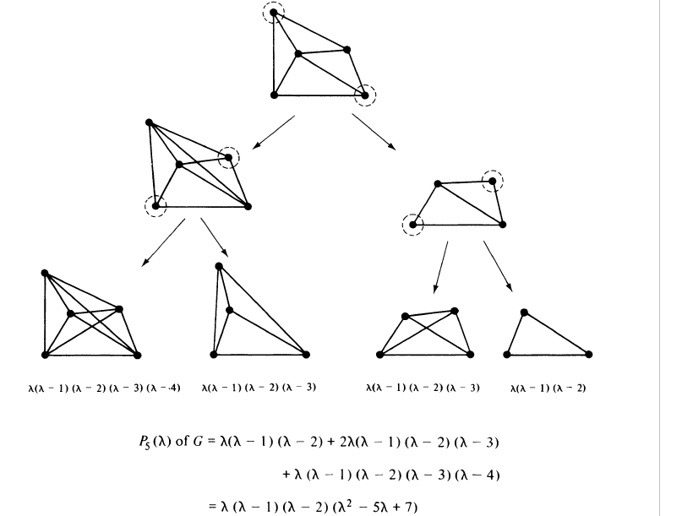

Slide 29
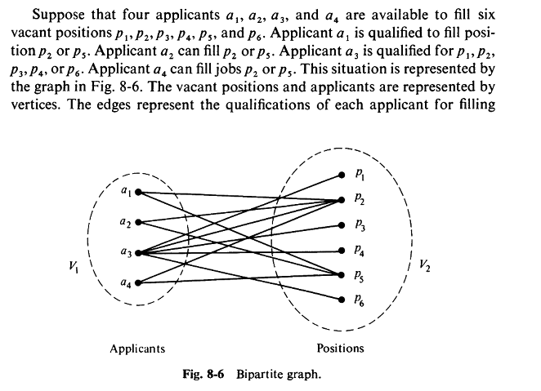
MATCHINGS

Slide 30
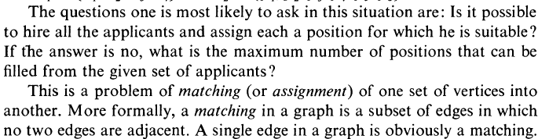

Slide 31

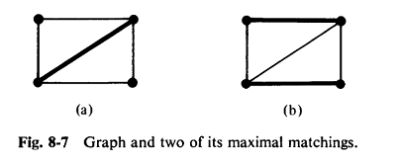

Slide 32
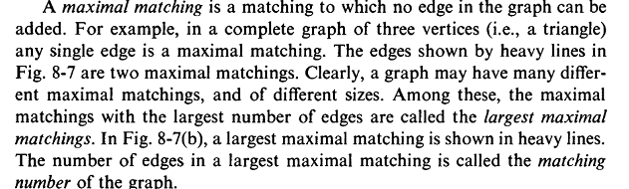

Slide 33


Slide 34
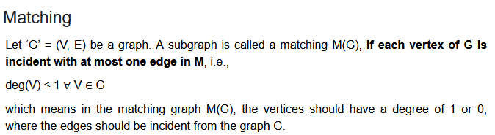
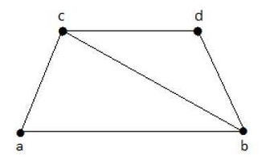
Example
Consider the graph

Slide 35
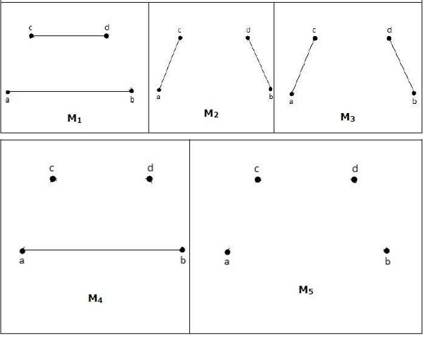

Slide 36

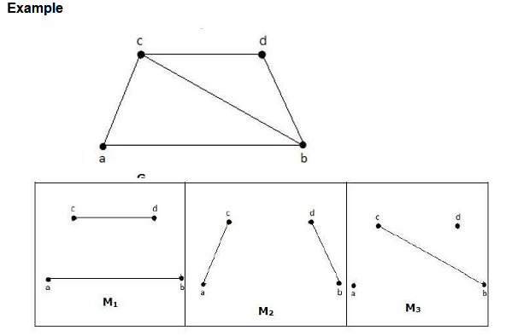

Slide 37
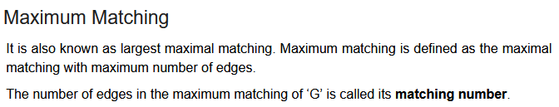
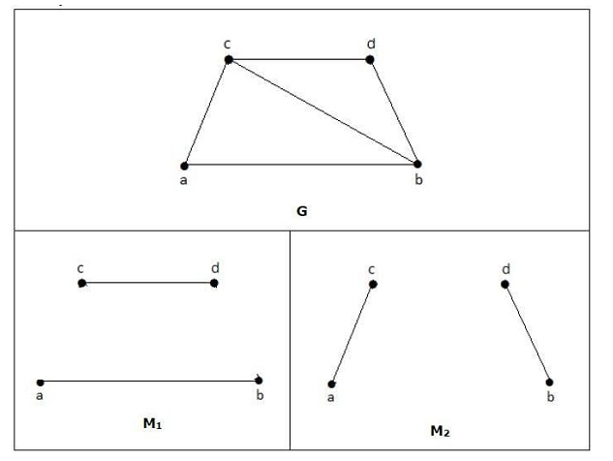
T
M1 and M2 are
maximum matching
of G. Hence the
matching number is 2

Slide 38
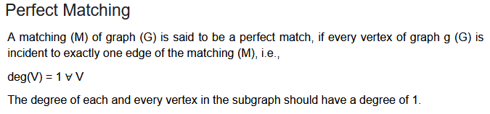
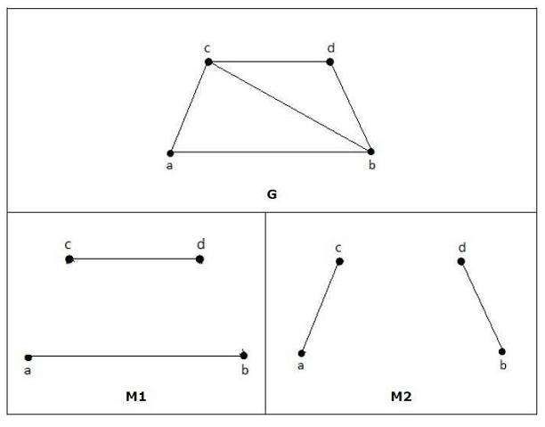
E

Slide 39
Every perfect matching of graph is also a maximum matching of graph, because there is no chance of adding one more edge in a perfect matching graph.
A maximum matching of graph need not be perfect. If a graph ‘G’ has a perfect match, then the number of vertices |V(G)| is even. If it is odd, then the last vertex pairs with the other vertex, and finally there remains a single vertex which cannot be paired with any other vertex for which the degree is zero. It clearly violates the perfect matching principle.

Slide 40
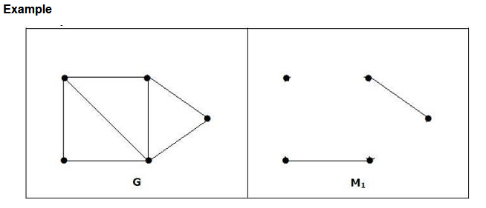
The converse of the above statement need not be true. If G has even number of vertices, then M1 need not be perfect.

Slide 41
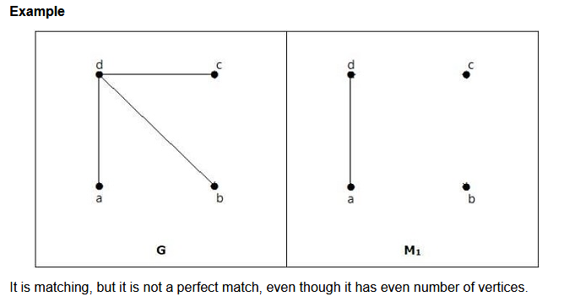

Slide 42
FOUR COLOR CONJECTURE
Consider the proper coloring of regions in a planar graph. The regions of a planar graph are said to be properly colored if no two adjacent regions have the same color.(Two regions are said to be adjacent if they have a common edge between them). The proper color of regions is called map coloring.
EVERY PLANAR GRAPH HAS A CHROMATIC NUMBER FOUR OR LESS

Slide 43
