Slide 1
CODING THEORY

Slide 2
INTRODUCTION
Process of communication involves transmitting some information carrying signal that is conveyed by a sender to a receiver.
Coding theory deals with minimizing the distortions of the conveyed message due to noise and retrieve the original message to the optimal extent possible.

Slide 3
ENCODERS AND DECODERS
ENCODER- a device which transforms the incoming messages in such a way that the presence of noise in the transformed message is detectable.
DECODER- a device which transforms the encoded message into their original form that can be understood by the receiver.

Slide 4
Transmitter→Encoder→Channel→Decoder→ Receiver
↑
Noise
The input message which consists of a sequence of letters, characters or symbols from a specified set – transformed by the encoder into a string of characters or symbols of another alphabet in a one-one fashion

Slide 6
GROUP CODE
Defn. If B={0,1}, then ,
is a group under the binary operation of addition modulo 2. The group is called a group code. It is abelian.
Defn. The codes obtained by introducing additional digits called parity digits to the digits in the original message are called Hamming codes. If the original message is a binary string of length m, the Hamming encoded message is string of length n (n>m). First m digits represents the information and the remaining (n-m) digits are used for the detection and correction of errors in the message received.

Slide 7
Contd.,
If the digit introduced in the last position gives an even number/odd number of 1’s in the encoded word of length n, the extra digit is called an even/odd parity check.
Eg: For a single even parity check , the words 000,001,010,011,100,101,110 and 111 become 0000,0011,0101,0110,1001,1010,1100 and 1111,

Slide 8
DEFINITIONS
1. The number of 1’s in the binary string
is called the weight of x and is denoted by |x|.
2. If x and y represent the binary strings x₁,x₂,…,x_{n} and y₁,y₂,…,y_{n}, the no. of positions in the strings for which x_{i}≠y_{j} is called the Hamming distance between x and y and denoted by H(x,y).
H(x,y)=weight of
(eg. 1) x=11010, u=10101, then
H(x,y)=| |=|01111|=4
3. The min distance of a code is the minimum of the Hamming distances between all pairs of encoded words in that code
(eg2)For x=10110,y=11110 and z=10011,
Then H(x,y)=1, H(y,z)=3 and H(z,x)=2. Min distance is 1.

Slide 9
GENERATOR MATRIX
Defn. When m,nϵZ⁺ and m<n ,the encoding function e:B^{m}→B^{n}, where B={0,1} is given by a mxn matrix G over B. This matrix G is called the generator matrix for the code and is of the form [I_{m}|A], I_{m} is the mxm unit matrix and A is an mx(n-m) matrix to be chosen suitably.
Now e(w)=wG

Slide 10
PROBLEM
Find the code words generated by the matrix
when encoding function is
Soln: B²={00,10,01,11}.
e(00)=[00000]; e(10)=[10110];
e(01)=[01011]; e(11)=[11101]

Slide 11
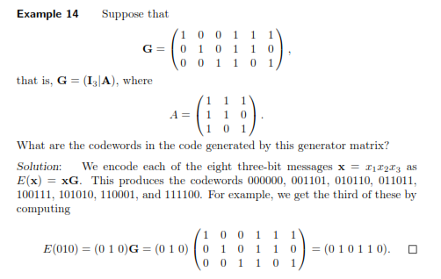
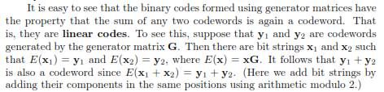

Slide 12

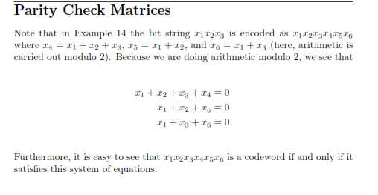

Slide 13
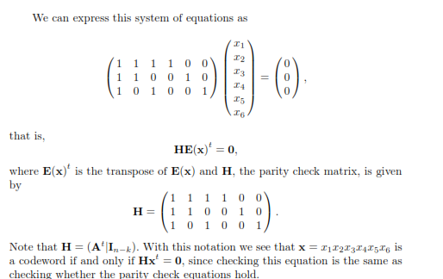

Slide 14
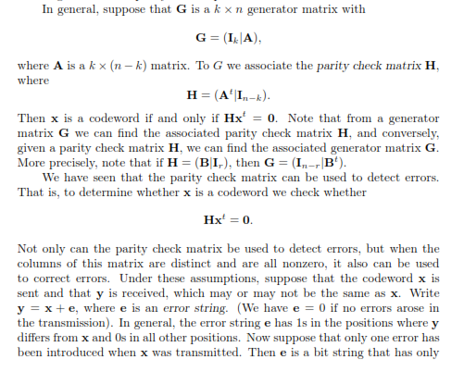

Slide 15
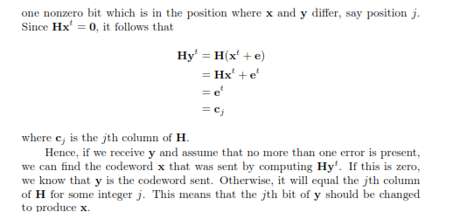
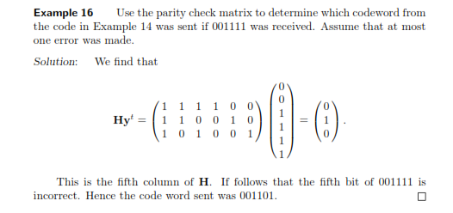

Slide 16
PARITY CHECK MATRIX AND DECODING SCHEME
1. If r is a received word considered as a (1xn) matrix and if H.r^{T}=[0], then there is no error in transmission and r is the code word transmitted. The decoded message then consists of the first m components of r.
2. If H.r^{T}=the ith column of H, then we conclude that a single error has occurred during transmission and it has occurred in the ith component of r. Changing the i^{th} component of r, we get the code word transmitted.

Slide 17
3. If neither case(1) nor case(2) occurs then we conclude that more than one transmission error have occurred.
Note:
Theorem: A code can correct a set of at the most k errors iff the min distance between any two code words is atleast 2k+1.

Slide 18
PROBLEM
1. Find the code words generated by the encoding function e:B²→B⁵ with respect to the parity check matrix

Slide 20
PROBLEM
2. Find the code words generated by the parity check matrix

Slide 21
PROBLEM
3. Given the generator matrix
Find the corresponding parity check matrix and use it to decode the following received words and hence, to find the original message. Are all the words decoded uniquely?
(i)110101 (ii)001111 (iii)110001 (iv)111111

Slide 22
SOLUTION

Slide 24
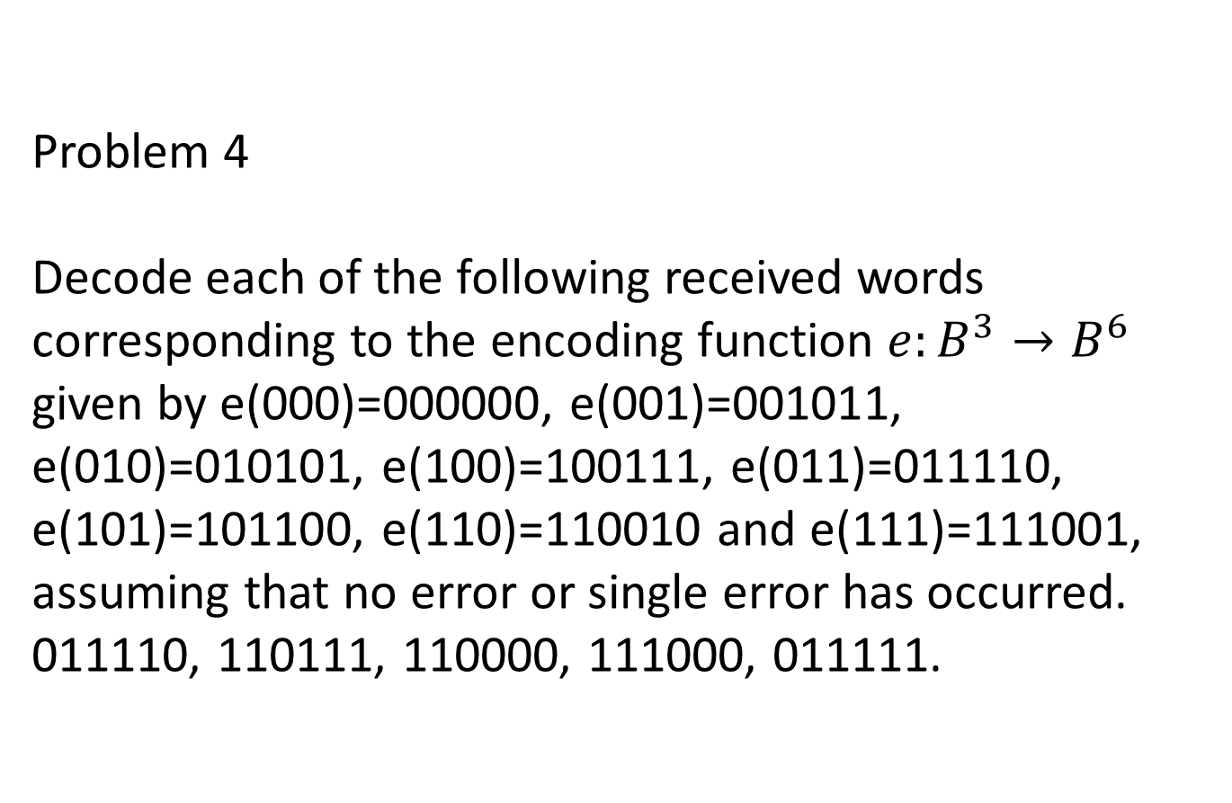
Problem 4 Decode each of the following received words corresponding to the encoding function $e:B^{3}→B^{6}$ given by e(000)=000000, e(001)=001011, e(010)=010101, e(100)=100111, e(011)=011110, e(101)=101100, e(110)=110010 and e(111)=111001, assuming that no error or single error has occurred. 011110, 110111, 110000, 111000, 011111.

Slide 25
DECODING TABLE
PROBLEM
1. Construct the decoding table for the group code is given by the generator matrix
Decoding the following received words using the decoding table obtained . Which of the words could not be decoded uniquely?
101111,011010,101110,111111.

Slide 26
G is a 3x6 matrix, it corresponds to the encoding function e:B³→B⁶.
B³={000,001,010,100,011,101,110,111}
e(000)=[000000]; e(001)=[001011]
e(010)=[010101]e(100)=[100111]; e(011)=[011110];e(101)=[101100]; e(110)=[110010];e(111)=[111001]
Form the decoding table by making these encoded words as the element as the first row and the coset leaders as the elements of the first column.

Slide 28
Decoding of the received words
(i)101111 appears in the 4th row and 4th column. The coset leader of the 4th row is 001000, which contains only one 1
Since the min weight of the code words is 3, atmost one error can be corrected in the received word
The corrected word, the code word transmitted is the top element of the 4th column. It is 100111. The original message is 100.

Slide 29
(ii) 011010 appears in the 5th row and 5th collumn . Hence the corresponding code word transmitted is 011110 and hence the original message is 011.
(iii) 101110 appears in the 6th row and 6th column. Hence the corresponding code word transmitted is 101100 and hence the original message is 101
(iv)111111 appears in the 8th row , the coset leader of which contains two 1’s the received word contains 2 errors. Hence they can’t be corrected and the code word transmitted cannot be uniquely determined.

