Slide 1
Engineering Design Visualization lab
Module 3
Dr.G.Venkatachalam
Professor / SMEC,
VIT Chennai Campus
Chennai

Slide 2
CONTENT
Introduction to Projection
First angle and third angle projection

Slide 3
Introduction to Projections

Slide 4
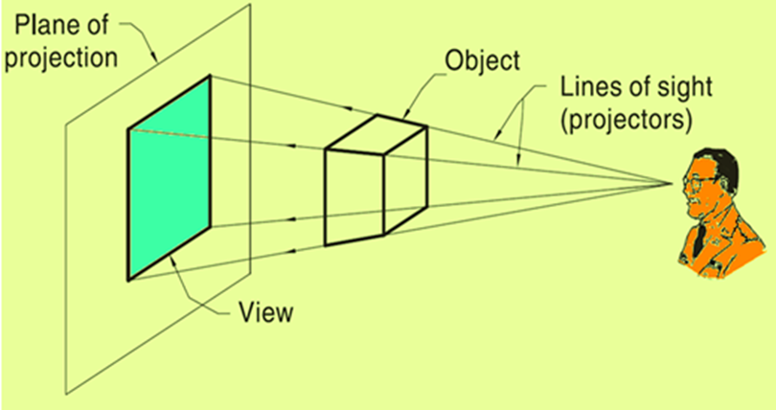
Theory of projections
Projection Theory
In engineering, 3-dimensonal objects and structures are represented graphically on a 2-dimensional media.
The act of obtaining the image of an object is termed “projection”
The image obtained by projection is known as a “view”
Based on two variables:
Line of sight
Plane of projection
Observer

Slide 5
Theory of projections
Line of Sight
An imaginary ray of light between an observer’s eye and an object.
In perspective projection, all lines of sight start at a single point
In parallel projection, all lines of sight are parallel

Slide 6
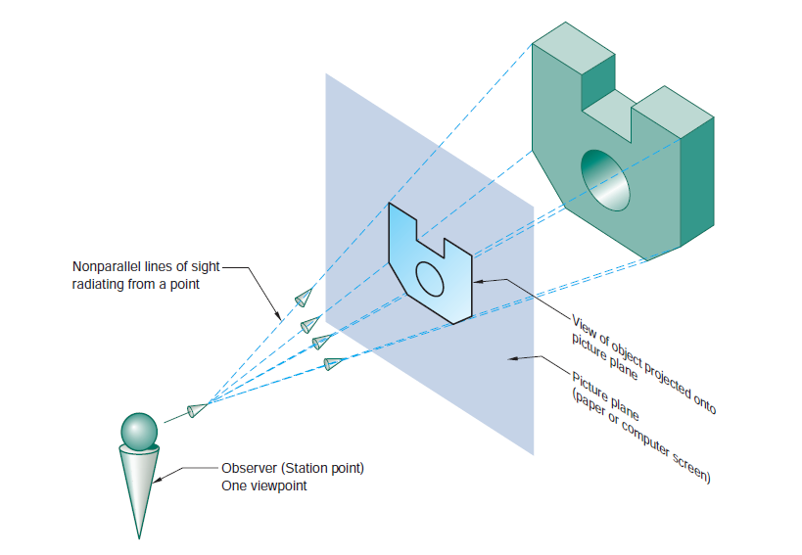

Slide 7
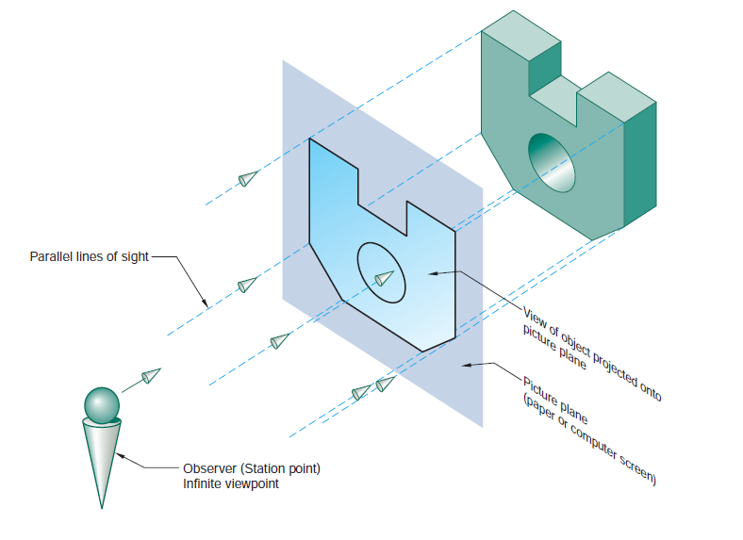

Slide 8
Theory of projections
Plane of Projection
An imaginary flat plane upon which the image created by the line of sight is projected
The image is produced by connecting the points where the lines of sight pierce the projection plane.
3-D object is transformed into a 2-D representation, also called projections

Slide 9
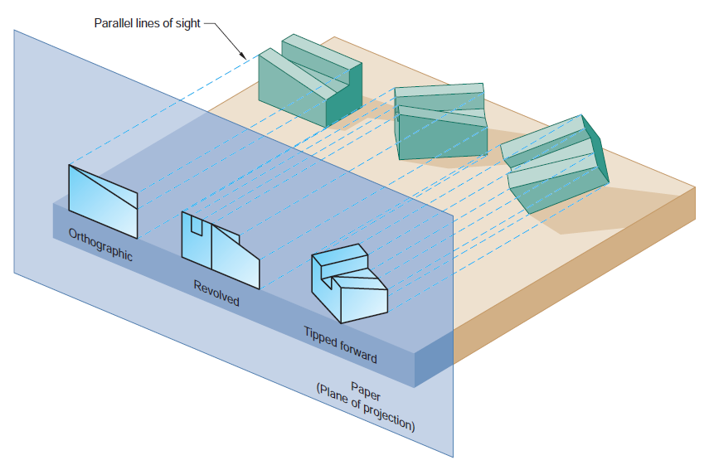
The paper or computer screen on which a drawing is created is a plane of projection

Slide 10
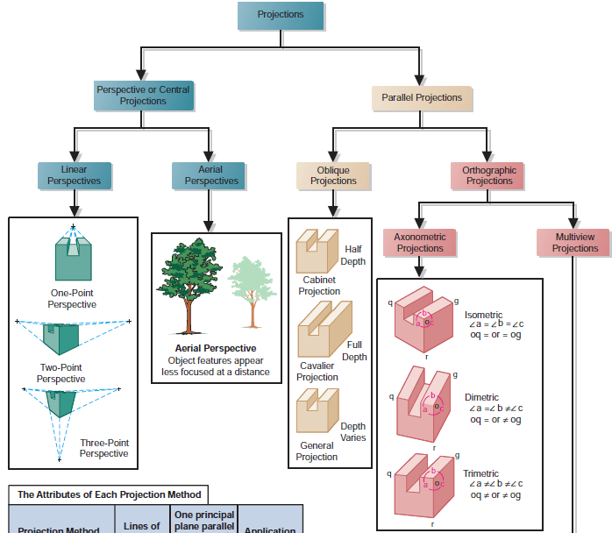

Slide 11
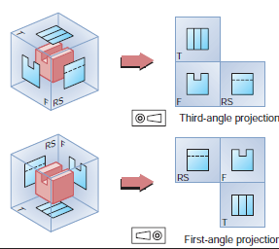

Slide 12
Perspective projection Vs Parallel projection
Perspective projection
Distance from the observer to the object is finite and the object is viewed from a single point – projectors are not parallel.
Perspective projections mimic what the human eyes see, however, they are difficult to draw.
Parallel projection
Distance from the observer to the object is infinite projection lines are parallel – object is positioned at infinity.
Less realistic but easier to draw

Slide 13
Multi-view Projection
Frontal plane of projection
Frontal plane of projection is the plane onto which the Front View (FV) of the multi-view drawing is projected.
Front view of an object shows the width and height dimensions

Slide 14
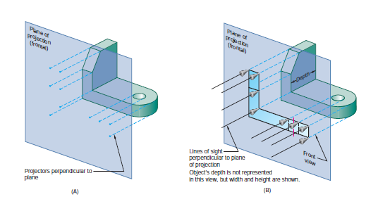

Slide 15
Multi-view Projection
Horizontal plane of projection
Horizontal plane of projection is the plane onto which the Top View of the multi-view drawing is projected
The Top view of an object shows the width and depth dimensions of the object.

Slide 16
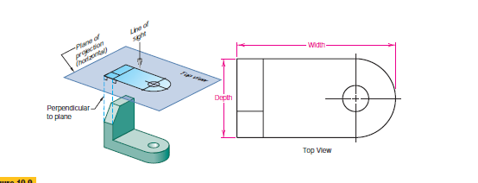

Slide 17
Multi-view Projection
Profile plane of projection
In multi-view drawings, the right side view is the standard side view used
The right side view of an object shows the depth and the height dimensions.
The right side view is projected onto the profile plane of projection, which is a plane that is parallel to the right side of the object.

Slide 18
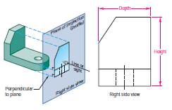
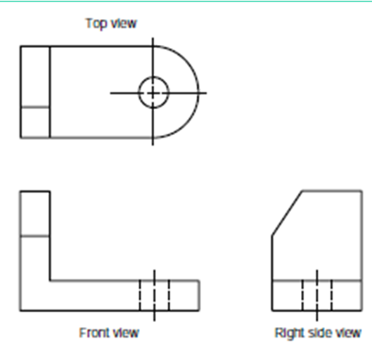
Relative positions and alignment of the views in a multi-view drawing

Slide 19
Six Principal Views
Six mutually perpendicular views that are produced by six mutually perpendicular planes of projection
six sides of the box become projection planes, showing the six views – Front, Top, Left, Right, Bottom And Rear.

Slide 20
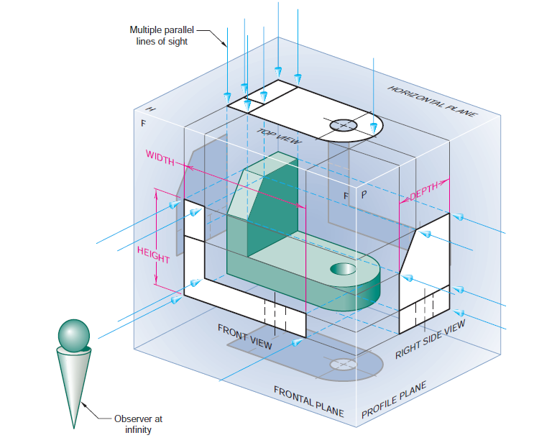
Imagine suspending an object in a glass box with major surfaces of the object positioned so that they are parallel to the sides of the box
Note: The plane of projection can be oriented to produce an infinite number of views of an object.

Slide 21
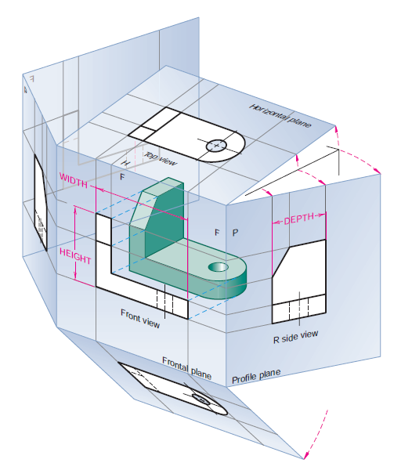
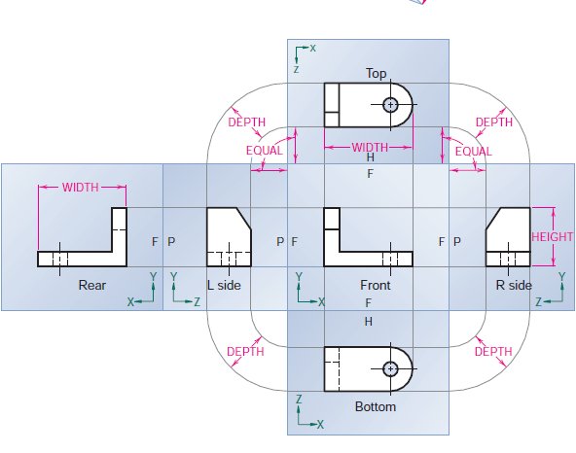
Six Principal Views
Unfolding the glass box to produce a six-view drawing

Slide 22
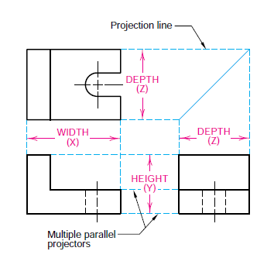
Six Principal Views
The three-view multi-view drawing is the standard used in engineering and technology, because many times the other three principal views are mirror images and do not add to the knowledge about the object
Conventional view placement

Slide 23
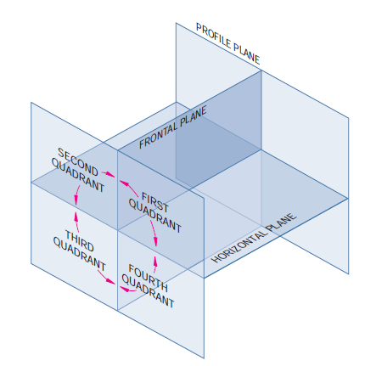
Projection Methods
The principal projection planes and quadrants used to
create first- and third-angle projection drawings

Slide 24
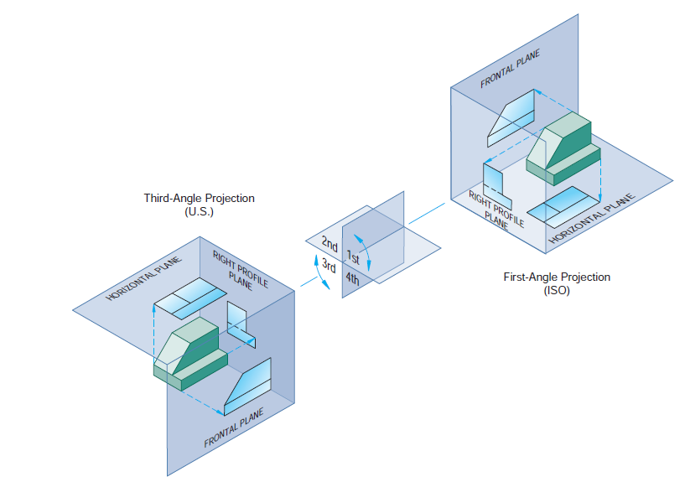
First Angle and Third Projection

Slide 25
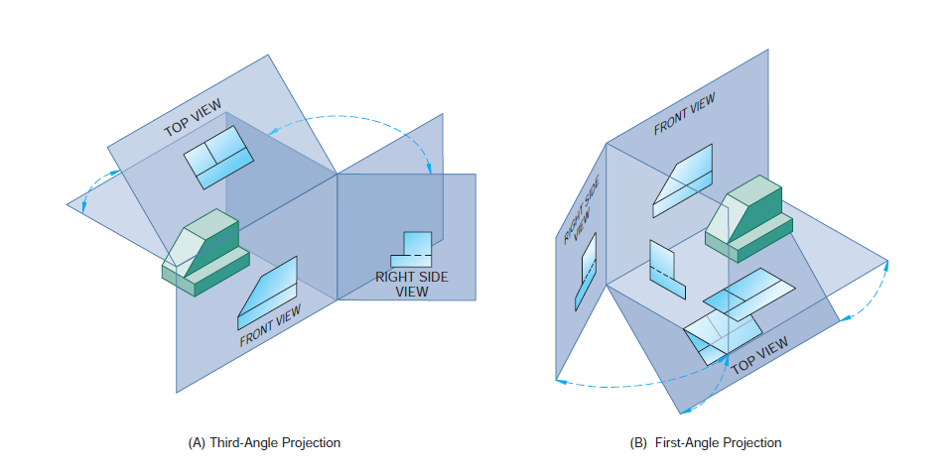
First Angle and Third Projection

Slide 26
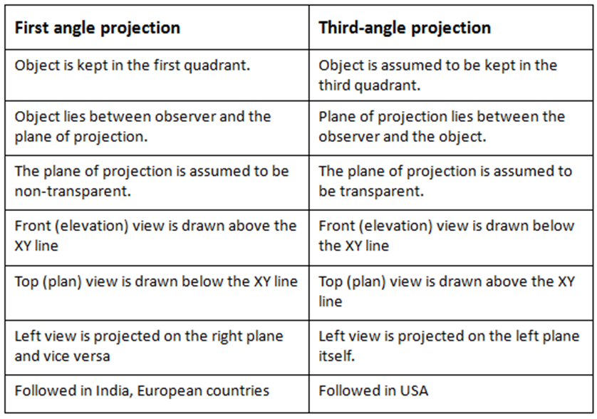
First Angle Vs Third Angle Projection

Slide 27
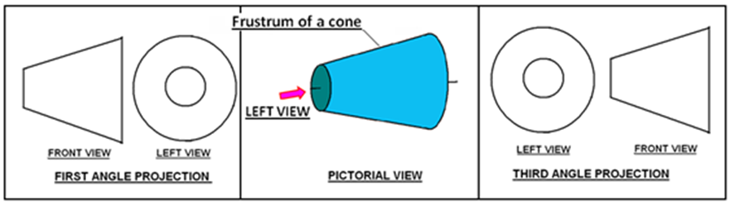

Symbol of projection
The type of projection obtained should be indicated symbolically in the space provided for the purpose in the title box of the drawing sheet.
The symbol recommended by BIS is to draw the two sides of a frustum of a cone placed with its axis horizontal The left view is drawn
Click Here

Slide 28
Projection of Points

Slide 29
ORTHOGRAPHIC PROJECTIONS
OF POINTS, LINES, PLANES, AND SOLIDS.
To draw projections of any object, One must have
following information
A) OBJECT
{ WITH IT’S DESCRIPTION, WELL DEFINED.}
B) OBSERVER
{ ALWAYS OBSERVING PERPENDICULAR TO RESP. REF.PLANE}.
C) LOCATION OF OBJECT,
{ MEANS IT’S POSITION WITH REFFERENCE TO H.P. & V.P.}
Terms ‘above’ & ‘below’ with respective to H.P.
Terms ‘infront’ & ‘behind’ with respective to V.P , form 4 quadrants.
Objects can be placed in any one of these 4 quadrants.

Slide 30
Notations
Following notations should be followed while naming
Different views in orthographic projections.
OBJECT POINT A LINE AB
IT’S TOP VIEW a a b
IT’S FRONT VIEW a’ a’ b’
IT’S SIDE VIEW a” a” b”
Same system of notations should be followed incase numbers, like 1, 2, 3 – are used.

Slide 31
2nd Quadrant
VP
2nd Quad.
1ST Quad.
F.V.
1st Quadrant
Y
Observer
X Y
HP
X
3rdQuadrant
Observer
3rd Quad.
4th Quad.
4th Quadrant
This quadrant pattern, If observed along x-y line ( in red arrow direction) Will exactly appear as shown on right side and hence,
It is further used to understand illustration properly.

Slide 32
Point A is
Placed In
different
quadrants
and it’s Fv & Tv
are brought in
same plane for
Observer to see
clearly.
Fv is visible as
it is a view on
VP. But as Tv is
is a view on Hp,
it is rotated
downward 90⁰,
In clockwise
direction.The
In front part of
Hp comes below
xy line and the
part behind Vp
comes above.
Observe and
note the
process.
POINT A IN
2ND QUADRANT
VP
POINT A IN
1ST QUADRANT
VP
a’
A
A
a’
a
HP
OBSERVER
HP
OBSERVER
a
a
HP
HP
OBSERVER
OBSERVER
a
a’
A
a’
POINT A IN
3RD QUADRANT
A
POINT A IN
4TH QUADRANT
VP
VP

Slide 33
PROJECTIONS OF A POINT IN FIRST QUADRANT.
POINT A ABOVE HP
& INFRONT OF VP
POINT A ABOVE HP
& IN VP
POINT A IN HP
& INFRONT OF VP
For Tv
For Tv
PICTORIAL
PRESENTATION
PICTORIAL
PRESENTATION
For Tv
a’
a’
A
A
For Fv
Y
Y
Y
For Fv
a
a’
X
a
a
X
X
A
For Fv
ORTHOGRAPHIC PRESENTATIONS
OF ALL ABOVE CASES.
Fv above xy,
Tv below xy.
Fv above xy,
Tv on xy.
Fv on xy,
Tv below xy.
VP
VP
VP
a’
a’
X
Y
X
Y
X
a’
Y
a
a
a
HP
HP
HP

Slide 34
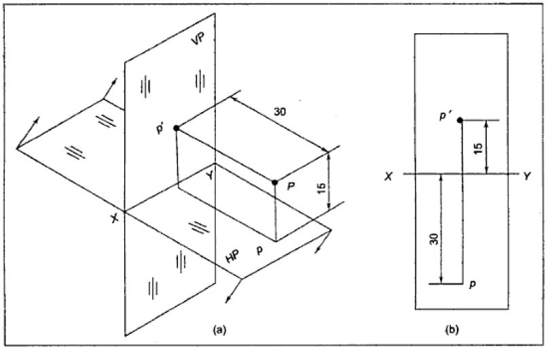
Projection of Points
Point P is 15 mm above HP and 30 mm in front of V.P. Draw its front and top view.

Slide 35
Projection of Points
Summary
The front view and top view of a point are always on the same vertical line
The distance of the front view of a point from XY line is always equal to the distance of the given point from HP
The distance of the top view of a point from the XY line is always equal to the distance of the given point from VP
If a given point is above HP, its front view is above XY line. If the given point is below HP, its front view is below XY line
If the given point is in front of VP, its top view is below XY line. If the given point is behind the VP, its top view is above XY line

Slide 36
Projection of straight line

Slide 37
CONTENT
Projection of straight line
Lines parallel to both reference plane
Lines parallel to one reference plane and inclined to the other at any angle between 0º to 90º
Lines inclined to both reference planes at any angle other than 0º to 90º

Slide 38
Projection of Lines
A line is a geometric primitive that has length and direction, but no thickness.
Straight line is the Locus of a point, which moves linearly.
Straight line is also the shortest distance between any two given points.
SIMPLE CASES OF THE LINE
A VERTICAL LINE ( LINE PERPENDICULAR TO HP & ll TO VP)
LINE PARALLEL TO BOTH HP & VP.
LINE INCLINED TO HP & PARALLEL TO VP.
LINE INCLINED TO VP & PARALLEL TO HP.
LINE INCLINED TO BOTH HP & VP.

Slide 39
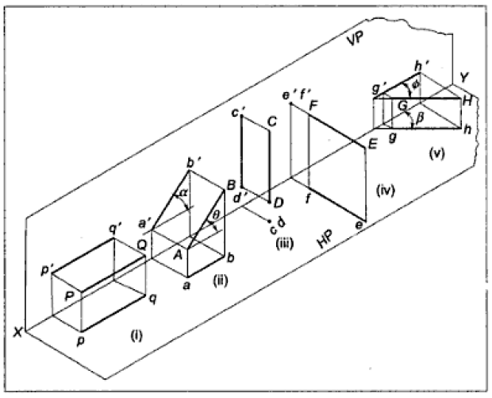
Projection of Lines

Slide 40
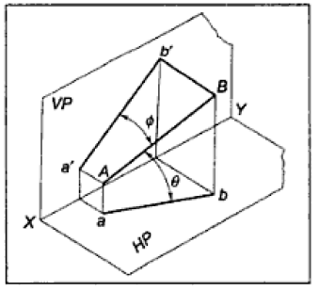
Projection of Lines

Slide 41
Projection of Lines
The problems of projections of lines can be divided into two categories
Lines parallel to one reference plane and inclined to the other at any angle between 0º to 90º
Lines inclined to both reference planes at any angle other than 0º to 90º

Slide 42
Lines parallel to one reference plane and inclined to the other at any angle between 0º to 90º

Slide 43
For TV
Orthographic Pattern
(Pictorial Presentation)
V.P.
a’
Note:
FV is a vertical line
Showing True Length
&
TV is a point.
a’
1.
V.P.
A
FV
FV
A Line
perpendicular
to HP
&
// to VP
b’
b’
Y
X
Y
B
For FV
TV
a b
X
Tv
a b
H.P.
Orthographic Pattern
(Pictorial Presentation)
Note:
FV & TV both are
// to xy
&
both show T. L.
V.P.
For TV
2.
a’
FV
b’
V.P.
b’
A Line
// to HP
&
// to VP
F.V.
B
a’
A
Y
X
Y
For FV
b
a
b
T.V.
TV
X
a
H.P.

Slide 44
FV inclined to xy
TV parallel to xy.
V.P.
3.
V.P.
b’
b’
A Line inclined to HP
and
parallel to VP
(Pictorial presentation)
B
F.V.
F.V.
a’
θ
θ
Y
X
Y
a’
θ
A
b
a
T.V.
b
X
T.V.
a
H.P.
Orthographic Projections
TV inclined to xy
FV parallel to xy.
V.P.
4.
V.P.
FV
A Line inclined to VP
and
parallel to HP
(Pictorial presentation)
F.V.
b’
a’
b’
a’
A
Ø
B
X
Y
a
Ø
a
Ø
b
TV
T.V.
b
H.P.

Slide 45
Lines inclined to both reference planes at any angle other than 0º to 90º

Slide 46
For TV
For TV
5.
A Line inclined to both
Hp and Vp
(Pictorial presentation)
b’
b’
V.P.
V.P.
B
F.V.
B
F.V.
α
α
Y
Y
On removal of object
i.e. Line AB
FV as a image on VP.
TV as a image on HP,
a’
a’
For FV
For Fv
A
A
β
X
β
X
a
T.V.
b
a
T.V.
b
V.P.
b’
FV
a’
α
X
Y
Orthographic Projections
Fv is seen on Vp clearly.
To see TV clearly, HP is rotated 90⁰ downwards,
Hence it comes below xy.
Note These Facts:-
Both FV & TV are inclined to xy.
(No view is parallel to xy)
Both FV & TV are reduced lengths.
(No view shows True Length)
a
β
TV
H.P.
b

Slide 47
Projection of Lines
Summary
A line joining any two points along the shortest route is called a straight line.
All problems are first quadrant problems.
Notation: Front view → with dash e.g. a’, a₁’ …
Top view → without dash e.g. a , a₁ …
If a line AB is parallel to a reference plane, then the projection of the line AB obtained on that reference plane will have true length and true inclination.
If a line AB is inclined to a reference plane, then the projection of the line AB obtained on that reference plane will have apparent length.

Slide 48
Projection of Lines
Vertical line →A line parallel to VP and perpendicular to HP.
Horizontal line → A line parallel to HP and perpendicular to VP.
Θ = True inclination of the line with the HP
Φ = True inclination of the line with the VP
Θ₁ = Apparent inclination of the line with the HP
Φ₁ = Apparent inclination of the line with the VP
True length makes true inclination
Apparent length makes apparent inclination.
Apparent inclinations are always greater than true inclinations.
Apparent lengths are shorter than the true length.

Slide 49
Projection of Lines
Line inclined to both the planes:
When the line is inclined to both the planes, both the top view and front view will have reduced length.
i.e. Front view length & Top view length
→ Apparent lengths

Slide 50
Projection of Lines
To Find True length and true inclinations of a line,
Many times if the top and front views of a line are given, the true length and true inclinations of a line is required to be determined.
The top and front views of the object can be drawn from if any of the following data are available:
Distance between the end projectors,
Distance of one or both the end points from HP and VP
Apparent inclinations of the line.
The problems may be solved by
(i) Rotating line method or
(ii) Rotating trapezoidal plane method or
(iii) Auxiliary plane method.

Slide 51
Line Inclined to both HP & VP
PROBLEM 1
Line AB is 75 mm long and it is 30⁰ & 40⁰ Inclined to HP & VP respectively.
End A is 12mm above HP and 10 mm in front of VP
Draw projections. Line is in 1st quadrant.
b’
b’₁
FV
TL
θ
b2’
a’
X
Y
a
LFV
Ø
1
Rotation of the front view:
With center a' and radius a'b' rotate the front view to the new position a'b2' parallel to the XYline.
Since a'b2‘ is parallel to the XY line, its corresponding top view will be in true length and at true inclination
TV
TL
b
b₁
Notes:
1) Draw xy line and one projector.
2) Locate a’ 12mm above xy line & a 10mm below xy line.
3) Take 30⁰ angle from a’ & 40⁰ from a and mark TL I.e. 75mm on both lines. Name those points b₁’ and b₁ respectively.
4) Join both points with a’ and a resp.
5) Draw horizontal lines (Locus) from both points.
6) Draw horizontal component of TL a b₁ from point b₁ and name it 1. ( the length a-1 gives length of FV as we have seen already.)
7) Extend it up to locus of a’ and rotating a’ as center locate b’ as shown. Join a’ b’ as Fv.
8) From b’ drop a projector down ward & get point b. Join a & b I.e. TV.

Slide 52
Line Inclined to both HP & VP
b’
b’₁
LOCUS OF b₁’
PROBLEM 2
Line AB 75mm long makes 45⁰ inclination with VP while it’s FV makes 55⁰.
End A is 10 mm above HP and 15 mm in front of VP.
If line is in 1st quadrant, draw it’s projections and find it’s inclination with HP.
FV
TL
55⁰
a’
X
y
a
LFV
1
Φ 45⁰
TV
TL
LOCUS OF b
b
b₁
Notes:
1.Draw x-y line.
2.Draw one projector for a’ & a
3.Locate a’ 10mm above x-y & TV a 15 mm below xy.
4.Draw a line 45⁰ inclined to xy from point a and cut TL 75 mm on it and name that point b_{1.} Draw locus from point b₁
5.Take 55⁰ angle from a’ for FV above xy line.
6.Draw a vertical line from b₁ up to locus of a and name it 1. It is horizontal component of TL & is LFV.
7.Continue it to locus of a’ and rotate upward up to the line of FV and name it b’. This a’ b’ line is FV.
8. Drop a projector from b’ on locus from point b₁ and name intersecting point b. Line a b is TV of line AB.
9.Draw locus from b’ and from a’ with TL distance cut point b₁‘.
10.Join a’ b₁’ as TL and measure it’s angle at a’.
It will be true angle of line with HP.

Slide 53
Line Inclined to both HP & VP
PROBLEM 3:
FV of line AB is 50⁰ inclined to xy and measures 55 mm long while it’s TV is 60⁰ inclined to xy line.
If end A is 10 mm above HP and 15 mm in front of VP, draw it’s projections,
find TL, inclinations of line with HP & VP.
b’
b’₁
FV
TL
50⁰
θ
a’
X
Y
a
Φ
60⁰
TL
b₁
b
Notes:
1.Draw xy line and one projector.
2.Locate a’ 10 mm above xy and a 15 mm below xy line.
3.Draw locus from these points.
4.Draw FV 50⁰ to xy from a’ and mark b’ Cutting 55mm on it.
5.Similarly draw TV 60⁰ to xy from a & drawing projector from b’. Locate point b and join a b.
6.Then rotating views as shown, locate True Lengths ab₁ & a’b₁’
and their angles with HP and VP.

Slide 54
Line Inclined to both HP & VP
PROBLEM 4
Line AB is 75 mm long .It’s FV and TV measure 50 mm & 60 mm long respectively.
End A is 10 mm above HP and 15 mm in front of VP.
Draw projections of line AB, if end B is in first quadrant.
Find angle with HP and VP.
b’
b’₁
FV
TL
θ
LTV
1’
a’
X
Y
a
LFV
1
Φ
TV
TL
b₁
b
Notes:
1.Draw xy line and one projector.
2.Locate a’ 10 mm above xy and a 15 mm below xy line.
3.Draw locus from these points.
4.Cut 60mm distance on locus of a’ & mark 1’ on it as it is LTV.
5.Similarly Similarly cut 50mm on locus of a and mark point 1 as it is LFV.
6.From 1’ draw a vertical line upward and from a’ taking TL ( 75mm ) in compass, mark b’₁ point on it. Join a’ b’₁ points.
7. Draw locus from b’₁
8. With same steps below get b₁ point and draw also locus from it.
9. Now rotating one of the components i.e. a-1 locate b’ and join a’ with it to get FV.
10. Locate TV similarly and measure Angles

Slide 55
Line Inclined to both HP & VP
d’
d’₁
LOCUS OF d’ & d’₁
PROBLEM 5
T.V. of a 75 mm long Line CD, measures 50 mm.
End C is in HP and 50 mm in front of VP.
End D is 15 mm in front of VP and it is above HP.
Draw projections of CD and find angles with HP and VP.
FV
TL
X
c’
θ
Y
d
d₁
LOCUS OF d & d₁
TL
TV
c
Φ
Notes:
1.Draw xy line and one projector.
2.Locate c’ on xy and c 50mm below xy line.
3.Draw locus from these points.
4.Draw locus of d 15 mm below xy
5.Cut 50mm & 75 mm distances on locus of d from c and mark points d & d₁ as these are TV and line CD lengths resp.& join both with c.
6.From d₁ draw a vertical line upward up to xy i.e. up to locus of c’ and draw an arc as shown.
7 Then draw one projector from d to meet this arc in d’ point & join c’ d’
8. Draw locus of d’ and cut 75 mm on it from c’ as TL
9.Measure Angles

Slide 56
Profile Plane – Side Views
In addition to two views namely front and top views, a third view known as side view is sometimes required to be projected.
A reference plane perpendicular to HP as well as the VP is selected. It is known as profile plane (PP).
In first angle projection, the left hand side view is drawn on right side of the front view. Similarly, right hand side view is drawn on the left side of the front view
In Third angle projection, the left side view is drawn on left side of the front view and right side view is drawn on right of the front view

Slide 57
LINE IN A PROFILE PLANE ( MEANS IN A PLANE PERPENDICULAR TO BOTH HP & VP)
For T.V.
ORTHOGRAPHIC PATTERN OF LINE IN PROFILE PLANE
VP
VT
PP
a’
a’
a”
A
Φ
FV
LSV
b’
b’
b”
θ
X
Y
HT
a
B
For F.V.
TV
a
b
b
HP
Results:-
1. TV & FV both are vertical, hence arrive on one single projector.
2. It’s Side View shows True Length ( TL)
3. Sum of it’s inclinations with HP & VP equals to 90⁰ (
4. It’s HT & VT arrive on same projector and can be easily located
From Side View.
θ
+
Φ
= 90⁰ )
OBSERVE CAREFULLY ABOVE GIVEN ILLUSTRATION AND 2nd SOLVED PROBLEM.

Slide 58
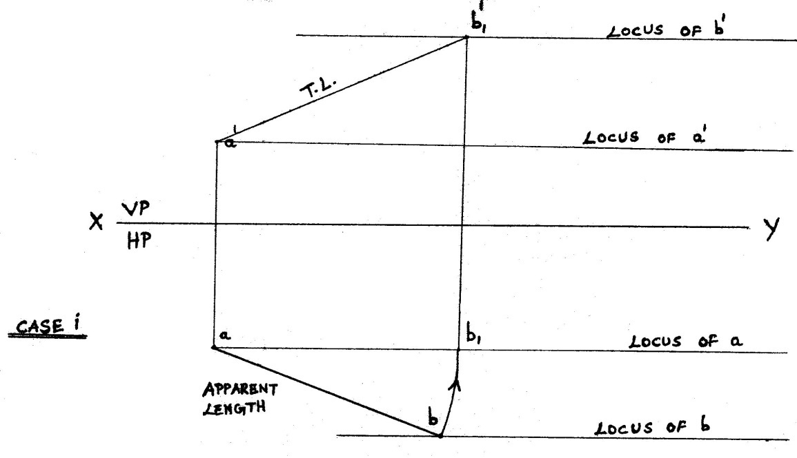
Procedure to get True length ( from Apparent length )
The apparent length should be made parallel to reference line XY.
Then draw a vertical projector.
Then use appropriate locus ( case i ) or true length as radius ( case ii ) or the appropriate inclined line ( case iii ) to intersect the above vertical projector to get true length.

Slide 59
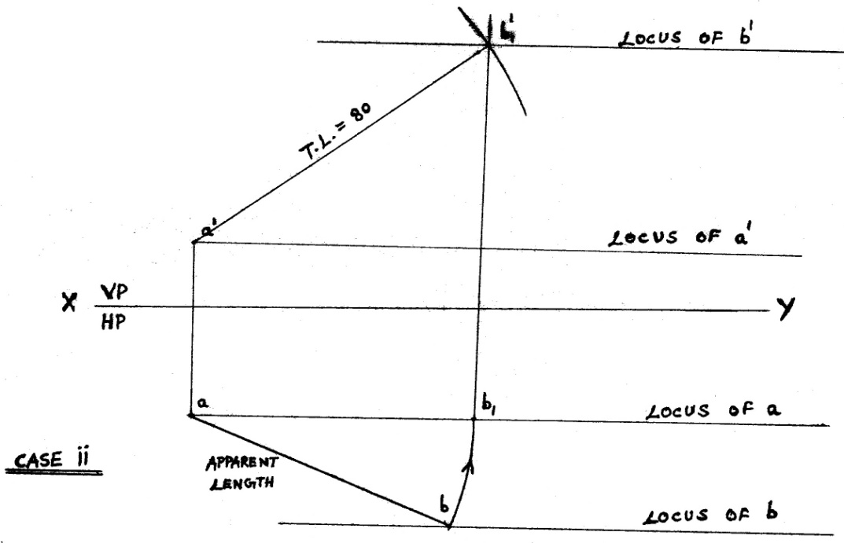
Procedure to get True length ( from Apparent length )
The apparent length should be made parallel to reference line XY.
Then draw a vertical projector.
Then use appropriate locus ( case i ) or true length as radius ( case ii ) or the appropriate inclined line ( case iii ) to intersect the above vertical projector to get true length.

Slide 60
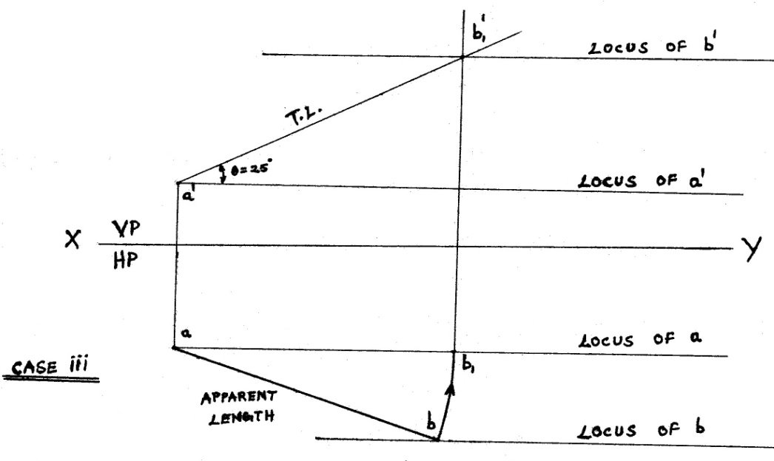
Procedure to get True length ( from Apparent length )
The apparent length should be made parallel to reference line XY.
Then draw a vertical projector.
Then use appropriate locus ( case i ) or true length as radius ( case ii ) or the appropriate inclined line ( case iii ) to intersect the above vertical projector to get true length.

Slide 61
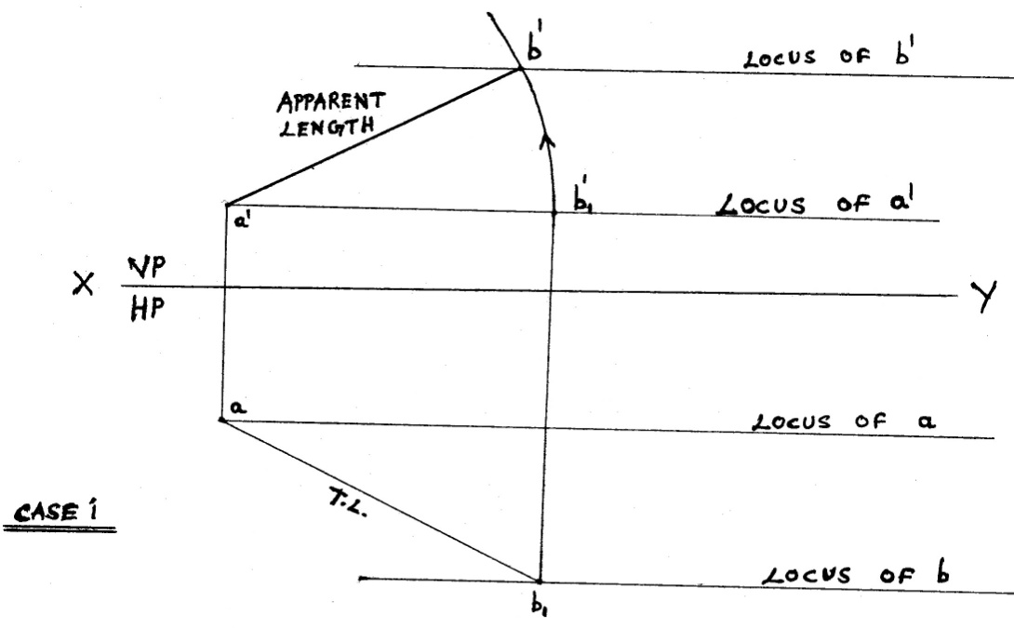
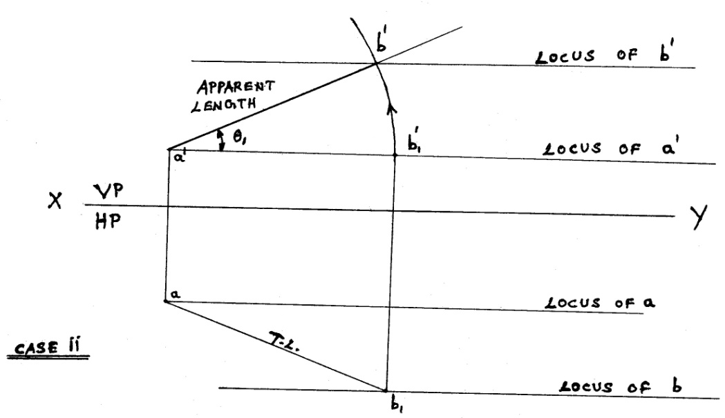
Procedure to get Apparent length ( from True length )
♥ Draw a vertical projector from the true length to get apparent length as a straight line parallel to the reference line XY.
♥ Then draw an arc taking the above apparent length as radius to intersect the appropriate locus ( case i ) or the appropriate inclined line ( case ii ) to get the required apparent length.
Note : When a line is inclined to both the reference planes ( H.P. & V.P.) the apparent lengths cannot be a straight line parallel to the reference line XY.

Slide 62
♣ The above procedure used to get true length and apparent length is Rotating line method.
♣ True length : To get true length above reference line XY , use apparent length below reference line XY and vice versa.
♣ Apparent length : To get apparent length above reference line XY , use true length below reference line XY and vice versa.
♣ a & a’ should lie on the same projector. b & b’ should lie on the same projector. m & m’ should lie on the same projector.
♣ While taking the angle Φ or Φ₁ , care should be taken to see that a’, a₁’, a, a₁ … and b’, b₁’, b, b₁… are grouped separately.

