Slide 1



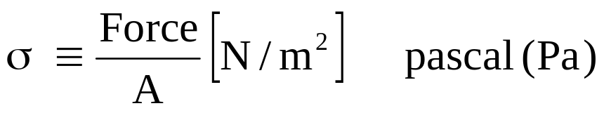
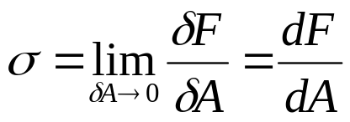
Chapter 2 Mechanics of Materials
A
Tensile stress (+)
Compressive stress (-)
Normal stress =
At a point:
Example: Estimate the normal stress on a shin bone (脛骨)

Slide 2


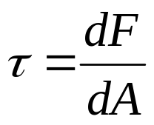
Shear stress (切應力) = τ = F tangential to the area / A
A
At a point,

Slide 3




Normal strain (正應變) ε = fractional change of length=
l
x
Shear strain (?) = deformation under shear stress =
x
F
F
fixed

Slide 4
Stress-strain curve
Work hardening
σ
Yield pt.
break
Elastic
deformation
o
ε
Hooke's law: In elastic region, σ ∝ ε, or σ/ ε = E
E is a constant, named as Young’s modulus or modulus of elasticity
Similarly, in elastic region, τ/γ = G, where G is a constant, named as shear modulus or modulus of rigidity.

Slide 5

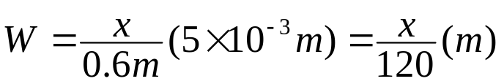
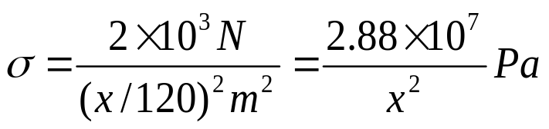
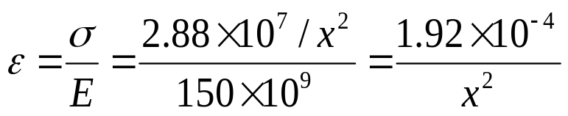
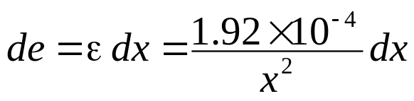
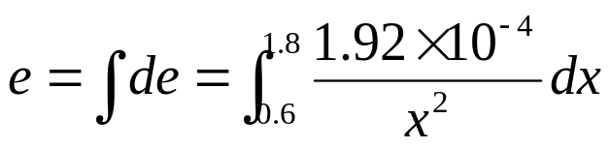
dx
Exercise set 2 (Problem 3)
Find the total
extension of the bar.
15mm
W
5mm
o
0.6m
1.2m
X
Width of a cross-sectional element at x:
Stress in this element :
Strain of this element:
The extension of this element :
The total extension of the whole bar is :
= 2.13 x 10⁻⁴ m

Slide 6
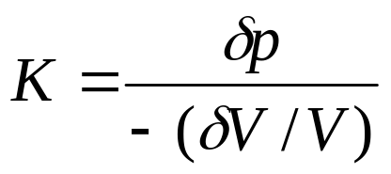
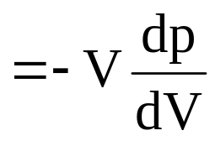


Bulk modulus ≡

Slide 7


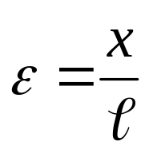
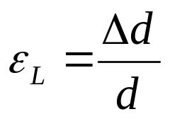
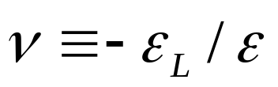
Poisson's ratio :
For a homogeneous isotropic material
d
F
F
x
normal strain :
lateral strain :
Poisson's ratio :
value of ν : 0.2 - 0.5

Slide 8




Double index notation for stress and strain
1st index: surface, 2nd index: force
For normal stress components : x ⇒ xx, y ⇒ yy , z ⇒ zz,
σ_{x} ⇒ σ_{xx}
z
σ_{zy}
σ_{zx}
σ_{yz}
σ_{xz}
σ_{xy}
σ_{yx}
y

Slide 9
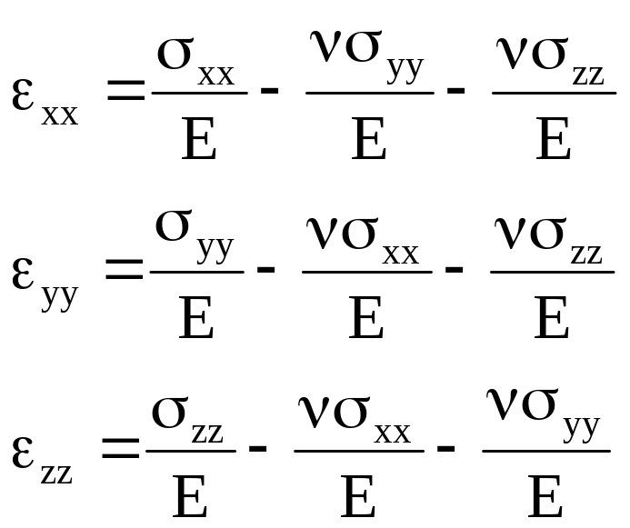
Joint effect of three normal stress components
z
y

Slide 10
Symmetry of shear stress components
Take moment about the z axis, total torque = 0,
(σ_{xy} ΔyΔz) Δx = (σ_{yx} Δx Δz) Δy, hence, σ_{xy} = σ_{yx} .
Similarly, σ_{yz} = σ_{zy} and σ_{xz} = σ_{zx}
y
σ_{yx}
σ_{xy}
Δy
x
z
Δz
Δx

Slide 11
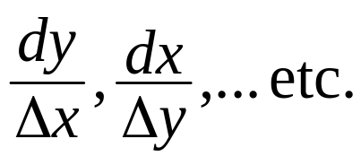



Original shear strain is “simple” strain =
There is no real deformation during pure rotation,
but “simple” strain ≠ 0.
γ₂
dy
Define pure rotation angle θ_{rot} and
pure shear strain, such that the angular displacements of the two surfaces are:
γ₁= θ_{rot}+ θ_{def} and γ₂= θ_{rot}- θ_{def} . Hence,
θ_{rot} = (γ₁+ γ₂)/2 and θ_{def} = (γ₁- γ₂)/2
θ_{rot}
Δx
θ_{def}
θ_{def}
Example: γ₁ = 0 and γ₂ = - γ,
so θ_{def} = (0+γ)/2 = γ/2 and θ_{rot}= (0-γ)/2 = -γ/2
Pure shear strain is γ/2
γ₂ = -γ
Δx

Slide 12
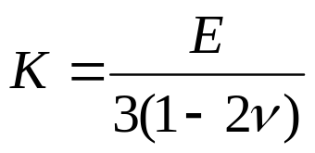
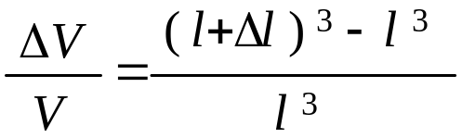


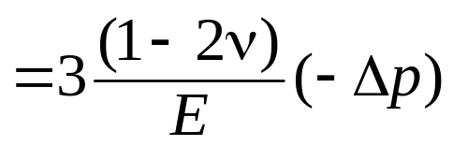
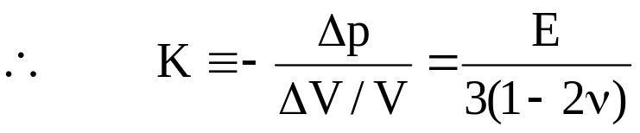
Example: Show that
Proof:
For hydrostatic pressure
l
l
l
ε_{xx} = ε_{yy} = ε_{zz} = ε, hence
3ε = ε_{xx}+ε_{yy}+ε_{zz} = (1-2v)(σ_{xx}+σ_{yy}+σ_{zz})/E
σ_{xx} =σ_{yy} =σ_{zz} = -Δp (compressive stress)

Slide 13


Example : Show that ε_{nn} = γ/2
Point C moves further along x- and y-direction by distances of AD(γ/2) and AD(γ/2) respectively.
ε_{nn} = [(AD . γ/2)² + (AD . γ/2)²]^{1/2} / [(AD)² + (AD)²]^{1/2} = γ/2
True shear strain: ε_{yx} = γ/2
Therefore, the normal component of strain is equal to the shear component of strain:
ε_{nn} = ε_{yx} and ε_{nn} = γ/2
C’
C
D’
A
D
Notes:
115/11/08

Slide 14
Example : Show that ε_{nn} = σ_{nn}/(2G)
Consider equilibrium along n-direction:
σ _{yx} (lW) sin 45º x2 = 2 (l cos 45º) W σ_{nn}
σ_{yx}
l
σ_{xy}
l
2 l cos 45º
σ_{n}
Therefore σ_{yx} = σ_{nn}
From definition : γ = σ_{xy} /G = σ_{nn} /G = 2 ε_{nn}

Slide 15
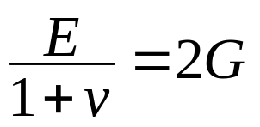
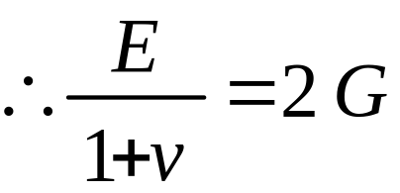
Example : Show
ε_{xx} = σ_{xx}/E - ν σ_{yy}/E- v σ_{zz}/E
Set σ_{xx} = σ _{nn} = -σ _{yy}, σ _{zz} = 0, ε_{xx} = ε_{nn}
ε_{nn} = (1+ν) σ _{nn} /E = σ _{nn} /2G (previous example)
-σ_{nn}
σ_{nn}
-σ_{nn}
σ_{nn}

Slide 16
Ex. 12 kN forces are applied to the top & bottom of a cube (20 mm edges), E = 60 GPa, ν = 0.3. Find (i) the force exerted by the walls, (ii) ε_{yy}
z
y
12kN
x
ε_{xx} = 0, σ_{yy} = 0 and
σ_{zz}= -12×10³ N/(20×10⁻³ m)² = 3×10⁷ Pa
ε_{xx} = (σ_{xx}- v σ_{yy}- v σ_{zz}) /E
0 = [σ_{xx}- 0 – 0.3×(- 3×10⁷)]/60×10⁹
∴ σ_{xx} = -9×10⁶ Pa (compressive)
Force = Aσ_{xx} = (20×10⁻³ m)²×(-9×10⁶ Pa) = -3.6 ×10³ N
(ii) ε_{yy} = (σ_{yy}- v σ_{zz}- v σ_{xx}) /E
= [0 – 0.3×(- 3×10⁷) – 0.3×(- 9×10⁶)]/60×10⁹ = 1.95×10⁻⁴

Slide 17
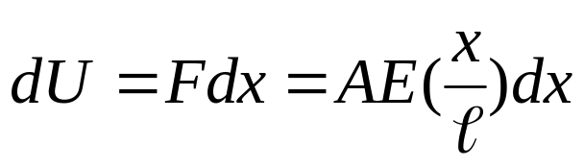
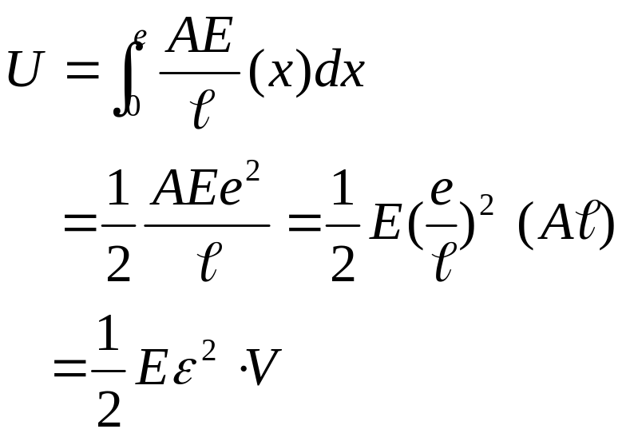


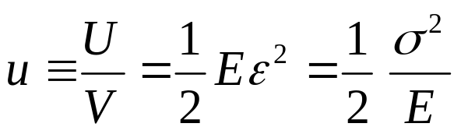
Elastic Strain Energy
    The energy stored in a small volume:
    ∴ The energy stored :
    ∴ Energy density in the material :
e=extension
x

Slide 18
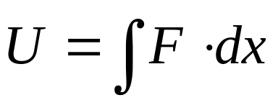
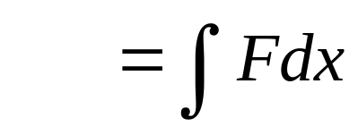
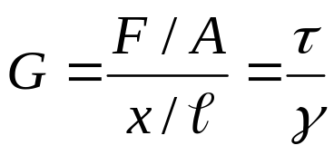
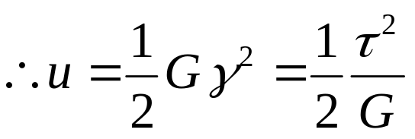

Similarly for shear strain :
F

