Slide 1
Stress & Strain: Axial Loading
Suitability of a structure or machine may depend on the deformations in the structure as well as the stresses induced under loading. Statics analyses alone are not sufficient.
Considering structures as deformable allows determination of member forces and reactions which are statically indeterminate.
Determination of the stress distribution within a member also requires consideration of deformations in the member.
This Chapter is concerned with deformation of a structural member under axial loading. Later chapters will deal with torsional and pure bending loads.
2 - <number>

Slide 2
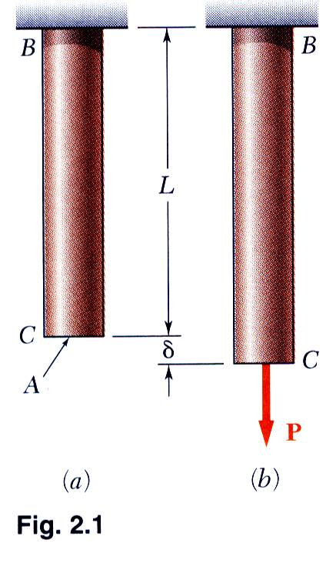
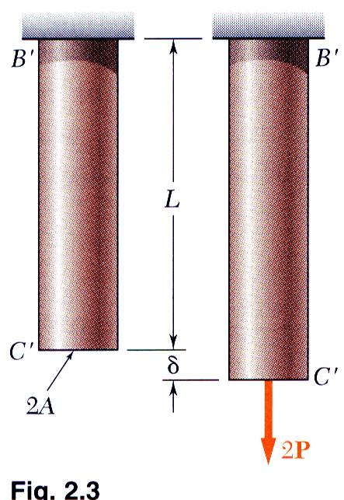
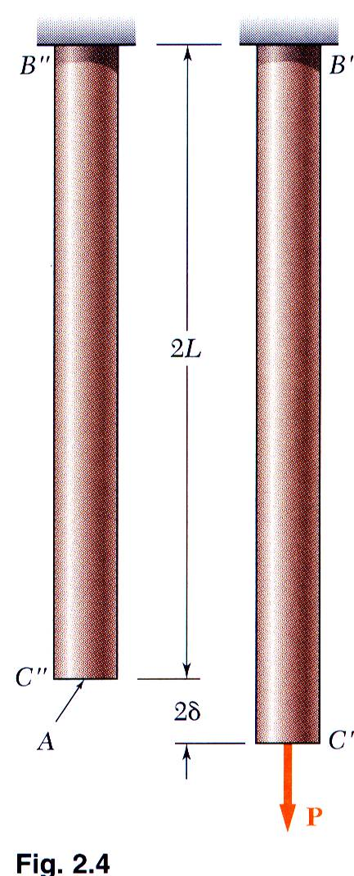
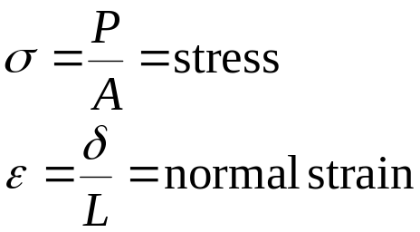
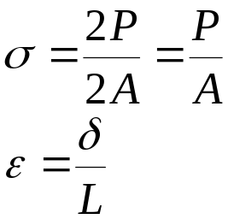
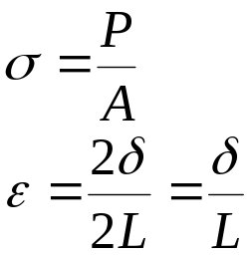
Normal Strain
2 - <number>

Slide 3
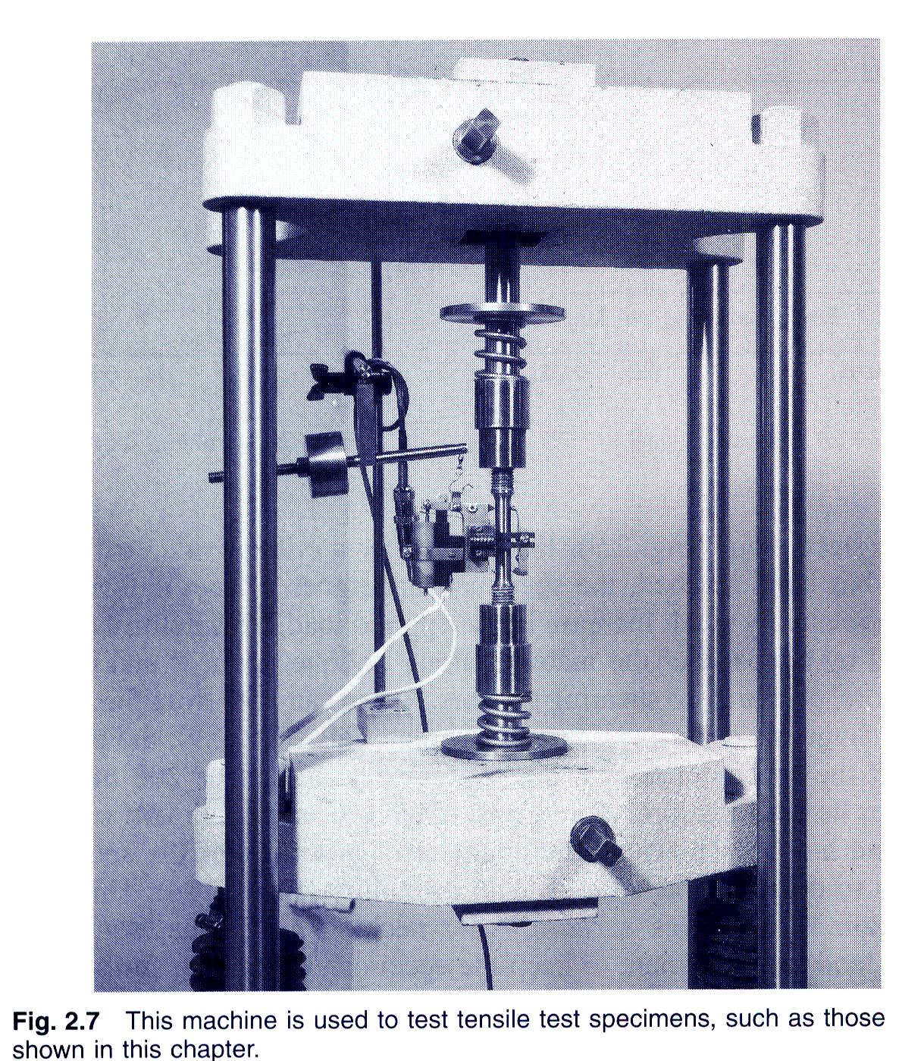
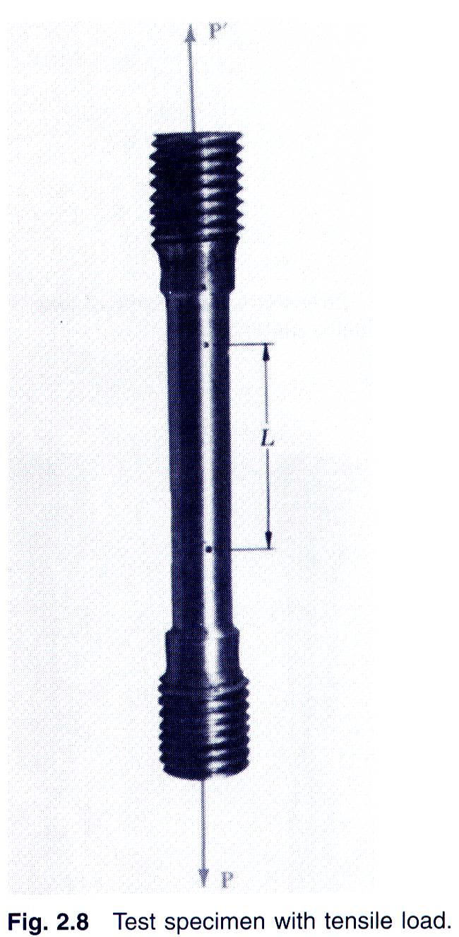
Stress-Strain Test
2 - <number>

Slide 4
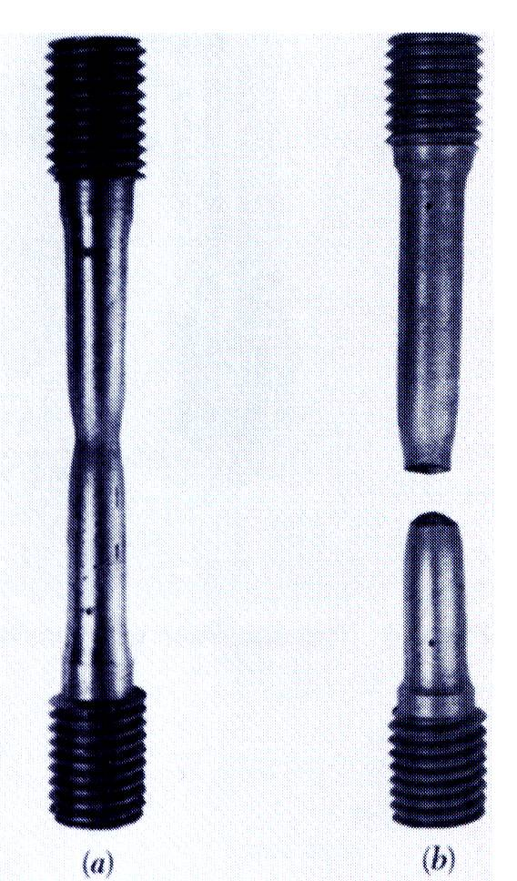
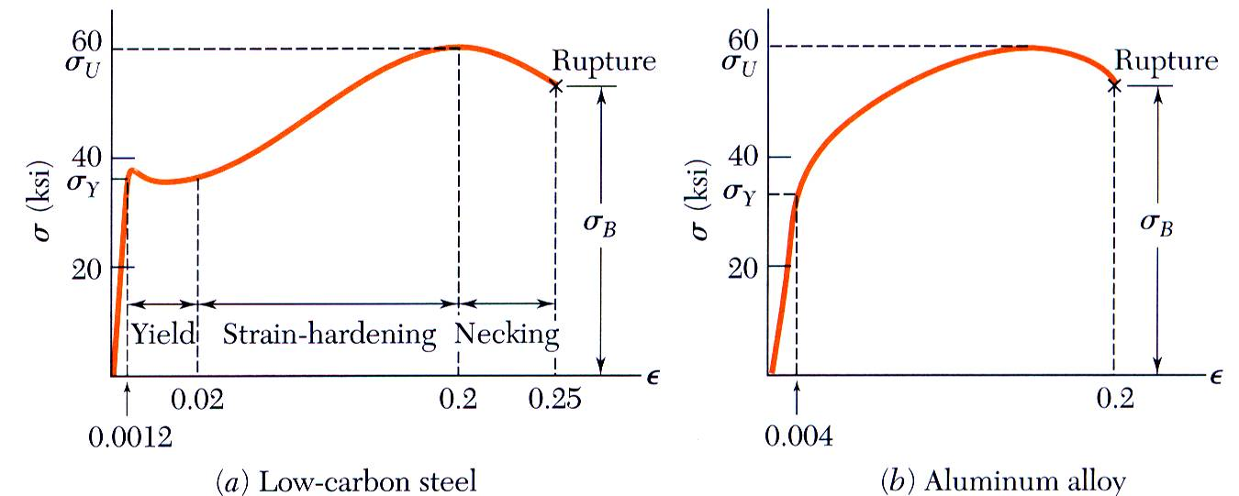
Stress-Strain Diagram: Ductile Materials
2 - <number>

Slide 5
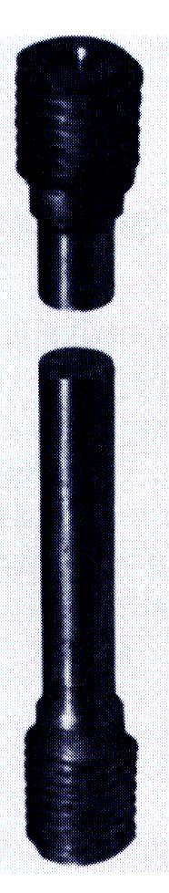
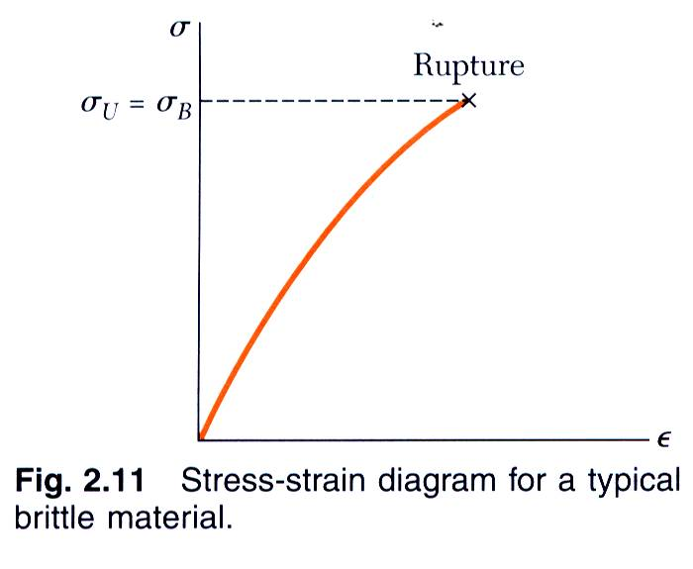
Stress-Strain Diagram: Brittle Materials
2 - <number>

Slide 6
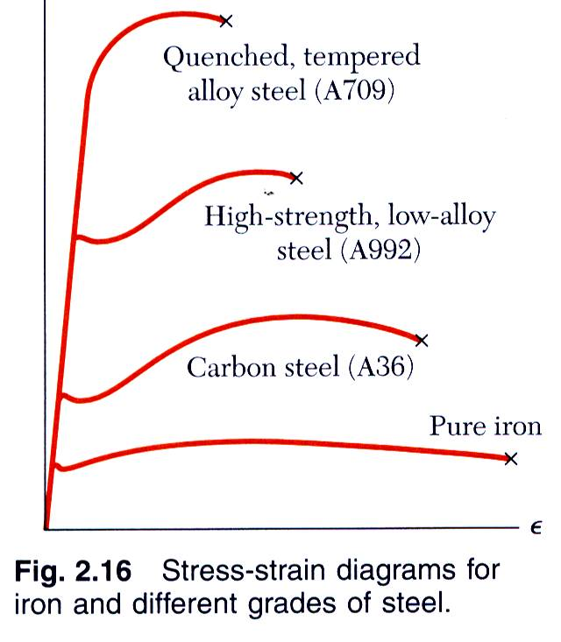
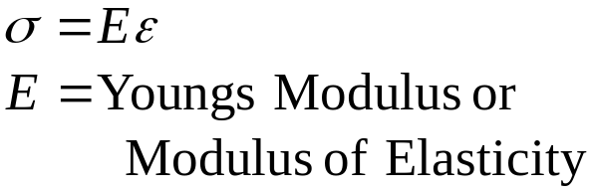
Hooke’s Law: Modulus of Elasticity
Below the yield stress
Strength is affected by alloying, heat treating, and manufacturing process but stiffness (Modulus of Elasticity) is not.
2 - <number>

Slide 7
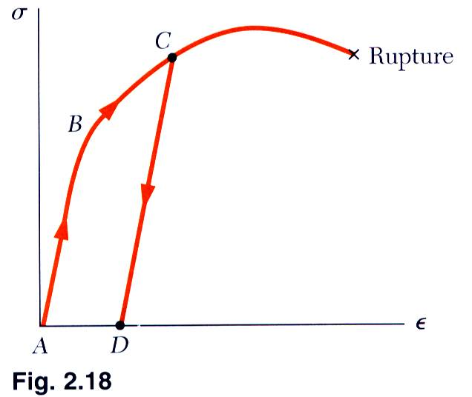
Elastic vs. Plastic Behavior
If the strain disappears when the stress is removed, the material is said to behave elastically.
The largest stress for which this occurs is called the elastic limit.
When the strain does not return to zero after the stress is removed, the material is said to behave plastically.
2 - <number>

Slide 8
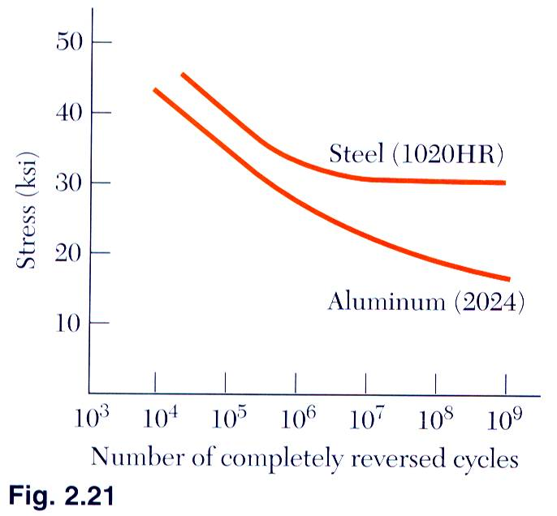
Fatigue
Fatigue properties are shown on S-N diagrams.
A member may fail due to fatigue at stress levels significantly below the ultimate strength if subjected to many loading cycles.
When the stress is reduced below the endurance limit, fatigue failures do not occur for any number of cycles.
2 - <number>

Slide 9
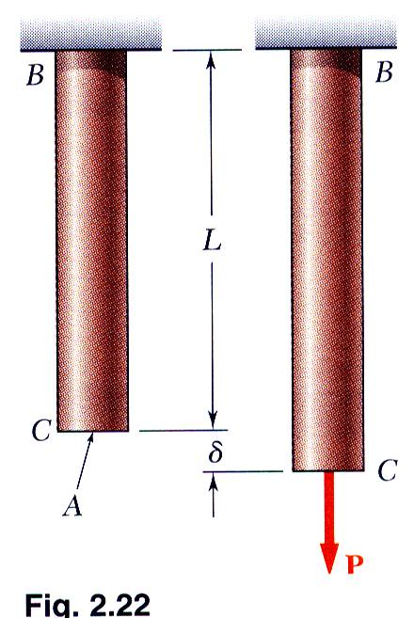
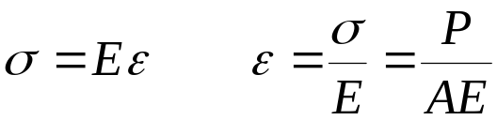
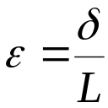
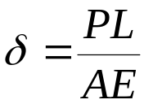
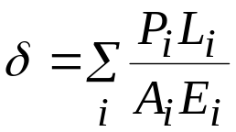
Deformations Under Axial Loading
From Hooke’s Law:
From the definition of strain:
Equating and solving for the deformation,
With variations in loading, cross-section or material properties,
2 - <number>

Slide 10
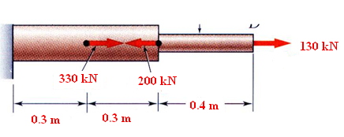

Example 2.01
SOLUTION:
Divide the rod into components at the load application points.
Apply a free-body analysis on each component to determine the internal force
Evaluate the total of the component deflections.
Determine the deformation of the steel rod shown under the given loads.
2 - <number>

Slide 11
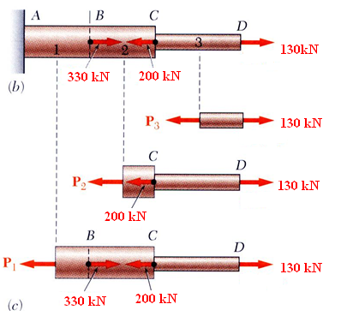
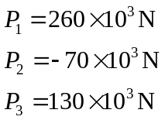
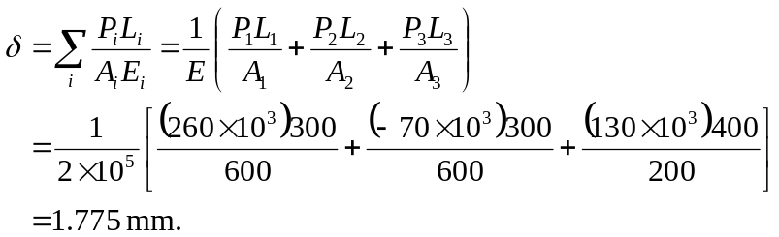

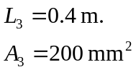

SOLUTION:
Divide the rod into three components:
Apply free-body analysis to each component to determine internal forces,
Evaluate total deflection,
2 - <number>

Slide 12
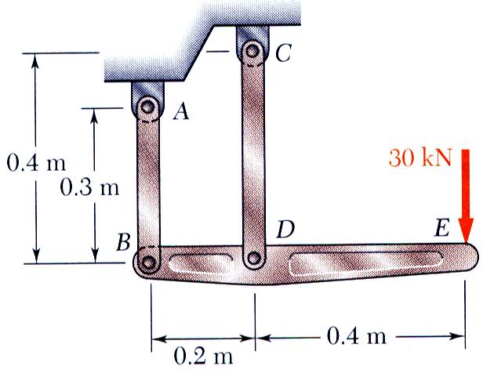
Sample Problem 2.1
SOLUTION:
Apply a free-body analysis to the bar BDE to find the forces exerted by links AB and DC.
Evaluate the deformation of links AB and DC or the displacements of B and D.
The rigid bar BDE is supported by two links AB and CD.
Link AB is made of aluminum (E = 70 GPa) and has a cross-sectional area of 500 mm². Link CD is made of steel (E = 200 GPa) and has a cross-sectional area of (600 mm²).
For the 30-kN force shown, determine the deflection a) of B, b) of D, and c) of E.
Work out the geometry to find the deflection at E given the deflections at B and D.
2 - <number>

Slide 13
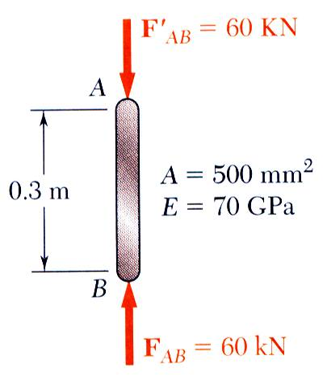
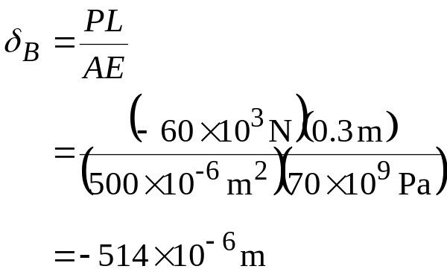
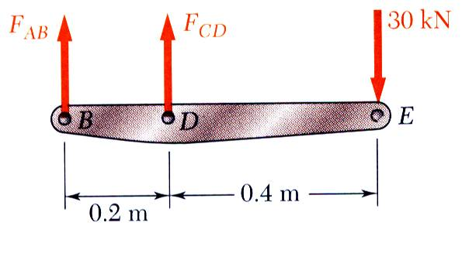

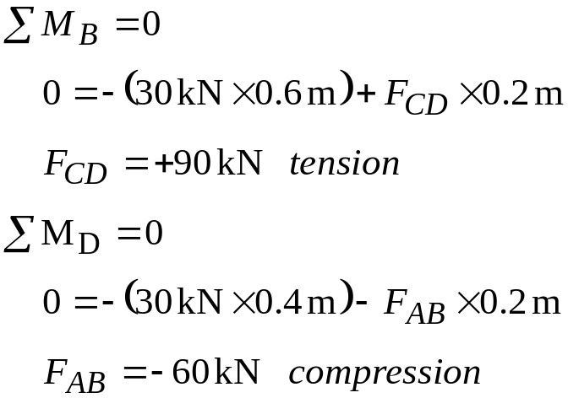
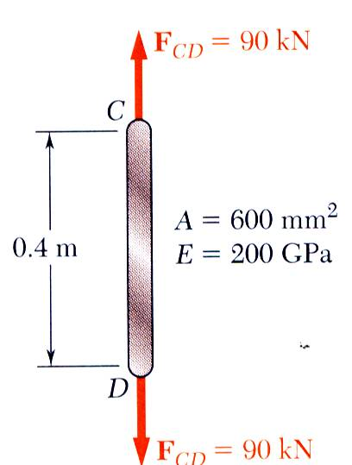
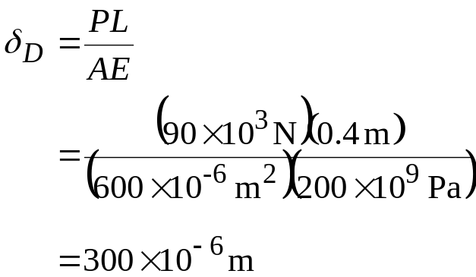

Sample Problem 2.1
SOLUTION:
Displacement of B:
Free body: Bar BDE
Displacement of D:
2 - <number>

Slide 14
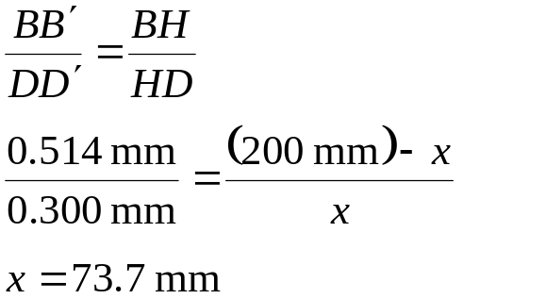
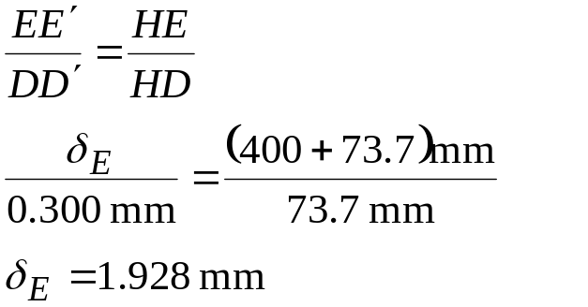
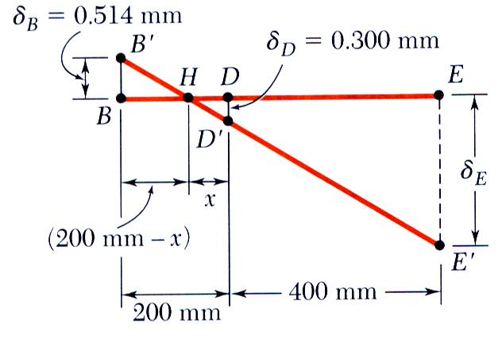

Sample Problem 2.1
Displacement of D:
2 - <number>

Slide 15
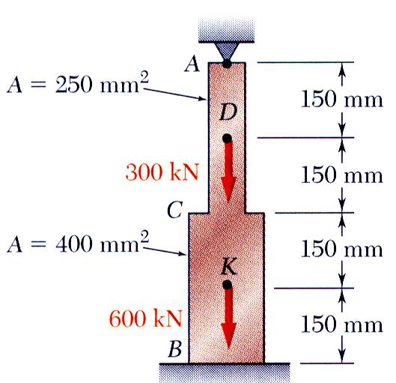
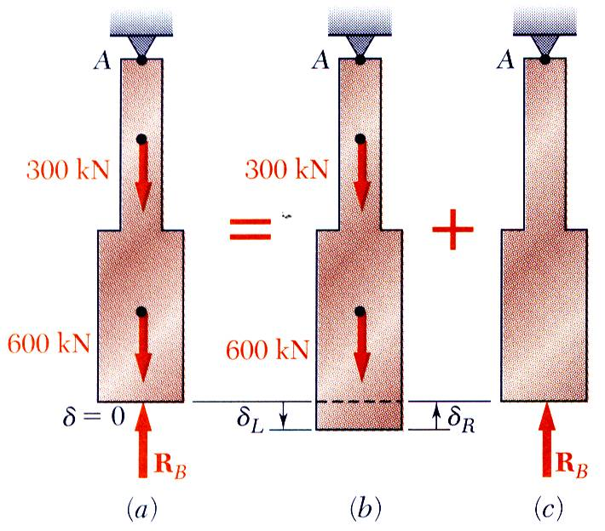

Static Indeterminacy
Structures for which internal forces and reactions cannot be determined from statics alone are said to be statically indeterminate.
A structure will be statically indeterminate whenever it is held by more supports than are required to maintain its equilibrium.
Redundant reactions are replaced with unknown loads which along with the other loads must produce compatible deformations.
Deformations due to actual loads and redundant reactions are determined separately and then added or superposed.
2 - <number>

Slide 16
Example 2.04
Determine the reactions at A and B for the steel bar and loading shown, assuming a close fit at both supports before the loads are applied.
SOLUTION:
Consider the reaction at B as redundant, release the bar from that support, and solve for the displacement at B due to the applied loads.
Solve for the displacement at B due to the redundant reaction at B.
Require that the displacements due to the loads and due to the redundant reaction be compatible, i.e., require that their sum be zero.
Solve for the reaction at A due to applied loads and the reaction found at B.
2 - <number>

Slide 17
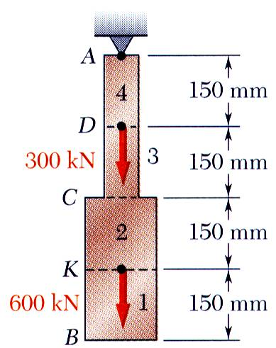
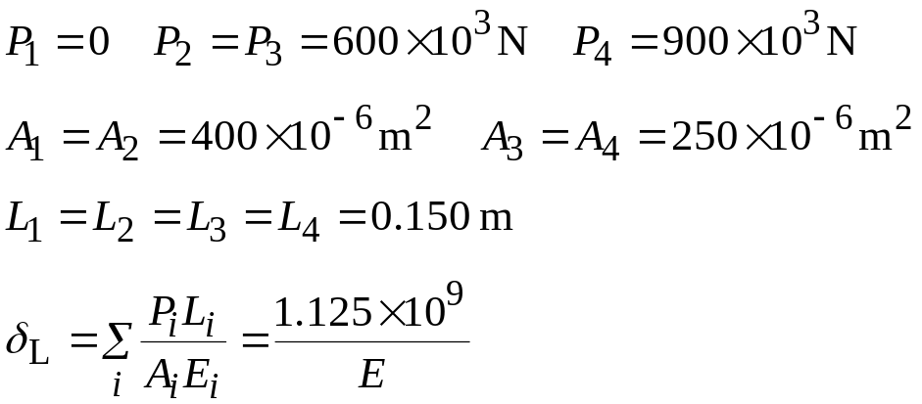
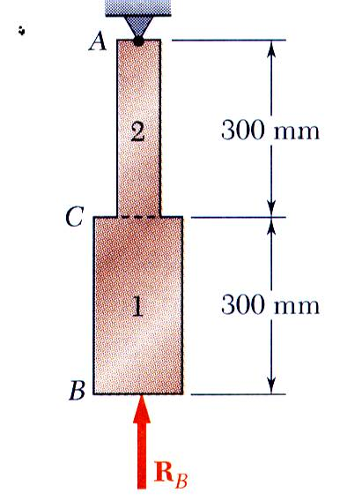
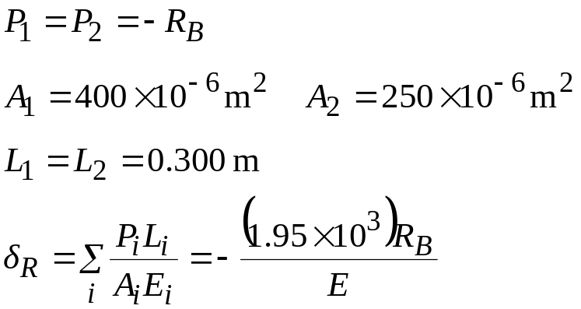
Example 2.04
SOLUTION:
Solve for the displacement at B due to the applied loads with the redundant constraint released,
Solve for the displacement at B due to the redundant constraint,
2 - <number>

Slide 18
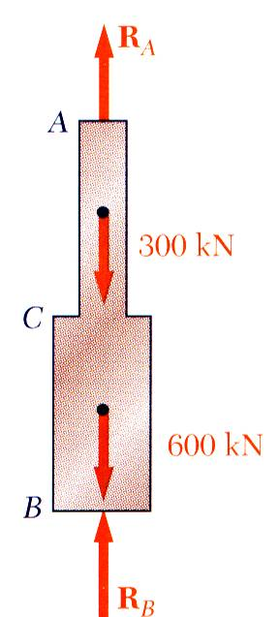
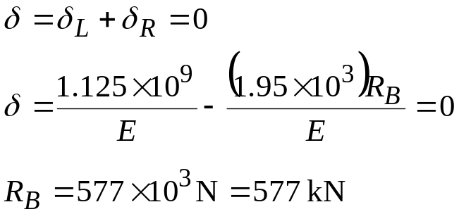
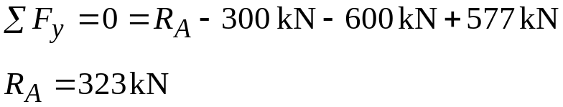
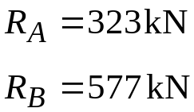
Example 2.04
Require that the displacements due to the loads and due to the redundant reaction be compatible,
Find the reaction at A due to the loads and the reaction at B
2 - <number>

Slide 19
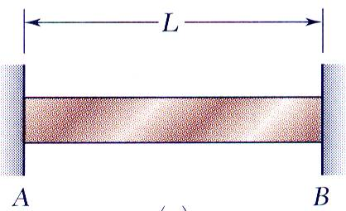
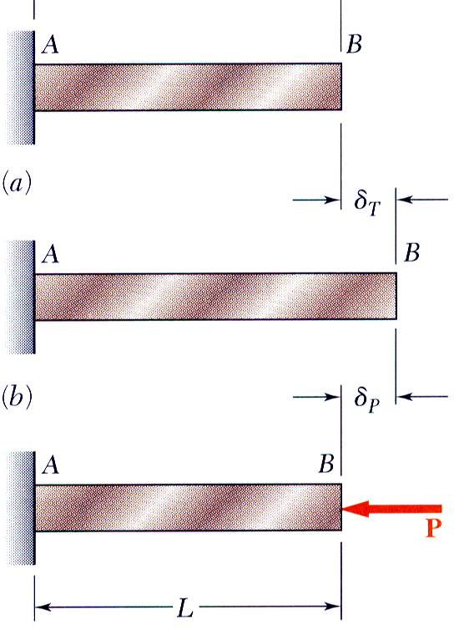
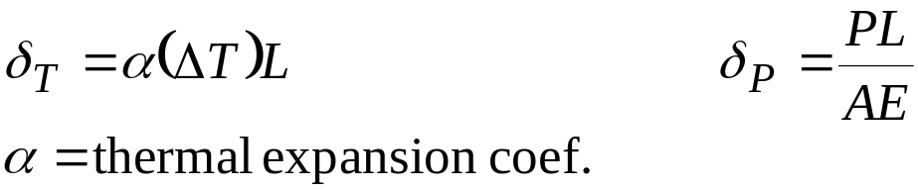

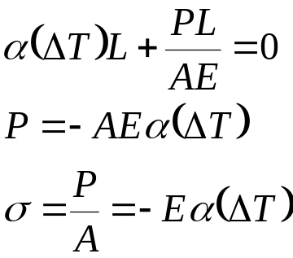
Thermal Stresses
A temperature change results in a change in length or thermal strain. There is no stress associated with the thermal strain unless the elongation is restrained by the supports.
Treat the additional support as redundant and apply the principle of superposition.
The thermal deformation and the deformation from the redundant support must be compatible.
2 - <number>

