Slide 1

Notes:
1st slide (Mandatory)

Slide 2
Data Base Management System

Slide 3
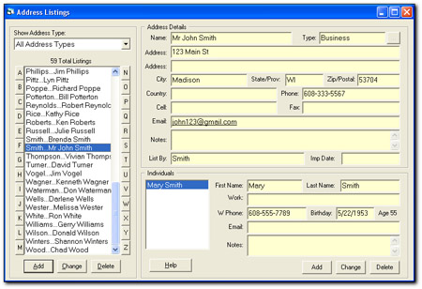
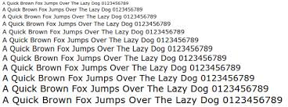


What is Data?
Data is information processed or stored by a computer.
This information may be in the form of text documents, images, audio clips, software programs, or other types of data.
Notes:
Title + Text

Slide 4
What is Database?
Database is a Systemtic collection of data.
A database is an organized collection of data, generally stored and accessed electronically from a computer system.
Notes:
Title + Text

Slide 5

What is DBMS?
Collection of data and set of programs to access and store these data in an easy and efficient manner.
Example : Let's consider the Facebook. It stores the data related to members, their friends, messages, advertisements etc.
Notes:
Title + Image + Text

Slide 6

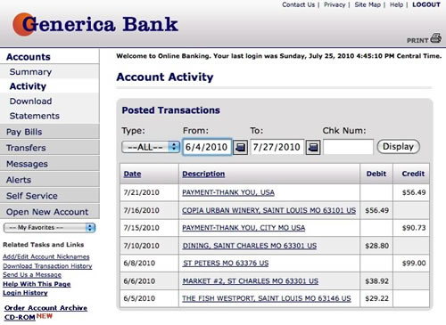

Why DBMS?
Notes:
Consider an example, you withdraw the money from atm, the details will upload in the bank automatically and you recieved a message also. Imagine that, if there is no database connectivity between atm and bank as well bank to our mobile, it is difficult to get the details about our transcation. For these kind of purpose we are using dbms.

Slide 7
peculiarity
No redundant data
Data Consistency and Integrity
Data Security
Privacy
Easy access to data
Easy recovery
Flexible
Notes:
No redundant data:
Normalization is used to remove the reindundancy, No data duplication and access time will be increased.
Data Consistency and Integrity:
Integrity : the correctness and completeness of the information in a database,
Consistency : when the content under question does not give us the chance to infer a contradiction directly or indirectly.
Data security:
Only authorized user is able to access the data.
Each user has a different set of access thus data is secured from the issues such as identity theft, data leaks and misuse of data.
Privacy:
Limited access means privacy of data.
Easy access to data:
Database systems manages data, so that the data is easily accessible with fast response times.
Easy recovery:
Database systems keeps the backup of data, it is easier to do a full recovery of data in case of a failure.
Flexible:
Database systems are more flexible than file processing systems.

Slide 8
Entity Relationship Model
The ER(Entity Relational Model) is a high-level conceptual data model diagram.
Entity-Relation model is based on the notion of real-world entities and the relationship between them.
ER modeling helps you to analyze data requirements systematically to produce a well-designed database.
Notes:
Title + Text

Slide 9
Why ER Diagram?
ER diagrams can be used by database designers as a blueprint for implementing data in specific software applications.
Entity-Relation model is based on the notion of real-world entities and the relationship between them.
ER modeling helps you to analyze data requirements systematically to produce a well-designed database.
Notes:
Title + Text

Slide 10
Components of the ER Diagram
Entities
Attributes
Relationships
In a University database, we might have entities for Students, Courses, and Lecturers. Students entity can have attributes like Rollno, Name, and DeptID. They might have relationships with Courses and Lecturers.
Notes:
Example:
In a University database, we might have entities for Students, Courses, and Lecturers. Students entity can have attributes like Rollno, Name, and DeptID. They might have relationships with Courses and Lecturers.

Slide 11
What is Entity?
An entity is a real-world object that are represented in database.
It can be any object,place,person or class. Data are stored about such entities.
Entity can be represented by rectangle shape.
Eaxample: Person, Place, Event, Car etc..
Entity
Notes:
Title + Text

Slide 12
What is Attributes?
Attributes are the properties which define the entity type.
For example, Roll_No, Name, DOB, Age, Address, Mobile_No are the attributes which defines entity type Student.
In ER diagram, attribute is represented by an oval.
Attribute
Notes:
Title + Text

Slide 13
What is Relationship?
Relationship is nothing but an association among two or more entities.
Diamonds symbol represents relationship types.
E.g: Tom works in the Chemistry department.
EElkrhbfi
Student
Enrolled in
Course
Notes:
Title + Text

Slide 14
ER diagram Symbols and Notation
Weak Entity
Weak Entity : Entity types that do not contain any key attribute, and hence can not be identified independently are called weak entity types
Weak Entity Relationship
Weak Enity Relationship :The entity sets which do not have sufficient attributes to form a primary key are known as weak entity sets
Multivalued Attribute
Multivalued attribute:
An attribute that can hold multiple values is known as multivalued attribute. It is represented with double ovals in an ER Diagram. For example – A person can have more than one phone numbers so the phone number attribute is multivalued.
Notes:
Weak Entity : Entity types that do not contain any key attribute, and hence can not be identified
independently are called weak entity types
Weak Enity Relationship :The entity sets which do not have sufficient attributes to form a primary key are known as weak entity sets
Multivalued attribute:
An attribute that can hold multiple values is known as multivalued attribute. It is represented with double ovals in an ER Diagram. For example – A person can have more than one phone numbers so the phone number attribute is multivalued.

Slide 15
Key Attribute
Key Attribute – The attribute which uniquely identifies each entity in the entity set is called key attribute.For example, Roll_No will be unique for each student. In ER diagram, key attribute is represented by an oval with underlying lines.
Composite Attribute
Composite Attribute – An attribute composed of many other attribute is called as composite attribute. For example, Address attribute of student Entity type consists of Street, City, State, and Country. In ER diagram, composite attribute is represented by an oval comprising of ovals.
Notes:
Key Attribute – The attribute which uniquely identifies each entity in the entity set is called key attribute.For example, Roll_No will be unique for each student. In ER diagram, key attribute is represented by an oval with underlying lines.
Composite Attribute – An attribute composed of many other attribute is called as composite attribute. For example, Address attribute of student Entity type consists of Street, City, State, and Country. In ER diagram, composite attribute is represented by an oval comprising of ovals.

Slide 16
Relational Model
The relational model represents the database as a collection of relations.
A relation is nothing but a table of values.
Every row in the table represents a collection of related data values. These rows in the table denote a real-world entity or relationship.
Notes:
Title + Text

Slide 17
Concepts
Attributes:
Each column has attributes. The properties which define a relation. E.g: Student roll no,name
Tables:
Each relation can be stored in tables. Each row called as records and each column called as attributes.
Tuples:
Tuple is a single row of a table, which contain single record.
Relation Schema:
Name of the relation with it's attributes.
Degree:
Total number of attributes which in the relation is called the degree of the relation.
Notes:
Attributes:
Each column has attributes. The properties which define a relation. E.g: Student roll no,name
Tables:
Each relation can be stored in tables. Each row called as records and each column called as attributes.
Tuples:
Tuple is a single row of a table, which contain single record.
Relation Schema:
Name of the relation with it's attributes.
Degree:
Total number of attributes which in the relation is called the degree of the relation.

Slide 18
Cardinality:
Total number of rows present in the table.
Column:
Column represents the set of values for a specific attribute.
Relation instance:
A relation instance is a tuple or row in a relation, i.e. one particular combination of attribute values.
Relation key :
Every row has one, two or multiple attributes, which is called relation key.
Attribute domain:
Every attribute has some pre-defined value and scope which is known as attribute domain
Notes:
Cardinality:
Total number of rows present in the table.
Column:
Column represents the set of values for a specific attribute.
Relation instance:
A relation instance is a tuple or row in a relation, i.e. one particular combination of attribute values.
Relation key :
Every row has one, two or multiple attributes, which is called relation key.
Attribute domain:
Every attribute has some pre-defined value and scope which is known as attribute domain

Slide 19
Primary Key
Tuple / Row
Customer Id | Customer Name | Status
1 | Goggle | Active
2 | Apple | Active
3 | Amazon | Inactive

Slide 20
Operations in Relational Model
Insert
Update
Delete
Select
Notes:
Insert:
Insert is used to insert data into the relation(Table).
Delete:
Delete is used to delete tuples(rows) from the table.
Update:
Modify allows you to change the values of some attributes in existing tuples.
Select:
Select allows you to choose a specific range of data.

Slide 21
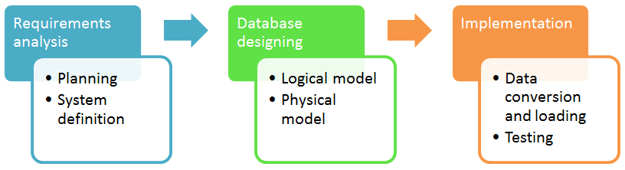
Database Design
Collection of processes that facilitate the designing, development, implementation and maintenance of enterprise data management systems.
Notes:
Title + Text

Slide 22
Requirements analysis
Planning
System Definition
Notes:
Planning:
This stages concerns with planning of entire Database Development Life Cycle It takes into consideration the Information Systems strategy of the organization.
System Definition:
This stage defines the scope and boundaries of the proposed database system.

Slide 23
Database designing
Logical Model:
This stage is concerned with developing a database model based on requirements. The entire design is on paper without any physical implementations or specific DBMS considerations.
Physical Model:
This stage implements the logical model of the database taking into account the DBMS and physical implementation factors
Notes:
Logical Model:
This stage is concerned with developing a database model based on requirements. The entire design is on paper without any physical implementations or specific DBMS considerations.
Physical Model:
This stage implements the logical model of the database taking into account the DBMS and physical implementation factors.

Slide 24
Implementation
Data Conversion and loading:
This stage is concerned with importing and converting data from the old system into the new database.
Testing:
this stage is concerned with the identification of errors in the newly implemented system .It checks the database against requirement specifications.
Notes:
Data Conversion and loading:
This stage is concerned with importing and converting data from the old system into the new database.
Testing:
this stage is concerned with the identification of errors in the newly implemented system .It checks the database against requirement specifications.

Slide 25
Normalization
Database normalization is a database schema design technique, by which an existing schema is modified to minimize redundancy and dependency of data.

Slide 26
Database Normalization Rules
First Normal Form
Second Normal Form
Third Normal Form
Boyce-codd Normal Form
Fourth Normal Form
Fifth Normal Form
Notes:
Logical Model:
This stage is concerned with developing a database model based on requirements. The entire design is on paper without any physical implementations or specific DBMS considerations.
Physical Model:
This stage implements the logical model of the database taking into account the DBMS and physical implementation factors.

Slide 27
First Normal Form
A database is in first normal form if it satisfies the following conditions:
Contains only atomic values
There are no repeating groups
Notes:
Atomic values:
An atomic value is a value that cannot be divided. For example, in the PRODUCT table , the values in the [Color] column in the first row can be divided into “red“ and "green", hence [PRODUCT] table is not in 1NF.
No repeating:
A repeating group means that a table contains two or more columns that are closely related. For example, a table that records data on a book and its author(s) with the following columns: [Book ID], [Author 1], [Author 2], [Author 3] is not in 1NF because [Author 1], [Author 2], and [Author 3] are all repeating the same attribute.

Slide 28
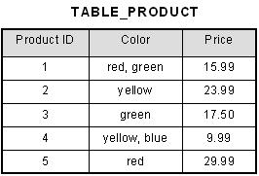
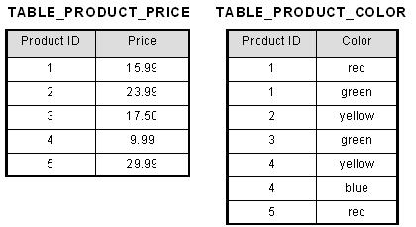

Slide 29
Second Normal Form
A relation is in second normal form if it is in 1NF and every non key attribute is fully functionally dependent on the primary key.
Physical Model
Notes:
Let's assume, a school can store the data of teachers and the subjects they teach. In a school, a teacher can teach more than one subject.
TEACHER_ID SUBJECT TEACHER_AGE
25 Chemistry 30
25 Biology 30
47 English 35
83 Math 38
83 Computer 38
In the given table, non-prime attribute TEACHER_AGE is dependent on TEACHER_ID which is a proper subset of a candidate key. That's why it violates the rule for 2NF.
Candidate Key:
The primary key uniquely identifies a record or row in the table and it follows one key per table approach. The candidate key also uniquely identifies a record or row in the table but it can have one key per table or many keys per table

Slide 30
StudentID | ProjectID | StudentName | ProjectName
S89 | P09 | Olivia | Geo Location
S76 | P07 | Jacob | Cluster Exploration
S56 | P03 | Ava | IoT Devices
S92 | P05 | Alexandra | Cloud Deployment

Slide 31
<StudentInfo>
StudentID | ProjectID | StudentName
S89 | P09 | Olivia
S76 | P07 | Jacob
S56 | P03 | Ava
S92 | P05 | Alexandra
<ProjectInfo>
ProjectID | ProjectName
P09 | Geo Location
P07 | Cluster Exploration
P03 | IoT Devices
P05 | Cloud Deployment

Slide 32
Third Normal Form
A database is in third normal form if it satisfies the following conditions:
It is in second normal form
There is no transitive functional dependency

Slide 33
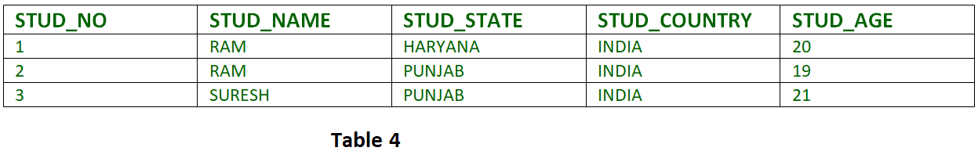
If A->B and B->C are two FDs then A->C is called transitive dependency.

Slide 34
{STUD_NO -> STUD_NAME, STUD_NO -> STUD_STATE, STUD_STATE -> STUD_COUNTRY, STUD_NO -> STUD_AGE}

Slide 35
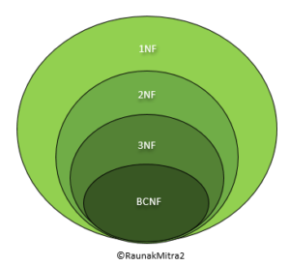
Boyce Codd normal form
BCNF is the advance version of 3NF. It is stricter than 3NF.
A table is in BCNF if every functional dependency X → Y, X is the super key of the table.
Notes:
Let's assume there is a company where employees work in more than one department.
EMPLOYEE table:
EMP_ID EMP_COUNTRY EMP_DEPTD EPT_TYPE EMP_DEPT_NO
India Designing D394 283
India Testing D394 300
UK Stores D283 232
In the above table Functional dependencies are as follows:
EMP_ID → EMP_COUNTRY
EMP_DEPT → {DEPT_TYPE, EMP_DEPT_NO}
Candidate key: {EMP-ID, EMP-DEPT}
The table is not in BCNF because neither EMP_DEPT nor EMP_ID alone are keys.
To convert the given table into BCNF, we decompose it into three tables:
EMP_COUNTRY table:
{EMP_ID, EMP_COUNTRY}
EMP_DEPT table:
{EMP_DEPTD,EPT_TYPE,EMP_DEPT_NO}
EMP_DEPT_MAPPING table:
{EMP_ID, EMP_DEPT}
Functional dependencies:
EMP_ID → EMP_COUNTRY
EMP_DEPT → {DEPT_TYPE, EMP_DEPT_NO}
Candidate keys:
For the first table: EMP_ID For the second table: EMP_DEPT For the third table: {EMP_ID, EMP_DEPT}
Now, this is in BCNF because left side part of both the functional dependencies is a key.

Slide 36
Consider a relation R with attributes (student, subject, teacher).
Student | Teacher | Subject
Jhansi | P.Naresh | Database
jhansi | K.Das | C
subbu | P.Naresh | Database
subbu | R.Prasad | C
Decomposition for BCNF
Teacher | Subject
P.Naresh | database
K.DAS | C
R.Prasad | C
Student | Teacher
Jhansi | P.Naresh
Jhansi | K.Das
Subbu | P.Naresh
Subbu | R.Prasad

Slide 37
Fourth Normal Form
A relation will be in 4NF if it is in Boyce Codd normal form and has no multi-valued dependency.
For a dependency A → B, if for a single value of A, multiple values of B exists, then the relation will be a multi-valued dependency.
Note
It should be in the Boyce-Codd Normal Form (BCNF).
the table should not have any Multi-valued Dependency.
Notes:
Example:
Table name: Student
STU_ID COURSE HOBBY
21 Computer Dancing
21 Math Singing
34 Chemistry Dancing
74 Biology Cricket
The given STUDENT table is in 3NF, but the COURSE and HOBBY are two independent entity.
Hence, there is no relationship between COURSE and HOBBY.
In the STUDENT relation, a student with STU_ID, 21 contains two courses, Computer and Math and two hobbies, Dancing and Singing.
So there is a Multi-valued dependency on STU_ID, which leads to unnecessary repetition of data.
So to make the above table into 4NF, we can decompose it into two tables:
STUDENT_COURSE:
{STU_ID,COURSE}
STUDENT_HOBBY:
{STU_ID,HOBBY}

Slide 38
s_id | course | hobby
1 | Science | Cricket
1 | Maths | Hockey
1 | Science | Hockey
1 | Maths | Cricket
CourseOpted Table
s_id | course
1 | Science
1 | Maths
2 | C#
2 | Php
And, Hobbies Table,
s_id | hobby
1 | Cricket
1 | Hockey
2 | Cricket
2 | Hockey

Slide 39
Fifth Normal Form
5NF also called project-join normal form (PJNF).
The fifth normal is defined with the join dependencies. If there is any decomposition of the Relational Schema R there will be lossless decomposition in join dependency.
So, the 5NF is called as project-join normal form (PJNF).
5NF is satisfied when all the tables are broken into as many tables as possible in order to avoid redundancy.
5NF is also known as Project-join normal form (PJ/NF).
Note:
R should be already in 4NF.
It cannot be further non loss decomposed (join dependency)

Slide 40
Transaction
A transaction is a unit of program execution that accesses and possibly updates various data items.
A transaction must see a consistent database.
During transaction execution the database may be temporarily inconsistent.

Slide 41
When the transaction completes successfully , the database must be consistent.
Multiple transactions can execute in parallel.
Two main issues to deal with:
Failures of various kinds, such as hardware failures and system crashes.
Concurrent execution of multiple transactions.

Slide 42
ACID Properties
Atomicity:
Either all operations of the transaction are properly reflected in the database or none.
Consistency:
Execution of a transaction in isolation preserves the consistency of the database.
The total amount before and after the transaction must be maintained.
Isolation:
Although multiple transactions may execute concurrently, each transaction must be unaware of other concurrently executing transactions. Intermediate transaction results must be hidden from other concurrently executed transactions.
This property ensures that multiple transactions can occur concurrently without leading to the inconsistency of database state
Durability:
After a transaction completes successfully, the changes it has made to the database persist, even if there are system failures
Notes:
Atomicity:
Either all operations of the transaction are properly reflected in the database or none.
A AND B TRANSACTION A-100 B+100
Consistency:
Execution of a transaction in isolation preserves the consistency of the database.
The total amount before and after the transaction must be maintained.
Isolation:
Although multiple transactions may execute concurrently, each transaction must be unaware of other concurrently executing transactions. Intermediate transaction results must be hidden from other concurrently executed transactions.
This property ensures that multiple transactions can occur concurrently without leading to the inconsistency of database state
Durability:
After a transaction completes successfully, the changes it has made to the database persist, even if there are system failures

Slide 43
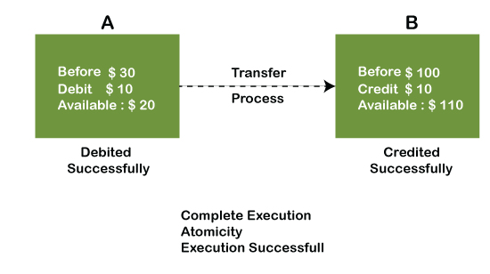
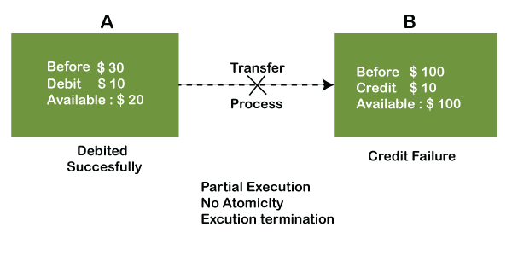
Atomicity

Slide 44
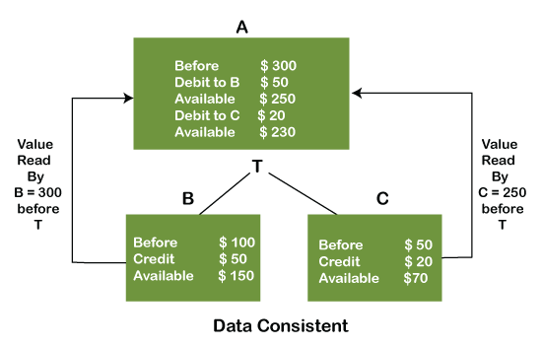

Slide 45
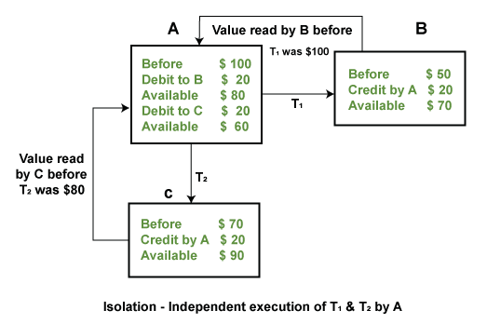

Slide 46
Transaction States
Active
Partially Committed
Failed
Aborted
Committed

Slide 47
Partially Committed
Committed
Active
Aborted
Failed
Notes:
Active : The initial state; the transaction stays in this state while it is executing
Partially committed : After the final statement has been executed
Failed : After the discovery that normal execution can no longer proceed
Aborted : After the transaction has been rolled back and the database restored to its state prior to the start of the transaction 
Two options after it has been aborted:
1. Restart the transaction; can be done only
2. If no internal logical error occurred
3. Kill the transaction
Committed : after successful completion

Slide 48
Concurrency Control
The technique is used to protect data when multiple users are accessing same data concurrently(same time) is called concurrency control.
Concurrency is the ability of a database to allow multiple users to affect multiple transactions. Other users can read the file, but may not edit data.
Need for concurrency control is data can be updated correctly when multiple transactions are executed successfully.

Slide 49
Lock Based Protocol
Lock is a mechanism to control concurrent access to the data item.
Data items can be locked in two modes:
1.Exclusive (X) Mode
2.Shared (S) Mode
Exclusive(X) Mode:
Data item can be both read as well as written. X-lock is requested using lock-X instructions.
Shared(S) Mode:
Data item can only be read. S-lock is requested using lock-S instructions.
Transaction can proceed only after request is granted
Notes:
Exclusive(X) Mode:
Data item can be both read as well as written. X-lock is requested using lock-X instructions.
Shared(S) Mode:
Data item can only be read. S-lock is requested using lock-S instructions.

Slide 50
Deadlock
A deadlock is a situation in which two or more transactions are waiting for one another to give up locks.
For example, Transaction A might hold a lock on some rows in the Accounts table and needs to update some rows in the Orders table to finish..

Slide 51
Conditions of Deadlock
Mutual exclusion Condition
Hold and wait Condition
No preemption Condition
Circular wait Condition
Notes:
Mutual exclusion condition:
Each resource assigned to 1 process or is available
Hold and wait condition:
Process holding resources can request additional
No preemption condition: Previously granted resource cannot forcibly taken away
Circular wait condition:
Must be a circular chain of 2 or more process

Slide 52
Strategies of Deadlock Handling
Deadlock Prevention
Deadlock Avoidance
Deadlock detection and recovery
Notes:
Deadlock Prevention:
The deadlock prevention approach does not allow any transaction to acquire locks that will lead to deadlocks. The convention is that when more than one transactions request for locking the same data item, only one of them is granted the lock.
Deadlock Avoidance:
The deadlock avoidance approach handles deadlocks before they occur. It analyzes the transactions and the locks to determine whether or not waiting leads to a deadlock.
Deadlock detection and recovery:
The deadlock detection and removal approach runs a deadlock detection algorithm periodically and removes deadlock in case there is one. It does not check for deadlock when a transaction places a request for a lock. When a transaction requests a lock, the lock manager checks whether it is available. If it is available, the transaction is allowed to lock the data item; otherwise the transaction is allowed to wait.

Slide 53

THANK YOU
Notes:
Thank you slide

