Slide 1

Notes:
1st slide (Mandatory)

Slide 2

TCS NQT
Topic/Course
Sub-Topic (Example: name of college)
Reasoning Ability
Notes:
Cover Page
Font: Nunito Sans
Primary colors: Black, White and Red (#F05136)
General Instruction:
Don’t edit this PPT (keep it for future reference)
Copy paste the required slide into your PPT. Format it there.
Write less, talk/present more
Use the font Nunito Sans Regular. You can download it from google fonts (https://fonts.google.com/specimen/Nunito+Sans).
Don’t change the size and/or positions of headings, texts, unless absolutely necessary. (minimum size: 20)
The size of the image must be adjusted according to the text. (try to make it look visually attractive)
1 image per slide. No more than 4 points per slide.

Slide 3

Visual Reasoning
Notes:
Section End/Start
Use this at section’s start or end. For example: “Questions” or “Time for Practice”. To be used for Impacts (get the student’s attention).

Slide 4
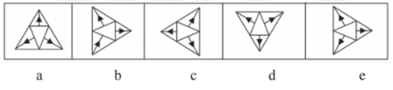


Question
Out of the five given figures, four are similar in a certain way. One
figure is not like the other four i.e., four figures form a group based on some common characteristics. Find out the figure which does not belong to the group i.e., which does not shares the common features/ characteristics with the other four figures.
A)
(a)
B)
(b)
C)
(c)
D)
(d)
E)
(e)
Notes:
(b) In all the given figures, the black arrow heads are facing outward, except in figure (b). Thus, figure (b) is the odd man out.

Slide 5

Question
Group the given figures into three classes using each figure only once.
A)
(1, 2, 6); (3, 4,7); (5)
B)
(1,3); (2, 6); (4,5,7)
C)
(1, 2, 6, 7); (3); (4, 5)
D)
(1,3); (2,4,5); (6,7)
Notes:
(d) There are certain figures given in the question which are to be grouped on the basis of their homogeneity. We must take into consideration the whole figure rather than just the outer or the inner portion of it. Observing each figure closely, we can notice that figures (1) and (3) are similar because of the V-shape inside of them. Similarly figures (2), (4) and (5) are similar as they form a series of geometrical figures which enclose the same figures within themselves. Figures (6) and (7) form a separate class as they enclose cross inside the geometrical figures. Hence, the three classes are [(1,3) , (2, 4, 5), (6, 7)].

Slide 6
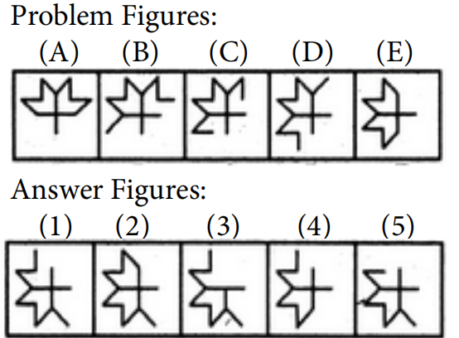
Question
Select a figure from amongst the Answer Figures which will continue the same series as established by the five Problem Figures.
A)
(1)
B)
(2)
C)
(3)
D)
(4)
E)
(5)
Notes:
(a) In the given question, we need to find the next figure in the sequence and for that, we need to establish a pattern among the problem figures. We can observe in the problem figures that the pattern is that in each figure, the small line forming the outline of the figure is removed from the right side and added to the left side of the figure to arrive at the next figure. Consequently, we can conclude that option (a) will follow the problem figure (E).

Slide 7
Question
Select a figure from amongst the Answer Figures which will continue the same series as established by the five Problem Figures.
A)
(1)
B)
(2)
C)
(3)
D)
(4)
E)
(5)
Notes:
(e) A simple way to approach this question is divide the big square box in each of the problem figures in 3 × 3 grid. Now, we may notice that there are two objects within the square box – one being a star and the other a rectangle. In problem figure (A), the star is placed at the leftmost top corner and the rectangle is placed exactly below it. In the next problem figure, both figures move one place down and in the next, one moves at the leftmost corner (star) and the other moves to the top of the middle column and this pattern follows. On checking problem figure (E) and comparing all the answer figures, we can conclude that answer figure must follow the given series of figures.

Slide 8
Question
Select a figure from amongst the Answer Figures which will continue the same series as established by the five Problem Figures.
#
#
#
#
#
A)
(1)
B)
(2)
#
C)
#
#
#
(3)
#
D)
(4)
E)
(5)
Notes:
(a) In this question, we must closely observe the movement of the trapezium within the square boxes in each problem figure. We can note that it moves to each corner in a clockwise fashion in subsequent problem figures. This must be followed in the answer figure and so, we can eliminate answer figures (2) and (5). We can also eliminate (4) as there is a square in the middle when it should be wither a kite or a hashtag. So, we can conclude based on the remaining options that there must a hashtag in the middle. Now, if we closely observe the problem figures, in every problem figure, there is a new figure introduced other than the figures that are common all the problem figures. For instance, in (A), there is a pentagon and in (B), it is triangle and so on. Also, notice that these figures are introduced at each corner, starting from the bottom left corner, and then are introduced in a clockwise fashion in the next square box. So, in (A), pentagon is at the bottom left; in (B), triangle is introduced at the top left corner, then hexagon is introduced at the top right corner and so on. Therefore, in the answer figure, the new figure must be introduced at the top left corner, following the sequence, which is an A-shaped figure. This is followed in answer figure (1) and hence, it is correct.

Slide 9
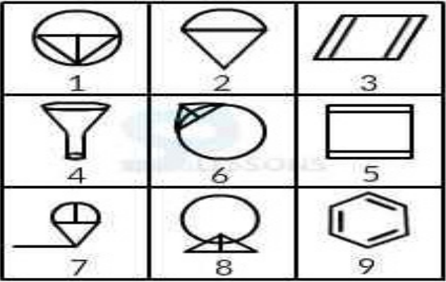
Question
Group the given figures into three classes using each figure only once.
A)
(1, 5, 8); (2, 6, 7); (3, 4, 9)
B)
(1, 5, 7); (2, 6, 8); (3, 4, 5)
C)
(1, 6, 8); (2, 4, 7); (3, 5, 9)
D)
(1, 5, 8); (2, 4, 7); (3, 6, 9)
Notes:
(c) Note that the numbers assigned to the figures do not follow a proper sequence. They are jumbled up. Now, by carefully observing the given set of figures, we can easily classify that figures 3, 5 and 9 are of the same class as they have a common characteristic that they are all simple polygons with certain number of lines within them. We can also find common characteristics between figures 1, 6 and 8. In these figures, each figure is combination of a circle, a triangle and a certain number of straight lines. The remaining figures, i.e. 2, 4 and 7 form a single class. This can also be determined by relating them to each other by the fact that each figure includes a figure that resembles a cone. Hence, the class of figures will be (1, 6, 8), (2, 4, 7) and (3, 5, 9).

Slide 10
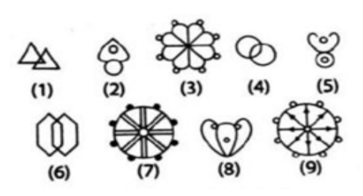
Question
Group the given figures into three classes using each figure only once.
A)
(1, 4, 8); (2, 5, 7); (3, 9, 6)
B)
(1, 4, 6); (2, 5, 8); (3, 7, 9)
C)
(1, 4, 6); (2, 5, 7); (3, 8, 9)
D)
(1, 2, 3); (4, 5, 6); (7, 8, 9)
Notes:
(b) On closely observing the given figures, we can conclude for sure that figures 3, 7 and 9 belong to the same class. We can also observe that figures 1, 4 and 6 are of the same class as they all involve two similar figures intersecting each other. The remaining figures, i.e. 2, 5 and 8 are of the same class

Slide 11
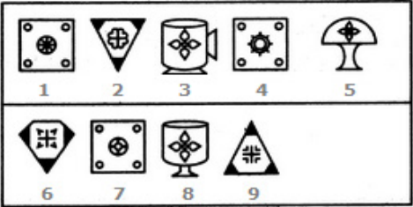
Question
Group the given figures into three classes using each figure only once.
A)
(1, 4, 7); (3, 6, 9); (2, 5, 8)
B)
(1, 6, 9); (2, 4, 7); (3, 5, 8)
C)
(1, 4, 7); (2, 6, 9); (3, 5, 8)
D)
(1, 5, 7); (2, 6, 9); (3, 4, 8)
Notes:
(c) On closely observing the given figures, we can conclude for sure that figures 1, 4 and 7 belong to the same class as they all involve some figures enclosed within a square. We can also classify figures 2, 6 and 9 into a single class as they involve figures which have their corners darkened. The remaining figure, i.e. 3, 5 and 8 form a single class.

Slide 12
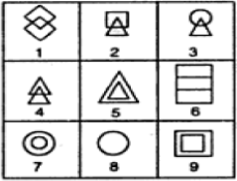
Question
Group the following figures with identical properties into three classes and select the correct alternative.
A)
(1, 4, 6); (3, 5, 8); (2, 7, 9)
B)
(1, 4, 8); (2, 3, 6); (5, 7, 9)
C)
(4, 5, 6); (2, 3, 8); (1, 7, 9)
D)
(1, 4, 6); (2, 3, 8); (5, 7, 9)
Notes:
(d) On closely observing the given figures, we can surely conclude that figures 5, 7 and 9 will form a common class as they involve geometrical figures enclosed within the same geometric figure, for instance, in figure 5 triangle is enclosed within a bigger triangle and the same if for circle in 7 and square in 9. We can also class figures 1 and 4 in the same class as they comprise of two similar geometrical figures overlapping each other. For the third figure in this class, if we observe the remaining figures closely, we can conclude that figure 6 can be the part of this class. Here, simply two similar rectangles are overlapping each other. The remaining three figures, i.e. 2, 3 and 8 can be classified in the class. Hence, option (d) is the correct answer.

Slide 13
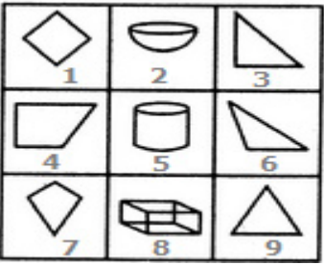
Question
Group the following figures with identical properties into three classes and select the correct alternative.
A)
(1, 4, 7); (2, 5, 8); (3, 6, 9)
B)
(1, 4, 7); (2, 5, 9); (3, 6, 7)
C)
(1, 3, 4); (2, 5, 8); (6, 7, 9)
D)
(1, 2, 3); (4, 5, 6); (7, 8, 9)

Slide 14
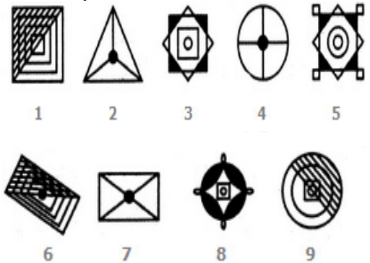
Question
Group the given figures into three classes using each figure only once.
A)
(2, 4, 7); (1, 6, 9); (3, 5, 8)
B)
(1, 3, 5); (2, 6, 7); (4, 8, 9)
C)
(1, 5, 7); (2, 3, 6); (4, 8, 9)
D)
(1, 3, 5); (2, 4, 7); (6, 8, 9)

Slide 15
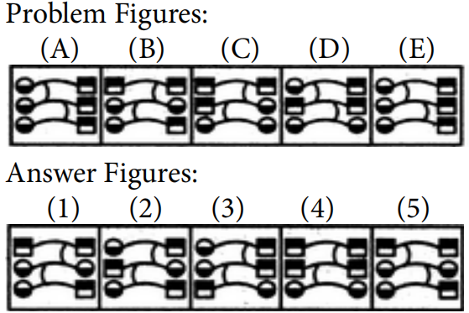
Question
Select a figure from amongst the Answer Figures which will continue the same series as established by the five Problem Figures.
A)
(1)
B)
(2)
C)
(3)
D)
(4)
E)
(5)

Slide 16
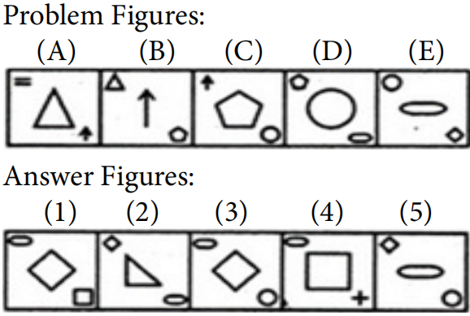
Question
Select a figure from amongst the Answer Figures which will continue the same series as established by the five Problem Figures.
A)
(1)
B)
(2)
C)
(3)
D)
(4)
E)
(5)

Slide 17


Question
Select a figure from amongst the Answer Figures which will continue the same series as established by the five Problem Figures.
A)
(1)
B)
(2)
C)
(3)
D)
(4)
E)
(5)
Notes:
Three and two arcs are inverted alternately. The central element rotates 90ºACW and 180º alternately.

Slide 18


Question
Select a figure from amongst the Answer Figures which will continue the same series as established by the five Problem Figures.
A)
(1)
B)
(2)
C)
(3)
D)
(4)
E)
(5)
Notes:
In each step, one dot is lost while another dot is replaced by a cross.

Slide 19

THANK YOU
Notes:
Thank you slide

