Slide 1


MINDTREE
Recently Asked | PYQ
PRIME CODING

Slide 2
Do share your interview experience and Coding questions with us.
So we can be helpful to each and everyone.
Share on Telegram, Whatsapp, Instagram, E-Mail or DM.
All Links in Description.

Slide 3
A server manages a queue of print jobs for multiple users. The server must handle jobs in the order they are received.
Question:
Which data structure is the best to implement the print job queue?
A. Stack
B. Queue
C. HashMap
D. Linked List

Slide 4
Answer: B
Explanation: A queue operates in a First-In, First-Out (FIFO) manner, which is appropriate for managing print jobs.

Slide 5
A social media app allows users to send messages to their followers. The app should notify all followers instantly when a message is posted.
Question:
Which data structure is most appropriate for managing a list of followers?
A. Stack
B. Tree
C. Linked List
D. Graph

Slide 6
Answer: D
Explanation: Social networks can be represented as graphs, where nodes represent users and edges represent follower relationships.

Slide 7
You need to optimize a search algorithm to find an element in a sorted list.
Question:
Which search algorithm is the most efficient for this case?
A. Linear Search
B. Binary Search
C. Depth-First Search
D. Breadth-First Search

Slide 8
Answer: B
Explanation: Binary search works efficiently on sorted lists with a time complexity of O(log n).

Slide 9
Consider the following Python code snippet:
x = [1, 2, 3]
y = x
x.append(4)
What will be the content of the variable y after this code executes?
A. [1, 2, 3]
B. [1, 2, 3, 4]
C. None
D. It will throw an error

Slide 10
Answer: B
Explanation: In Python, lists are mutable and passed by reference, so changes made to x will reflect in y.

Slide 11
A developer is optimizing code that frequently searches for elements in a sorted array.
Which algorithm should they use to minimize time complexity?
A. Linear Search
B. Quick Sort
C. Binary Search
D. Merge Sort

Slide 12
Answer: C
Explanation: Binary search efficiently finds an element in a sorted array with a time complexity of O(log n).

Slide 13
You are using a TCP/IP model in networking. You need to troubleshoot an issue with the transport layer. Which of the following would you investigate first?
A. IP addressing
B. Packet routing
C. Data encryption
D. TCP handshake

Slide 14
Answer: D
Explanation: TCP handshake occurs at the transport layer, handling reliable data transmission.

Slide 15
In a circular linked list, which of the following conditions defines the end of the list?
A. The next node points to NULL
B. The next node points to the head
C. The next node points to the tail
D. There is no end in a circular list

Slide 16
Answer: B
Explanation: In a circular linked list, the last node points back to the head of the list.

Slide 17
You are managing memory allocation in C++. You create a pointer using new to allocate memory. Which of the following must you do to prevent a memory leak?
A. Use malloc() to deallocate memory
B. Use delete to deallocate memory
C. Use free() to deallocate memory
D. No need to deallocate, it is handled automatically

Slide 18
Answer: B
Explanation: In C++, you must manually deallocate dynamically allocated memory using delete to avoid memory leaks.

Slide 19
A file transfer protocol is transferring files from a client to a server. The client notices that large files take a long time. Which layer of the OSI model should be optimized to improve this process?
A. Application
B. Transport
C. Session
D. Network

Slide 20
Answer: D
Explanation: The network layer is responsible for packet routing and can be optimized for larger data transfers.

Slide 21
Consider this SQL query:
SELECT * FROM Employees WHERE Salary > (SELECT AVG(Salary) FROM Employees);
What will this query return?
A. Employees with the highest salary
B. Employees with salary above average
C. Employees with salary below average
D. All employees

Slide 22
Answer: B
Explanation: The query selects all employees whose salary is greater than the average salary.

Slide 23
In a dynamic programming solution to the knapsack problem, which of the following conditions holds true?
A. Items can be added repeatedly
B. Items are added based on fractional weight
C. Subproblems are solved independently
D. Overlapping subproblems are solved using memoization

Slide 24
Answer: D
Explanation: Dynamic programming uses memoization to solve overlapping subproblems efficiently.

Slide 25
You are given a graph representing a network with 5 nodes. What is the shortest path from node A to node E?
A -- 3 -- B -- 2 -- D -- 5 -- E
| |
4 3
| |
C -- 6 -- F
A. A -> C -> F -> D -> E
B. A -> B -> D -> E
C. A -> C -> B -> D -> E
D. A -> B -> C -> F -> D -> E

Slide 26
Answer: B
Explanation: The shortest path from A to E via D and B is 10 units.

Slide 27
Look at the following UML diagram. Which relationship is represented here?
Class A Class B
A. Inheritance
B. Composition
C. Association
D. Aggregation

Slide 28
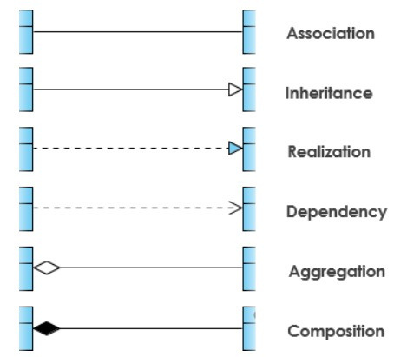
Answer: C
Explanation: The arrow between two classes typically represents an association in UML diagrams.

Slide 29
You are given two sorted arrays, A and B, of sizes n and m respectively. You need to merge them into a single sorted array. What is the time complexity of an efficient solution?
A. O(n + m)
B. O(n * m)
C. O(n log m)
D. O(n log n)

Slide 30
Answer: A
Explanation: Merging two sorted arrays can be done in O(n + m) by comparing the elements in a single pass.

Slide 31
In a peer-to-peer (P2P) network, which statement is true?
A. Each node has a central server
B. All nodes have equal status and share resources directly
C. There is a single point of failure
D. Nodes can only download files

Slide 32
Answer: B
Explanation: In a P2P network, all nodes act as both clients and servers, sharing resources without central authority.

Slide 33
Which of the following is true for static variables in C?
A. Automatically initialized to zero
B. Must be manually initialized
C. Cannot be initialized
D. Initialized to garbage values

Slide 34
Answer: A. Automatically initialized to zero
Explanation: Static variables in C are initialized to zero by default.

Slide 35
In a 3x3 matrix multiplication, what is the time complexity?
A. O(n)
B. O(n^2)
C. O(n^3)
D. O(log n)

Slide 36
Answer: C. O(n^3)
Explanation: Matrix multiplication typically has a cubic time complexity.

Slide 37
Which of the following implements dynamic arrays in Java?
A. LinkedList
B. ArrayList
C. HashMap
D. TreeSet

Slide 38
Answer: B. ArrayList
Explanation: ArrayList in Java resizes dynamically when new elements are added.

Slide 39
You are tasked to design a program for a library system. If you need to manage books using both title and author name as keys, which data structure would be ideal?
A. Array
B. HashMap
C. LinkedList
D. Stack

Slide 40
Answer: B. HashMap
Explanation: HashMap allows you to store key-value pairs and retrieve them efficiently using title and author as keys.

Slide 41
In a distributed system, multiple processes access shared resources. Which of the following synchronization techniques will prevent race conditions?
A. Deadlock
B. Semaphore
C. Starvation
D. Thrashing

Slide 42
Answer: B. Semaphore
Explanation: Semaphores are used to control access to shared resources and avoid race conditions.

Slide 43
Sayandip Shubham Adesh Varun
Mukesh Priyanka Venkata Vijaey
Adarsh Divyansh Kaushik Pawan
Hariom Harsh Harsha Abhishek
Sakshi Akhilesh Ankit Ananya
Saksham Sparsh Nilraj Gopal
WWW.PRIMECODING.IN

Slide 44
1:1 Mock Sessions
Prepare like Actual Interview
Detailed Technical session
HR and Managerial Round
Resume Review
Persnolised Feedback
Suggestions for future Improvement
Expert Guidance
WWW.PRIMECODING.IN

Slide 45
A software development team is following Agile methodology. During which Agile phase are potential roadblocks discussed by the team?
A. Sprint planning
B. Daily stand-up
C. Retrospective
D. Review

Slide 46
Answer: B. Daily stand-up
Explanation: Daily stand-ups are used to discuss any issues or roadblocks the team is facing.

Slide 47
Which of the following sorting algorithms has the best average-case time complexity?
A. Bubble Sort
B. Quick Sort
C. Insertion Sort
D. Selection Sort

Slide 48
Answer: B. Quick Sort
Explanation: Quick Sort has an average-case time complexity of O(n log n), which is better than O(n^2) algorithms like Bubble Sort or Insertion Sort.

Slide 49
What is the output of the following code?
int a = 10;
int *p = &a;
cout << *p;
A. Address of a
B. 10
C. Garbage value
D. Compilation error

Slide 50
Answer: B. 10
Explanation: The pointer p holds the address of a. Dereferencing p gives the value stored in a, which is 10.

Slide 51
What is the maximum number of edges in an undirected graph with 6 vertices?
A. 10
B. 15
C. 20
D. 30

Slide 52
Answer: B. 15
Explanation: The maximum number of edges in an undirected graph with n vertices is given by the formula n(n-1)/2. For 6 vertices, the maximum number of edges is 6(6-1)/2 = 15.

Slide 53
Which data structure can be used to efficiently find the median in a stream of integers?
A. Stack
B. Queue
C. Min-Heap and Max-Heap
D. Binary Search Tree

Slide 54
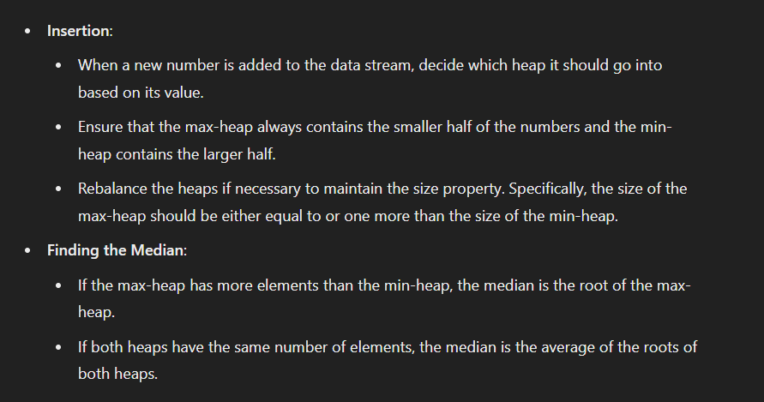
Answer: C. Min-Heap and Max-Heap
Explanation: By maintaining two heaps (Min-Heap for the larger half and Max-Heap for the smaller half), you can efficiently track the median in a stream.

Slide 55
Which of the following protocols is used for sending emails?
A. HTTP
B. FTP
C. SMTP
D. SNMP

Slide 56
Answer: C. SMTP
Explanation: Simple Mail Transfer Protocol (SMTP) is the protocol used for sending emails.

Slide 57
An operating system uses virtual memory. When the available physical memory is full and additional memory is needed, which strategy is used to free up space?
A. Paging
B. Thrashing
C. Swapping
D. Segmentation

Slide 58
Answer: C. Swapping
Explanation: Swapping involves moving some pages from RAM to disk to free up space for new processes or data.

Slide 59
The following sequence of operations is performed on an initially empty stack:
push(5), push(3), pop(), push(7), push(8), pop(), pop()
What will be the content of the stack after the last operation?
A. [5]
B. [7, 5]
C. [3, 7, 8]
D. Empty

Slide 60
Answer: A. [5]
Explanation: After performing the operations step-by-step, the final stack contains only the element 5.

Slide 61
A binary tree is displayed as follows:
10
/ \
5 15
/ \ / \
3 7 12 18
What is the in-order traversal of this binary tree?
A. 10, 5, 3, 7, 12, 15, 18
B. 3, 5, 7, 10, 12, 15, 18
C. 18, 15, 12, 10, 7, 5, 3
D. 5, 3, 7, 15, 12, 18

Slide 62
Answer: B. 3, 5, 7, 10, 12, 15, 18
Explanation: In-order traversal visits the nodes in the order: left subtree, root, right subtree. Hence, the correct order is 3, 5, 7, 10, 12, 15, 18.

Slide 63
An ER diagram shows two entities: Students and Courses. Each student can enroll in multiple courses, and each course can have multiple students.
What is the cardinality of the relationship between Students and Courses?
A. One-to-One
B. One-to-Many
C. Many-to-One
D. Many-to-Many

Slide 64
Answer: D. Many-to-Many
Explanation: Since each student can enroll in multiple courses and each course can have multiple students, the relationship is many-to-many.

Slide 65

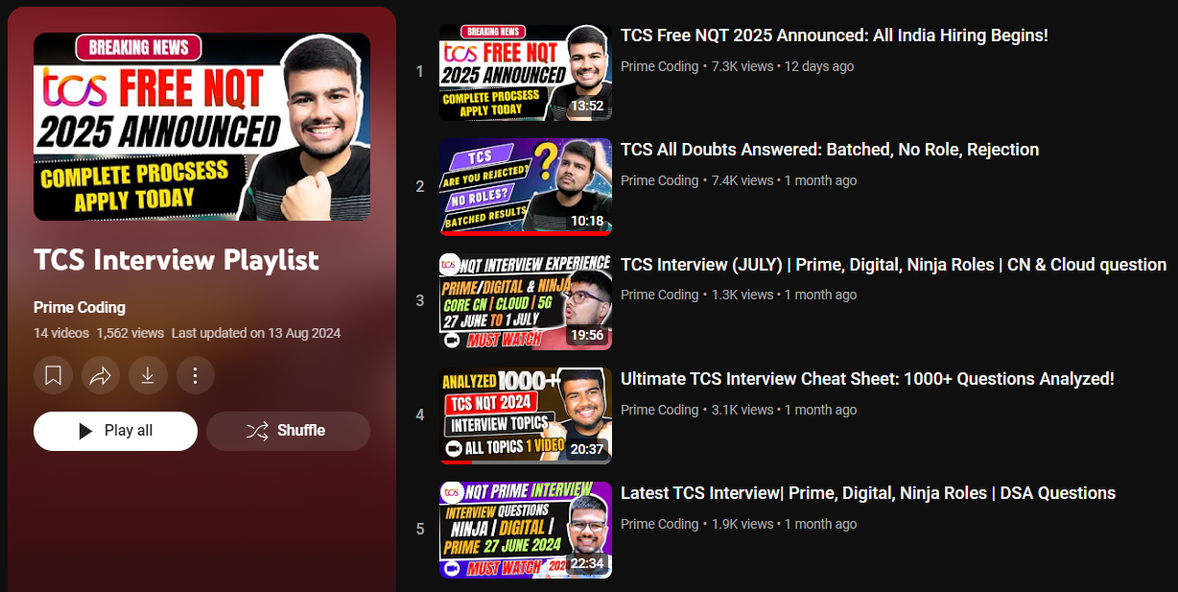

Preparation Resource

Slide 66
Thank You.
PRIME CODING

