Slide 1


Slide 2

TCS NQT Numerical – What’s Expected
26 Qs in 40 minutes
Expect Qs from:
Permutation, Combination and Probability
Numbers
Geometry and Mensuration
Progression
Time and Work
Time Speed and Distance
Percentages, SI and CI
Profit, Loss, Partnerships and Averages
Ratios and Proportions
Puzzles
Base Conversion
Equations
Notes:
Title + Bullets
No more than 4 points. Please use another similar slide incase you have more points.

Slide 3

Numerical Ability Qs from 2019

Slide 4
Question 1
The total income of Santhanam in the years 2011, 2012 and 2013 was Rs.36,400. His income increased by 20% each year. What was his income in 2013?
A)
10000
B)
8800
C)
12000
D)
14400

Slide 5

Question 1
The total income of Santhanam in the years 2011, 2012 and 2013 was Rs.36,400. His income increased by 20% each year. What was his income in 2013?
A)
10000
B)
8800
C)
12000
D)
14400

Slide 6
Question 2
A geometric box and a pencil box together cost Rs. 150. The cost of the geometric box is 100 rupees more than the pencil box. What is the cost of the pencil box in rupees?
A)
20
B)
25
C)
30
D)
35

Slide 7
Question 2
A geometric box and a pencil box together cost Rs. 150. The cost of the geometric box is 100 rupees more than the pencil box. What is the cost of the pencil box in rupees?
A)
20
B)
25
C)
30
D)
35

Slide 8
Question 3
A cyclist buys a cycle for 30 pounds paying with a 60 pound cheque. The seller changes the cheque next door and gives the cyclist change. The cheque bounces so the seller paid his neighbour back. The cycle cost the seller 23 pounds. How much did the seller lose?
A)
53
B)
20
C)
23
D)
60

Slide 9
Question 3
A cyclist buys a cycle for 30 pounds paying with a 60 pound cheque. The seller changes the cheque next door and gives the cyclist change. The cheque bounces so the seller paid his neighbour back. The cycle cost the seller 23 pounds. How much did the seller lose?
A)
53
B)
20
C)
23
D)
60

Slide 10
Question 4
You have three tuples: (1,2), (2.4), (3,6). What is the shape of the function that describes these?
A)
S-shaped
B)
Parabolic
C)
Straight line
D)
Quadrilateral

Slide 11
Question 4
You have three tuples: (1,2), (2.4), (3,6). What is the shape of the function that describes these?
A)
S-shaped
B)
Parabolic
C)
Straight line
D)
Quadrilateral

Slide 12
Question 5
The probability that there are 53 Mondays in a leap year is (Express answer as a ratio p/q)
A)
2/7
B)
6/77
C)
3/7
D)
1/7

Slide 13
Question 5
The probability that there are 53 Mondays in a leap year is (Express answer as a ratio p/q)
A)
2/7
B)
6/77
C)
3/7
D)
1/7

Slide 14
Question 6
Arun wrapped a gift for his friend in a big box, which contains 4 small boxes. Each of these small boxes again contain 3 boxes. Each of these boxes contain 3 boxes. The gift is randomly kept in one of the smallest boxes. If you can open one of the smallest boxes, what is the probability that the gift is in it?
A)
1/36
B)
1/53
C)
1/52
D)
1/48

Slide 15
Question 6
Arun wrapped a gift for his friend in a big box, which contains 4 small boxes. Each of these small boxes again contain 3 boxes. Each of these boxes contain 3 boxes. The gift is randomly kept in one of the smallest boxes. If you can open one of the smallest boxes, what is the probability that the gift is in it?
A)
1/36
B)
1/53
C)
1/52
D)
1/48

Slide 16
Question 7
Velan and Karan together can build a bridge in 5 hours. Karan works twice as long as Velan does if he has to do the job alone. How long will it take Velan to complete the job alone?
A)
25
B)
7.5
C)
10
D)
15

Slide 17
Question 7
Velan and Karan together can build a bridge in 5 hours. Karan works twice as long as Velan does if he has to do the job alone. How long will it take Velan to complete the job alone?
A)
25
B)
7.5
C)
10
D)
15

Slide 18
Question 8
Udvama Pradipa Udarka is a tall, lean tower with 24 floors. Its security chief Lokabahya is very popular (or notorious depending on one's math knowledge or lack thereof) among the visitors. Once a visitor asked him the ratio of people in 24th floor to those in ground floor. Lokabahya said that it four persons are added to both the floors, the ratio of fraction becomes 9/11. Instead, if five move out of each of the floors, then the result is 3/4. What is the fraction? What is your answer like 10/11 without any blank space anywhere.
A)
22/39
B)
23/42
C)
23/29
D)
21/42

Slide 19
Question 8
Udvama Pradipa Udarka is a tall, lean tower with 24 floors. Its security chief Lokabahya is very popular (or notorious depending on one's math knowledge or lack thereof) among the visitors. Once a visitor asked him the ratio of people in 24th floor to those in ground floor. Lokabahya said that if four persons are added to both the floors, the ratio of fraction becomes 9/11. Instead, if five move out of each of the floors, then the result is 3/4. What is the fraction?
A)
22/39
B)
23/42
C)
23/29
D)
21/42

Slide 20
Question 9
Whenever a force acts on a body obliquely, it's split into vertical and horizontal components for further analysis. If the force acting on a stone has the same horizontal and vertical components of value 2500/4/2 newtons, what's the value of oblique force?
A)
2500/2
B)
2500
C)
2500/4
D)
1500

Slide 21
Question 9
Whenever a force acts on a body obliquely, it's split into vertical and horizontal components for further analysis. If the force acting on a stone has the same horizontal and vertical components of value 2500/4/2 newtons, what's the value of oblique force?
A)
2500/2
B)
2500
C)
2500/4
D)
1500

Slide 22
Question 10
I, j, k, l and m are positive integers in ascending order such that (8 - i)(8 + j)(8 - k)(8 - l)(8 + m) = 3927. What is the value of I + j + k + l + m?
A)
19
B)
25
C)
35
D)
14

Slide 23
Question 10
I, j, k, l and m are positive integers in ascending order such that (8 - i)(8 + j)(8 - k)(8 - l)(8 + m) = 3927. What is the value of I + j + k + l + m?
A)
19
B)
25
C)
35
D)
14

Slide 24
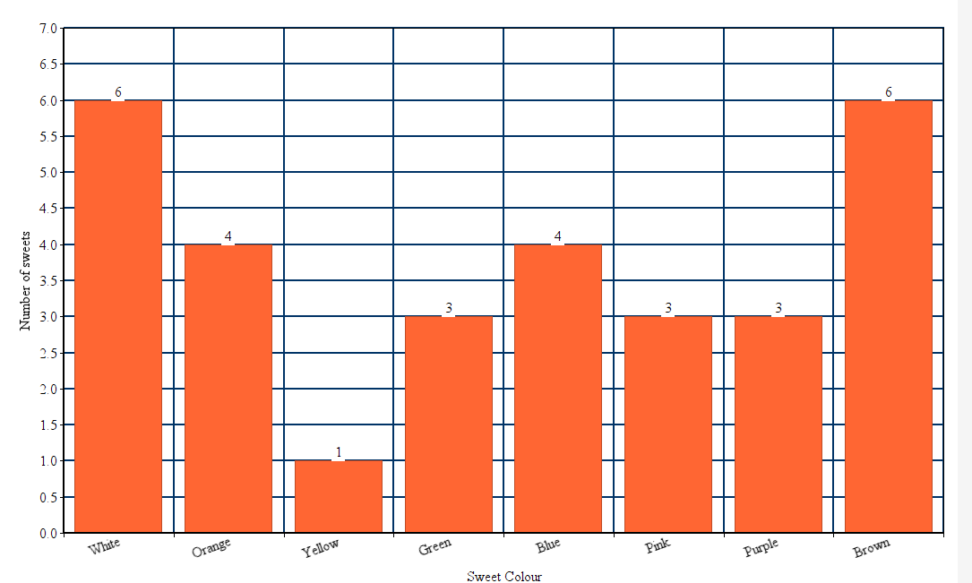
Question 12
Anmol picks sweets from a bag without looking. The distribution of sweets of each colour in the bag is given below. What is the probability that Anmol will pick a white sweet?
A)
0.3
B)
0.6
C)
0.5
D)
0.2

Slide 25
Question 12
Anmol picks sweets from a bag without looking. The distribution of sweets of each colour in the bag is given below. What is the probability that Anmol will pick a white sweet?
A)
0.3
B)
0.6
C)
0.5
D)
0.2

Slide 26
Question 13
Using principle of moments, one can weigh any item using a single weighing stone. In one such experiment, a food packet was kept hanging at a distance of 15 cm to the left of a rod's center. It was countered by a 50 gm weighing stone, kept at a distance of 45cm to the right of the center. What's the weight of food packet?
A)
125 gm
B)
150 gm
C)
100 gm
D)
200 gm

Slide 27
Question 13
Using principle of moments, one can weigh any item using a single weighing stone. In one such experiment, a food packet was kept hanging at a distance of 15 cm to the left of a rod's center. It was countered by a 50 gm weighing stone, kept at a distance of 45cm to the right of the center. What's the weight of food packet?
A)
125 gm
B)
150 gm
C)
100 gm
D)
200 gm

Slide 28
Question 14
Some scientists interpret satellite data to mean that glaciers are melting faster than in earlier centuries. In each decade since the industrial revolution, the amount of glacier melt has doubled and some scientists predict that all the glaciers will have melted away by the year 2037. If indeed this were true, in which year, would we have lost 50% of all the glaciers?
A)
2027
B)
2037
C)
2017
D)
2008

Slide 29
Question 14
Some scientists interpret satellite data to mean that glaciers are melting faster than in earlier centuries. In each decade since the industrial revolution, the amount of glacier melt has doubled and some scientists predict that all the glaciers will have melted away by the year 2037. If indeed this were true, in which year, would we have lost 50% of all the glaciers?
A)
2027
B)
2037
C)
2017
D)
2008

Slide 30
Question 15
A very crowded street in T. Nagar contains 100 buildings. The buildings are numbered from 1 to 100. How many 9's are used by the Chennai Corporation in numbering these buildings?
A)
21
B)
19
C)
20
D)
9

Slide 31
Question 15
A very crowded street in T. Nagar contains 100 buildings. The buildings are numbered from 1 to 100. How many 9's are used by the Chennai Corporation in numbering these buildings?
A)
21
B)
19
C)
20
D)
9

Slide 32
Question 16
The total number of men, women and children working in a factory is 18. They earn Rs. 4000 in a day. If the sum of the wages of all men, all women and all children is in the ratio Of 18 : 10 : 12 and if the wages Of an individual man, woman and child is in the ratio 6 : 5 : 3, then how much a woman earn in a day?
A)
Rs. 400
B)
Rs. 250
C)
Rs. 150
D)
Rs. 120
Notes:
Option B
Ratio of number of men, women and children
= 18/6 : 10/5 : 12/3 = 3x : 2x : 4x
… (3x + 2x + 4x) = 18
… x = 2
Therefore, number of women = 4
Share of all women = 10/40 x 4000 = Rs. 1000
(… 18 + 10 + 12 = 40)
…Share of each woman = 1000/4 = Rs. 250

Slide 33
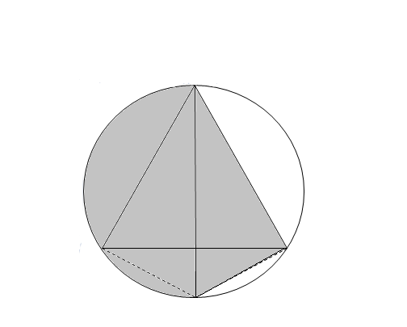
Question 16
An equilateral triangle ABD is inscribed in a circle as shown in the figure. AC is a diameter of the circle. If the radius of the circle is 10 cm, what is the area of the shaded portion?
A
A)
243.7 cm²
B)
192.4 cm²
C)
221.4 cm²
D)
B
D
273.1 cm²
C

Slide 34
Question 16
An equilateral triangle ABD is inscribed in a circle as shown in the figure. AC is a diameter of the circle. If the radius of the circle is 10 cm, what is the area of the shaded portion?
A
A)
243.7 cm²
B)
192.4 cm²
C)
221.4 cm²
D)
B
D
273.1 cm²
C

Slide 35
Question 17
I have a two-digit number. The unit's digit is twice as ten’s digit. If I reverse the number and subtract 36 from it, I get the initial number. What's the number I started with?
A)
48
B)
53
C)
60
D)
73

Slide 36
Question 17
I have a two-digit number. The unit's digit is twice as ten’s digit. If I reverse the number and subtract 36 from it, I get the initial number. What's the number I started with?
A)
48
B)
53
C)
60
D)
73

Slide 37
Question 18
The statement: “All fathers are men some are teachers or politicians but no teacher is a politician” can be represented in Venn diagram as (M Men, F Father, T = Teacher, P Politician) which of the following options?
U
T
C)
U
A)
T
F
M
P
M
F
P
B)
U
D)
U
M
T
M
T
F
F
P
P

Slide 38
Question 18
The statement: “All fathers are men some are teachers or politicians but no teacher is a politician” can be represented in Venn diagram as (M Men, F Father, T = Teacher, P Politician) which of the following options?
U
T
C)
U
A)
T
F
M
P
M
F
P
B)
U
D)
U
M
T
M
T
F
F
P
P

Slide 39
Question 19
From the given table, the function f(n) is
n | f(n)
8 | 3
32 | 5
128 | 7
512 | 9
A)
n log₂(n)
B)
log₂(n)
C)
exp(n)
D)
2n

Slide 40
Question 19
From the given table, the function f(n) is
n | f(n)
8 | 3
32 | 5
128 | 7
512 | 9
A)
n log₂(n)
B)
log₂(n)
C)
exp(n)
D)
2n

Slide 41
Question 20
Mary Meeker in her annual Internet Trends Report said that Americans are spending even more time on digital media - 6.3 hours a day in 2018, up 5 percent from the year before.” How much time did Americans spend on digital media in 2017.
A)
5 h 53 min
B)
6 h
C)
6 h 10 min
D)
5 h

Slide 42
Question 20
Mary Meeker in her annual Internet Trends Report said that Americans are spending even more time on digital media - 6.3 hours a day in 2018, up 5 percent from the year before.” How much time did Americans spend on digital media in 2017? (Approx.)
A)
5 h 53 min
B)
6 h
C)
6 h 10 min
D)
5 h

Slide 43
Question 21
Two alloys A and B are both made of iron and zinc. The ratios of iron to zinc in the two alloys are 5:3 and 1:2 respectively. A and B are combined in the ratio 4:3 to yield a new alloy C. What is the ratio of iron and zinc in C?
A)
4:3
B)
2:3
C)
5:2
D)
1:1

Slide 44
Question 21
Two alloys A and B are both made of iron and zinc. The ratios of iron to zinc in the two alloys are 5:3 and 1:2 respectively. A and B are combined in the ratio 4:3 to yield a new alloy C. What is the ratio of iron and zinc in C?
A)
4:3
B)
2:3
C)
5:2
D)
1:1

Slide 45

Question 22
What is the probability that a clerk while randomly placing 5 letters (each intended for a particular recipient) in 5 addressed envelopes will place exactly one of those letters in a wrong envelope?
A)
5!
B)
1/5!
C)
0
D)
None of these

Slide 46
Question 23
If f(x) = x², what is the shape of f(x)?
A)
S-shaped
B)
Parabolic
C)
Circular
D)
Quadrilateral

Slide 47
Question 23
If f(x) = x², what is the shape of f(x)?
A)
S-shaped
B)
Parabolic
C)
Circular
D)
Quadrilateral

Slide 48
Question 24
A race horse starts chasing a wild pony 2 hours after the pony bolts the stable. The race horse finally catches up with the pony after 3 hours. If the average speed of the race horse is 49 km/h, then the average speed of the wild pony is _______ kmph.
A)
30.4 km/h
B)
29.4 km/h
C)
19.6 km/h
D)
32.67 km/h

Slide 49
Question 24
A race horse starts chasing a wild pony 2 hours after the pony bolts the stable. The race horse finally catches up with the pony after 3 hours. If the average speed of the race horse is 49 km/h, then the average speed of the wild pony is
A)
30.4 km/h
B)
29.4 km/h
C)
19.6 km/h
D)
32.67 km/h

Slide 50
Question 25
Twin brothers Lava and Kusha wrote the TCS NQT test. While Lava scored 45% and got 4 marks below the cut off, Kusha scored 60% and got 8 marks above cut-off and got selected for interview. What was the maximum marks in the test?
A)
100
B)
90
C)
80
D)
60

Slide 51
Question 25
Twin brothers Lava and Kusha wrote the TCS NQT test. While Lava scored 45% and got 4 marks below the cut off, Kusha scored 60% and got 8 marks above cut-off and got selected for interview. What was the maximum marks in the test?
A)
100
B)
90
C)
80
D)
60

Slide 52
Question 26
We live and work in a time of rapidly advancing technology. A social media start-up is doubling the number of users each weeks. It took just 47 weeks to acquire a million users. How long did it take to acquire half a-million users?
A)
45 weeks
B)
23.5 weeks
C)
24 weeks
D)
46 weeks

Slide 53
Question 26
We live and work in a time of rapidly advancing technology. A social media start-up is doubling the number of users each weeks. It took just 47 weeks to acquire a million users. How long did it take to acquire half a-million users?
A)
45 weeks
B)
23.5 weeks
C)
24 weeks
D)
46 weeks

Slide 54
Question 27
The kids Phalaa and Adhiphalaa (don't confuse with Balaa and Adhibalaa, the abracadabra that sage Vishwamitra taught to Rama and Lakshmana to successfully stay the demoness Taadaka) carry some fruits. Being tender and small, each could carry only a single digit number of fruits. Adhiphalaa has three times the fruits that Phalaa has. If the digits corresponding to Phalaa’s and Adhiphalaa’s fruits are written in that order, the resulting two digit number is a multiple of three. How many fruits does Adhiphalaa have?
A)
9
B)
2
C)
3
D)
6

Slide 55
Question 27
The kids Phalaa and Adhiphalaa (don't confuse with Balaa and Adhibalaa, the abracadabra that sage Vishwamitra taught to Rama and Lakshmana to successfully stay the demoness Taadaka) carry some fruits. Being tender and small, each could carry only a single digit number of fruits. Adhiphalaa has three times the fruits that Phalaa has. If the digits corresponding to Phalaa’s and Adhiphalaa’s fruits are written in that order, the resulting two digit number is a multiple of three. How many fruits does Adhiphalaa have?
A)
9
B)
2
C)
3
D)
6

Slide 56
Question 28
Rajesh has Rs. 850 in his purse made up entirely of notes of Rs. 50 denomination. His wife Latha, on the other hand, has only notes of Rs. 20 denomination in her purse and they amount to Rs. 460. Rajesh and Latha redistribute the notes between the two purses so that if one were to choose one of the two purses at random and then randomly draw a note from it, the probability of the note being of Rs. 50 denomination is maximized. After this redistribution, there will be a total of how much money in the purse with the larger amount of money?
A)
600
B)
660
C)
680
D)
1200

Slide 57
Question 28
Rajesh has Rs. 850 in his purse made up entirely of notes of Rs. 50 denomination. His wife Latha, on the other hand, has only notes of Rs. 20 denomination in her purse and they amount to Rs. 460. Rajesh and Latha redistribute the notes between the two purses so that if one were to choose one of the two purses at random and then randomly draw a note from it, the probability of the note being of Rs. 50 denomination is maximized. After this redistribution, there will be a total of how much money in the purse with the larger amount of money?
A)
600
B)
660
C)
680
D)
1200

Slide 58
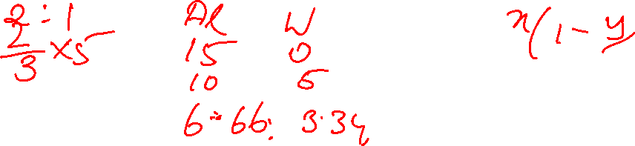
Question 29
Sura, a strongly distilled alcoholic drink was used in ancient India as an
anesthetic by surgeons. A 15 L cask initially contains pure Sura up to the brim. The Sura is diluted by removing 5 L and replacing that quantity with water. If Sura is diluted twice, what is the ration of Sura to water in the cask?
A)
2:1
B)
1:1
C)
1:2
D)
4:5

Slide 59
Question 29
Sura, a strongly distilled alcoholic drink was used in ancient India as an
anesthetic by surgeons. A 15 L cask initially contains pure Sura up to the brim. The Sura is diluted by removing 5 L and replacing that quantity with water. If Sura is diluted twice, what is the ration of Sura to water in the cask?
A)
2:1
B)
1:1
C)
1:2
D)
4:5

Slide 60
Question 30
The speed of a common snail is about 1 mm per second. It secretes a bit of mucus that coats the ground beneath and helps it to move along. This snail we are interested in now has a problem with this secretion and so it moves one mm in the first second and in the subsequent seconds it moves only half the distance covered in the previous second. Algae, the good it cherishes, is at 3 mm distance from this snail. In how much time it will reach its food?
A)
It will never reach its food
B)
2.5 seconds
C)
2.7685 seconds
D)
3 seconds

Slide 61
Question 30
The speed of a common snail is about 1 mm per second. It secretes a bit of mucus that coats the ground beneath and helps it to move along. This snail we are interested in now has a problem with this secretion and so it moves one mm in the first second and in the subsequent seconds it moves only half the distance covered in the previous second. Algae, the good it cherishes, is at 3 mm distance from this snail. In how much time it will reach its food?
A)
It will never reach its food
B)
2.5 seconds
C)
2.7685 seconds
D)
3 seconds

Slide 62
Question 31
The muzzle velocity of a bullet in 5.56 INSAS rifle (Indian version of AK47) is 882 m/s. A sergeant holds this rifle facing the sky and shoots a bullet. What's the bullet's maximum reachable altitude? Assume g = 9.8 m/s. (Hint: vA2 = uA2 + 2gs)
A)
39660 m
B)
39690 m
C)
40000 m
D)
40069 m

Slide 63
Question 31
The muzzle velocity of a bullet in 5.56 INSAS rifle (Indian version of AK47) is 882 m/s. A sergeant holds this rifle facing the sky and shoots a bullet. What's the bullet's maximum reachable altitude? Assume g = 9.8 m/s. (Hint: vA2 = uA2 + 2gs)
A)
39660 m
B)
39690 m
C)
40000 m
D)
40069 m

Slide 64
Question 32
Ahilyanagari Express running at a speed of 60 km/h and Cholan Express at 120 km/h take 10 s to cross each other, when they are running in opposite directions (these two trains operate in the same route only as a mathematical fantasy and not in reality). If Cholan express is 120 m longer than Ahilyanagari Express, what's the length in meters of the latter?
A)
190 m
B)
380 m
C)
60 m
D)
70 m

Slide 65
Question 32
Ahilyanagari Express running at a speed of 60 km/h and Cholan Express at 120 km/h take 10 s to cross each other, when they are running in opposite directions (these two trains operate in the same route only as a mathematical fantasy and not in reality). If Cholan express is 120 m longer than Ahilyanagari Express, what's the length in meters of the latter?
A)
190 m
B)
380 m
C)
60 m
D)
70 m

Slide 66
Question 33
A police car starts chasing a fugitive in a BMW 4 hours after the BMW escapes from the scene of crime at 10 a.m. The BMW drives for 10 Km through crowded roads of Shanghai and then drives into a highway, where the traffic allows vehicles to move twice as fast. After a while, the police car finally catches up with the BMW after a chase that lasted 5 hours. By this time the moon was up in the sky for 4 hours. If the average speed of the police car is 50 km/h, then the average speed of the BMW is km/h.
A)
27 km/h
B)
29 km/h
C)
27.78 km/h
D)
29.78 km/h

Slide 67
Question 33
A police car starts chasing a fugitive in a BMW 4 hours after the BMW escapes from the scene of crime at 10 a.m. The BMW drives for 10 Km through crowded roads of Shanghai and then drives into a highway, where the traffic allows vehicles to move twice as fast. After a while, the police car finally catches up with the BMW after a chase that lasted 5 hours. By this time the moon was up in the sky for 4 hours. If the average speed of the police car is 50 km/h, then the average speed of the BMW is km/h.
A)
27 km/h
B)
29 km/h
C)
27.78 km/h
D)
29.78 km/h

Slide 68
Question 34
How many four-digit numbers, each divisible by 4 can be formed using the digits 4, 5, 6, 7, 8 and 9, if repetition is allowed across all numbers?
A)
256
B)
284
C)
324
D)
None of these
Notes:
Answer: C
In order that the number be divisible by 4, the last two digits of the number have to be 44, 48, 56, 64, 76, 84, 96, 68 or 88. The first two digits of these numbers can be filled in 9 x 6 = 54 ways (numbers can be repeated). Hence, the there are 54 x 6 = 324 such numbers.

Slide 69
Question 35
The number of triangle that can be drawn out of 20 points of which 12 are collinear is _________.
A)
750
B)
796
C)
825
D)
920
Notes:
Answer: D
For drawing a triangle we need 3 non collinear points. This can be done in: ⁸C₃ + ⁸C₂ x ¹²C₁ + ⁸C₁ x ¹²C₂ = 56 + 336 + 528 = 920

Slide 70
Question 36
The expression 3(x²) – mx + 10 leaves a remainder of -2 when divided by x-3. What's the value of m?
A)
18
B)
13
C)
15
D)
8

Slide 71
Question 37
12 litres of water is poured into an aquarium of dimensions 50 cm length, 30 cm breadth and 40 cm height. By what height (in cm) will the water rise?
A)
10
B)
20
C)
6
D)
8

Slide 72
Question 37
12 litres of water is poured into an aquarium of dimensions 50 cm length, 30 cm breadth and 40 cm height. By what height (in cm) will the water rise?
A)
10
B)
20
C)
6
D)
8

Slide 73
Question 38
Two finals are scheduled The Wimbledon match and the World Cup Cricket at the same time. Anu wants to watch the Wimbledon finals and her brother Vinu wants to watch WCC final. They decide to roll a tetrahedral die twice. The tetrahedral is numbered 1,2,3.4 on its four sides and all numbers are equally likely to appear. Anu rolls first and then Vinu rolls. If the number on the first roll is strictly greater than the number on the second roll, Anu wins and gets to watch ‘Wimbledon. What is the probability that Anu will get to watch Wimbledon?
A)
7/16
B)
9/16
C)
3/4
D)
1/2

Slide 74
Question 38
Two finals are scheduled The Wimbledon match and the World Cup Cricket at the same time. Anu wants to watch the Wimbledon finals and her brother Vinu wants to watch WCC final. They decide to roll a tetrahedral die twice. The tetrahedral is numbered 1,2,3.4 on its four sides and all numbers are equally likely to appear. Anu rolls first and then Vinu rolls. If the number on the first roll is strictly greater than the number on the second roll, Anu wins and gets to watch ‘Wimbledon. What is the probability that Anu will get to watch Wimbledon?
A)
7/16
B)
9/16
C)
3/4
D)
1/2

Slide 75
Question 39
How many numbers lying between 3000 and 4000 and which are divisible by 5 can be made with the digits 3, 4, 5, 6, 7 and 8, without repetition?
A)
6
B)
12
C)
13
D)
15

Slide 76
Question 40
Ms. Trikonapriya wants to decorate her abode's frontage with a triangular lawn. The two sides of this lawn are of 5 m and 6 m, subtending an angle of 30⁰. If the lawn maintainer charges Rs.10 per square meter, how much would Trikonapriya pay to him for the entire lawn?
A)
Rs. 75
B)
Rs. 80
C)
Rs. 60
D)
Rs. 65

Slide 77
Question 40
Ms. Trikonapriya wants to decorate her abode's frontage with a triangular lawn. The two sides of this lawn are of 5 m and 6 m, subtending an angle of 30⁰. If the lawn maintainer charges Rs.10 per square meter, how much would Trikonapriya pay to him for the entire lawn?
A)
Rs. 75
B)
Rs. 80
C)
Rs. 60
D)
Rs. 65

Slide 78
Question 41
Bhaskar wanted to send some documents to Shakuntala. He had her address ‘without the 6-digit pin code. He didn't want to risk sending documents without pin code. So, he called Shakuntala. She did not give the pin code directly, she said, “The first four digits are 1910 in hexadecimal and the last four digits are 3177 in octal”. Bhaskar could courier the documents now. What is her pin code?
A)
641763
B)
641663
C)
624763
D)
623473

Slide 79
Question 41
Bhaskar wanted to send some documents to Shakuntala. He had her address ‘without the 6-digit pin code. He didn't want to risk sending documents without pin code. So, he called Shakuntala. She did not give the pin code directly, she said, “The first four digits are 1910 in hexadecimal and the last four digits are 3177 in octal”. Bhaskar could courier the documents now. What is her pin code?
A)
641763
B)
641663
C)
624763
D)
623473

Slide 80
Question 42
If it takes 10 3D printers 10 minutes to print 10 models, how long will it take 100 printers to print 100 models?
A)
100 min
B)
20 min
C)
10 min
D)
30 min

Slide 81
Question 42
If it takes 10 3D printers 10 min to print 10 models, how long will it take 100 printers to print 100 models?
A)
100 min
B)
20 min
C)
10 min
D)
30 min

Slide 82
Question 43
Eighty cricket balls have been packed equally into two bags A and B. 20 of these balls have been signed by Kapil Dev. Some of the signed balls are in bag A and the rest in bag B. One bag is selected and a ball is randomly picked from that. Given that the ball is signed, the probability that it is from Bag B is computed to be 44%, If bag A is twice more likely to be selected than Bag B, how many of the signed balls are in Bag B?
A)
4
B)
16
C)
12
D)
8

Slide 83
Question 43
Eighty cricket balls have been packed equally into two bags A and B. 20 of these balls have been signed by Kapil Dev. Some of the signed balls are in bag A and the rest in bag B. One bag is selected and a ball is randomly picked from that. Given that the ball is signed, the probability that it is from Bag B is computed to be 44%, If bag A is twice more likely to be selected than Bag B, how many of the signed balls are in Bag B?
A)
4
B)
16
C)
12
D)
8

Slide 84
Question 44
In the normal course, Ravi, Sanjay and Mukund can each individually build a wall in 5, 8 and 10 days respectively. Due to difficult terrain and slushy conditions at the site, the individual time required for each to complete the work has increased by 20%, 25% and 50% respectively. How long will they take to build the wall if they work together?
A)
3 days
B)
4 days
C)
6 days
D)
2 6/17 days

Slide 85
Question 44
In the normal course, Ravi, Sanjay and Mukund can each individually build a wall in 5, 8 and 10 days respectively. Due to difficult terrain and slushy conditions at the site, the individual time required for each to complete the work has increased by 20%, 25% and 50% respectively. How long will they take to build the wall if they work together?
A)
3 days
B)
4 days
C)
6 days
D)
2 6/17 days

Slide 86
Question 45
The difference between the ages of two of my three grandchildren is 3. My elder grandchild is three times older than the age of my youngest grandchild and my eldest grandchild’s age is two years more than the ages of my two youngest grandchildren added together. How old is my eldest grandchild?
A)
10 years
B)
12 years
C)
15 years
D)
13 years

Slide 87
Question 45
The difference between the ages of two of my three grandchildren is 3. My elder grandchild is three times older than the age of my youngest grandchild and my eldest grandchild’s age is two years more than the ages of my two youngest grandchildren added together. How old is my eldest grandchild?
A)
10 years
B)
12 years
C)
15 years
D)
13 years

Slide 88
Question 46
If company A sells a service for Rs. 50 per hour then which of the following could be a revenue function for company A?
A)
R(t) = 50 * t
B)
R(50) = 50 + t
C)
R(t) = 50 + t*t
D)
R(t) = 50 + t

Slide 89
Question 46
If company A sells a service for Rs. 50 per hour then which of the following could be a revenue function for company A?
A)
R(t) = 50 * t
B)
R(50) = 50 + t
C)
R(t) = 50 + t*t
D)
R(t) = 50 + t

Slide 90
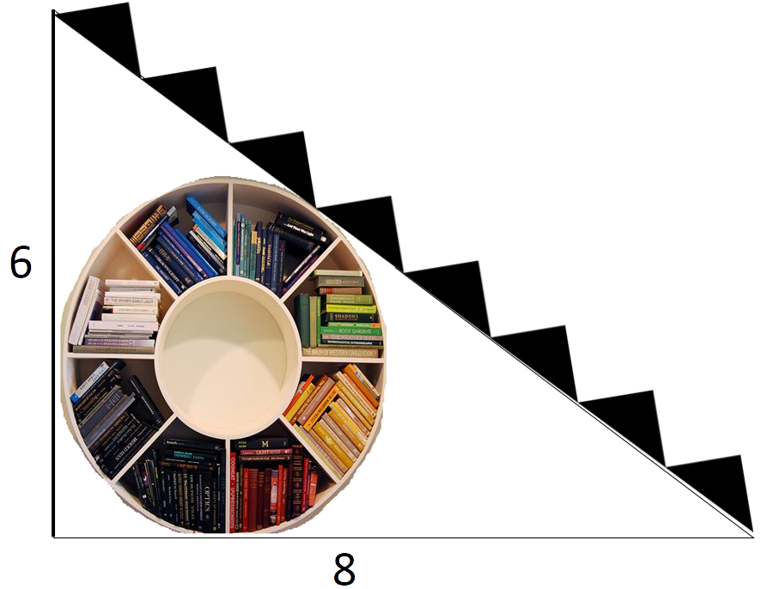
Question 47
There is a circular bookshelf under a stair in a Government library. The wall is 6 ft. height, the distance of the base of the stairs from the corner of the room is 8ft. What is the radius of the circular bookshelf in feet?
A)
1 ft.
B)
2 ft.
C)
3 ft.
D)
4 ft.

Slide 91
Question 47
There is a circular bookshelf under a stair in a Government library. The wall is 6 ft. height, the distance of the base of the stairs from the corner of the room is 8ft. What is the radius of the circular bookshelf in feet?
A)
1 ft.
B)
2 ft.
C)
3 ft.
D)
4 ft.

Slide 92
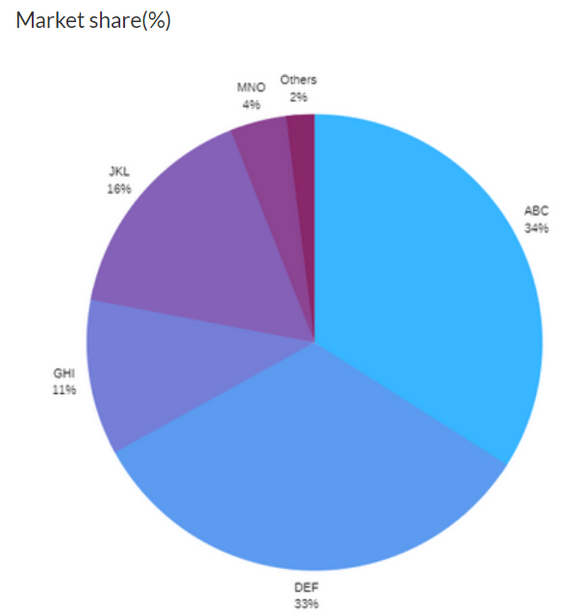
Question 48
Here is a pi-chart showing the market share of a set of banks. If the value of the market share of DEF is 6600 Cr, what is the market share of ABC and JKL together?
A)
15000 Cr
B)
8000 Cr
C)
10000 Cr
D)
12000 Cr

Slide 93
Question 48
Here is a pi-chart showing the market share of a set of banks. If the value of the market share of DEF is 6600 Cr, what is the market share of ABC and JKL together?
A)
15000 Cr
B)
8000 Cr
C)
10000 Cr
D)
12000 Cr

Slide 94
Question 49
In a country, 60% of the male citizen and 70% of the female citizen are eligible to vote. 70% of the male citizens eligible to vote voted, and 60% of female citizens eligible to vote voted. What fraction of the citizens voted during the election?
A)
0.49
B)
0.42
C)
0.48
D)
0.54

Slide 95
Question 49
In a country, 60% of the male citizen and 70% of the female citizen are eligible to vote. 70% of the male citizens eligible to vote voted, and 60% of female citizens eligible to vote voted. What fraction of the citizens voted during the election?
A)
0.49
B)
0.42
C)
0.48
D)
0.54

Slide 96
Question 50
A lady has some socks and hats in her closet - 17 blue, 47 red, and 24 yellow. The lights are out and it is totally dark. In spite of the darkness, she can make out the difference between a hat and a sock. She takes out an item out of the closet only if she is sure that it is a sock. How many socks must she take out to make sure she has two socks of each colour?
A)
73
B)
64
C)
57
D)
55

Slide 97
Question 50
A lady has some socks and hats in her closet - 17 blue, 47 red, and 24 yellow. The lights are out and it is totally dark. In spite of the darkness, she can make out the difference between a hat and a sock. She takes out an item out of the closet only if she is sure that it is a sock. How many socks must she take out to make sure she has two socks of each colour?
A)
73
B)
64
C)
57
D)
55

Slide 98
Question 51
In function P(x, y) = 85x (50y + 150000), what value indicates the increase in P that corresponds to increase in x, when y is kept a constant?
A)
85
B)
135
C)
35
D)
50

Slide 99
Question 51
In function P(x, y) = 85x (50y + 150000), what value indicates the increase in P that corresponds to increase in x, when y is kept a constant?
A)
85
B)
135
C)
35
D)
50

Slide 100
Question 52
A clock is started at noon. By 10 minutes past 5, the hour hand has turned through
A)
155⁰
B)
145⁰
C)
160⁰
D)
150⁰

Slide 101
Question 52
A clock is started at noon. By 10 minutes past 5, the hour hand has turned through
A)
155⁰
B)
145⁰
C)
160⁰
D)
150⁰

Slide 102
Question 53
Ram Speaks truth 40% of the time and Laxman speaks truth 60% of the time. Percentage of cases Ram and Laxman are likely to contradict each other in stating the same fact is
A)
48%
B)
52%
C)
50%
D)
60%

Slide 103
Question 53
Ram Speaks truth 40% of the time and Laxman speaks truth 60% of the time. Percentage of cases Ram and Laxman are likely to contradict each other in stating the same fact is
A)
48%
B)
52%
C)
50%
D)
60%

Slide 104
Question 54
Car A trails car B by 50 meters. Car B travels at 45km/hr. Car C travels from the opposite direction at 54km/hr. Car C is at a distance of 220 meters from Car B. If car A decides to overtake Car B before cars B and C cross each other, what is the minimum speed at which car A must travel?
A)
36 km/hr
B)
45 km/hr
C)
67.5 km/hr
D)
18 km/hr
Notes:
To begin with, let us ignore car A. Car B and car C travel in opposite directions. Their relative speed = Sum of the two speeds = 45 + 54 kmph = 99kmph.
= 99 * (5/18)m/s = 55/2 m/s = 27.5m/s
The relative distance = 220m. So, time they will take to cross each other = 220/27.5 = 8 seconds
Now, car A has to overtake car B within 8 seconds. The relative distance = 50m
Relative speed should be at least 50/8 m/s = 6.25 m/s.
=>6.25 * (18/5) kmph = 22.5 kmph
Car B travels at 45kmph, so car A should travel at at least 45 + 22.5 = 67.5kmph.
Hence, the answer is 67.5kmph.
Choice C is the correct answer.

Slide 105
Question 55
Uma has 50 red and 50 blue balls. She has two bowls with her. She has to distribute the balls in these two bowls in such a way that none of the bowls are left empty. If one were to choose one of the two bowls at random and then randomly draw a ball from it, the probability of the ball being red is maximized. After this distribution, what will be the total number of balls in the bowl with a larger number of balls?
A)
59
B)
72
C)
99
D)
1

Slide 106
Question 55
Uma has 50 red and 50 blue balls. She has two bowls with her. She has to distribute the balls in these two bowls in such a way that none of the bowls are left empty. If one were to choose one of the two bowls at random and then randomly draw a ball from it, the probability of the ball being red is maximized. After this distribution, what will be the total number of balls in the bowl with a larger number of balls?
A)
59
B)
72
C)
99
D)
1

Slide 107
Question 56
Bhaskar called his friend Shakuntala to celebrate his wedding anniversary. Shakuntala reached the street where he was living but forgot the door number. She called Bhaskar for his door number. Being a geek in math, he didn't give the door number directly. But told this “ It is the middle number of the three numbers where the difference between first and second numbers is same as that between second and third. The product of first and last is 273 and sum of all three is 51." Shakuntala reached his house on time. His door number is
A)
17
B)
13
C)
21
D)
19

Slide 108
Question 56
Bhaskar called his friend Shakuntala to celebrate his wedding anniversary. Shakuntala reached the street where he was living but forgot the door number. She called Bhaskar for his door number. Being a geek in math, he didn't give the door number directly. But told this “ It is the middle number of the three numbers where the difference between first and second numbers is same as that between second and third. The product of first and last is 273 and sum of all three is 51." Shakuntala reached his house on time. His door number is
A)
17
B)
13
C)
21
D)
19

Slide 109
Question 57
A Volvo bus from Chennai to Bangalore has 5 stops in between. At each stop half of the people will get down. After reaching Bangalore there are only 2 people left out. How many people are there in the bus at starting?
A)
64
B)
128
C)
256
D)
32

Slide 110
Question 57
A Volvo bus from Chennai to Bangalore has 5 stops in between. At each stop half of the people will get down. After reaching Bangalore there are only 2 people left out. How many people are there in the bus at starting?
A)
64
B)
128
C)
256
D)
32

Slide 111
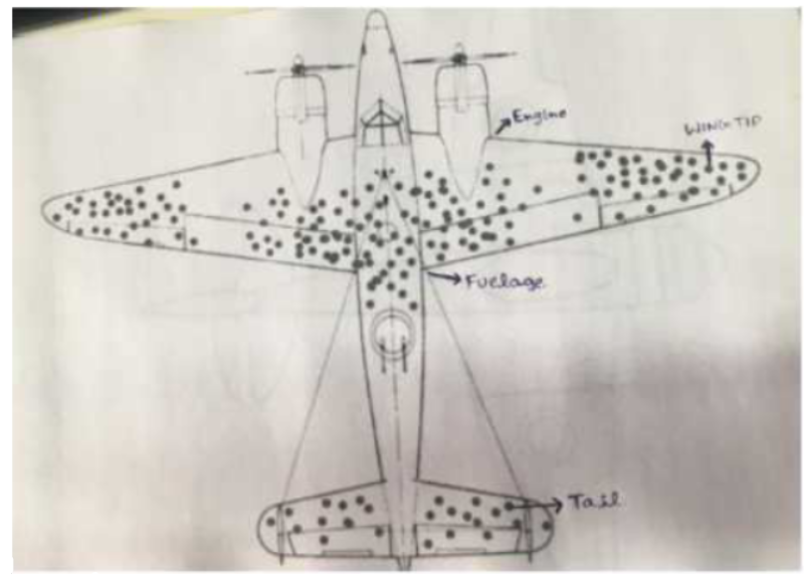
Question 58
The figure below depicts the damage done to aircrafts that had returned their base from missions in World war 2. The bullet holes per square foot in the Tail, Wingtips, Fuselage, and Engine are 1.1, 1.5, 1.8, and 0.2 respectively. Where does the Air-force need to primarily reinforce the aircraft to minimize losses to enemy fire and to maximize their return home?
A)
Tail
B)
Wingtips
C)
Fuselage
D)
Engine

Slide 112
Question 58
The figure below depicts the damage done to aircrafts that had returned their base from missions in World war 2. The bullet holes per square foot in the Tail, Wingtips, Fuselage, and Engine are 1.1, 1.5, 1.8, and 0.2 respectively. Where does the Air-force need to primarily reinforce the aircraft to minimize losses to enemy fire and to maximize their return home?
A)
Tail
B)
Wingtips
C)
Fuselage
D)
Engine

Slide 113
Question 59
There is a horse and a saddle. The sum of their cost is Rs.1100. The cost of the horse is Rs.1000 greater than saddle. What is the cost of saddle?
A)
Rs. 100
B)
Rs. 50
C)
Rs. 110
D)
Rs. 1000

Slide 114
Question 59
There is a horse and a saddle. The sum of their cost is Rs.1100. The cost of the horse is Rs.1000 greater than saddle. What is the cost of saddle?
A)
Rs. 100
B)
Rs. 50
C)
Rs. 110
D)
Rs. 1000

Slide 115


THANK YOU

