Slide 1


Slide 2

Clocks, Calendars & Cubes
Topic/Course
Sub-Topic (Example: name of college)

Slide 3




Question
How often between 11 o’clock and 12 o’clock are the hands of the clock together at an integral number value?
55
56
4
5

Slide 4




Question
How many palindromes are there in a clock from noon to midnight (For Example 5.45 is a palindrome)?
52
72
57
62

Slide 5






Question
What will be the time shown by wall clock after 1234567890 hours, when at the moment , it shows 11 am?
11:00 a.m.
11:00 p.m.
4:00 a.m.
5:00 a.m.

Slide 6










Question
There are sixty markings on a clock. The minute hand was exactly on one of those markings. Nine markings away from the minute hand was the hour hand. What could be the time on the clock in such a case?
5:14
6:20
7:48
3:09

Slide 7












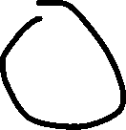


Question
In a particular year, the month of January had exactly 4 Thursdays and 4 Sundays. On which day of the week did January 1 occur?
Monday
Tuesday
Wednesday
Thursday

Slide 8
Question
Pinky was born on 29th, February 2016 which happened to be a Monday. If she lives till her birthday in 2099, how many birthdays would she celebrate on a Monday other than what is given?
1
2
3
5

Slide 9
Question
In a year N, the 259th day of the year is a Saturday. In the year N + 1, the 222nd day of the year is also a Saturday. What is the 119th day of the year N - 1?
Thursday
Saturday
Friday
Tuesday

Slide 10
Question
A wall clock was slow by 10 minutes. In comparison to the wall clock,
a table clock was 10 minutes ahead of it. In comparison to the table
clock, an alarm clock was 5 minutes behind and in comparison to the
alarm clock, a wrist watch was 5 minutes fast. At noon, all the clocks
were adjusted to show noon. What will be the time shown at 6:00 p.m.
in the wrist watch?
6:00 p.m.
6:10 p.m.
8:00 p.m.
8:09 p.m.

Slide 11
Question
Directions for questions: A solid cube is painted red on two adjacent sides and black on the sides opposite to the red sides, and green on the remaining sides. It is then cut into 64 smaller cubes of equal size.
How many cubes have only one side coloured?
16
24
28
32

Slide 12
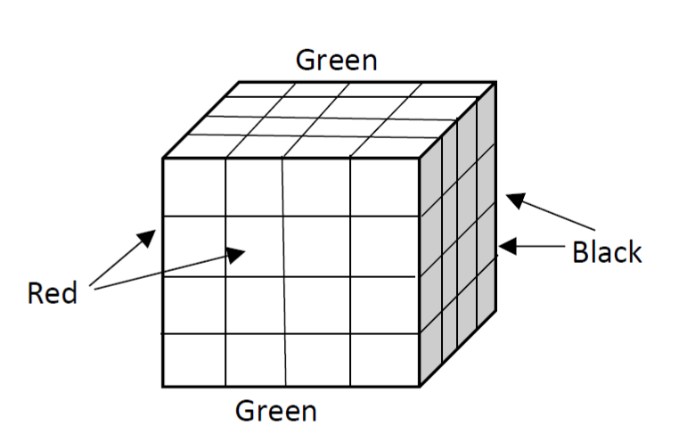
Solution

Slide 13
Question
Directions for questions: A solid cube is painted red on two adjacent sides and black on the sides opposite to the red sides, and green on the remaining sides. It is then cut into 64 smaller cubes of equal size.
How many cubes have at least one side as red?
16
24
28
32

Slide 14
Solution

Slide 15
Question
Directions for questions: A solid cube is painted red on two adjacent sides and black on the sides opposite to the red sides, and green on the remaining sides. It is then cut into 64 smaller cubes of equal size.
How many cubes are there which are red on one side and black on the opposite side?
0
4
8
16

Slide 16
Solution

Slide 17
Question
Directions for questions: A solid cube is painted red on two adjacent sides and black on the sides opposite to the red sides, and green on the remaining sides. It is then cut into 64 smaller cubes of equal size.
How many cubes have one face green and one of the adjacent faces black or red?
8
16
24
28

Slide 18
Solution

Slide 19

THANK YOU

