Slide 1

Notes:
1st slide (Mandatory)

Slide 2

Data Interpretation & Direction Sense
Notes:
Section End/Start
Use this at section’s start or end. For example: “Questions” or “Time for Practice”. To be used for Impacts (get the student’s attention).

Slide 3

Questions
Directions: Refer to the graph and answer the given question:
Notes:
Question + Normal Options

Slide 4
Question
What is the approximate average of number of scarves sold by store N in 2004, 2005 and 2006 together?
A)
307
B)
310
C)
330
D)
309
E)
301
Notes:
Question + Normal Options

Slide 5
Questions
Directions: Refer to the graph and answer the given question:
Notes:
Question + Normal Options

Slide 6

Question
What is the approximate average of number of scarves sold by store N in 2004, 2005 and 2006 together?
A)
307
B)
310
C)
330
D)
309
E)
301
Notes:
Question + Normal Options

Slide 7
Question
What is the difference between number of scarves sold by store M in 2003 and 2004 together and number of scarves sold by store N in 2005 and 2006 together?
A)
50
B)
75
C)
60
D)
55
E)
70
Notes:
Question + Normal Options

Slide 8
Questions
Directions: Refer to the graph and answer the given question:
Notes:
Question + Normal Options

Slide 9
Question
What is the difference between number of scarves sold by store M in 2003 and 2004 together and number of scarves sold by store N in 2005 and 2006 together?
A)
50
B)
75
C)
60
D)
55
E)
70
Notes:
Question + Normal Options

Slide 10



Question
The number of scarves sold by store M is approximately increased by what percent from 2004 to 2005?
A)
112
B)
116
C)
118
D)
110
E)
120
Notes:
Question + Normal Options

Slide 11
Questions
Directions: Refer to the graph and answer the given question:
Notes:
Question + Normal Options

Slide 12
Question
The number of scarves sold by store M is approximately increased by what percent from 2004 to 2005?
A)
112
B)
116
C)
118
D)
110
E)
120
Notes:
Question + Normal Options

Slide 13






Question
If the total number of scarves sold by stores M and N together in 2010 is 110% of that in 2004, then what is the total number of scarves sold by stores M and N together in 2010?
A)
528
B)
524
C)
520
D)
504
E)
512
Notes:
Question + Normal Options

Slide 14
Questions
Directions: Refer to the graph and answer the given question:
Notes:
Question + Normal Options

Slide 15
Question
If the total number of scarves sold by stores M and N together in 2010 is 110% of that in 2004, then what is the total number of scarves sold by stores M and N together in 2010?
A)
528
B)
524
C)
520
D)
504
E)
512
Notes:
Question + Normal Options

Slide 16
Question
If the ratio between total number of scarves sold by stores M and N together in 2003 and that in 2008 is 9 : 11, then what is the total number of scarves sold by stores M and N together in 2008?
A)
670
B)
990
C)
770
D)
885
E)
995
Notes:
Question + Normal Options

Slide 17
Question
Directions: Refer to the graph and answer the given question:
Notes:
Question + Normal Options

Slide 18
Question
If the ratio between total number of scarves sold by stores M and N together in 2003 and that in 2008 is 9 : 11, then what is the total number of scarves sold by stores M and N together in 2008?
A)
670
B)
990
C)
770
D)
885
E)
995
Notes:
Question + Normal Options

Slide 19
Question
Directions: Read the following table carefully and answer the question given below.
The following table shows the number of men and women and the percentage of children in five different societies.
Societies | Men | Women | Children
P | 120 | 80 | 20%
Q | 180 | 60 | 40%
R | 150 | 50 | 50%
S | 80 | 200 | 30%
T | 100 | 170 | 10%
Notes:
Question + Normal Options

Slide 20
Question
Societies | Men | Women | Children
P | 120 | 80 | 20%
Q | 180 | 60 | 40%
R | 150 | 50 | 50%
S | 80 | 200 | 30%
T | 100 | 170 | 10%
Notes:
Question + Normal Options

Slide 21





Question
Find the average number of women living in all the societies.
A)
122
B)
132
C)
112
D)
142
E)
102
Notes:
Question + Normal Options

Slide 22
Question
Find the average number of women living in all the societies.
A)
122
B)
132
C)
112
D)
142
E)
102
Notes:
Question + Normal Options

Slide 23




Question
Find the ratio between the total number of men in society P and Q to the total number of children in society S and T together.
A)
1 : 1
B)
2 : 3
C)
3 : 1
D)
4 : 3
E)
2 : 1
Notes:
Question + Normal Options

Slide 24
Question
Find the ratio between the total number of men in society P and Q to the total number of children in society S and T together.
A)
1 : 1
B)
2 : 3
C)
3 : 1
D)
4 : 3
E)
2 : 1
Notes:
Question + Normal Options

Slide 25
Question
Number of women in society P is what percent of the number of children in society R?
A)
25%
B)
40%
C)
33.33%
D)
66.67%
E)
50%
Notes:
Question + Normal Options

Slide 26
Question
Number of women in society P is what percent of the number of children in society R?
A)
25%
B)
40%
C)
33.33%
D)
66.67%
E)
50%
Notes:
Question + Normal Options

Slide 27
Question
What is the difference between the total number of adults in society R and the total number of adults in society Q?
A)
10
B)
20
C)
40
D)
15
E)
25
Notes:
Question + Normal Options

Slide 28
Question
What is the difference between the total number of adults in society R and the total number of adults in society Q?
A)
10
B)
20
C)
40
D)
15
E)
25
Notes:
Question + Normal Options

Slide 29
Question
Number of men in society Q is how much percent less than the number of children in society R?
A)
20%
B)
5%
C)
33.33%
D)
10%
E)
25%
Notes:
Question + Normal Options

Slide 30
Question
Number of men in society Q is how much percent less than the number of children in society R?
A)
20%
B)
5%
C)
33.33%
D)
10%
E)
25%
Notes:
Question + Normal Options

Slide 31
Question
Directions: The following line graphs shows the number of males and females' employees in five different offices. Read the graph carefully and answer the following questions.
Notes:
Question + Normal Options

Slide 32
Question
If in the new office F, the total number of employees is 20% more than the total employees of office E and the number of female employees is 160. then find the difference between the number of male employees in office F and E.
A)
60
B)
20
C)
40
D)
30
E)
80
Notes:
Question + Normal Options

Slide 33
Question
Directions: The following line graphs shows the number of males and females' employees in five different offices. Read the graph carefully and answer the following questions.
Notes:
Question + Normal Options

Slide 34
Question
If in the new office F, the total number of employees is 20% more than the total employees of office E and the number of female employees is 160. then find the difference between the number of male employees in office F and E.
A)
60
B)
20
C)
40
D)
30
E)
80
Notes:
Question + Normal Options

Slide 35
Question
Find the ratio between the female employees in office B and C together to the male employees in office D and E together.
A)
6 : 5
B)
11 : 88
C)
21 : 11
D)
4 : 5
E)
8 : 11
Notes:
Question + Normal Options

Slide 36
Question
Directions: The following line graphs shows the number of males and females' employees in five different offices. Read the graph carefully and answer the following questions.
Notes:
Question + Normal Options

Slide 37
Question
Find the ratio between the female employees in office B and C together to the male employees in office D and E together.
A)
6 : 5
B)
11 : 88
C)
21 : 11
D)
4 : 5
E)
8 : 11
Notes:
Question + Normal Options

Slide 38
Question
What will be the average number of male employees in the office B, C and E together?
A)
340
B)
220
C)
280
D)
260
E)
240
Notes:
Question + Normal Options

Slide 39
Question
Directions: The following line graphs shows the number of males and females' employees in five different offices. Read the graph carefully and answer the following questions.
Notes:
Question + Normal Options

Slide 40
Question
What will be the average number of male employees in the office B, C and E together?
A)
340
B)
220
C)
280
D)
260
E)
240
Notes:
Question + Normal Options

Slide 41
Question
The total number of female employees B and C together is what percent of the total number of male employees in the same office?
A)
80%
B)
140%
C)
78.4%
D)
71.4%
E)
120%
Notes:
Question + Normal Options

Slide 42
Question
Directions: The following line graphs shows the number of males and females' employees in five different offices. Read the graph carefully and answer the following questions.
Notes:
Question + Normal Options

Slide 43
Question
The total number of female employees B and C together is what percent of the total number of male employees in the same office?
A)
80%
B)
140%
C)
78.4%
D)
71.4%
E)
120%
Notes:
Question + Normal Options

Slide 44
Question
What will be the difference between the total number of employees in office C to the total number of employees in office B?
A)
240
B)
180
C)
220
D)
260
E)
280
Notes:
Question + Normal Options

Slide 45
Question
Directions: The following line graphs shows the number of males and females' employees in five different offices. Read the graph carefully and answer the following questions.
Notes:
Question + Normal Options

Slide 46
Question
What will be the difference between the total number of employees in office C to the total number of employees in office B?
A)
240
B)
180
C)
220
D)
260
E)
280
Notes:
Question + Normal Options

Slide 47

Question
Directions for question: Eight persons M through T are standing in such a way that O is 20 m apart from N towards West, N is 30 m South with respect to M. M is 40 m towards West with respect to Q. P is 50 m towards South with respect to Q. R is 15 m apart from S towards North. T is 20 m towards East with respect to S. R is 40 m towards West with respect to P.
In which direction is Q standing with respect to R?
North-West
North
North-East
Cannot be determined

Slide 48
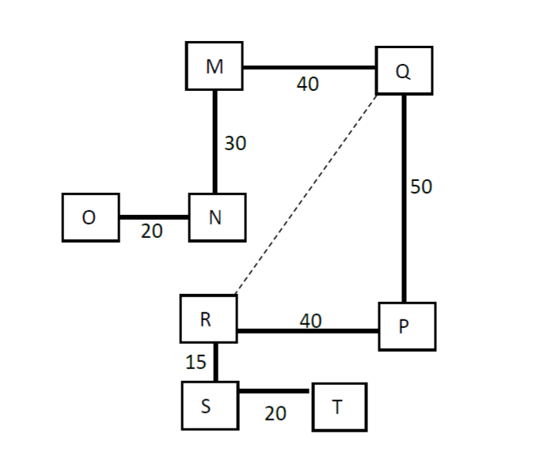


Solution

Slide 49
Question
Directions for question: Eight persons M through T are standing in such a way that O is 20 m apart from N towards West, N is 30 m South with respect to M. M is 40 m towards West with respect to Q. P is 50 m towards South with respect to Q. R is 15 m apart from S towards North. T is 20 m towards East with respect to S. R is 40 m towards West with respect to P.
If one more person U is standing towards South-West with respect to P, then in which direction is T, standing with respect to U?
South-West
North-East
North-West
Cannot be determined

Slide 50
Solution

Slide 51
Question
Directions for question: Eight persons M through T are standing in such a way that O is 20 m apart from N towards West, N is 30 m South with respect to M. M is 40 m towards West with respect to Q. P is 50 m towards South with respect to Q. R is 15 m apart from S towards North. T is 20 m towards East with respect to S. R is 40 m towards West with respect to P.
What is the total distance covered by O if he first goes to the point where M is standing and from there, goes to the point where P is standing? (Assume that O takes the shortest route in both cases)
90.62 units
115.27 units
100.09 units
Cannot be determined

Slide 52
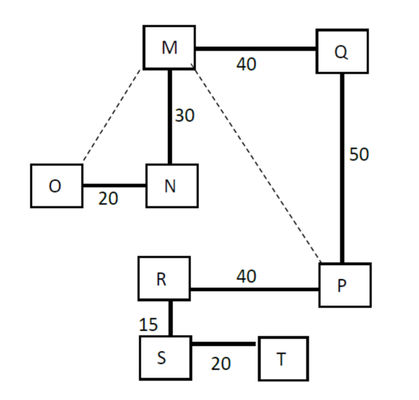
















Solution

Slide 53


THANK YOU
Notes:
Thank you slide

