Slide 1
Characta2D
Character Controller made on custom physics

Slide 2
Why custom physics?
A pure physics-based solution for a platform character is like the hell
For example, wall jumps (and other stuff) are difficult
you need to compute collision and decide the movement for yourself, using collider to mostly listen to collision instead of letting the engine decide what's 'great'

Slide 3
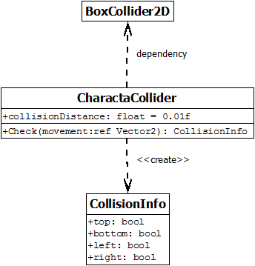
CharactaCollider
Requires an Unity’s BoxCollider2D: it doesn't break the environment standard physics system
Handles the collision detection
Predicts the collision based on the movement

Slide 4
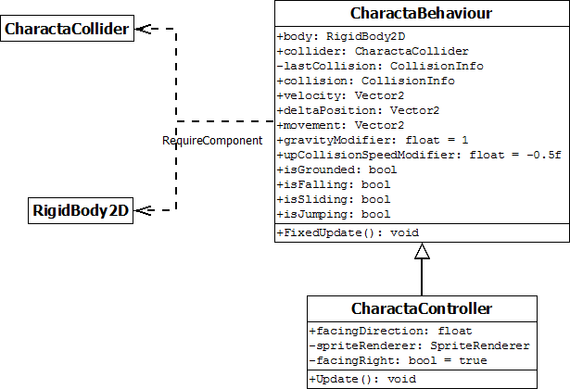
CharactaController
Manages the sprite flipping
Manages the user input
Requires an Unity’s RigidBody2D: it is automatically set to Kinematic body type, which means that the rigid body does still move via its velocity, but the velocity is not affected by forces or gravity.

Slide 5
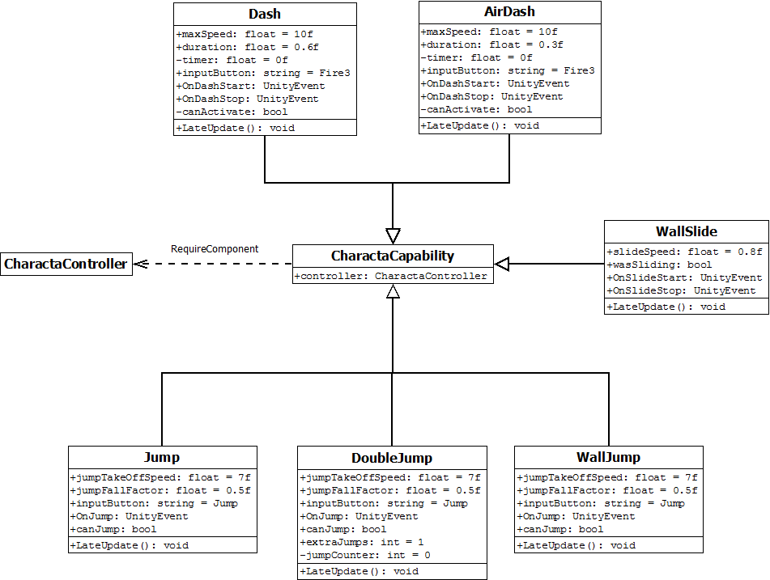
Capability System
Define different types of capabilities
Simply add these components to the CharactaController to enable jumps, wall jumps and so on.
Create Characta Capabilities by yourself. Customize your package.

Slide 6
Characta2D
Credits: Vito Domenico Tagliente
vitodomenicotagliente@gmail.com

