Slide 1
Life software project
Developed based on PYTHON 3.6

Slide 2
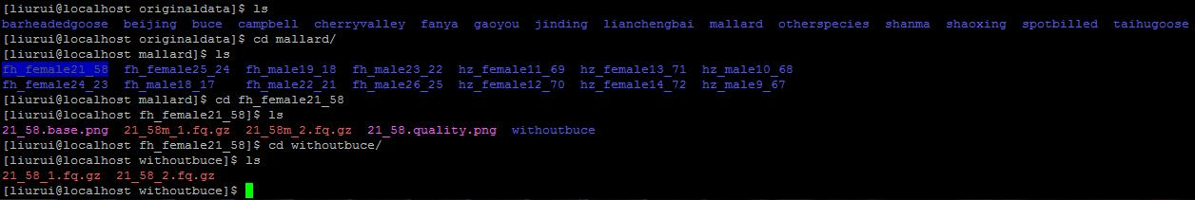
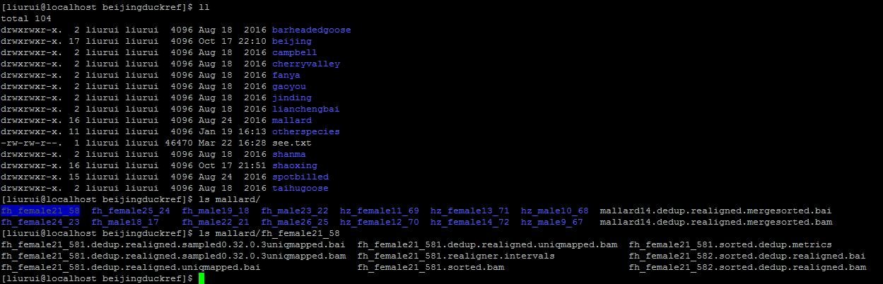
web interaction 0.1 edition is available (python3 autodemo.py)
以鸭的进化项目的PCA，早期选择，dadi等分析为例。使用该web system辅助进行分析
鸭进化项目的下机数据
对每个个体，每个pool的群体，生成bam，之后排序，去PCR重复，去比对reads，realignment，等数据处理

Slide 3
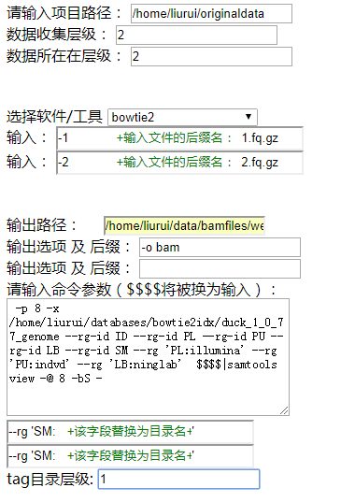
鸭进化项目的下机数据的目录结构
（层级为1）
fh_female21_58
::::
mallard
图例： 目录
文件（ 后 缀名为2.fq.gz/
1.fq.gz的文件）
Spotbille
fh_female21_58
（层级为2）
项目根路径
（层级为0）
beijing
:::::
告诉系统，将根目录下第二层每个目录下面的一对fq数据，用bowtie2生成一个bam文件！
gaoyou
::::
fh_female21_58
::::
shaoxing
fh_female21_58
Notes:
We do not care about the format, we care about what information we need.

Slide 5
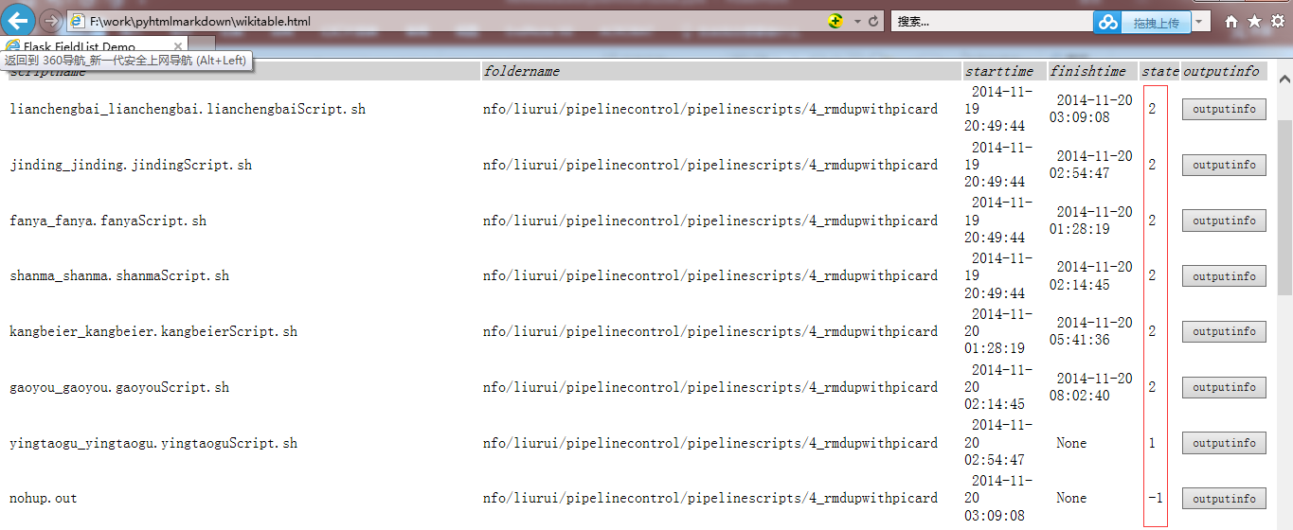
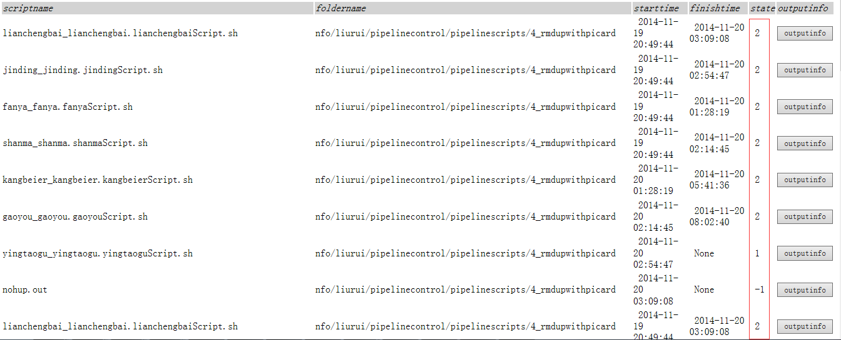
程序运行监控

Slide 6
Life is an integrated biology data analyses and observation system.
Current version mainly consist of four modules, focus on evolutionary genomics, and could be easily develop into more powerful system to visualize, mine and analyses genomes data.
As its idea is to simple the data process and to manipulate the data in a intuition way that is in line with mathematic description of evolutionary theory. It is easy to vary to design new idea, observation, calculation and theory.

Slide 7
data management and visualization module
Module 1
vcf，depth
Variants data management were designed based on population genetics
Outgroup populations
Ref fasta of close species
Close related species
snp_toplevel table
vcf
m:1
Produce snp_toplevel table
Data
base
Table correspond to vcf
fq
m:m
bam
1:1
m:m
vcf
m:m
。。。
Table correspond to vcf
Toplevel table could be modified dynamically

Slide 8
… …

Slide 9
analysis pipeline management module
Module 2
NGS project usually involve in multiple data sets and multiple steps. Similar commands with same parameters but different input and output could be produced by program. In this way could not only avoid mistaken by manually commands coding, reduce labor. Arrangement rule could also help to manage data and pipeline scripts.
In the base of such semi automatic arrangement, an B/S mode system is easy to implement

Slide 10
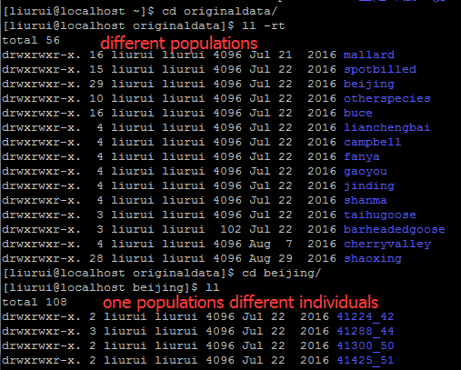
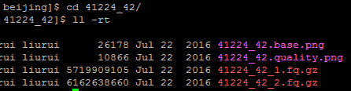
Data store and naming agreement
Similar data were stored in different folders but same suffix. Those folders are under same folder and same depth.
For example.
A batch of paired
fastq data.

Slide 11
Scripts template
Produce batch of scripts: scriptcontrol.py
For example. produce bam file from paired fastq for all individuals of different populations. Template file was shown blow.

Slide 12
Produce scripts for every individual paired fq files according the template
Produce batch of scripts: scriptcontrol.py
Python ~/life/src/pipelinecontrol/scriptcontrol.py -c 1_getbam_D2L.sh –d 2 –s /pathto/step1_scripts –m 1 -1 2
It will produce runnable scripts that is used to call bam for every individual of all populations.
Input data files were in the second level folder under the 0-the level folder.
Produce scripts for every second level folder under the 0-th level folder. This parameter is usually same with -d
Template file describe as above
-c Template file
-d depth of input data (inputdatafilesrootpath=0th level)
-s folder to store scripts
-m mode1/2
-I depth of intercept folders
-l names of intercept folders in the assigned level
-t level of the folder name used to substitute tha ${tag}
-1
-2
scriptcontrol.py
input
output
Produce batch of scripts
Create folders for all output data

Slide 13
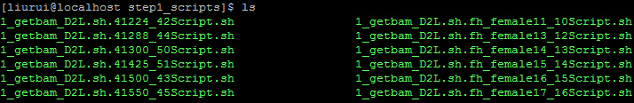
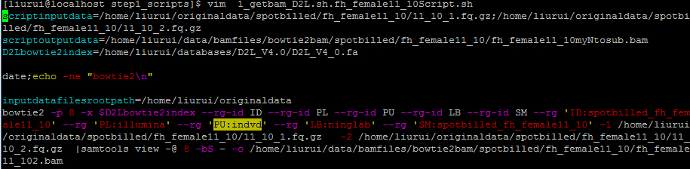
mode 1 results (many input to many output)
Produce batch of scripts: scriptcontrol.py
All those (output, scripts) folders and scripts were produce automaticly

Slide 14
Mode 2: many input to one output
Produce batch of scripts: scriptcontrol.py

Slide 15
Task and record management module
Module 3
Throw several scripts into running at once untill run all scripts.
Monitor the state of all scripts run in webpage or by mysql visual schema
Record parameters , logfile, input data and output data.

Slide 16
… …

Slide 17
analysis module
Module 4

Slide 18
overview
Detect selection signal:Detectsignalacrossgenome_master.py
-o path to ouput prefix name
-T targetpopvcf depthconfig (multiple –R when multiple populations were used, omit when calculate Hp)
-R refpopvcf depthconfig (multiple)
-t toplevel_snp_table (to know ancestral allele and context bases)
-c/-b multiple chromosome list or bed like file ( -c or –b only one is needed)
-p type of signal (early, hp, Fst)
-C freq_correlation file ,for “early” only
-n number of individuals , for “early” only. Decide to divid frequency in to how many bins
-1 frequency correlation calculate slaver programm name
-2 slaver that slide window to calculate signal
-w window size
-s slide steps
Detectsignalacrossgenome_master.py
input
output
winfile
(freq_correlation file)
. . . . . .
Calculate different population parameters in each window
slave
slave
slave
Whole genome was divided into multiple chromosomes or scaffolds (-c). And each scaffold was calculated by Slave programm simultaneously.

Slide 19
usage
Detect selection signal:Detectsignalacrossgenome_master.py
Python-3.3.3/python life/src/NGS/Analysis/Detectsignalacrossgenome_master.py -o /home/bioinfo/liurui/data/detectselection/uniqmap/earlystageselectivesweep/finaleditionfromproducetoslidwin -n 14 -t mspsgjlksy10pop_toplevel_pekingduckref -T mallard.VCFBAMconfig -T spotbilled.VCFBAMconfig -R gaoyou.VCFBAMconfig -R lianchengbai.VCFBAMconfig -R jinding.VCFBAMconfig -R campbell.VCFBAMconfig -R cherryvalley.VCFBAMconfig -R beijing.VCFBAMconfig -R shaoxing.VCFBAMconfig -R shanma.VCFBAMconfig -w 20000 -s 10000 -c pekingduckchrominfo.autosomescaffolds_1 -c pekingduckchrominfo.autosomescaffolds_2 -c pekingduckchrominfo.autosomescaffolds_3 -c pekingduckchrominfo.autosomescaffolds_4 -c pekingduckchrominfo.autosomescaffolds_5 -c pekingduckchrominfo.autosomescaffolds_6 -c pekingduckchrominfo.autosomescaffolds_7 -c pekingduckchrominfo.autosomescaffolds_8 -1 life/src/NGS/Slave/Detectsignalacrossgenome_producecorrelation_slave.py -2 life/src/NGS/Slave/Detectsignalacrossgenome_slidewin_slave.py -p early
Split whole genome into different stretch to calculate in different slave process or machine

Slide 20
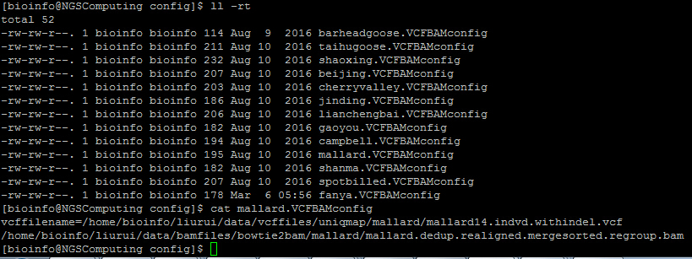
-T/-R mallard.VCFBAMconfig file
Detect selection signal:Detectsignalacrossgenome_master.py
Population vcf file
Bam file list that used to produce vcf file.
Used to check sites is uncovered or fixed as reference allele whhen multiple populations are used in frequency calculation

Slide 21
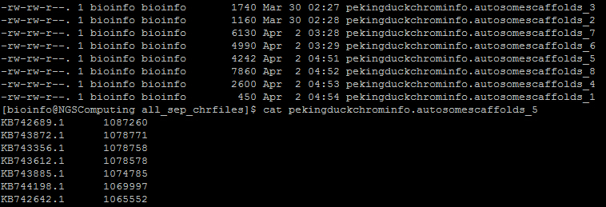
-c pekingduckchrominfo.autosomescaffolds_1
Detect selection signal:Detectsignalacrossgenome_master.py
In this case , calculation was divided into 8 threads. And all the results from those 8 threads will be merged automatically in the end.
Scaffold ID
Scaffold length

Slide 22
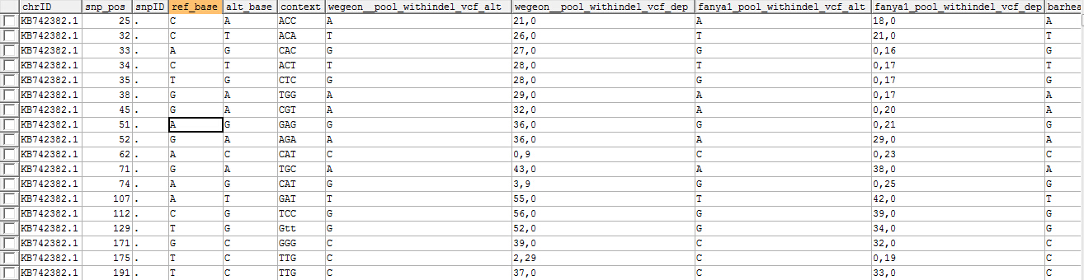
-t mspsgjlksy10pop_toplevel_pekingduckref
Detect selection signal:Detectsignalacrossgenome_master.py
Ref allele depth, alt allele depth
Thit table can be initially create by such command:
CREATE TABLE `mspsgjlksy10pop_toplevel_pekingduckref` (
`chrID` char(128) NOT NULL DEFAULT '',
`snp_pos` bigint(20) NOT NULL DEFAULT '0',
`snpID` char(128) NOT NULL,
`ref_base` varchar(1000) DEFAULT NULL,
`alt_base` varchar(1000) DEFAULT NULL,
`context` varchar(3) DEFAULT NULL, PRIMARY KEY (`chrID`,`snp_pos`)
) ENGINE=InnoDB DEFAULT CHARSET=utf8
The other information(sites and out group population information) could be filled automatically when this table is used.
CREATE TABLE `mspsgjlksy10pop_toplevel_pekingduckref` (
`chrID` char(128) NOT NULL DEFAULT '',
`snp_pos` bigint(20) NOT NULL DEFAULT '0',
`snpID` char(128) NOT NULL,
`ref_base` varchar(1000) DEFAULT NULL,
`alt_base` varchar(1000) DEFAULT NULL,
`context` varchar(3) DEFAULT NULL,
`wegeon__pool_withindel_vcf_alt` char(128) DEFAULT NULL,
`wegeon__pool_withindel_vcf_dep` char(128) DEFAULT NULL,
`fanya1_pool_withindel_vcf_alt` char(128) DEFAULT NULL,
`fanya1_pool_withindel_vcf_dep` char(128) DEFAULT NULL,
`barheadedgoose_pool_withindel_vcf_alt` char(128) DEFAULT NULL,
`barheadedgoose_pool_withindel_vcf_dep` char(128) DEFAULT NULL,
`taihudomesticgoose_pool_withindel_vcf_alt` char(128) DEFAULT NULL,
`taihudomesticgoose_pool_withindel_vcf_dep` char(128) DEFAULT NULL,
PRIMARY KEY (`chrID`,`snp_pos`)
) ENGINE=InnoDB DEFAULT CHARSET=utf8
Notes:
虽然 dynamicInsertUpdateAncestralContext对象的insertorUpdatetopleveltable fill context or/and ancestral (using outgroupVCFBAMconfig_beijingref in config.properties) automaticly, 但是对于已有SNP但是没有context的记录还是需要用

Slide 23
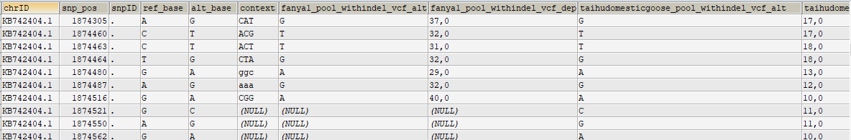
取消no covered改为0,0

Slide 24
config.properties file
Detect selection signal:Detectsignalacrossgenome_master.py
[mysqldatabase]
ip=10.2.48.147
username=root
password=1234567
webdbname=ninglabweb
vcfdbname=ninglabvariantdata
ghostdbname=ninglabvariantdata_tmp
genomeinfodbname=genomebasicinfo
pekingduckchromtable=pekingduckchrominfo
TranscriptGenetable=pekinduckmiRNA_Transcript
outgroupVCFBAMconfig_beijingref=/home/liurui/data/config/BJ/fanyaBJ.VCFBAMconfig;/home/liurui/data/config/BJ/taihugooseBJ.VCFBAMconfig
beijingreffa=/home/liurui/databases/Anas_platyrhynchos.BGI_duck_1.0.dna_sm.toplevel.fa
pathtoPython=Python3.3/python
Mysql database information
Database that (-t )mspsgjlksy10pop_toplevel_pekingduckref belong to
Out group information;
Python path

Slide 25
overview
$∂$a$∂i simulation$ : bootstrapdadisimulation.py
-n popname(multiple when multiple populations were used in model, two values assign the population name and sample size that be projected to for assigned model)
-f fs file (containing population name that assigned in -n options)
-m assign demography model that code built-in dadicode.py
-b repeat times (two values assigning repeat times and time limit for every run)
-l total length of genome stretch that SNPs come from
-p parameters of demographical model (multiple , 4 values assign parameter name, initial value, lower bound, upper bound for each parameter) initial value will be little different in each simulation in the range of lower bound and upper bound
bootstrapdadisimulation.py
input
output
Simulation result
Residual arrays
Call dadicode.py and setting different initial parameters
dadicode.py
Collect and convert time, population size, migration rate into real. And collect residuals arrays

Slide 26
usage
$∂$a$∂i simulation$ : bootstrapdadisimulation.py
rewriting line 32-th with your python2.7 config “pythonpath_pre=‘~/Python-2.7/python ~/life/src/NGS/Analysis/usedadiPy2_7/dadicode.py ‘”
rewriting line 468-th with proper mutation rate
python ~/life/src/NGS/Analysis/usedadiPy2_7/bootstrapdadisimulation.py -n mallard14 26 -n quantizpool 24 -f fs_file.dilutetodensity0.01 -m split_mig_1_IM -p nuA 2 1e-05 50 -p s 0.5 0 1 -p TA 0.3 1e-06 10 -p TS 0.1 1e-06 5 -p m12 1 1e-06 8 -p m21 1 1e-06 8 -l 480650.4721472733 -T m_d -b 100 15
-b 100 15, indicate running 100 times simulations ,terminate this simulation run when its running time beyond 15 mins

Slide 27
overview
CatalogSNP_getAAseq_CDSseq.py
VCF variant annotation program
Classify SNPs according its location in intron, utr, intergenetic or synonymous and nosynonymous
Translate mutation CDS into mutation AA seq
.cds file: SNPs annotation of CDS region
.UTR file:
. Intergenic file:
.utr file :
.intron file:
.mutcds file：fill mutate SNPs into CDS sequence
.mutaa file: translate mutate CDS sequence in to amino acid sequence
.refaa file: original amino acid sequcenc.
-v SNPs mysql table name
-V VCF file name
-r reference fasta file
-g GTF file
-o output path
-b bed file（…ing）
-m min length of the scaffolds (for –v only)
-5,-3 define distance from the start/stop codon as 5’/3’ UTR, in the case UTR annotation are absent in GTF annotation
CatalogSNP_withaaseq_cdsseq.py
input
output

Slide 28
GO enrichment analysis were implemented in GOenrichment() func in geneUtil.py
Fisher’s Exact Test
gotablefile could download from ensembl biomart . An example were given “gotablefile.lite”

Slide 29
ShareAllele.py 程序
-a --archaicPopConfig 为空，则只统计BBAA，BABA,ABBA等在ΔAF上的分布。并不生成joinSNP 文件
-l –filelist 为空 –v --snpfilelist不为空则为标准状态，生成joinSNP文件，同时统计分布
有一次 将程序改成多线程模式，joinSNP文件生成完成了，但是报错了，于是加了-l –filelist 参数，读取标准模式下生成的文件前缀的列表文件，完成后续工作，即直接统计joinSNP文件（跳过已完成的join操作）得到FreqStratifiedBBAA的dump文件，在得到最终的分布数据文件total.FreqStratifiedBBAA
travelCountjoinWg 方式生成的 FreqStratifiedBBAA文件最正确。
countJoinFile 和travelCountjoinWg生成的joinSNP最终merge文件应该是等效的。

