Slide 1
Life software project
Developed by PYTHON 3.3

Slide 2
Life is an integrated biology data analyses and observation system.
Current version mainly consist of four modules, focus on evolutionary genomics, and could be easily develop into more powerful system to visualize, mine and analyses genomes data.
As its idea is to simple the data process and to manipulate the data in a intuition way that is in line with mathematic description of evolutionary theory. It is easy to vary to design new idea, observation, calculation and theory.

Slide 3
data management and visualization module
Module 1
vcf，depth
Variants data management were designed based on population genetics
Outgroup populations
Ref fasta of close species
Close related species
snp_toplevel table
vcf
m:1
Produce snp_toplevel table
Data
base
Table correspond to vcf
fq
m:m
bam
1:1
m:m
vcf
m:m
。。。
Table correspond to vcf
Toplevel table could be modified dynamically

Slide 4
… …

Slide 5
analysis pipeline management module
Module 2
NGS project usually involve in multiple data sets and multiple steps. Similar commands with same parameters but different input and output could be produced by program. In this way could not only avoid mistaken by manually commands coding, reduce labor. Arrangement rule could also help to manage data and pipeline scripts.
In the base of such semi automatic arrangement, an B/S mode system is easy to implement

Slide 6
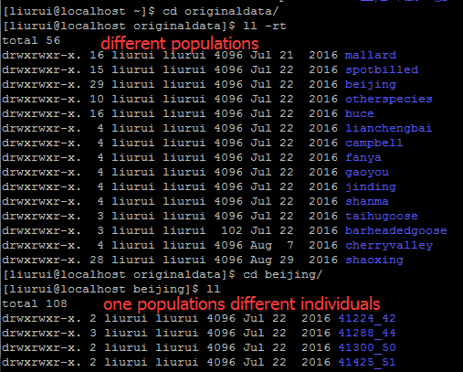
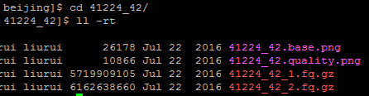
Data store and naming agreement
Similar data were stored in different folders but same suffix. Those folders are under same folder and same depth.
For example.
A batch of paired
fastq data.

Slide 7
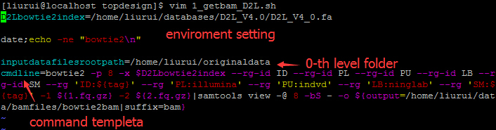
Scripts template
Produce batch of scripts: scriptcontrol.py
For example. produce bam file from paired fastq for all individuals of different populations. Template file was shown blow.
${} represent variable parameters in each scripts.

Slide 8
Produce scripts for every individual paired fq files according the template
Produce batch of scripts: scriptcontrol.py
Python ~/life/src/pipelinecontrol/scriptcontrol.py -c 1_getbam_D2L.sh –d 2 –s /pathto/step1_scripts –m 1 -1 2
It will produce runnable scripts that is used to call bam for every individual of all populations.
Input data files were in the second level folder under the 0-the level folder.
Produce scripts for every second level folder under the 0-th level folder. This parameter is usually same with -d
Template file describe as above
-c Template file
-d depth of input data (inputdatafilesrootpath=0th level)
-s folder to store scripts
-m mode1/2
-I depth of intercept folders
-l names of intercept folders in the assigned level
-t level of the folder name used to substitute tha ${tag}
-1
-2
scriptcontrol.py
input
output
Produce batch of scripts
Create folders for all output data

Slide 9
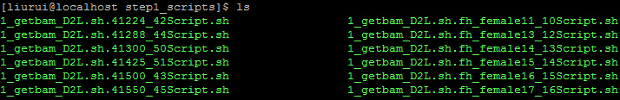
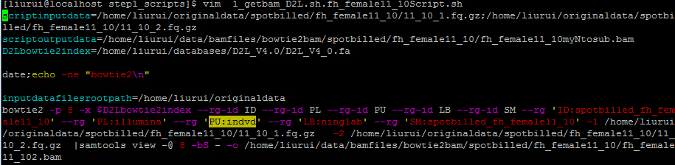
mode 1 results (many input to many output)
Produce batch of scripts: scriptcontrol.py
All those (output, scripts) folders and scripts were produce automaticly

Slide 10
Mode 2: many input to one output
Produce batch of scripts: scriptcontrol.py

Slide 11
Task and record management module
Module 3
Throw several scripts into running at once untill run all scripts.
Monitor the state of all scripts run in webpage or by mysql visual schema
Record parameters , logfile, input data and output data.

Slide 12
… …

Slide 13
analysis module
Module 4

Slide 14
overview
Detect selection signal:Detectsignalacrossgenome_master.py
-o path to ouput prefix name
-T targetpopvcf depthconfig (multiple –R when multiple populations were used, omit when calculate Hp)
-R refpopvcf depthconfig (multiple)
-t toplevel_snp_table (to know ancestral allele and context bases)
-c/-b multiple chromosome list or bed like file ( -c or –b only one is needed)
-p type of signal (early, hp, Fst)
-C freq_correlation file ,for “early” only
-n number of individuals , for “early” only. Decide to divid frequency in to how many bins
-1 frequency correlation calculate slaver programm name
-2 slaver that slide window to calculate signal
-w window size
-s slide steps
Detectsignalacrossgenome_master.py
input
output
winfile
(freq_correlation file)
. . . . . .
Calculate different population parameters in each window
slave
slave
slave
Whole genome was divided into multiple chromosomes or scaffolds (-c). And each scaffold was calculated by Slave programm simultaneously.

Slide 15
usage
Detect selection signal:Detectsignalacrossgenome_master.py
Python-3.3.3/python life/src/NGS/Analysis/Detectsignalacrossgenome_master.py -o /home/bioinfo/liurui/data/detectselection/uniqmap/earlystageselectivesweep/finaleditionfromproducetoslidwin -n 14 -t mspsgjlksy10pop_toplevel_pekingduckref -T mallard.VCFBAMconfig -T spotbilled.VCFBAMconfig -R gaoyou.VCFBAMconfig -R lianchengbai.VCFBAMconfig -R jinding.VCFBAMconfig -R campbell.VCFBAMconfig -R cherryvalley.VCFBAMconfig -R beijing.VCFBAMconfig -R shaoxing.VCFBAMconfig -R shanma.VCFBAMconfig -w 20000 -s 10000 -c pekingduckchrominfo.autosomescaffolds_1 -c pekingduckchrominfo.autosomescaffolds_2 -c pekingduckchrominfo.autosomescaffolds_3 -c pekingduckchrominfo.autosomescaffolds_4 -c pekingduckchrominfo.autosomescaffolds_5 -c pekingduckchrominfo.autosomescaffolds_6 -c pekingduckchrominfo.autosomescaffolds_7 -c pekingduckchrominfo.autosomescaffolds_8 -1 life/src/NGS/Slave/Detectsignalacrossgenome_producecorrelation_slave.py -2 life/src/NGS/Slave/Detectsignalacrossgenome_slidewin_slave.py -p early
Split whole genome into different stretch to calculate in different slave process or machine

Slide 16
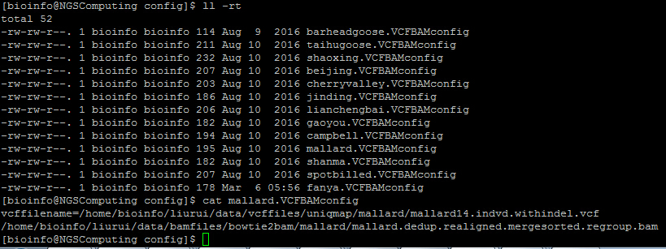
-T/-R mallard.VCFBAMconfig file
Detect selection signal:Detectsignalacrossgenome_master.py
Population vcf file
Bam file list that used to produce vcf file.
Used to check sites is uncovered or fixed as reference allele whhen multiple populations are used in frequency calculation

Slide 17
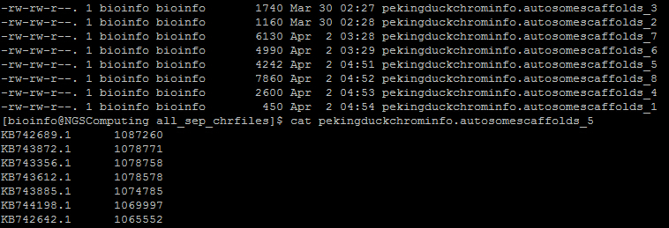
-c pekingduckchrominfo.autosomescaffolds_1
Detect selection signal:Detectsignalacrossgenome_master.py
In this case , calculation was divided into 8 threads. And all the results from those 8 threads will be merged automatically in the end.
Scaffold ID
Scaffold length

Slide 18
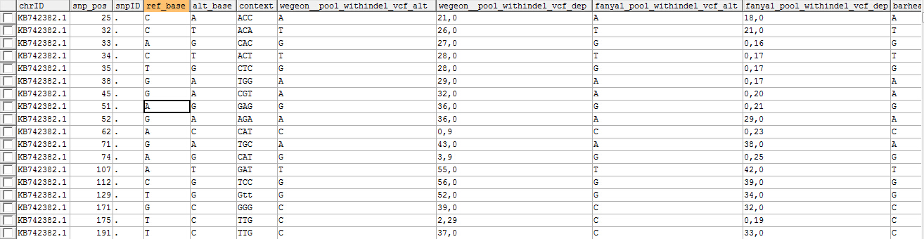
-t mspsgjlksy10pop_toplevel_pekingduckref
Detect selection signal:Detectsignalacrossgenome_master.py
Ref allele depth, alt allele depth
Thit table can be initially create by such command:
CREATE TABLE `mspsgjlksy10pop_toplevel_pekingduckref` (
`chrID` char(128) NOT NULL DEFAULT '',
`snp_pos` bigint(20) NOT NULL DEFAULT '0',
`snpID` char(128) NOT NULL,
`ref_base` varchar(1000) DEFAULT NULL,
`alt_base` varchar(1000) DEFAULT NULL,
`context` varchar(3) DEFAULT NULL, PRIMARY KEY (`chrID`,`snp_pos`)
) ENGINE=InnoDB DEFAULT CHARSET=utf8
The other information(sites and out group population information) could be filled automatically when this table is used.
CREATE TABLE `mspsgjlksy10pop_toplevel_pekingduckref` (
`chrID` char(128) NOT NULL DEFAULT '',
`snp_pos` bigint(20) NOT NULL DEFAULT '0',
`snpID` char(128) NOT NULL,
`ref_base` varchar(1000) DEFAULT NULL,
`alt_base` varchar(1000) DEFAULT NULL,
`context` varchar(3) DEFAULT NULL,
`wegeon__pool_withindel_vcf_alt` char(128) DEFAULT NULL,
`wegeon__pool_withindel_vcf_dep` char(128) DEFAULT NULL,
`fanya1_pool_withindel_vcf_alt` char(128) DEFAULT NULL,
`fanya1_pool_withindel_vcf_dep` char(128) DEFAULT NULL,
`barheadedgoose_pool_withindel_vcf_alt` char(128) DEFAULT NULL,
`barheadedgoose_pool_withindel_vcf_dep` char(128) DEFAULT NULL,
`taihudomesticgoose_pool_withindel_vcf_alt` char(128) DEFAULT NULL,
`taihudomesticgoose_pool_withindel_vcf_dep` char(128) DEFAULT NULL,
PRIMARY KEY (`chrID`,`snp_pos`)
) ENGINE=InnoDB DEFAULT CHARSET=utf8

Slide 19
config.properties file
Detect selection signal:Detectsignalacrossgenome_master.py
[mysqldatabase]
ip=10.2.48.147
username=root
password=1234567
webdbname=ninglabweb
vcfdbname=ninglabvariantdata
ghostdbname=ninglabvariantdata_tmp
genomeinfodbname=genomebasicinfo
pekingduckchromtable=pekingduckchrominfo
TranscriptGenetable=pekinduckmiRNA_Transcript
outgroupVCFBAMconfig_beijingref=/home/liurui/data/config/BJ/fanyaBJ.VCFBAMconfig;/home/liurui/data/config/BJ/taihugooseBJ.VCFBAMconfig
beijingreffa=/home/liurui/databases/Anas_platyrhynchos.BGI_duck_1.0.dna_sm.toplevel.fa
pathtoPython=Python3.3/python
Mysql database information
Database that (-t )mspsgjlksy10pop_toplevel_pekingduckref belong to
Out group information;
Python path

Slide 20
overview
$∂$a$∂i simulation$ : bootstrapdadisimulation.py
-n popname(multiple when multiple populations were used in model, two values assign the population name and sample size that be projected to for assigned model)
-f fs file (containing population name that assigned in -n options)
-m assign demography model that code built-in dadicode.py
-b repeat times (two values assigning repeat times and time limit for every run)
-l total length of genome stretch that SNPs come from
-p parameters of demographical model (multiple , 4 values assign parameter name, initial value, lower bound, upper bound for each parameter) initial value will be little different in each simulation in the range of lower bound and upper bound
bootstrapdadisimulation.py
input
output
Simulation result
Residual arrays
Call dadicode.py and setting different initial parameters
dadicode.py
Collect and convert time, population size, migration rate into real. And collect residuals arrays

Slide 21
usage
$∂$a$∂i simulation$ : bootstrapdadisimulation.py
rewriting line 32-th with your python2.7 config “pythonpath_pre=‘~/Python-2.7/python ~/life/src/NGS/Analysis/usedadiPy2_7/dadicode.py ‘”
rewriting line 468-th with proper mutation rate
python ~/life/src/NGS/Analysis/usedadiPy2_7/bootstrapdadisimulation.py -n mallard14 26 -n quantizpool 24 -f fs_file.dilutetodensity0.01 -m split_mig_1_IM -p nuA 2 1e-05 50 -p s 0.5 0 1 -p TA 0.3 1e-06 10 -p TS 0.1 1e-06 5 -p m12 1 1e-06 8 -p m21 1 1e-06 8 -l 480650.4721472733 -T m_d -b 100 15
-b 100 15, indicate running 100 times simulations ,terminate this simulation run when its running time beyond 15 mins

Slide 22
overview
CatalogSNP_getAAseq_CDSseq.py
VCF variant annotation program
Classify SNPs according its location in intron, utr, intergenetic or synonymous and nosynonymous
Translate mutation CDS into mutation AA seq
.cds file: SNPs annotation of CDS region
.UTR file:
. Intergenic file:
.utr file :
.intron file:
.mutcds file：fill mutate SNPs into CDS sequence
.mutaa file: translate mutate CDS sequence in to amino acid sequence
.refaa file: original amino acid sequcenc.
-v SNPs mysql table name
-V VCF file name
-r reference fasta file
-g GTF file
-o output path
-b bed file（…ing）
-m min length of the scaffolds (for –v only)
-5,-3 define distance from the start/stop codon as 5’/3’ UTR, in the case UTR annotation are absent in GTF annotation
CatalogSNP_withaaseq_cdsseq.py
input
output

Slide 23
GO enrichment analysis were implemented in GOenrichment() func in geneUtil.py
Fisher’s Exact Test
gotablefile could download from ensembl biomart . An example were given “gotablefile.lite”

