Slide 1
Life software project

Slide 2
Life is an integrated biology data analyses and observation system.
Current version mainly consist of four modules, focus on evolutionary genomics, and could be easy to develop into more powerful system to visualize, mine and analyses genomes.
As its idea is to simple the data process and to manipulate the data in a intuition way that is in line with mathematic description of evolutionary theory. It is easy to vary to design new idea, observation, calculation and theory.

Slide 3
data management module

Slide 4
analysis pipeline management module

Slide 5
overview
Detect selection signal: scriptcontrol.py

Slide 6
task management module

Slide 7
analysis module

Slide 8
overview
Detect selection signal:Detectsignalacrossgenome_master.py
-o path to ouput prefix name
-T targetpopvcf depthconfig (multiple –R when multiple populations were used, omit when calculate Hp)
-R refpopvcf depthconfig (multiple)
-t toplevel_snp_table (to know ancestral allele and context bases)
-c/-b multiple chromosome list or bed like file ( -c or –b only one is needed)
-p type of signal (early, hp, Fst)
-C freq_correlation file ,for “early” only
-n number of individuals , for “early” only. Decide to divid frequency in to how many bins
-1 frequency correlation calculate slaver programm name
-2 slaver that slide window to calculate signal
-w window size
-s slide steps
Detectsignalacrossgenome_master.py
input
output
winfile
(freq_correlation file)
. . . . . .
slave
slave
slave
Whole genome was divided into multiple chromosomes or scaffolds (-c). And each scaffold was calculated by Slave programm simultaneously.

Slide 9
usage
Detect selection signal:Detectsignalacrossgenome_master.py
Python-3.3.3/python life/src/NGS/Analysis/Detectsignalacrossgenome_master.py -o /home/bioinfo/liurui/data/detectselection/uniqmap/earlystageselectivesweep/finaleditionfromproducetoslidwin -n 14 -t mspsgjlksy10pop_toplevel_pekingduckref -T mallard.VCFBAMconfig -T spotbilled.VCFBAMconfig -R gaoyou.VCFBAMconfig -R lianchengbai.VCFBAMconfig -R jinding.VCFBAMconfig -R campbell.VCFBAMconfig -R cherryvalley.VCFBAMconfig -R beijing.VCFBAMconfig -R shaoxing.VCFBAMconfig -R shanma.VCFBAMconfig -w 20000 -s 10000 -c pekingduckchrominfo.autosomescaffolds_1 -c pekingduckchrominfo.autosomescaffolds_2 -c pekingduckchrominfo.autosomescaffolds_3 -c pekingduckchrominfo.autosomescaffolds_4 -c pekingduckchrominfo.autosomescaffolds_5 -c pekingduckchrominfo.autosomescaffolds_6 -c pekingduckchrominfo.autosomescaffolds_7 -c pekingduckchrominfo.autosomescaffolds_8 -1 life/src/NGS/Slave/Detectsignalacrossgenome_producecorrelation_slave.py -2 life/src/NGS/Slave/Detectsignalacrossgenome_slidewin_slave.py -p early

Slide 10
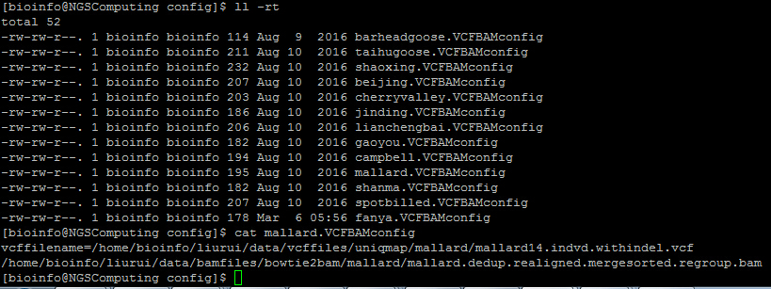
-T/-R mallard.VCFBAMconfig file
Detect selection signal:Detectsignalacrossgenome_master.py
Population vcf file
Bam file list that used to produce vcf file.
Used to check sites is uncovered or fixed as reference allele whhen multiple populations are used in frequency calculation

Slide 11
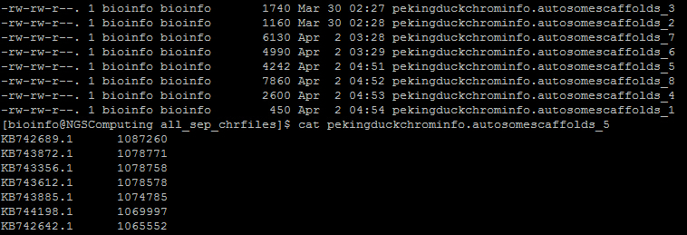
-c pekingduckchrominfo.autosomescaffolds_1
Detect selection signal:Detectsignalacrossgenome_master.py
In this case , calculation was divided into 8 threads. And all the results from those 8 threads will be merged automatically in the end.
Scaffold ID
Scaffold length

Slide 12
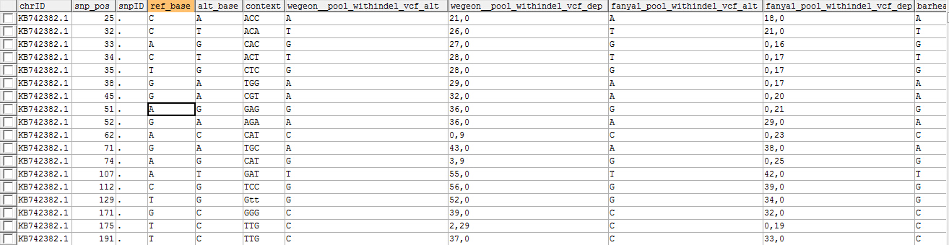
-t mspsgjlksy10pop_toplevel_pekingduckref
Detect selection signal:Detectsignalacrossgenome_master.py
Ref allele depth, alt allele depth
Thit table can be initially create by such command:
CREATE TABLE `mspsgjlksy10pop_toplevel_pekingduckref` (
`chrID` char(128) NOT NULL DEFAULT '',
`snp_pos` bigint(20) NOT NULL DEFAULT '0',
`snpID` char(128) NOT NULL,
`ref_base` varchar(1000) DEFAULT NULL,
`alt_base` varchar(1000) DEFAULT NULL,
`context` varchar(3) DEFAULT NULL, PRIMARY KEY (`chrID`,`snp_pos`)
) ENGINE=InnoDB DEFAULT CHARSET=utf8
The other information(sites and out group population information) could be filled automatically when this table is used.
CREATE TABLE `mspsgjlksy10pop_toplevel_pekingduckref` (
`chrID` char(128) NOT NULL DEFAULT '',
`snp_pos` bigint(20) NOT NULL DEFAULT '0',
`snpID` char(128) NOT NULL,
`ref_base` varchar(1000) DEFAULT NULL,
`alt_base` varchar(1000) DEFAULT NULL,
`context` varchar(3) DEFAULT NULL,
`wegeon__pool_withindel_vcf_alt` char(128) DEFAULT NULL,
`wegeon__pool_withindel_vcf_dep` char(128) DEFAULT NULL,
`fanya1_pool_withindel_vcf_alt` char(128) DEFAULT NULL,
`fanya1_pool_withindel_vcf_dep` char(128) DEFAULT NULL,
`barheadedgoose_pool_withindel_vcf_alt` char(128) DEFAULT NULL,
`barheadedgoose_pool_withindel_vcf_dep` char(128) DEFAULT NULL,
`taihudomesticgoose_pool_withindel_vcf_alt` char(128) DEFAULT NULL,
`taihudomesticgoose_pool_withindel_vcf_dep` char(128) DEFAULT NULL,
PRIMARY KEY (`chrID`,`snp_pos`)
) ENGINE=InnoDB DEFAULT CHARSET=utf8

Slide 13
config.properties file
Detect selection signal:Detectsignalacrossgenome_master.py
[mysqldatabase]
ip=10.2.48.147
username=root
password=1234567
webdbname=ninglabweb
vcfdbname=ninglabvariantdata
ghostdbname=ninglabvariantdata_tmp
genomeinfodbname=genomebasicinfo
pekingduckchromtable=pekingduckchrominfo
TranscriptGenetable=pekinduckmiRNA_Transcript
outgroupVCFBAMconfig_beijingref=/home/liurui/data/config/BJ/fanyaBJ.VCFBAMconfig;/home/liurui/data/config/BJ/taihugooseBJ.VCFBAMconfig
beijingreffa=/home/liurui/databases/Anas_platyrhynchos.BGI_duck_1.0.dna_sm.toplevel.fa
pathtoPython=Python3.3/python
Mysql database information
Database that (-t )mspsgjlksy10pop_toplevel_pekingduckref belong to
Out group information;
Python path

Slide 14
overview
$∂$a$∂i simulation$ : bootstrapdadisimulation.py
-n popname(multiple when multiple populations were used in model, two values assign the population name and sample size that be projected to for assigned model)
-f fs file (containing population name that assigned in -n options)
-m assign demography model that code built-in dadicode.py
-b repeat times (two values assigning repeat times and time limit for every run)
-l total length of genome stretch that SNPs come from
-p parameters of demographical model (multiple, 4 values assign parameter name, initial value, lower bound, upper bound) initial value will be little different in each simulation in the range of lower bound and upper bound
bootstrapdadisimulation.py
input
output
Simulation result
Residual arrays
Call dadicode.py by Setting different initial parameters
dadicode.py
Collect and convert time, population size, migration rate into real. And collect residuals arrays

Slide 15
$∂$a$∂i simulation$ : GenerateSNPfilefromvcftable.py
~/liurui/software/Python-3.3.3/python ~/liurui/software/life/src/NGS/Analysis/usedadiPy2_7/GenerateSNPfilefromvcftable.py -t mspsgjlksy10pop_toplevel_pekingduckref -m 10000 -d 0.01 -o m_sp_sx_pk_gy_lcb_jd_sm_ytg_kbe_fanyaonly -C /home/bioinfo/liurui/data/vcffiles/uniqmap/pool/p_m_sx_sp_gy_kbe_sm_lcb_ytg_jd_10pool10.SNV.vcf -v pekingduck27_indvd_withindel_vcf 54 -v shaoxingqingkeegg27_indvd_withindel_vcf 40 -v mallard14_indvd_withindel_vcf 26 -v spotbilled13_indvd_withindel_vcf 26 -v gaoyou__pool_withindel_vcf 20 -v jinding__pool_withindel_vcf 20 -v kangbeier__pool_withindel_vcf 20 -v lianchengbai__pool_withindel_vcf 20 -v shanma__pool_withindel_vcf 20 -v yingtaogu__pool_withindel_vcf 20 -n 26 -q pekingduck27_indvd_withindel_vcf -q shanma__pool_withindel_vcf -q lianchengbai__pool_withindel_vcf -q shaoxingqingkeegg27_indvd_withindel_vcf -q jinding__pool_withindel_vcf -q gaoyou__pool_withindel_vcf

