Slide 1

Twitter Marketing Classification & forecasting
Alex Gamboa, Gerard Tieng, Vito Perez

Slide 2
Project Background
We are working with a Los Angeles based marketing and networking expert with more than 10,000 followers on Twitter.
We were able to access two years of native Twitter analytics.
We are giving our client a better understanding of her tweets and social media influence.

Slide 3

Goal of Twitter Analytics
This project is to create models that can benefit a social media influencer to create better branding and add value to future performance.
There is a lot of data illustration on past data but we wanted to use machine learning to give brands awareness and guidance.
Part 1: Tweet Classifications
Part 2: Tweets Forecasting

Slide 4


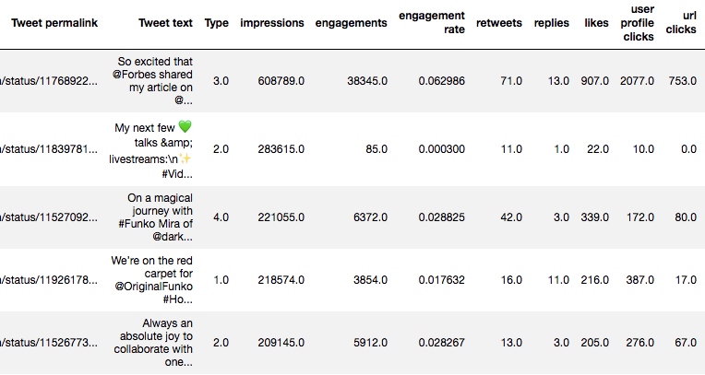

Understanding the Twitter Analytics

Slide 5




Brand Message Types:
After understanding the brand, we manually sorted each tweet in the set and labeled each as one of their 4 core message types.
1. Business & Promotions (brand message, weblinks, hashtags)
4. Replies & Miscellaneous (replies and other tweets)
3. Positivity & Wellness (directed towards the brands audience, hashtags)
2. Spotlight & Shout Out (using @Tags to give support to other users)

Slide 6

Machine Learning Multi-Classifier
In the absence of a person to view each tweet, we are looking to find if supervised machine learning plus Natural Language Processing libraries can correctly classify the text of any given tweet from their account into one of the four types of message category.

Slide 7
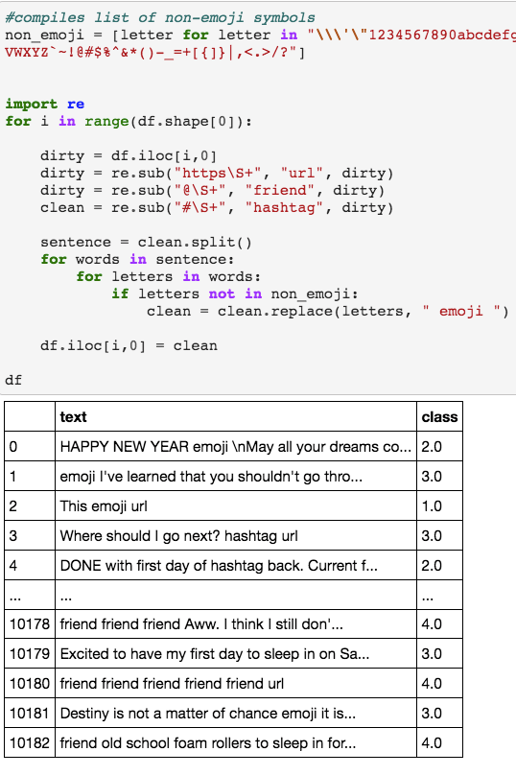
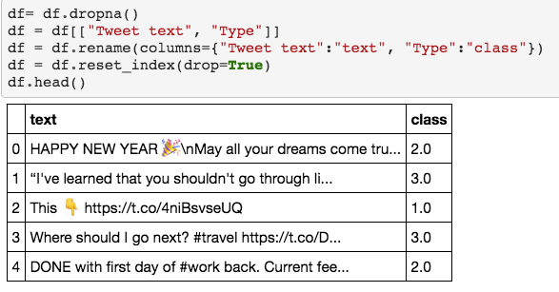
Data Cleansing
We have to drop any null values before working with the set
Create a new column for tweet types and classification
There are a lot of tweets with non-words and symbols (like emojis, hashtags, and links). We created simple words to describe the characters

Slide 8
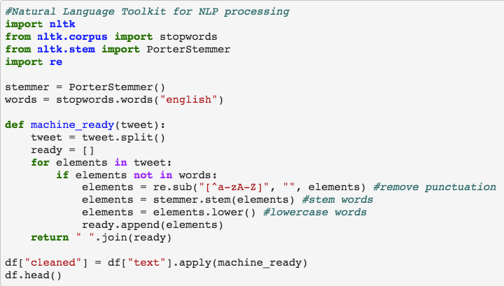
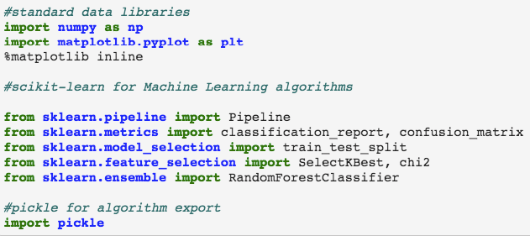
Machine Learning Pre Process
The Porter Stemmer() function will be used to consolidate related words into root strings (e.g., happy, happiness = “happi”).
Stop words is a common filter for non-essential words (i.e. “the” and “a”)
The following code will split apart each tweet into individual words and stem each word before assembling the full tweet back together as a ”cleaned” string.

Slide 9

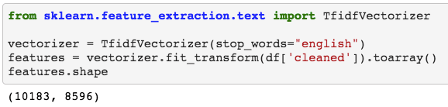
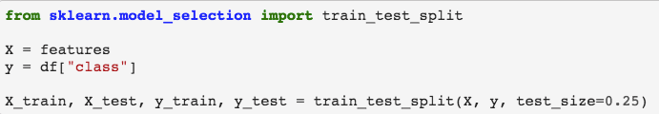
ML - Vectorization
We’ll use sklearn’s Vectorizer to convert the contents of each tweet as an array notating the appearance of each word for machine learning.
The dataset will need to be vectorized as an array in order for computers to process language.
Each unique word (+8,500) will be represented in its own position in the vector and a combination of the vector positions will form a tweet.

Slide 10
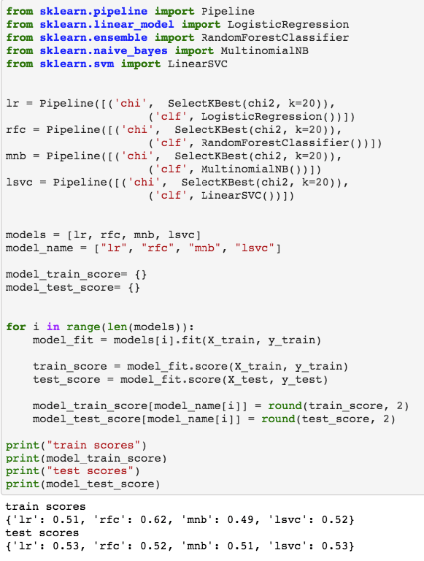

Using 4 model Algorithms
We are comparing the use of 4 different model algorithms to see which is best used to predict our clients 4 core message types.
Using Pipeline will help us keep track of the models used along with the Kbest priority feature selector
Random Forest Classifier appears to be the most accurate of all the models, although the classifier is only right about half the time in any scenario.

Slide 11

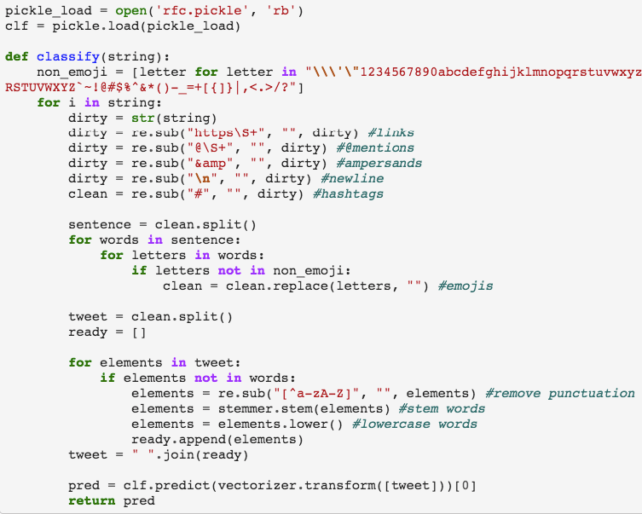
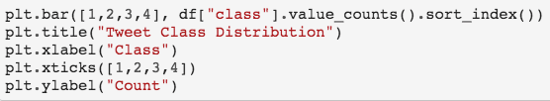
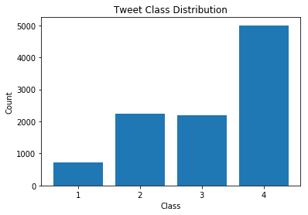

TWEETS ANALYSIS
Using the Pickle Library we have exported the RFC algorithm to a file.
We’ll program a custom classify function to accept the tweet string, filter it through the classifier, and return the result.
Interestingly, when looking at the distribution of the values, about half of the tweets in the dataset belong in the Class 4 category.
TESTING OUR ALGORITHM

Slide 12
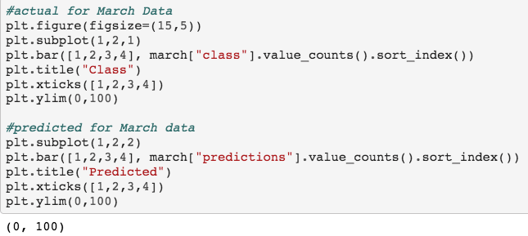
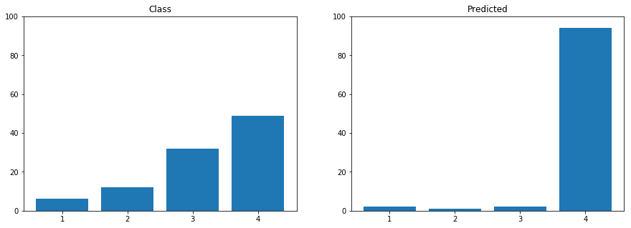
Exploring the Algorithm
We used 100 tweets from March 2020 which has never been used in testing or training to validate the data.
According to the bar plots below, the classifier isn’t near the 50% projected accuracy of our algorithm for this set.
This can be because of a shift in tweets based upon COVID-19 changing normal behaviors and events.

Slide 13
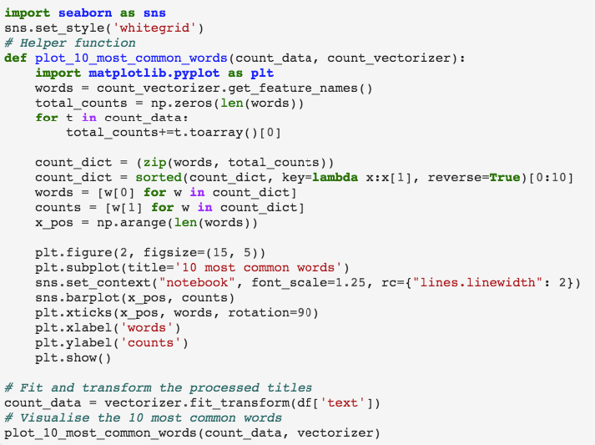
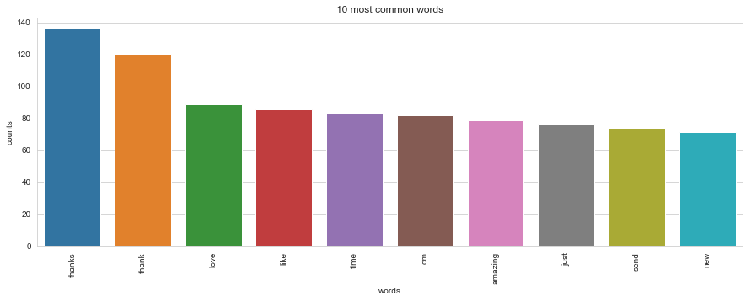
Considering Other Models
In further research and experimentation, Latent Dirichlet Allocation (LDA) had been identified as a potential solution for the classification our data via unsupervised topic modeling.
The model will display information on the most common terms and potential relationships of such terms to other form of patterns.

Slide 14
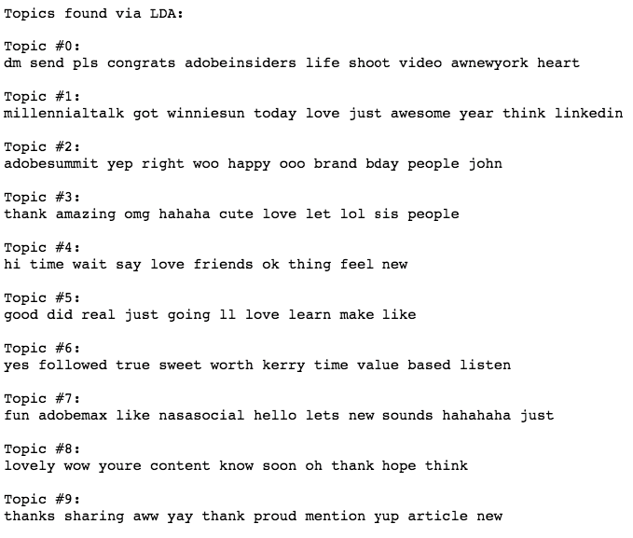
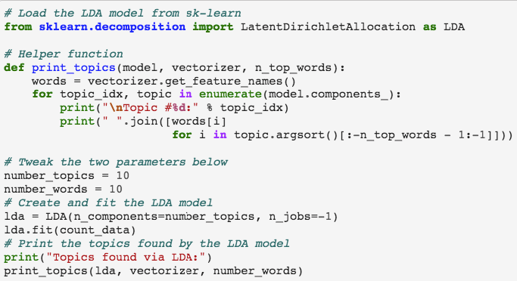
Latent Dirichlet Allocation (LDA)
Unsupervised training has naturally segmented a few popular topics from the dataset including themes like LinkedIn, DnD & Adobe (Class 1), gratitude content (Class 2), but no easily visible tweets from Class 3 (positivity) & 4 (replies).

Slide 15

Machine Learning Multi-Classifier conclusion
A conversation on the twitter platform can be very unique and varied (e.g. the contextual use of images/gifs/emoji, replies, and changes in topics) in comparison to a traditional string expression from an email or product review.
We anticipate a more accurate model could be created with more training data and more disciplined style of writing under the identified classes.

Slide 16


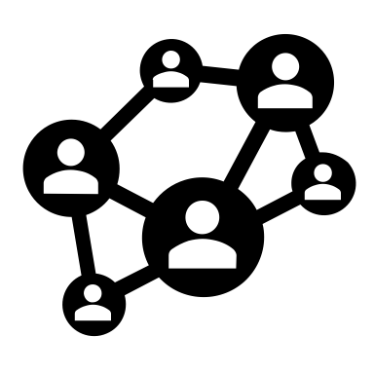
Performance Forecasting
We are using FB prophet to forecast future performance for brand goal setting.
We will use prediction modeling for Promotions, Spotlight, and Positivity message types.
Prediction modeling will be based on 5 criteria: Impressions, URL Clicks, Likes, Retweets, and Replies.

Slide 17
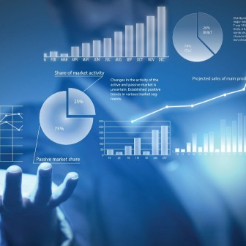
FB Prophet to Forecast Performance
Facebook Prophet provides a model that can be trained on time series data in order to predict future outcomes.
The Prophet object, requires a data frame with a date column and a y (output) column. After plotting a forecast, it will detect and mark points of change in the plot.

Slide 18
Steps to Forecast:
Import dependencies and clean data frame to correct date format.
Select the type of brand message (e.g. “Promotions”)
Identify the column of value (e.g. “Impressions”) and clean the outliers
Clean and organize the data frame for plotting

Slide 19
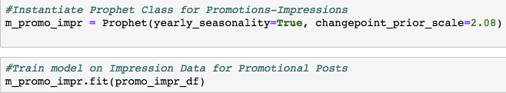
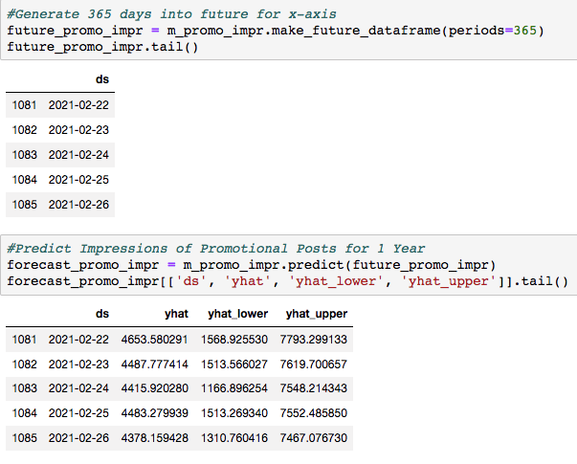
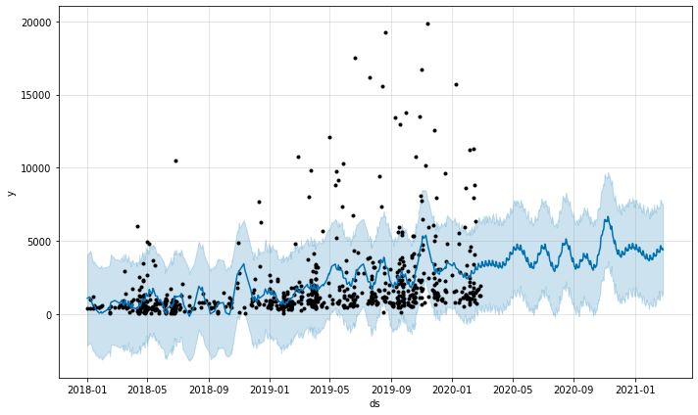
Train Model on Historical Data and Create the Prediction Forecast for Impressions

Slide 20
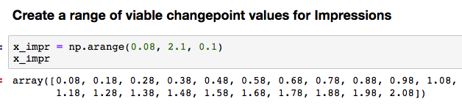
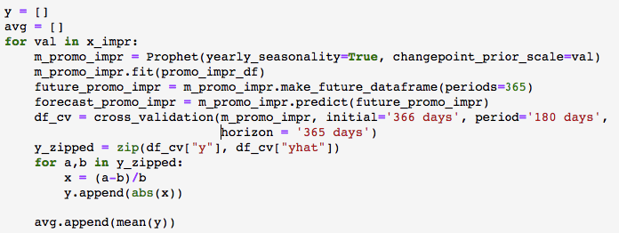
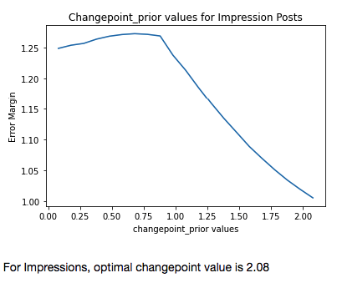
Calibrating your Prediction Model
The objective of this analysis is to determine the optimal changepoint value parameter when instantiating the Prophet model object. This is done by plotting a range of changepoint values vs the average margin error.
Loop through range of changepoint values
We test the model by tuning the changepoint parameter to each value in the range above.
Produce a prediction data frame, then isolate y-actual and y-theoretical values, and calculate margin error per entry. Take the mean of all the margin errors and append to list; this list will be the y values for the plot below.
The changepoint value with the lowest average margin error will be the optimal parameter for the Prophet model. (2.08)

Slide 21
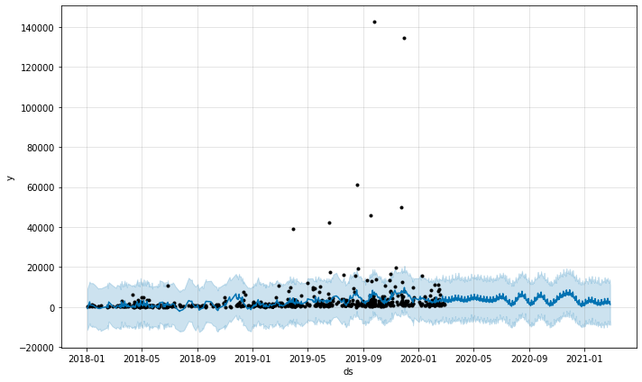
Comparison of Changepoint:
Finding the right Changepoint can change the prediction model by a lot.
Here is a comparison of Forecast of Impressions for Promotional Posts
Yearly Forecast Trend
Changepoint scale of 2.08 Changepoint scale of 0.5

Slide 22
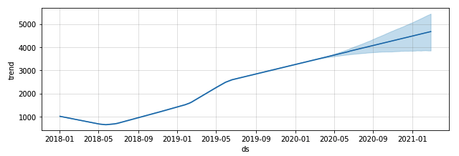
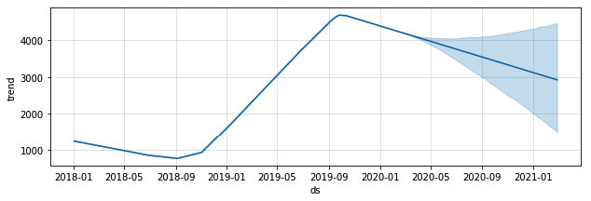
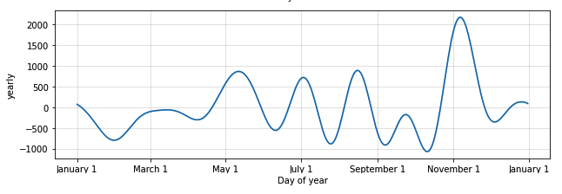
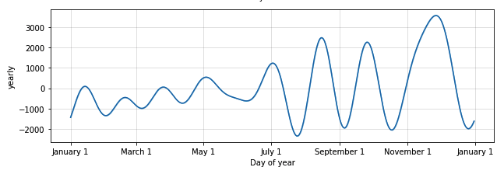
Comparison of Changepoint:
Yearly Forecast Trend
Seasonal Trend
Changepoint scale of 2.08 Changepoint scale of 0.5

Slide 23
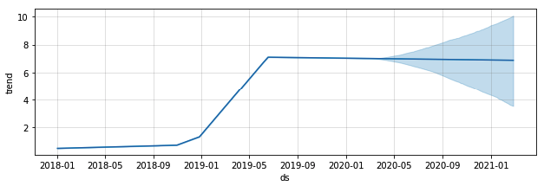
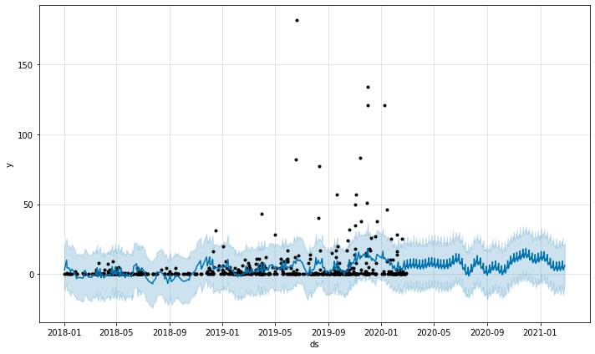
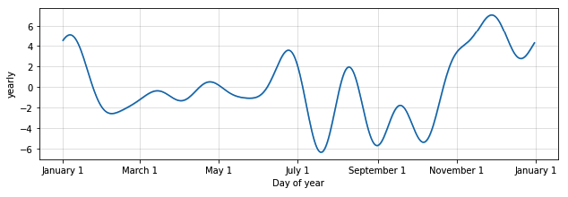
1. Promotional Forecast:
Daily Trend
Promotional tweets are closely related to the brands business and usually involve a URL link and a call to action. We would put emphasis of viewing forecast of clicks for promotional post.
Yearly Forecast Trend
Seasonal Trend

Slide 24
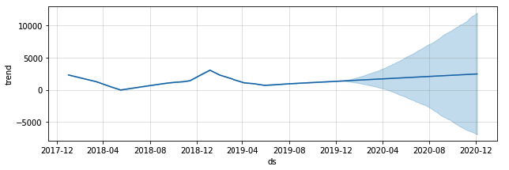
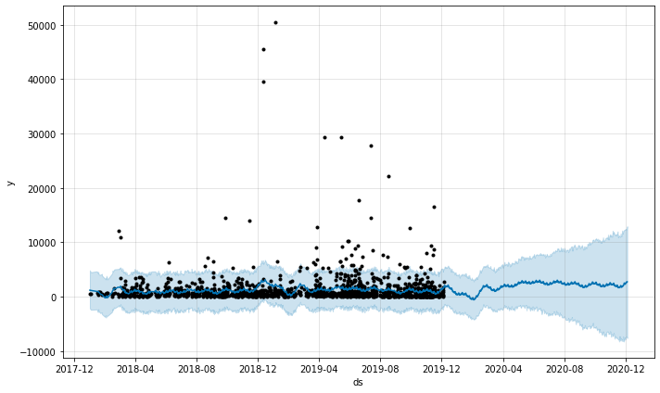
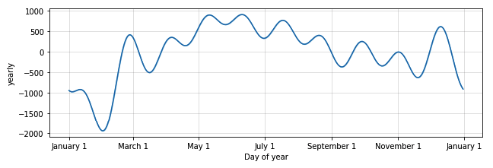
2. Spotlight Forecast:
Daily Trend
Spotlight tweets are closely related to the brands recognition and twitter community involvement. We would put emphasis of viewing forecast of Impressions for spotlight post.
Yearly Forecast Trend
Seasonal Trend

Slide 25
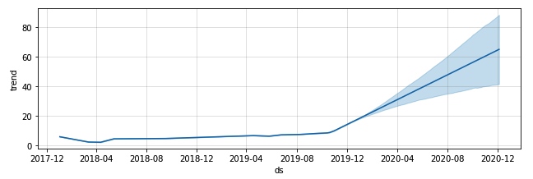
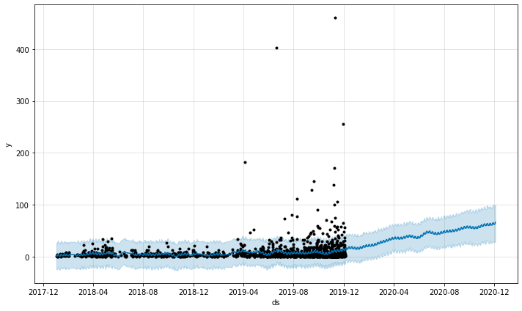
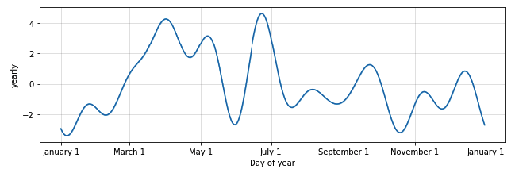
3. Positivity Forecast:
Daily Trend
Positivity tweets are closely related to the brands perspective and values towards its audience. We would put emphasis of viewing forecast of likes to see if the audience is still engaging in positivity post.
Yearly Forecast Trend
Seasonal Trend

Slide 26

FB Prophet – Forecast conclusion
Forecast prediction can allow the client to understand where future performance can go with continuous performance on twitter.
The model can help set a range of brand goals by predicting low or high margins on future tweets.
Critical note: the dataset indicates that the social media branding/marketing industry is very volatile. Relative error is a better measure of accuracy rather than a standard scale.

Slide 27
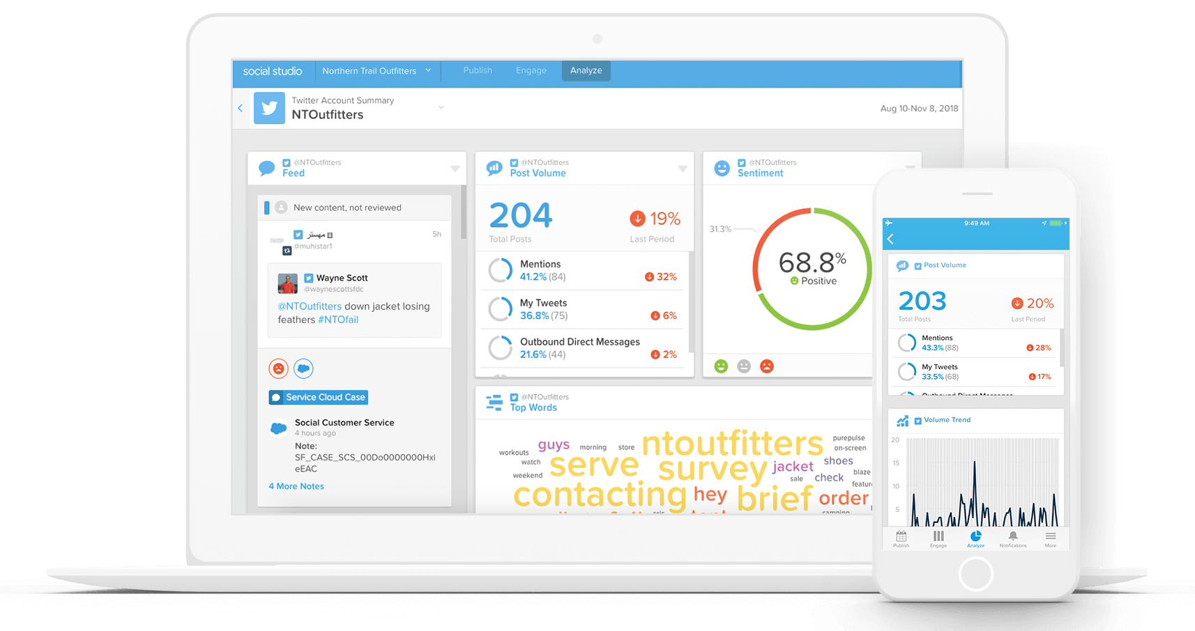
Next Steps:
Create an engaging dashboard to give clients a better understanding of brand impressions, engagement, and forecasting.
The client can use the dashboard to create brand goals for engagement and take more educated approaches to grow their brand.

Slide 28
Thank you!

