Slide 1
PD MODELING — METHODOLOGY & VALIDATION
Home Credit Default Risk
XGBoost benchmark and a fully auditable WoE/IV logistic regression scorecard
Technical deep dive: feature engineering, variable selection, multicollinearity diagnostics, and validation protocol
Kaggle: Home Credit Default Risk

Slide 2
SCOPE & VALIDATION PROTOCOL
Dataset, scope decision, and evaluation methodology
307,511
8.07%
156
80/20
clients (application_train
+ aggregated bureau.csv)
historical bad rate
columns after merge
(154 candidate features)
stratified train/validation
split, seed fixed
SCOPE DECISION
VALIDATION METHODOLOGY
This slice of the pipeline is intentionally limited to application_train.csv plus aggregated bureau.csv, not the full relational schema (previous_application, POS_CASH_balance, credit_card_balance, installments_payments). The goal was to validate a complete pipeline end to end before scaling data complexity, a deliberate MVP-style sequencing rather than a scope gap.
XGBoost: stratified 5-fold CV for the performance estimate, plus a fixed 80/20 split for SHAP and gain-curve artifacts
Scorecard: WoE tables and bin edges computed strictly on the training split, applied (never recalculated) on validation
Gain curves use out-of-fold predictions (XGBoost, full base) or held-out validation (scorecard); the two are not on identical populations, noted explicitly wherever compared
02

Slide 3
FEATURE ENGINEERING
Column-by-column aggregation of bureau.csv
bureau.csv (1,716,428 rows, 17 columns, 5.61 rows/client) aggregated to SK_ID_CURR level using an explicit per-column rule, not blanket mean/sum:
Rule | Applied to | Rationale
sum | AMT_CREDIT_SUM, AMT_CREDIT_SUM_DEBT, AMT_CREDIT_SUM_LIMIT, AMT_ANNUITY | Total exposure is additive across credits
mean | DAYS_CREDIT, CREDIT_DAY_OVERDUE, AMT_* fields | Typical per-credit profile, normalized by count
max | CREDIT_DAY_OVERDUE, AMT_CREDIT_MAX_OVERDUE, DAYS_CREDIT_UPDATE | Worst-case signal a mean would dilute
count / crosstab | CREDIT_ACTIVE (4 categories) | Low cardinality, equivalent to one-hot via count
nunique + mode count | CREDIT_TYPE (15 categories) | Diversification and concentration signals
excluded | CREDIT_CURRENCY | 99.92% concentrated in one category, no discriminative power
Result: 29 features, bureau_agg (305,811 clients). Merged into application_train via SK_ID_CURR (left join): 44,020 clients (14.3%) have no bureau history, an MNAR pattern consistent with prior EDA findings, not a merge defect.
03

Slide 4
XGBOOST BASELINE
Hyperparameters and 5-fold stratified validation
HYPERPARAMETERS
5-FOLD STRATIFIED CV (154 FEATURES)
n_estimators | 200
max_depth | 4
learning_rate | 0.05
scale_pos_weight | 11.39 (train class ratio)
tree_method | hist
enable_categorical | True (native pandas category dtype)
Fold | AUC
1 | 0.7558
2 | 0.7640
3 | 0.7570
4 | 0.7628
5 | 0.7544
Mean (std) | 0.7588 (±0.0039)
HOLDOUT
0.7614
single 80/20 split, within fold range
No tuning performed at this stage; near-default hyperparameters used as a reference point (see Limitations).
The holdout AUC (0.7614) falls inside the fold range (0.7544–0.7640), confirming it is not a favorable-split artifact. Standard deviation (0.0039) is small relative to the mean, indicating stable generalization.
04

Slide 5
FEATURE REDUCTION
Redundancy diagnostics in the 15-feature XGBoost variant
Top 15 selected by native feature importance from the train-only baseline model (avoiding validation-based selection bias). Two suspected redundancies were tested empirically, not assumed from correlation alone:
CONFIRMED: DAYS_EMPLOYED removed
TESTED AND REVERTED: AMT_GOODS_PRICE kept
DAYS_EMPLOYED and YEARS_EMPLOYED are a deterministic linear transform of each other (YEARS = -DAYS/365). Both appeared in the naive top-15.
AMT_GOODS_PRICE correlates 0.99 with AMT_CREDIT, but is not a deterministic transform (down payments, partial financing cause divergence).
Mean k-fold AUC: 0.7514 → 0.7525
Mean k-fold AUC: 0.7525 → 0.7499 (removed)
Removing the exact duplicate improved AUC (AMT_CREDIT was promoted into the set), confirming zero information loss.
Removal measurably hurt AUC: high correlation without an exact functional relationship still carried marginal signal. Both variables kept.
Principle: correlation is a reason to test removal, not a rule to remove automatically. Final: 15 features, mean k-fold AUC 0.7525, holdout AUC 0.7538.
05

Slide 6
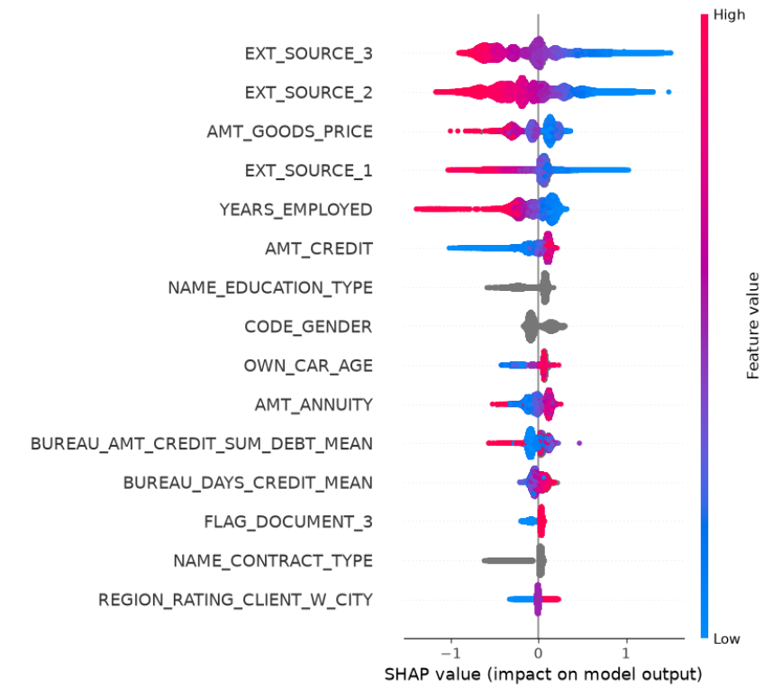
EXPLAINABILITY
SHAP (aggregate)
SHAP — TOP DRIVERS (15-feature model)
EXT_SOURCE_3, EXT_SOURCE_2, EXT_SOURCE_1: dominant, high value pushes prediction toward lower risk
AMT_GOODS_PRICE, AMT_CREDIT, AMT_ANNUITY: higher values associate with lower risk
Categorical variables (NAME_EDUCATION_TYPE, CODE_GENDER, NAME_CONTRACT_TYPE) show no color gradient: real effect, no "more/less" scale
Limitation: explains the model in aggregate, not any individual applicant's score
06

Slide 7
FROM MODEL TO SCORECARD
Why WoE/IV, and the underlying formulas
RATIONALE
IV THRESHOLDS (SIDDIQI)
XGBoost captures non-linearity natively (tree splits); WoE exists specifically to give a linear model that same capability
Logistic regression's additive structure (intercept + Σ coefficient × WoE) is exactly what a point table requires
Regulatory expectation in credit risk: an auditable, coefficient-level explanation for every decision
IV range | Strength
< 0.02 | No discrimination
0.02 – 0.10 | Weak
0.10 – 0.30 | Medium
0.30 – 0.50 | Strong
> 0.50 | Suspicious (possible leakage)
WoE = ln( %good / %bad )
IV = Σ (%good − %bad) × WoE
%good/%bad computed with additive (Laplace) smoothing, α = 0.5, to avoid ln(x/0) when a bin has zero bad cases.
07

Slide 8
VARIABLE UNIVERSE
Full IV scan, concept-level deduplication, instability correction
155 candidate variables scanned for IV. Concept-based deduplication (regex grouping of _AVG/_MODE/_MEDI variants and DAYS_X/YEARS_X pairs, keeping the highest-IV variable per group) reduced this to 121.
INSTABILITY CORRECTIONS APPLIED TO THE TOP-40 BUFFER (11 VARIABLES FLAGGED)
Group | Variables | Correction
1 — sparse Missing bin | EXT_SOURCE_2, AMT_GOODS_PRICE, DAYS_LAST_PHONE_CHANGE | Merged into nearest numeric bin by WoE
2 — single rare category | CODE_GENDER (XNA, 4 records) | Left as documented residual; insufficient volume for any merge criterion
3 — many small categories | OCCUPATION_TYPE, ORGANIZATION_TYPE, NAME_INCOME_TYPE, WALLSMATERIAL_MODE | Collapsed into 'Other_grouped', cascading merge into nearest large category if still unstable
4 — dominant Zero value | BUREAU_AMT_CREDIT_SUM_DEBT_SUM (29.2% zero), BUREAU_AMT_CREDIT_SUM_LIMIT_MEAN (79.9% zero) | Zero isolated as its own explicit bin
AMT_GOODS_PRICE required a dedicated resolution: naive 10-bin WoE was non-monotonic (not a small-sample artifact, all bins > 18,900 records). Finer binning (20 bins) raised IV from 0.0919 to 0.1025; iterative surgical merging (smallest WoE-difference pairs first) reduced to 12 bins at IV 0.1006, validated stable across 5 folds (WoE std 0.005–0.037 per bin). Later excluded from the final set on business-communication grounds, not statistical grounds, and replaced by ELEVATORS_AVG.
08

Slide 9
MULTICOLLINEARITY PRUNING
Correlation-based reduction: 30 → 22 variables
Sign-check on the initial 30-variable logistic regression flagged 8 of 30 coefficients with an unexpected sign (WoE convention: coefficient should be negative, since higher WoE = safer bin = lower log-odds of default). Systematic pairwise correlation scan (|r| ≥ 0.7) identified two redundant clusters:
Cluster | Variables (highest |r|) | Kept (highest IV)
Property attributes | TOTALAREA_MODE, LIVINGAREA_AVG, FLOORSMAX_AVG, ELEVATORS_AVG (r = 0.84–0.94) | FLOORSMAX_AVG
Bureau credit dates | BUREAU_DAYS_CREDIT_MEAN/MIN, _UPDATE_MEAN, _ENDDATE_MEAN, DAYS_ENDDATE_FACT_MEAN (r = 0.71–0.89) | BUREAU_DAYS_CREDIT_MEAN
Bureau amounts | BUREAU_AMT_CREDIT_SUM_DEBT_MEAN/SUM (r = 0.85); LIMIT_MEAN/SUM (r = 0.81) | The _MEAN variant of each pair
Rule: within each correlated pair, keep the higher-IV variable, drop the other. Result: 8 variables removed, 22 remain.
0.7417
0.7408
8 → 4
AUC before
AUC after
Sign inconsistencies
09

Slide 10
GROUPED STEPWISE DIAGNOSIS
Siddiqi's information-type grouping applied to the remaining 4 sign flips
4 variables still showed unexpected coefficient signs after correlation pruning. Siddiqi's grouped-regression method (Ch. 10, Exhibit 10.14) evaluates variables by information-type group before combining, deliberately entering the dominant group last:
GROUPS (IN ENTRY ORDER): personal/demographic (10) → current credit (2) → bureau history (7) → external score (3, entered last)
Cumulative step | AGE_YEARS | BUREAU_CREDIT_ACTIVE_CLOSED_COUNT
+ demographic | -0.4663 (correct) | —
+ current credit | -0.4323 (correct) | —
+ bureau history | -0.3068 (correct) | +0.4029 (unexpected)
+ external score | +0.1241 (flips) | +0.0247 (n.s., p = 0.63)
ABLATION CONFIRMS DOMINANCE
Model refit without any EXT_SOURCE variable: AGE_YEARS returns to -0.3202 (correct sign). AUC drops to 0.6845 (from 0.7408), quantifying how much predictive power the external score alone contributes.
AGE_YEARS's sign flip is explained by dominance from EXT_SOURCE. BUREAU_CREDIT_ACTIVE_CLOSED_COUNT is not, it is unexpected before EXT_SOURCE even enters, and becomes statistically non-significant (p = 0.63) in the full model. This diagnosis explains 1 of 4 remaining flips; the other 3 (including BUREAU_CREDIT_ACTIVE_CLOSED_COUNT) required a different approach, covered next.
10

Slide 11
FINAL PRUNING: BACKWARD ELIMINATION
From 22 to 17 variables, method named explicitly
Correlation and VIF ruled out multicollinearity as the cause of the remaining sign flips (BUREAU_DAYS_CREDIT_UPDATE_MAX, NAME_INCOME_TYPE_BINNED, BUREAU_CREDIT_ACTIVE_CLOSED_COUNT): all VIF values in the bureau cluster stayed below 2.2, well under the conventional concern threshold (5). With no isolable statistical cause, the remaining decision criterion was empirical: does removing the variable measurably reduce AUC?
Bureau-group variable | Max pairwise |r| | VIF
BUREAU_DAYS_CREDIT_ENDDATE_MEAN | 0.63 | 2.14
BUREAU_DAYS_CREDIT_UPDATE_MAX | 0.60 | 2.02
BUREAU_DAYS_CREDIT_MEAN | 0.63 | 1.96
BUREAU_CREDIT_ACTIVE_ACTIVE_COUNT | 0.59 | 1.82
BUREAU_AMT_CREDIT_SUM_DEBT_MEAN | 0.60 | 1.76
BUREAU_CREDIT_ACTIVE_CLOSED_COUNT | 0.53 | 1.50
BUREAU_AMT_CREDIT_SUM_LIMIT_MEAN | 0.36 | 1.20
BACKWARD ELIMINATION, STEP BY STEP
Step | n vars | AUC
Correlation pruning | 22 | 0.7408
− BUREAU_CREDIT_ACTIVE_CLOSED_COUNT (p = 0.63, formal significance test) | 21 | 0.7408
− AGE_YEARS, NAME_INCOME_TYPE_BINNED, BUREAU_DAYS_CREDIT_UPDATE_MAX (tested together) | 18 | 0.7406
− BUREAU_DAYS_CREDIT_ENDDATE_MEAN (coef ≈ 0.011) | 17 | 0.7406
Every step above is the same criterion applied twice, once formally (p-value, a statistical test of whether a coefficient could be zero given the other variables), once by direct ablation (remove and re-measure AUC). Total cost: 0.0011 AUC (0.7417 → 0.7406) to eliminate every sign inconsistency across 13 removed variables.
VIF rules out combined multicollinearity as the cause; it does not identify what the cause is. This is a valid, honest outcome, not a dead end: it tells us the remaining decision has to be made on predictive contribution, not on a diagnosed statistical defect.
11

Slide 12
FINAL MODEL
17-variable logistic regression, all coefficients sign-consistent
Variable | Coefficient
EXT_SOURCE_2 | -0.7628
EXT_SOURCE_3 | -0.7553
NAME_EDUCATION_TYPE_BINNED | -0.5863
EXT_SOURCE_1 | -0.5264
AMT_CREDIT | -0.5188
CODE_GENDER | -0.4689
YEARS_EMPLOYED | -0.3594
ORGANIZATION_TYPE_BINNED | -0.3495
Variable | Coefficient
FLOORSMAX_AVG | -0.3235
BUREAU_CREDIT_ACTIVE_ACTIVE_COUNT | -0.2549
BUREAU_AMT_CREDIT_SUM_LIMIT_MEAN | -0.2411
OCCUPATION_TYPE_BINNED | -0.2383
REGION_POPULATION_RELATIVE | -0.2029
DAYS_ID_PUBLISH | -0.1957
BUREAU_AMT_CREDIT_SUM_DEBT_MEAN | -0.1653
DAYS_LAST_PHONE_CHANGE | -0.1610
BUREAU_DAYS_CREDIT_MEAN | -0.0793
All 17 coefficients negative, consistent with WoE convention (higher WoE = safer bin = lower log-odds of default). No exceptions.
12

Slide 13
POINT SCALE CALIBRATION
Factor/Offset derivation and two calibration attempts
Score = Offset + Factor × ln(odds)
Attempt | Parameters | Result
1 | PDO=20, Score=600, Odds=50:1 (market convention) | Range too narrow (402–582); anchor point (50:1) far safer than the actual 11.4:1 base odds
2 | PDO=20, Score=500, Odds=11.4:1 (bad-rate-implied) | Mean did not land on 500 (439.6); class_weight='balanced' shifted the model's own intercept away from the true prior
Final | PDO=40, Score=500, Offset anchored on the model's own empirical mean log-odds on training data | Mean 500.16, std 52.72, range 312–669 (validation)
Factor = PDO / ln(2)
Offset = Score_ref − Factor × ln(Odds_ref)
Key lesson: class_weight='balanced' recalibrates the model's intercept to treat classes as equally weighted, so the population's average predicted log-odds no longer matches the true 8.07% bad rate directly. The offset must anchor on the model's own empirical average, not a theoretical bad-rate-implied value.
Point contribution per bin: base_points_per_characteristic + (−Factor × coefficient × WoE), with the constant term (Offset − Factor × intercept) distributed evenly across the 17 characteristics. Validated additively: summed points reproduce the model's direct score within rounding.
13

Slide 14
VALIDATION
AUC, KS, Gini, and leakage controls
AUC
KS
Gini
0.7406
0.3621
0.4812
Gini = 2 × AUC − 1 (0.4812, confirmed). KS in the "reasonable to good" range by common thresholds (30–40).
LEAKAGE CONTROLS
WoE tables and bin edges frozen strictly on the training split; validation data is only ever looked up, never used to recompute bins or categories
Numeric bins matched by position (pd.cut with fixed edges, labels=False), not by Interval-object identity, avoiding a floating-point mismatch bug found and fixed during development
Categorical rare-category collapsing frozen as an explicit raw-category-to-bucket dictionary; unseen categories at scoring time fall back to 'Other_grouped' or 'Missing', never a new bucket
14

Slide 15
BUSINESS GAIN: SCORECARD VS. XGBOOST
Absolute and relative default-rate reduction
Rejected | XGBoost (pp) | Scorecard (pp) | Scorecard (relative %)
5% | 1.33 | 1.19 | 14.7%
10% | 2.10 | 1.95 | 24.2%
15% | 2.73 | 2.45 | 30.4%
20% | 3.24 | 2.93 | 36.3%
25% | 3.68 | 3.38 | 41.9%
30% | 4.04 | 3.76 | 46.6%
~90–93%
of the XGBoost baseline's business gain is retained by the 17-variable scorecard, at every rejection threshold tested
15

