Slide 1


Slide 2
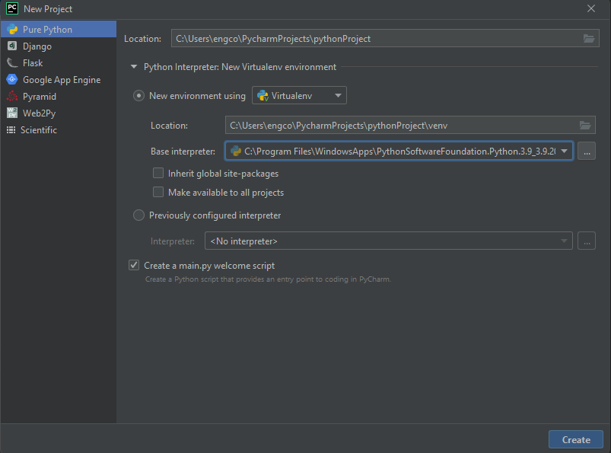
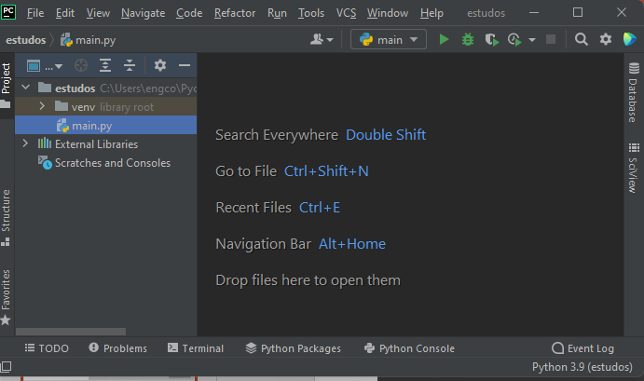
Cuidados com o ENV

Slide 3
Links
https://pypi.org/project/pip/
https://docs.djangoproject.com/en/3.2/
https://getbootstrap.com/docs/5.0/getting-started/introduction/
https://id.heroku.com/login
https://cdnjs.com/libraries/font-awesome
https://whitenoise.evans.io/en/stable/django.html
https://devcenter.heroku.com/articles/django-assets
https://designer.gravit.io
https://django-bootstrap4.readthedocs.io/en/latest/quickstart.html#settings

Slide 4
Start
Pip install Django ou
pip install django whitenoise gunicorn django-bootstrap-v5 pyrebase
Django-admin startproject projeto .
Python manage.py startapp home

Slide 5
Settings.py
import os
DEBUG = False
ALLOWED_HOSTS = ['*']

Slide 6
Settings.py
INSTALLED_APPS = [
…
'home',
'bootstrap5’,
]

Slide 7
Settings.py
MIDDLEWARE = [
'django.middleware.security.SecurityMiddleware',
'whitenoise.middleware.WhiteNoiseMiddleware’,
…

Slide 8
Settings.py
TEMPLATES = [
{
'BACKEND': 'django.template.backends.django.DjangoTemplates',
'DIRS': ['templates’],
…

Slide 9
Settings.py - POSTGRESS
DATABASES = {
'default': {
'ENGINE': 'django.db.backends.postgresql_psycopg2',
'NAME': 'solution',
'USER':'postgres',
'PASSWORD':'master',
'HOST': 'localhost',
'PORT': '5432',
}
}
https://pypi.org/project/psycopg2/
pip install psycopg2-binary
import psycopg2

Slide 10
Settings.py – MYSQL – SQLITE3
DATABASES = {
'default': {
'ENGINE': 'django.db.backends.mysql',
'NAME': ‘BANCO',
'USER': 'root',
'PASSWORD': '',
'PORT': '3306',
'HOST': 'localhost',
}
}
DATABASES = {
'default': {
'ENGINE': 'django.db.backends.sqlite3',
'NAME': BASE_DIR / 'db.sqlite3',
}
}

Slide 11
Settings.py
LANGUAGE_CODE = 'pt-br'
TIME_ZONE = 'America/Sao_Paulo’
…

Slide 12
urls.py – do projeto
from home import views
from django.conf import settings
from django.conf.urls.static import static
urlpatterns = [
path('',views.index),
path(‘outro_app/',views.index),
path('admin/', admin.site.urls),
]+static(settings.MEDIA_URL,document_root=settings.MEDIA_ROOT)

Slide 13
Settings.py
STATIC_URL = "/static/"
STATIC_ROOT = os.path.join(BASE_DIR,'staticfiles')
MEDIA_ROOT = os.path.join(BASE_DIR,'media')
MEDIA_URL = 'media/’
…
STATICFILES_STORAGE = 'whitenoise.storage.CompressedManifestStaticFilesStorage'

Slide 14
Settings.py
from django.contrib.messages import constants as minhas_msg
MESSAGE_TAGS = {
minhas_msg.INFO:'alert-info',
minhas_msg.ERROR:'alert-danger',
minhas_msg.WARNING:'alert-warning',
minhas_msg.SUCCESS:'alert-success',
}

Slide 15
View - home
from django.shortcuts import render
def index(request):
return render(request, 'home/index.html')

Slide 16
index - home
{% load static %}
{% load bootstrap5 %}
<!doctype html>
<html lang="pt">
<head>
<meta charset="UTF-8">
<meta name="viewport"
content="width=device-width, user-scalable=no, initial-scale=1.0, maximum-scale=1.0, minimum-scale=1.0">
<meta http-equiv="X-UA-Compatible" content="ie=edge">
<title>Home</title>
{% bootstrap_css %}
{% bootstrap_javascript %}
</head>
…

Slide 17
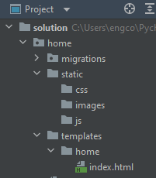
Project / Pasta / Files

Slide 18
Model
class Produto(models.Model):
produto = models.CharField(max_length=20, default=None)
preco = models.DecimalField(decimal_places=2, max_digits=10,default=None)
foto = models.ImageField(blank=True, upload_to='foto_produto/%y/%m/%d/')
def __str__(self):
return self.produto
class detContato(admin.ModelAdmin):
list_display = ('id', 'nome', 'telefone', 'email')
admin.site.register(Contato, detContato)

Slide 19
DJANGO ADMIN / MIGRATIONS
python .\manage.py makemigrations
python .\manage.py migrate
python .\manage.py createsuperuser
python .\manage.py runserver

Slide 20
admin
class detContato(admin.ModelAdmin):
list_display = ('id', 'nome', 'telefone', 'email')
admin.site.register(Contato, detContato)

Slide 21
View na mão
from django.shortcuts import render, redirect
from django.contrib import messages, auth
from django.core.validators import validate_email
from django.contrib.auth.models import User
from django.contrib.auth.decorators import login_required
from .models import Perfil, Aluno
import pyrebase

Slide 22
View – obter dados
def cadastrar(request):
if request.method != 'POST':
return render(request, 'aluno/cadastrar.html’)
…
email = request.POST.get('email’)
…
Print(dir(request))

Slide 23
View validações
if len(senha1) < 6:
messages.add_message(request, messages.WARNING, 'Senha deve ter no mínimo 6 caracter')
return render(request, 'aluno/cadastrar.html')
if User.objects.filter(username=usuario).exists():
messages.add_message(request, messages.WARNING, 'Usuário já existe')
return render(request, 'aluno/cadastrar.html')

Slide 24
View create/save object
user = User.objects.create_user(
username=usuario,
email=email,
first_name=nome,
last_name=sobrenome,
password=senha1
)
messages.add_message(request, messages.SUCCESS, 'Cadastrado com sucesso')
user.save()
return redirect('login')

Slide 25
View login
from django.contrib import auth
usuario = request.POST.get('usuario')
senha1 = request.POST.get('senha1')
user = auth.authenticate(request, username=usuario, password=senha1)
if not user:
messages.add_message(messages.ERROR, 'Usuário ou senh inválido')
return render(request, 'aluno/login.html')
else:
auth.login(request, user)
return redirect('dashboard')
def logout(request): auth.logout(request) return redirect('home’)

Slide 26
View decorations/dados
@login_required(redirect_field_name='login')
def dashboard(request):
…
print(dir(request.user))
print(request.user.id)
print(request.user.email)
print(request.user.is_authenticated)
print(request.user.is_superuser)
print(request.user.last_login)
print(request.user.is_active)
print(request.user.password)

Slide 27
form
from django import forms
class Aluno(models.Model):
endereco = models.CharField(max_length=50)
telefone = models.CharField(max_length=15)
fotos = models.ImageField(blank=True,upload_to='foto_aluno/%y/%m/%d/')
telefone = models.ForeignKey(Telefone,on_delete=models.CASCADE)
id_user = models.ForeignKey( User,on_delete=models.DO_NOTHING,default="")
class Perfil(forms.ModelForm):
class Meta:
model = Aluno
exclude = ()

Slide 28
form
from .models import Aluno
def inserePerfil(request):
if request.method != 'POST':
form_perfil = Perfil()
return render(request, 'aluno/dashboard.html', {'form_perfil': form_perfil})
dados = Perfil(request.POST,request.FILES)
if not dados.is_valid():
form_perfil = Perfil(request.POST)
return render(request, 'aluno/dashboard.html', {'form_perfil': form_perfil})
else:
dados.save()
return render(request, 'aluno/dashboard.html')

Slide 29
firebase
https://github.com/thisbejim/Pyrebase
Pip install pyrebase
data = {"name": "Mortimer 'Morty' Smith"}
db.child("users").push(data)
import pyrebase
config = {
'apiKey’: “sua_api_key",
'authDomain': "teste-a226f.firebaseapp.com",
'databaseURL': "https://teste-a226f-default-rtdb.firebaseio.com",
'projectId': "teste-a226f",
'storageBucket': "teste-a226f.appspot.com",
'messagingSenderId': "118337505200",
'appId': "1:118337505200:web:db542142a02202d474f875",
'measurementId': "G-L5PVR05VG2"
}
firebase = pyrebase.initialize_app(config)
def conectar_firebase():
db = firebase.database()
return db
data = {"name": "Mortimer 'Morty' Smith"}
db.child("users").child("Morty").set(data)
db.child("users").child("Morty").update(
{"name": "Mortiest Morty"}
)
db.child("users").child("Morty").remove()

Slide 30
firebase
https://github.com/thisbejim/Pyrebase
users = db.child("users").get()
print(users.val())
{"Morty": {"name": "Mortimer 'Morty' Smith"}, "Rick": {"name": "Rick Sanchez"}}
all_users = db.child("users").get()
for user in all_users.each():
print(user.key())
print(user.val())
all_users = db.child("users").get()

Slide 31
firebase
https://github.com/thisbejim/Pyrebase
users_by_name = db.child("users").order_by_child("name").limit_to_first(3).get()
users_by_name = db.child("users").order_by_child("name").get()
users_by_score = db.child("users").order_by_child("score").equal_to(10).get()
users_by_score = db.child("users").order_by_child("score").start_at(3).end_at(10).get()
users_by_key = db.child("users").order_by_key().get()

Slide 32
firebase
https://github.com/thisbejim/Pyrebase
users_by_name = db.child("users").order_by_child("name").limit_to_first(3).get()
users_by_name = db.child("users").order_by_child("name").get()
users_by_score = db.child("users").order_by_child("score").equal_to(10).get()
users_by_score = db.child("users").order_by_child("score").start_at(3).end_at(10).get()
users_by_key = db.child("users").order_by_key().get()

Slide 33
actions
@admin.action(description='Mark selected stories as published')
def make_published(modeladmin, request, queryset):
queryset.update(status='p')
class ArticleAdmin(admin.ModelAdmin):
list_display = ['title', 'status']
ordering = ['title']
actions = [make_published]
admin.site.register(Article, ArticleAdmin)
mudar o nome Django admin no ambiente
admin.site.site_header = "Penachin"
admin.site.site_title = "Administração"
admin.site.index_title = "Painel admisnitrativo"
estilo ADM
https://django-grappelli.readthedocs.io/en/latest/quickstart.html
admin.site.register(Article, ArticleAdmin)

Slide 34
Exibindo Media/Static
pip install djstatic
in to
wsgi.py
from dj_static import Cling, MediaCling
application = Cling(MediaCling(get_wsgi_application()))

