Slide 1
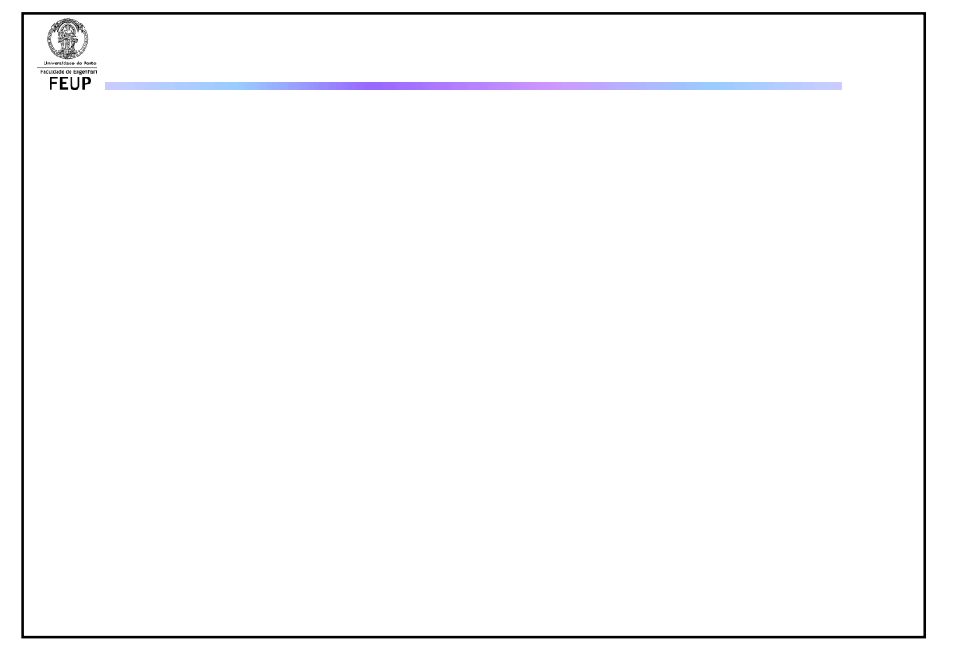
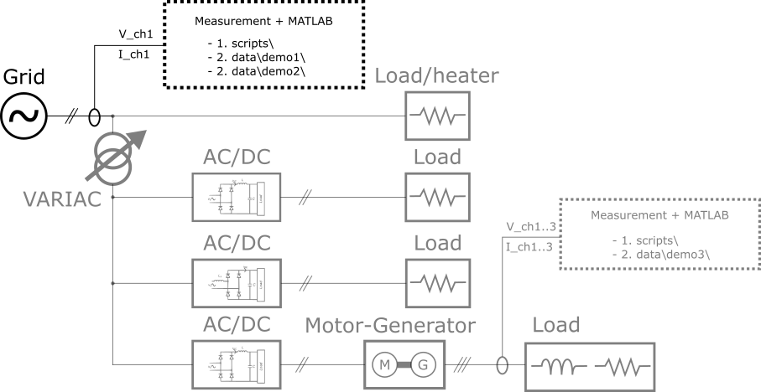
Demo 1
Repository: github.com/vitormorais/SummerSchool_PowerQuality

Slide 2
Demo 1: Objectives
Acquire measurement: grid voltage
Load measurement to MatLab
Perform Power Quality Analysis
Assessment of EN 50160 compliance
Repository: github.com/vitormorais/SummerSchool_PowerQuality

Slide 3
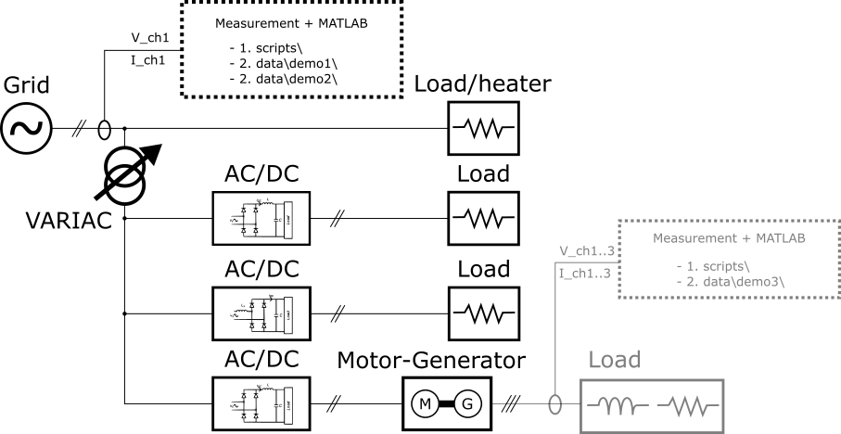
Demo 2
Repository: github.com/vitormorais/SummerSchool_PowerQuality

Slide 4
Demo 2: Objectives
Acquire measurement: grid current
Load measurement to MatLab
Perform Spectrum Analysis
Repository: github.com/vitormorais/SummerSchool_PowerQuality

Slide 5
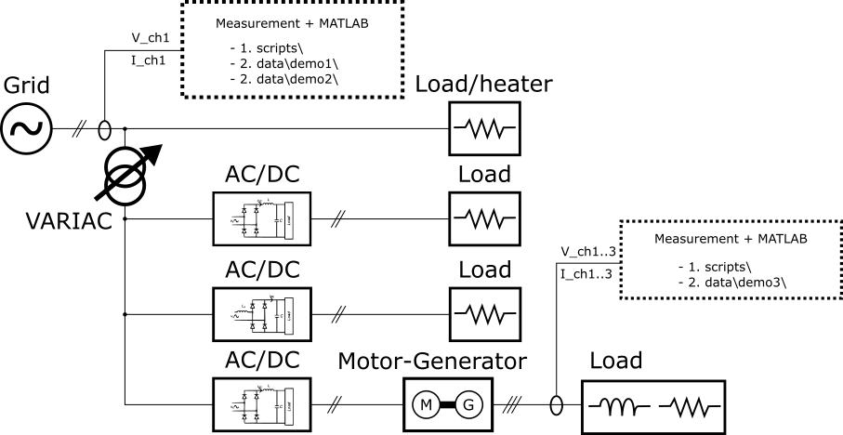
Demo 3
Repository: github.com/vitormorais/SummerSchool_PowerQuality

Slide 6
Demo 3: Objectives
Acquire measurement: 3p voltage + current
Load measurement to MatLab
Perform Spectrum Analysis
Repository: github.com/vitormorais/SummerSchool_PowerQuality

