Slide 1

SAO TOME AND PRINCIPE
Creating maps in MS PowerPoint
United Nations
Office for the Coordination of Humanitarian Affairs (OCHA)
Regional Office of West and Central Africa (ROWCA)
The aim of this PowerPoint pack to provide you with some simple maps so that you can add your own data and information to them and use in presentations or reports. The maps are saved to the background so that your write or draw over them without touching the map itself. The PowerPoint pack provides all the tools that you would need to produce including symbols, callout boxes, legends and labels. All you need to do is copy and paste.
April 2021

Slide 2
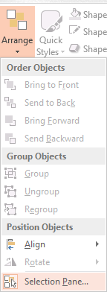
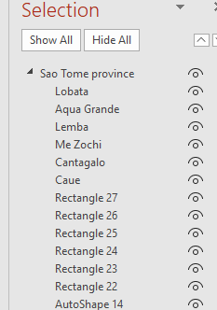
How to select District and Chiefdoms using Selection Panel
Under Home menu tab
select “Arrange” → Selection Panel
From the Section Panel select the object(s) on the map and then do the necessary changes
Click on arrow to expand the group to see objects
Click on this icon to Hide and unhide objects

Slide 3
SAO TOME AND PRINCIPE
Provinces
As of DD Month YYYY
PRINCIPE
SAO TOME
Les frontières indiquées et les désignations utilisées sur cette carte n'impliquent pas l'approbation des Nations Unies.
Date de création : DD Mmm YYYY Sources: OCHA, ANSD. Feedback: xxxx@un.org www.unocha.org www.reliefweb.int

Slide 4
SAO TOME AND PRINCIPE
Districts
As of DD Month YYYY
PAGUE
LOBATA
AGUA GRANDE
ME ZOCHI
LEMBA
CANTAGALO
CAUE
Les frontières indiquées et les désignations utilisées sur cette carte n'impliquent pas l'approbation des Nations Unies.
Date de création : DD Mmm YYYY Sources: OCHA, ANSD. Feedback: xxxx@un.org www.unocha.org www.reliefweb.int

Slide 5
SAO TOME AND PRINCIPE
Sao Tome province
As of DD Month YYYY
LOBATA
AGUA GRANDE
ME ZOCHI
LEMBA
CANTAGALO
CAUE
Les frontières indiquées et les désignations utilisées sur cette carte n'impliquent pas l'approbation des Nations Unies.
Date de création : DD Mmm YYYY Sources: OCHA, ANSD. Feedback: xxxx@un.org www.unocha.org www.reliefweb.int

Slide 6
SAO TOME AND PRINCIPE
Principe province
As of DD Month YYYY
PAGUE
Les frontières indiquées et les désignations utilisées sur cette carte n'impliquent pas l'approbation des Nations Unies.
Date de création : DD Mmm YYYY Sources: OCHA, ANSD. Feedback: xxxx@un.org www.unocha.org www.reliefweb.int

Slide 7




















Humanitarian icons v.02
Updated – November 2019
CLUSTERS
CAMP COORDINATION AND CAMP MANAGEMENT
EARLY
RECOVERY
EDUCATION
EMERGENCY
TELECOMMUNICATIONS
FOOD
SECURITY
HEALTH
LOGISTICS
NUTRITION
PROTECTION
SHELTER
WATER, SANITATION
AND HYGIENE
OTHER SECTORS
AGRICULTURE
CHILD PROTECTION
CHILD CARE/
CHILD FRIENDLY
COORDINATION
ENVIRONMENT
FISHERY
MULTI-CLUSTER/
MULTI-SECTOR
RULE OF LAW
AND JUSTICE
SAFETY
AND SECURITY
Copy and paste these icons directly to your powerpoint or word document
Customizable color
More icons can be downloaded here

Slide 8
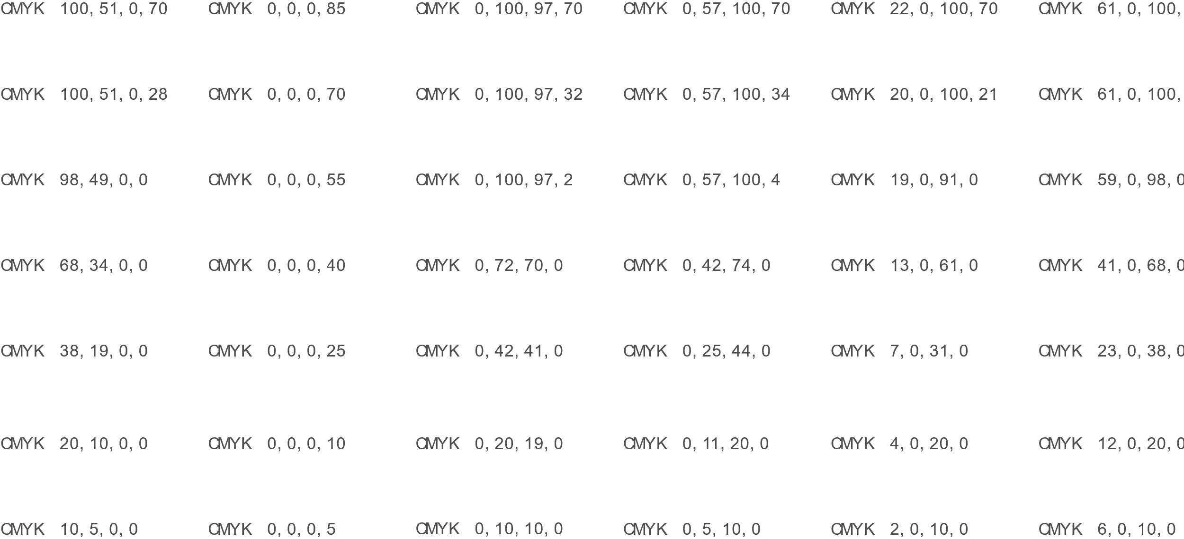
Color palette
Copy and paste these color boxes directly to your powerpoint or word document
Use the Eyedropper to assign color of your choice

Slide 9
[Country]
[Country]

