Slide 1
JoBfinderIOSS
Students:
Hana Hasanicaj 191511
Murat Useini 191546
Lorik Klenja 191530

Slide 2

Introduction
Finding jobs that best suit the interests and skill set is quite a challenging task for the job seekers. The difficulties arise from not having proper knowledge of the organization’s objective, work culture and current job openings. In addition, finding the right candidate with the desired qualifications to fill their current job openings is an important task for the recruiters of any organization.

Slide 3
For improving the recruitment process JobFinderIOSS improves job seeker/providing experience and application is going to provide an opportunity for candidates to search out specified jobs.

Slide 4
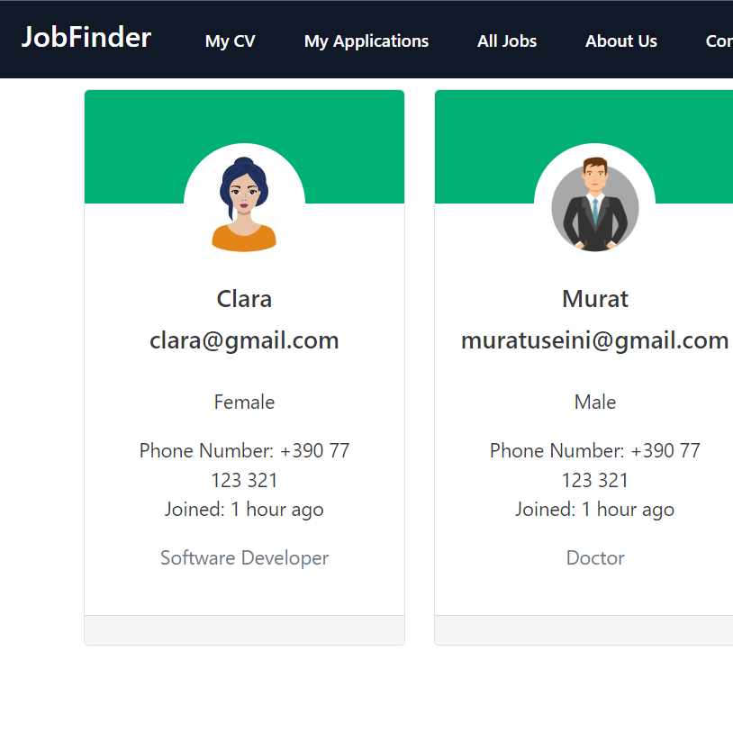
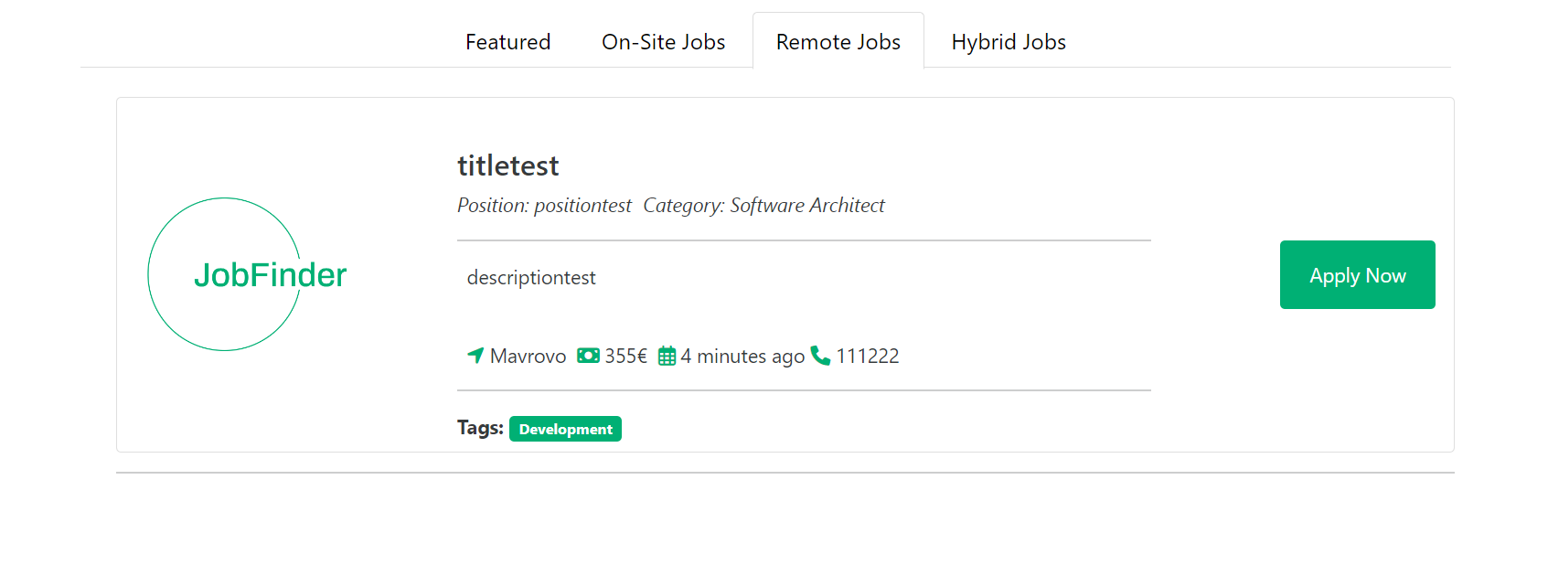
JobFinderIOSS – Application Structure
Application is divided in two parts
Personal Accounts – Users from this category can apply to jobs, see list of all jobs and do searching based on job type (remote, hybrid, on site) and can see all jobs which user has applied
Recruiters – Users from this category can create job posts and look for talents

Slide 5
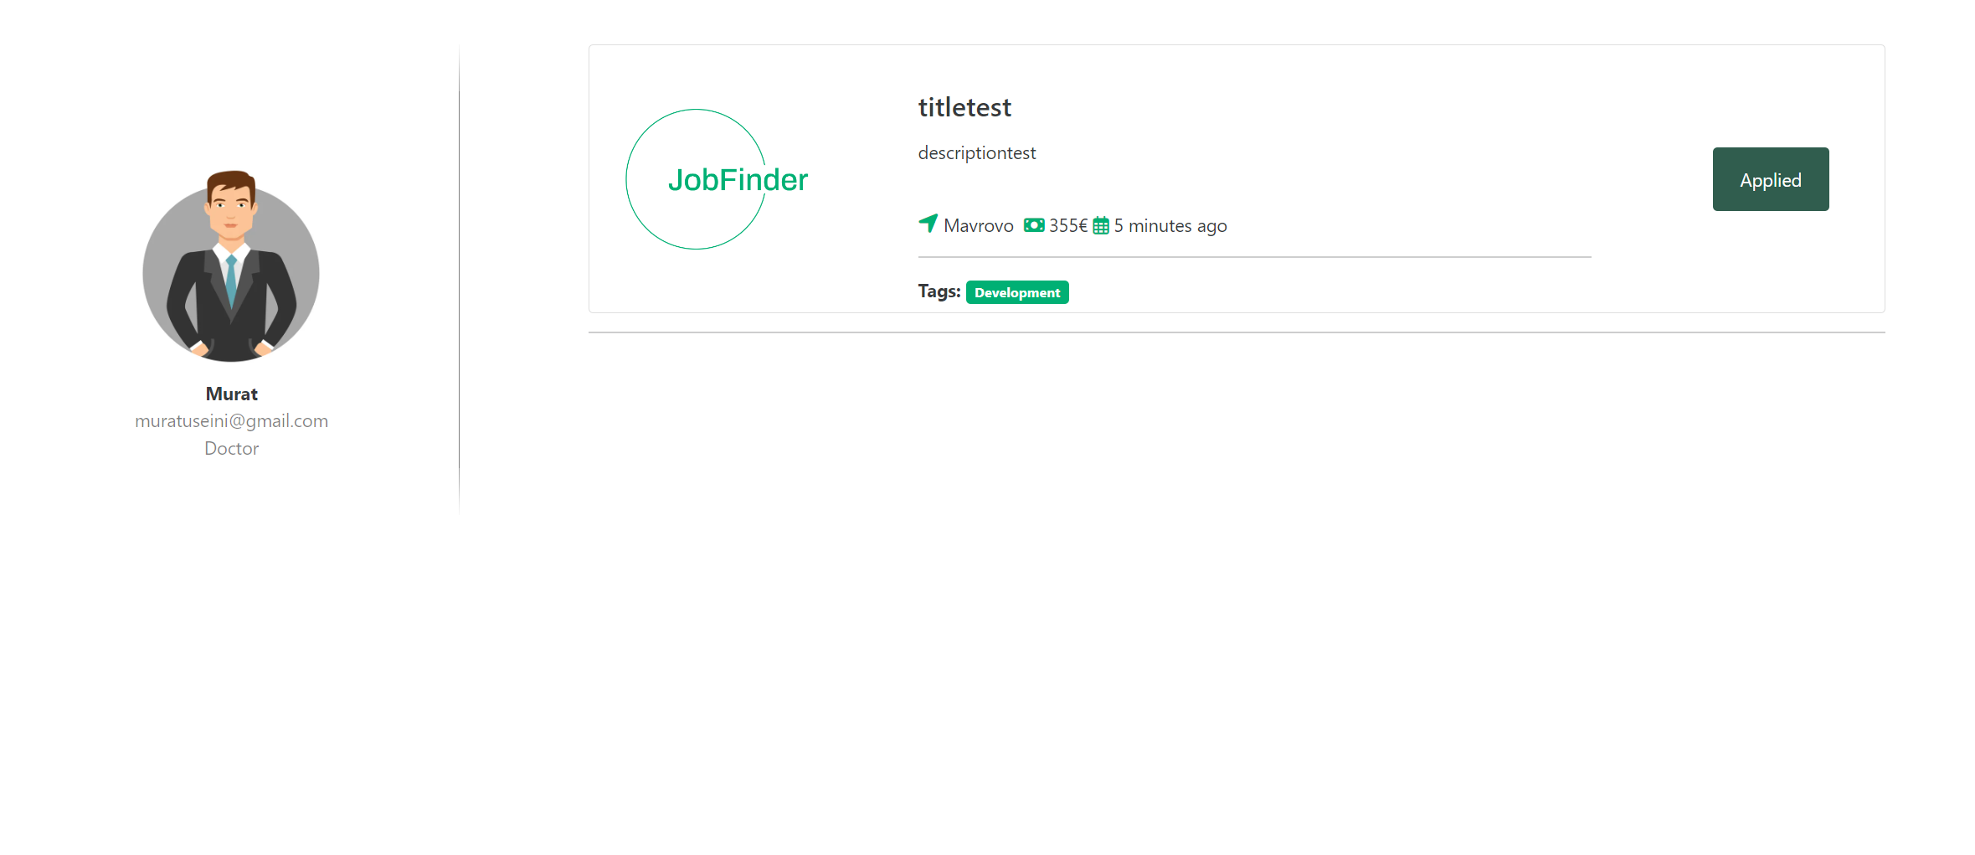
JobFinderIOSS – Application Structure
Personal Accounts
Users from this category also can see all jobs which he/she has applied

Slide 6
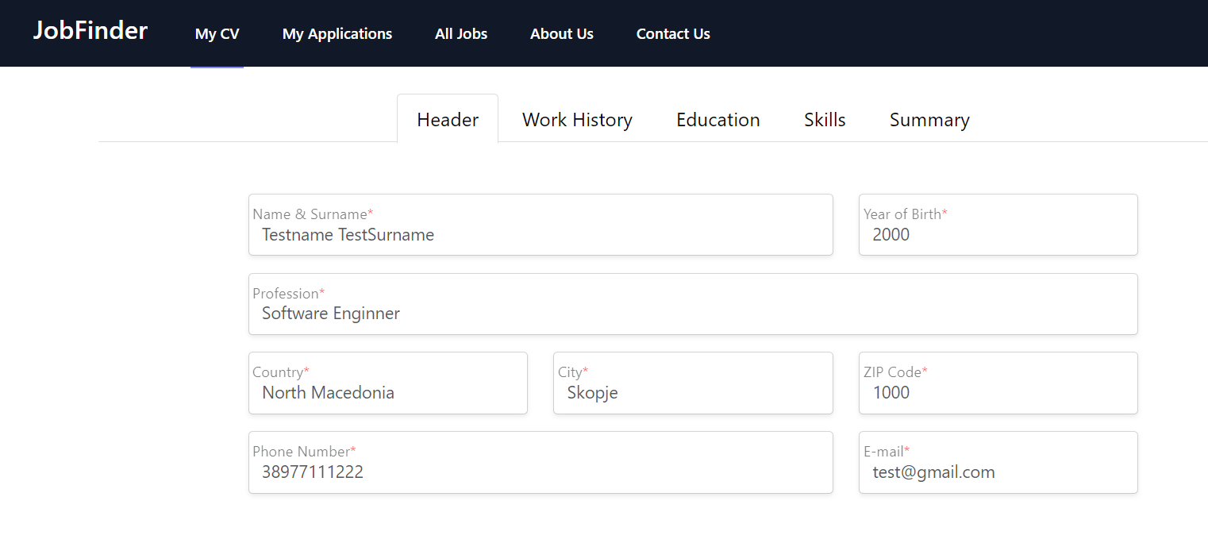
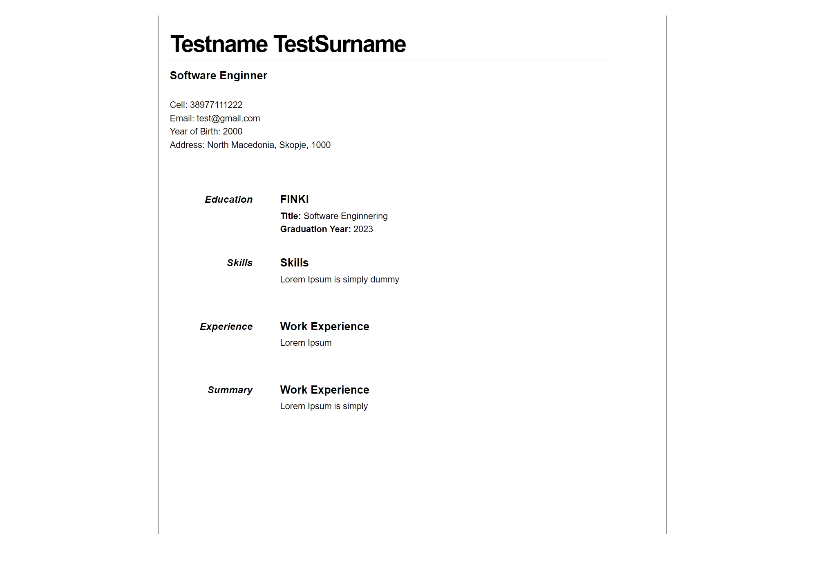
Creating CV’s
The goal of a CV is to present a clear and concise overview of the candidate's credentials and make them stand out as a strong candidate for the job. JobFinderIOSS makes sure that each candidate has its own cv

Slide 7
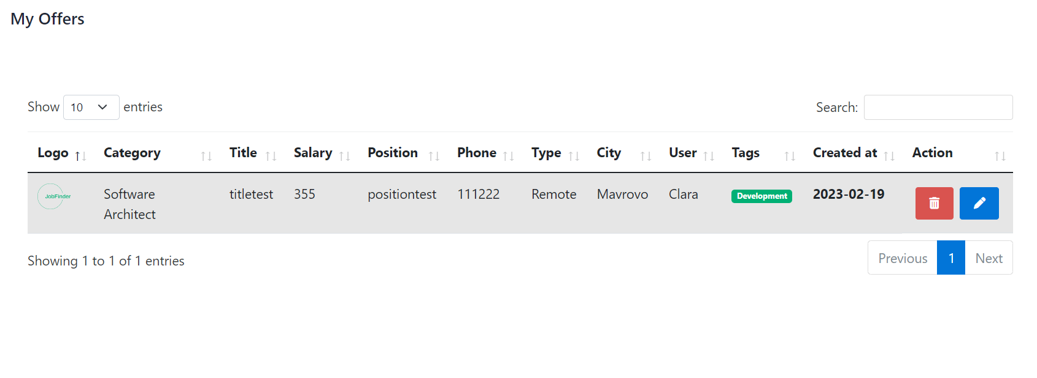
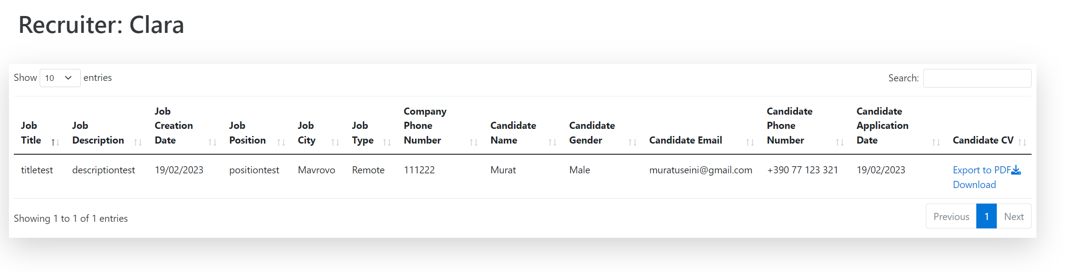
JobFinderIOSS – Application Structure
Recruiters
Users from this category can see all job posts which he/she has created, potential candidates and get more information from user’s just by downloading user’s CV (Curriculum Vitae)

Slide 8



Conclusion
A job portal is an essential tool for job seekers and employers to connect with each other. It provides various features such as job search, resume posting, job alerts, and employer profiles that make the job search process easy and efficient. A well-designed and implemented job portal can transform the job market and revolutionize the recruitment process.

Slide 9
THANK YOU

