Slide 1
ZIKEY 字鑰
Which character should
I learn next and why?
青
A connected map, visible evidence,
and a learning order you can steer.
清 晴
請 情
Functional local prototype
Lin Wei-De · W16157093
Information Visualization · NCKU
ZIKEY 字鑰 / Progress Review / 5 November 2026
01
Notes:
[0:00–1:00 | 60 sec] I am Lin Wei-De, W16157093. ZIKEY helps Mandarin self-learners decide what character to learn next. A vocabulary list gives an order, but does not explain the value of a character for what I already know. My prototype connects characters through documented components, reveals words that become readable, and lets the learner change the recommendation goal. Today I will show a working local pipeline, explain its visual encodings and demonstrate one task. This is implementation progress, not evidence that learning outcomes improve.

Slide 2
Data, AI, visualization and learner feedback
DATA
AI
VISUALIZATION
HUMAN
Preserved snapshots
Score + local explanation
Three linked views
Select, steer, mark known
TOCFL + MMH + CC-CEDICT
NetworkX + Ollama
Streamlit + D3 + Plotly
One shared learner state
One traceable transformation
TOCFL: 請問 / qĭngwèn / Novice 1 / source row
→ qǐngwèn · {請, 問} · “Excuse me, may I ask...?” · source retained
ZIKEY 字鑰 / Progress Review / 5 November 2026
02
Notes:
[1:00–2:00 | 60 sec] Data: SC-TOP TOCFL workbook 20240923; Make Me a Hanzi dictionary snapshot and CC-CEDICT snapshot downloaded November 4, 2026. Exact URLs, SHA-256 hashes and terms are in data/processed/sources.json. No simplified-to-traditional conversion was used for joins. The raw workbook preserves words, pinyin, POS and source rows. Make Me a Hanzi contributes the IDS decomposition and available sound and meaning annotations. CC-CEDICT contributes English senses. Preparation expands exact slash alternatives, excludes annotated or non-CJK forms, and preserves raw snapshots. Tone-sensitive matching selects a unique dictionary sense where possible; ambiguous matches remain labelled. Deterministic scoring computes the ranking. The local model selects supported evidence sentences. D3 and Plotly show the result. The learner selects a goal or marks a character known, which recomputes scores and coverage. This closes the loop without a cloud API.

Slide 3
Real data, with visible quality limits
290 learning characters · 450 words · 556 IDS leaf edges
Source | Fields used | Version / terms
TOCFL | Traditional words, reading, level, POS | 2024-09-23 workbook
Make Me a Hanzi | Radical, IDS, available origin hints | SHA-256 snapshot / LGPL
CC-CEDICT | English senses and readings | 2026-11-04 / CC BY-SA 4.0
6 missing glosses / 84 senses need review / 30 missing origin records
Vocabulary bands are derived from pilot words. Missing data stays labelled.
Sources: SC-TOP (2024), skishore (n.d.), CC-CEDICT contributors (2026)
ZIKEY 字鑰 / Progress Review / 5 November 2026
03
Notes:
[2:00–3:00 | 60 sec] Data: SC-TOP TOCFL workbook 20240923; Make Me a Hanzi dictionary snapshot and CC-CEDICT snapshot downloaded November 4, 2026. Exact URLs, SHA-256 hashes and terms are in data/processed/sources.json. No simplified-to-traditional conversion was used for joins. We parsed 7,292 distinct accepted Chinese forms upstream, then built a reproducible pilot of 450 words fitting 290 learning characters, including required qing demo words. The graph has 556 flattened IDS leaf edges and 506 total nodes when structural components are included. Typed visual relationships are stored separately and do not inflate scoring degree. The minimum level of a containing pilot word determines the displayed vocabulary band; it is not an official character level. Six word glosses are missing, 84 sense matches need review, and 30 character etymology records are missing. These remain visible rather than being filled by an LLM. TOCFL public download does not establish open redistribution permission; the raw bundle remains local coursework.

Slide 4
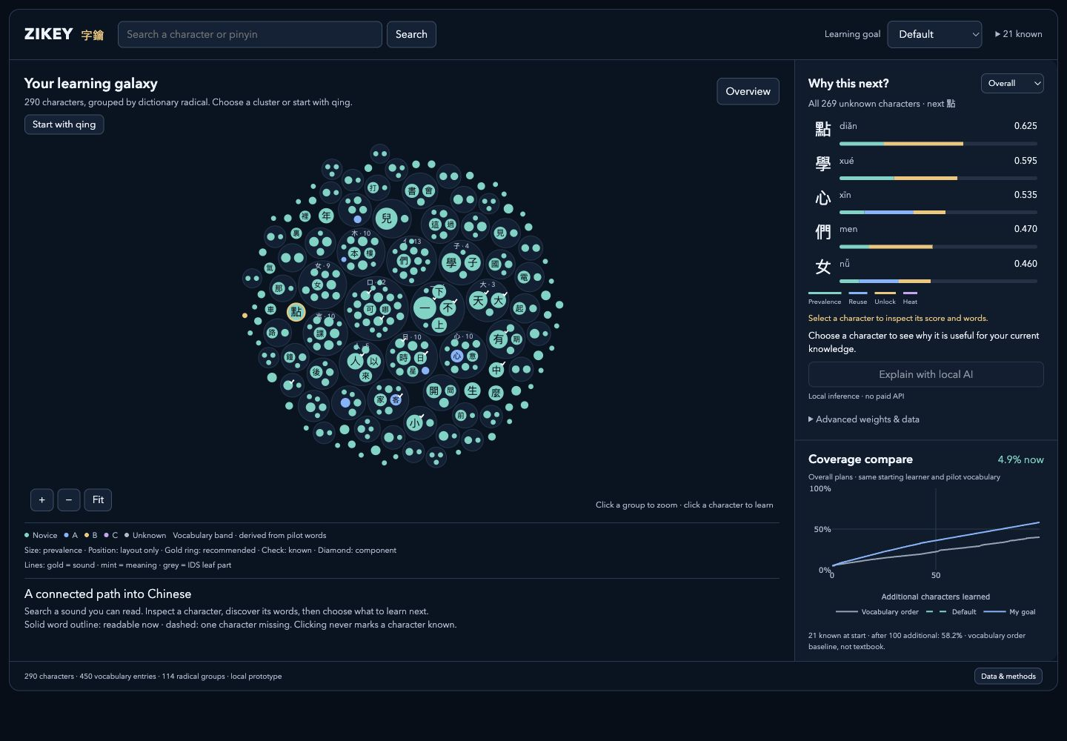
Explore the overview, then focus on learning
Colour
Derived vocabulary band
Size
Pilot vocabulary prevalence
Ring / check
Recommended / known
Position
Packing layout only
ZIKEY 字鑰 / Progress Review / 5 November 2026
04
Notes:
[3:00–4:00 | 60 sec] This screenshot is the running application, not an AI-generated UI. Each circle is one real learning character. Clusters group dictionary radicals; their proximity is only packing layout, not a linguistic similarity metric. Node size shows vocabulary prevalence in this pilot, not corpus frequency. Node colour shows a derived vocabulary band, with Unknown supported. A gold ring highlights the top recommendation in the current scope; a check denotes known. The overview reduces detail until zoomed. Searching qing enters a documented sound family, while selecting a radical enters a radical group. Returning to overview restores the previous camera. In focus, component-only nodes use diamonds and typed lines distinguish sound, meaning and IDS leaf relationships.

Slide 5
Recommendations expose their evidence
Default: prevalence 35% · reuse 25% · unlock 40% · heat 0%
One missing character
請問
Learning 請 unlocks this
word only if 問 is known.
Local AI selects supported explanations. The visible formula determines the ranking.
ZIKEY 字鑰 / Progress Review / 5 November 2026
05
Notes:
[4:00–5:15 | 75 sec] Native chart data is computed from core.py for the sample learner with 21 known characters and Default weights, filtered to the 青 family. Prevalence counts pilot entries containing a character. Reuse counts other learning characters using it as a named leaf in flattened IDS. Unlock counts entries whose remaining unknown character set contains only that character. Heat is zero unless explicitly enabled; simulated heat is separately labelled. Each signal is divided by the maximum among all currently unknown characters and multiplied by normalized weights. Scope filters the global scores, so family bars remain comparable. Default weights are 35,25,40,0; Read more is 25,15,60,0; See structure is 15,65,20,0. The model does not train or set these weights: Ollama selects up to two evidence sentences from a supplied set. Invalid output falls back to a labelled template. The distinct contribution is inspectable learner-relative scoring and interactive steering; similar graph tools also offer learned marks and word unlocks, so I do not claim those alone are novel.

Slide 6
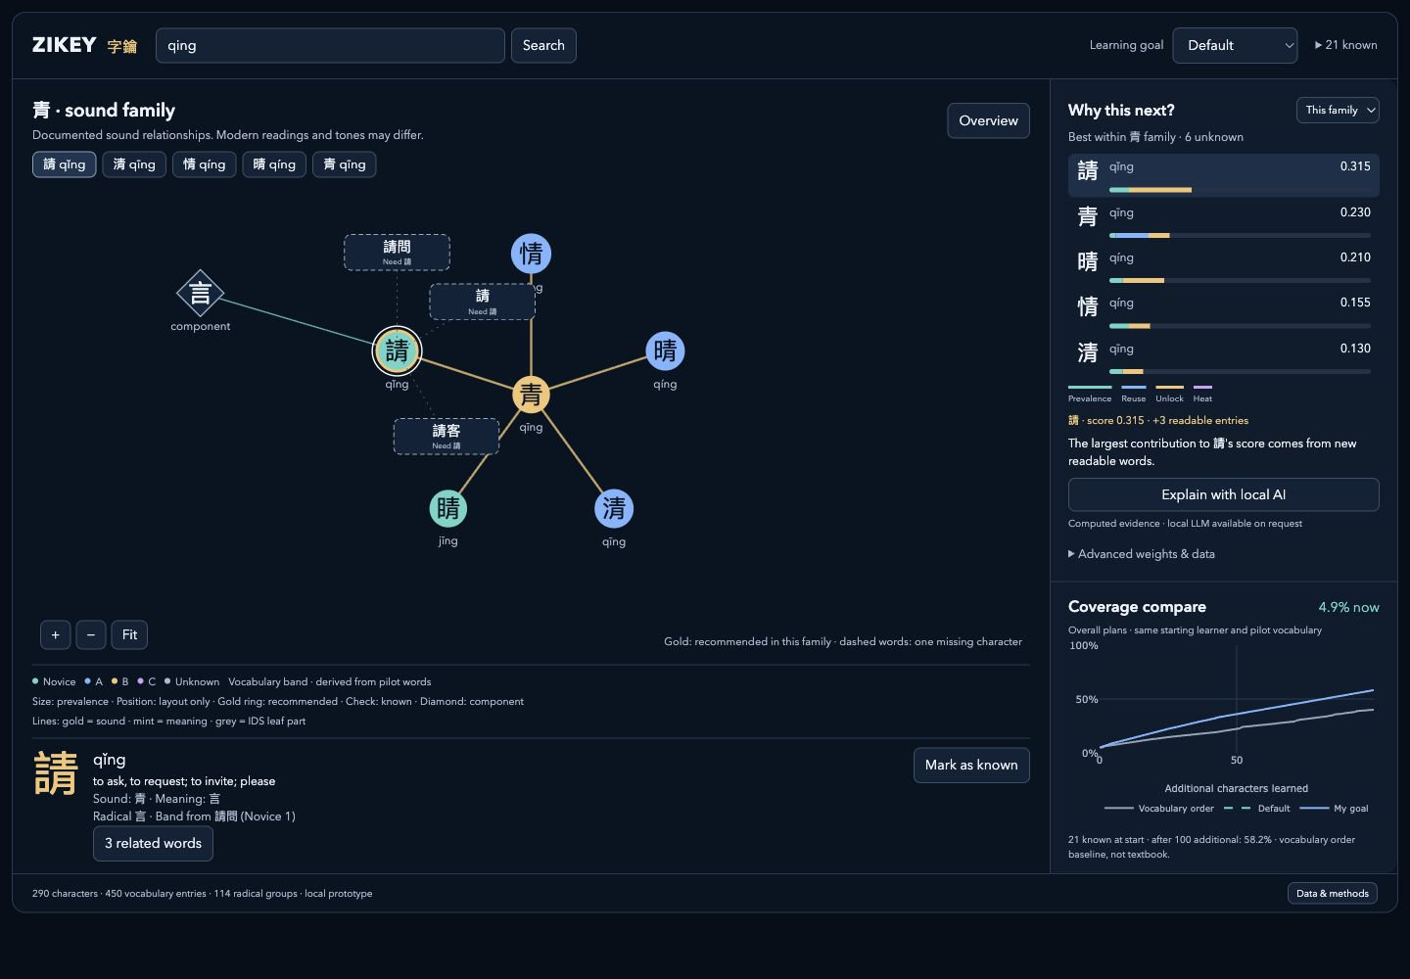
Live task: choose and learn the next character
1
Search qing → select 請
2
Inspect parts + 請問
3
Explain; change the goal
4
Mark known; see updates
ZIKEY 字鑰 / Progress Review / 5 November 2026
06
Notes:
[5:15–8:00 | 165 sec LIVE DEMO] Open http://127.0.0.1:8501. Start from a fresh session with the labelled 21-character sample learner. 1. Show the overview, then search qing. Say that qing search ignores tones, but readings remain different, and 睛 belongs to the documented family with jīng reading. 2. Click 請 in the graph. Point out sound 青, meaning 言, word pills and the shared selection in the recommendation view. Open 請問: 問 is already known and 請 is missing. 3. Close details, request local AI. Explain the supported-evidence mode and template fallback; a cached result is acceptable but disclose it. 4. Change goal to See structure: 青 becomes first within this family while 請 stays selected. Coverage remains an Overall comparison. 5. Restore Default. Mark 請 known: known count becomes22, coverage4.9→5.6%, the three word pills become readable, and 請 leaves candidate ranking. Unmark to show reversibility. Return to overview and demonstrate preserved camera if time. If service fails, use this screenshot or the captioned screenshot walkthrough; identify it as backup evidence, not live interaction.

Slide 7
What has been verified
22 automated tests passed
Linked browser task verified
5 supported local-AI checks
Fresh requests: 5.5–13.6 s
21 → 22 known characters
4.9% → 5.6% readable words
In-sample vocabulary simulation. Learning effectiveness remains untested.
ZIKEY 字鑰 / Progress Review / 5 November 2026
07
Notes:
[8:00–8:45 | 45 sec] Source: deliverables/progress-review-evidence.json, current Python test log and current browser evidence. The chart starts all orders from the same21 known characters and uses the same450 word forms. Orders are recomputed after every added character. At100 additional characters: vocabulary order40.0%, Default58.2%, Read more58.4%. These are in-sample simulations, not learner or text-comprehension outcomes. All22 automated tests pass, including repeated character counting, unlock prerequisites, score totals, monotonic coverage, zero weights, scope navigation, provenance and unchanged scores after visual metadata. Current browser checks cover search, graph keyboard selection, mark/unmark, goal steering, word details, local AI and overview camera restore. Five local-model evidence checks succeeded:3 fresh requests5.5–13.6s and2 cache hits around0.01s. Mobile was checked for horizontal overflow; no learner study or expert language validation has happened.

Slide 8
Roadblocks, decisions and next work
Roadblock | Implemented decision | Next evidence
Ambiguous / missing language fields | Source-backed matches; visible gaps | Review readings and 84 senses
Crowded graph and linked state | Overview → focus; separate edge types | T1–T3 tasks with 3–5 learners
Local AI latency / unsupported prose | Cache + constrained selection + fallback | Measure more devices and requests
Coverage proxy and curated subset | Same words / start; honest baseline | Corpus frequency; held-out evaluation
Deferred: ALS, accounts, cloud hosting, full 10,000-node graph and learning-effect claims
ZIKEY 字鑰 / Progress Review / 5 November 2026
08
Notes:
[8:45–9:40 | 55 sec] The most important limitation is language-data ambiguity. I retained dictionary alternatives and labelled unresolved matches instead of letting the model invent a gloss. Expert checking of Taiwanese readings and ambiguous senses comes next. The graph is intentionally bounded: radical grouping organizes the overview while documented phonetic families support focus, and typed visual edges stay separate from structural scoring. Browser QA found Plotly document CSS did not cross the Streamlit component shadow root; explicit positioning now keeps all SVG layers inside the coverage view. The local model has noticeable first-request latency, so results are cached and failure is explicit. Next I will validate senses, obtain licensed corpus frequency, and ask3–5 learners to perform the proposal tasks T1–T3, recording completion, time and comments. This usability check will not establish long-term learning effectiveness. ALS remains deferred until sufficient multi-user data exists.

Slide 9
References and AI disclosure
CC-CEDICT contributors. (2026). CC-CEDICT [Data set]. MDBG. Retrieved November 4, 2026, from
https://www.mdbg.net/chinese/dictionary?page=cc-cedict
Hanzi Constellation. (n.d.). Explore [Interactive visualization]. Retrieved November 4, 2026, from
https://hanzi-constellation.app/explore?c=青
skishore. (n.d.). Make Me a Hanzi [Data set]. GitHub. Retrieved November 4, 2026, from
https://github.com/skishore/makemeahanzi
Steering Committee for the Test Of Proficiency–Huayu. (2024). 華語八千詞表 [Chinese vocabulary list].
https://tocfl.edu.tw/tocfl/assets/files/vocabulary/8000zhuyin_202409.zip
Development: Codex assisted code, tests and slides. Runtime: local Qwen selects supplied evidence.
ZIKEY 字鑰 / Progress Review / 5 November 2026
09
Notes:
[9:40–10:00 | 20 sec] These are the source datasets and the visual reference. APA7 references are visible on the slide, with dynamic dictionary retrieval dates. Codex assisted development, tests and presentation authoring; the student must review the submitted material. The runtime model qwen2.5-coder:7b selects supported evidence locally; it is separate from the development assistant. Source terms and hashes are retained. The submission is a proof of functional progress. End at10 minutes and invite2 minutes of questions.

