Slide 1
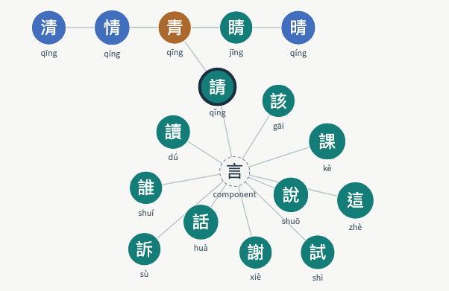
ZIKEY
Seeing and steering
your next character
Self-study offers long vocabulary lists.
Learners need connected steps and
reasons they can inspect.
A working interactive prototype
Lin Wei-De W16157093
Information Visualization, NCKU
ZIKEY / Progress demonstration / 5 November 2026
01
Notes:
Lin Wei-De, W16157093. This is a working proof of concept for the approved proposal. The user starts with pinyin, explores characters and words, and steers a transparent recommendation. The image is a screenshot of the actual local D3 component, not a generated mockup. AI use disclosure: Codex assisted with code, tests and this deck. Student review remains necessary.

Slide 2
Real data in a bounded pilot
290 characters 450 vocabulary entries 556 graph edges
Source | Fields used | Snapshot / attribution
TOCFL | Traditional words, pinyin, level | Workbook dated 2024-09-23
Make Me a Hanzi | Components, radical, origin hints | LGPL v3+ dictionary
CC-CEDICT | English word meanings | 2026-11-04 / CC BY-SA 4.0
6 missing English glosses / 30 missing origin records
Missing fields stay visible. Vocabulary prevalence serves as a labelled proxy for corpus frequency.
ZIKEY / Progress demonstration / 5 November 2026
02
Notes:
Sources: TOCFL 20240923 workbook, https://tocfl.edu.tw/tocfl/index.php/exam/download ; Make Me a Hanzi, https://github.com/skishore/makemeahanzi ; CC-CEDICT snapshot 2026-11-04, https://www.mdbg.net/chinese/dictionary?page=cc-cedict . Local data/processed/sources.json records snapshot hashes and terms.
450 unique Chinese word forms were selected using forced demonstration entries followed by earliest official level/source rows that fit 290 learning characters. Slash alternatives were expanded. Annotated and non-CJK entries were excluded, with counts retained. TOCFL is a public download but no open redistribution license was identified. This bundle stays local for coursework.

Slide 3
Local system and data flow
01
Preserved source snapshots
Process once into characters, words and leaf-component edges.
02
Inspectable recommendation
Compute four signals from the current known-character set.
03
Three linked views
D3 network, score breakdown and Plotly coverage comparison.
04
On-device explanation
Ollama selects up to two supported evidence sentences.
One shared selection and known-character set connect the entire page.
ZIKEY / Progress demonstration / 5 November 2026
03
Notes:
Sources: TOCFL 20240923 workbook, https://tocfl.edu.tw/tocfl/index.php/exam/download ; Make Me a Hanzi, https://github.com/skishore/makemeahanzi ; CC-CEDICT snapshot 2026-11-04, https://www.mdbg.net/chinese/dictionary?page=cc-cedict . Local data/processed/sources.json records snapshot hashes and terms.
Implementation: Python / pandas / NetworkX for processing and deterministic scoring. Streamlit session state synchronizes selection and known characters. A bidirectional D3 v7 component sends selected character events to Python. Plotly renders weighted contributions and recomputed coverage. Ollama qwen2.5-coder:7b selects evidence locally. No cloud LLM or paid API. Local lookup logging is opt-in, session-only and does not retain names or free-text queries. Model outputs are cached locally.

Slide 4
Four inspectable scoring signals
Default weights: prevalence 35%, reuse 25%, unlock 40%, heat 0%
Unlock example
請問
Learning 請 unlocks this
entry only when 問 is
already known.
The LLM explains evidence. The numeric ranking comes from the displayed score.
ZIKEY / Progress demonstration / 5 November 2026
04
Notes:
Sources: TOCFL 20240923 workbook, https://tocfl.edu.tw/tocfl/index.php/exam/download ; Make Me a Hanzi, https://github.com/skishore/makemeahanzi ; CC-CEDICT snapshot 2026-11-04, https://www.mdbg.net/chinese/dictionary?page=cc-cedict . Local data/processed/sources.json records snapshot hashes and terms.
Source: deliverables/presentation-evidence.json, computed by core.py. This native editable chart shows the five highest scores for the sample learner, Default weights. Each raw signal is divided by its maximum over currently unknown candidates, then multiplied by the normalized weight. Default weights: prevalence 35%, component reuse 25%, unlock gain 40%, heat 0%. Reuse counts named leaf parts in flattened IDS expressions, not necessarily immediate top-level parts. Heat starts at zero. No ALS or collaborative filtering was trained.

Slide 5
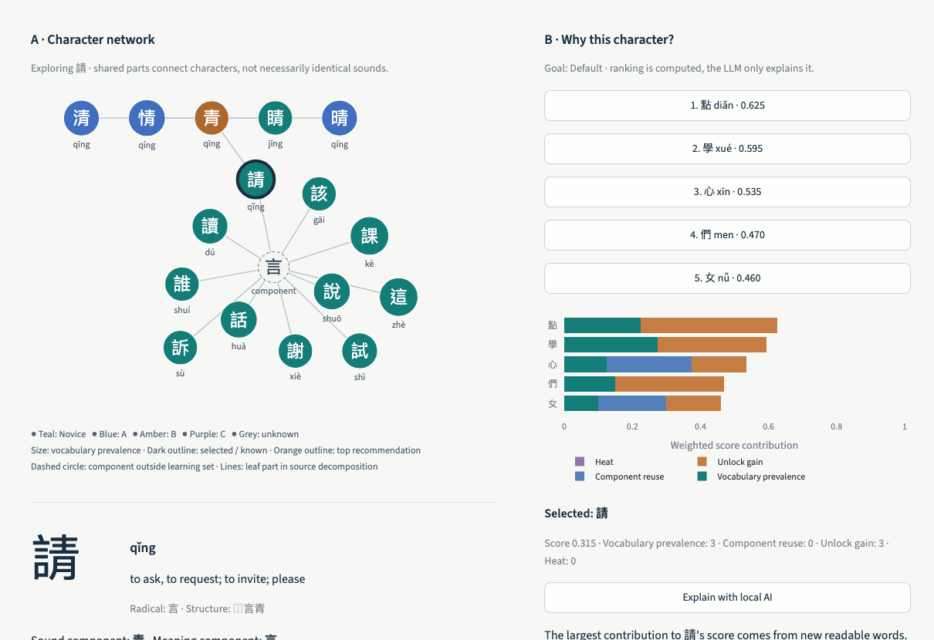
Linked exploration and steering
Search and select
A graph click updates the
selected character everywhere.
Steer the next step
Change the goal or weights.
Mark a character as known.
Recompute what becomes readable.
All screenshots show the running application.
ZIKEY / Progress demonstration / 5 November 2026
05
Notes:
Actual browser screenshot: local ZIKEY app with 請 selected. The full page also includes character meanings, a known-character toggle, local explanation and a coverage chart below the captured area. Demo path: search qing, click 請 in the graph, inspect its sound and meaning parts, request a local explanation, change the goal, mark/unmark 請, then inspect updated vocabulary coverage. The captioned video is a recording of these actual UI interactions.

Slide 6
Coverage comparison and validation
Same learner, same 450 words, 100 additional characters
14 automated tests passed
5 local LLM checks passed
Keyboard and responsive checks
No browser page errors
Next
Corpus frequency and richer data
Learner task testing
Language and usability review
In-sample vocabulary simulation. Learning effectiveness and real-text comprehension remain untested.
ZIKEY / Progress demonstration / 5 November 2026
06
Notes:
Source: deliverables/presentation-evidence.json and core.py. The editable chart samples every 10 steps from full step-by-step recomputation. Both recommendation orders and vocabulary order start from the same 21 known characters and use the same 450 words. After 100 additional characters: vocabulary order 40.0%, Default 58.2%, Read more 58.4%. This is an in-sample deterministic simulation with a curated subset and an objective related to the evaluation measure. It is not held-out evidence, real-text comprehension, or a user learning result. Automated results: 14 tests passed; browser interaction/responsive checks passed without page errors or failed requests; five real local-model calls produced supported evidence. Warm requests in that five-call run took about 3 seconds; first call 14 seconds. Learner testing and linguistic expert review remain pending. AI use: Codex assisted development/testing/deck; qwen2.5-coder:7b selects supported explanations locally.

