Slide 1


A.K.V.S CHAKRAVARTH Y
P HEMANTH KUMAR
22891A1201
22891A1241
9.09 LPA
7.07 LPA

Slide 2

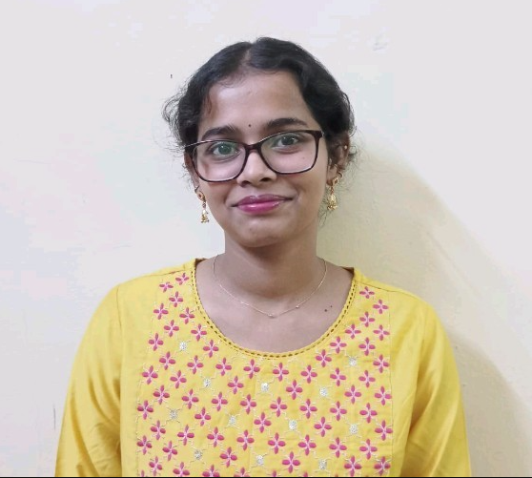
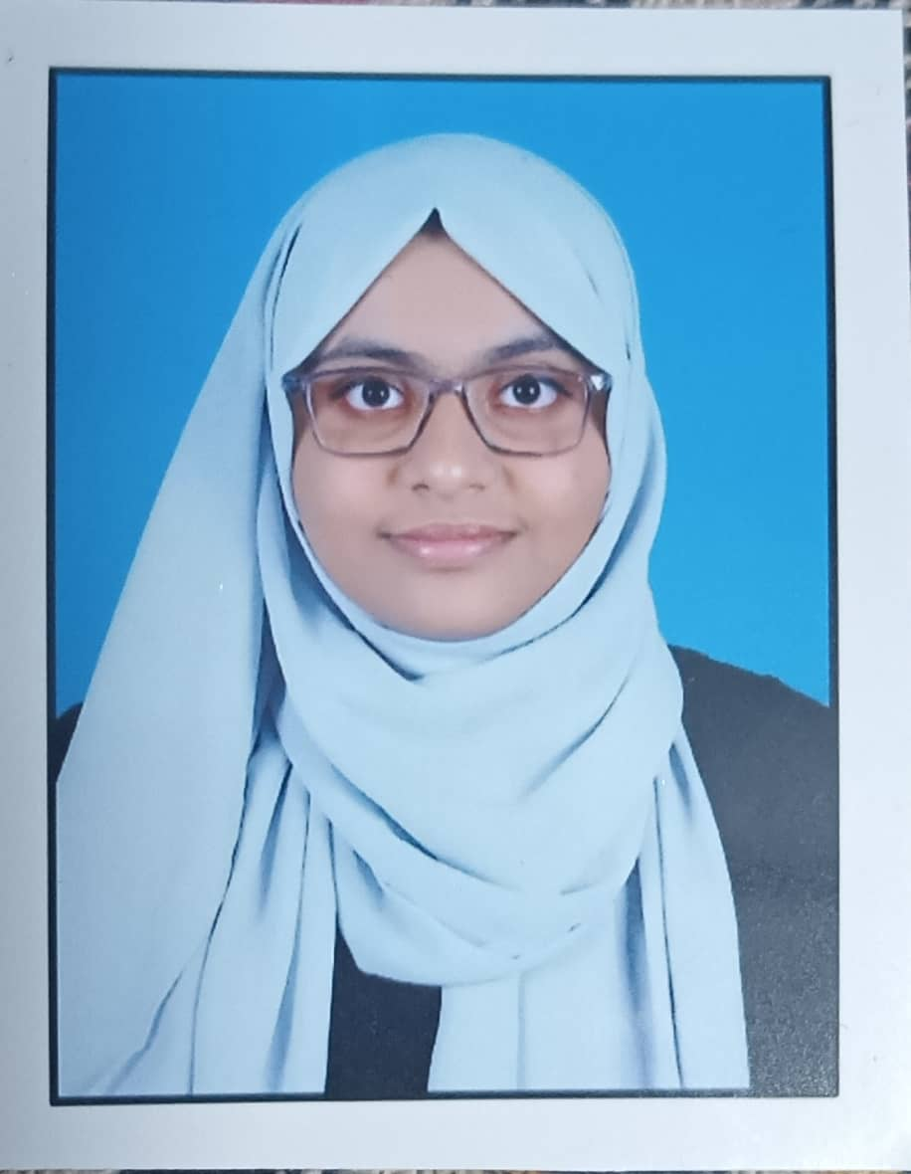

RAYAVARAPU KHYATHI PRADHA
SHAIK FARHA BEGUM
22891A1247
22891A1255
7.07 LPA
7.07 LPA

Slide 3
RAYAVARAPU KHYATHI PRADHA
SHAIK FARHA BEGUM
22891A1247
22891A1255
7.07 LPA
7.07 LPA

