Slide 1
Ploutus.D ATM Malware
Keeton Hohensee, Esad Turkan, Vittal, Michael Huebel
Ploutus.D ATM Malware operates on ATMs that run Windows 10, 8, 7, and XP and is designed to force ATMs to dispense cash without the use of a card. Taking advantage of the physical vulnerability of ATM machine locations.

Slide 2
Ploutus.D ATM Malware
Ploutus.D is engineered to force ATMs to dispense cash to one deploying it.
In order to weaponize Ploutus.D the threat actor needs access to the top portion of the ATM, the ability to connect a keyboard, and then use an activation code. This code is a unique ID generated per ATM and current month and day of the attack, which when entered will dispense the cash.
The concern here is that different variants of Ploutus.D Malware have been deployed since as early as 2013, which shows the attackers are persistently making the upgrades necessary to deploy this malware.
Ploutus, the malware has been on the scene since 2013.
In Oct. 2017 the malware had accounted for 64M USD in losses, according to a paper presented at Virus Bulletin by Thiago Marques, researcher at Kaspersky Lab.

Slide 3
The effects of the Plotus attacks
The plotus malware was originally used in mexico in 2013 and has been detected as recent as 2017 in The US.
The main Target of the plotus malware was to retrieve money from ATMs.
27% of tested ATMs had the malware on it.
It only takes 15 min to install the malware in order for criminals to send an SMS and be able to retrieve money from the ATM.

Slide 4
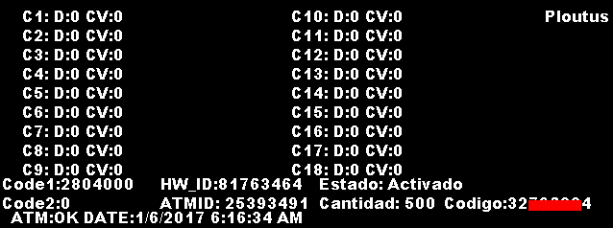
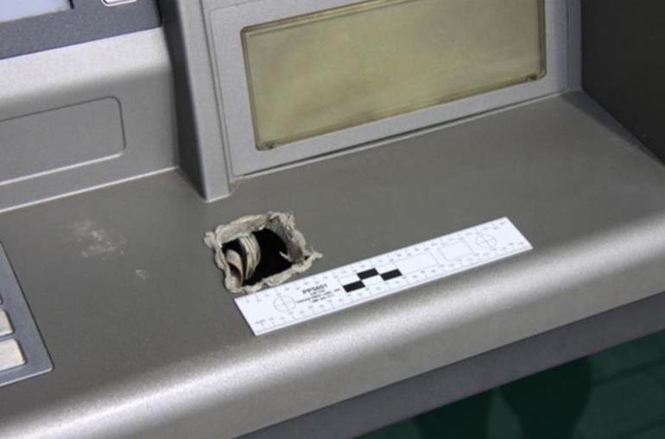
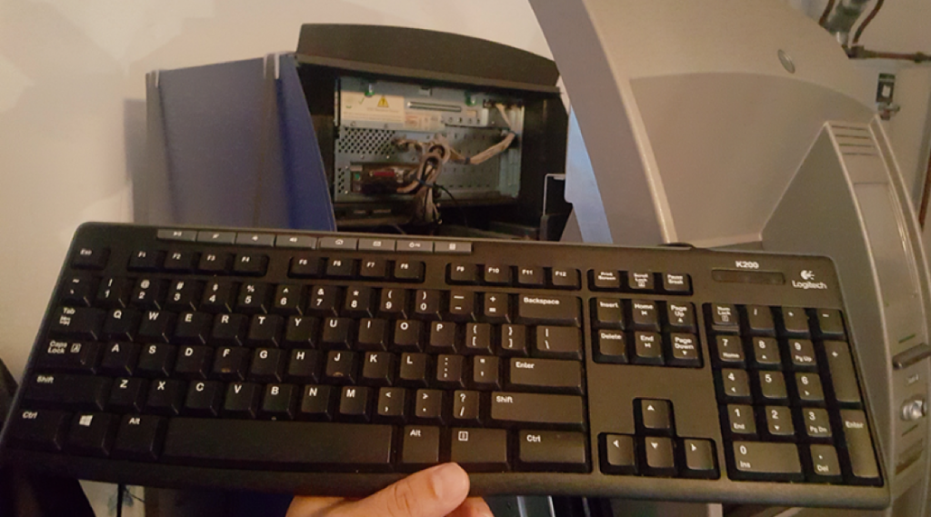
How was the threat first identified and what was the timeline of of events associated?
Using Indicators Of Compromise (IOCs)- to identify potentially malicious activity on a system or network, you can detect if you’re currently infected.
Additionally, left-behind remnants of a previous infection may also be reported.
Recognizing Jackpotting Attacks
Physical access is necessary to perform this attack as well as potential damage to the device. Routine sweeps should be made by the device administrator to ensure there is no damage to the locking mechanism, top hat, or casing indicating that the device has been tampered with. Additionally, if the device has a built-in tamper alarm to the opening of the top hat, it should be enabled.

Slide 5
What steps can or should be taken to mitigate risk in cases where users have already been affected?
Report instances (including failed attempts) to defraud or compromise systems to the appropriate law enforcement and regulatory authorities.
Perform a risk assessment of the entire ATM estate, recognizing that different ATMs, even of the same model, can have different levels of software and firmware installed or configured.
Use a golden image disk known to be free of malware to deploy locked-down whitelisting. This will avoid the possibility of introducing malware that may already be present on other whitelisted ATMs.

Slide 6
What steps can or should be taken to mitigate risk for future threats similar to the one uncovered.
Disable access to the Windows desktop at the ATM, and maintain a robust password management policy.
Enhance the physical security of the ATM cabinet or top box, including the use of high security locks, keys and alarm systems.
Set and maintain strong BIOS password protection to prevent settings from being changed without correct authorization.
Effectively monitor the operation of ATMs, paying special attention to unusual patterns of power outages, resets, communication failures and an uncharacteristic low number of transactions at normally high transacting ATMs.
Implement strong encryption between the ATM and the host. Enable message authentication codes (MAC) to protect the integrity of messages between the ATM and the host.

Slide 7
What steps can or should be taken to mitigate risk for future threats similar to the one uncovered.
Implement secure remote key loading for ATM encryption keys, and prevent the entering of encryption keys via the ATM supervisor or administrator keyboard.
Deploy full hard disk encryption (FHDE) and encryption and authentication solutions to protect internal communications between the genuine ATM PC core and ATM modules, including the dispenser.
Prevent unauthorized USB devices from being installed (USB whitelisting).
Disable in BIOS the ability to boot or auto-run software from USB sticks and CD/DVD drives.
Train staff and service personnel to be vigilant in detecting any changes to the ATM which may indicate that unauthorized access to the ATM cabinet has occurred, including:
Inspection for holes cut in the fascia,
Damaged locks, and
Out-of-place internal cables.

Slide 8
What steps can or should be taken to mitigate risk for future threats similar to the one uncovered.
Engage ATM solution providers and other specialists for guidance on installing and correctly configuring any applicable hardware, firmware or software to detect and prevent malware and black box attacks.
Ensure ATMs and all related systems comply with the latest PCI standards where applicable.
Ensure that firewalls and anti-malware protection are correctly configured, including whitelisting solutions that cannot be disabled without generating a remotely monitored alert and audit trail.

Slide 9
Questions

