Slide 1
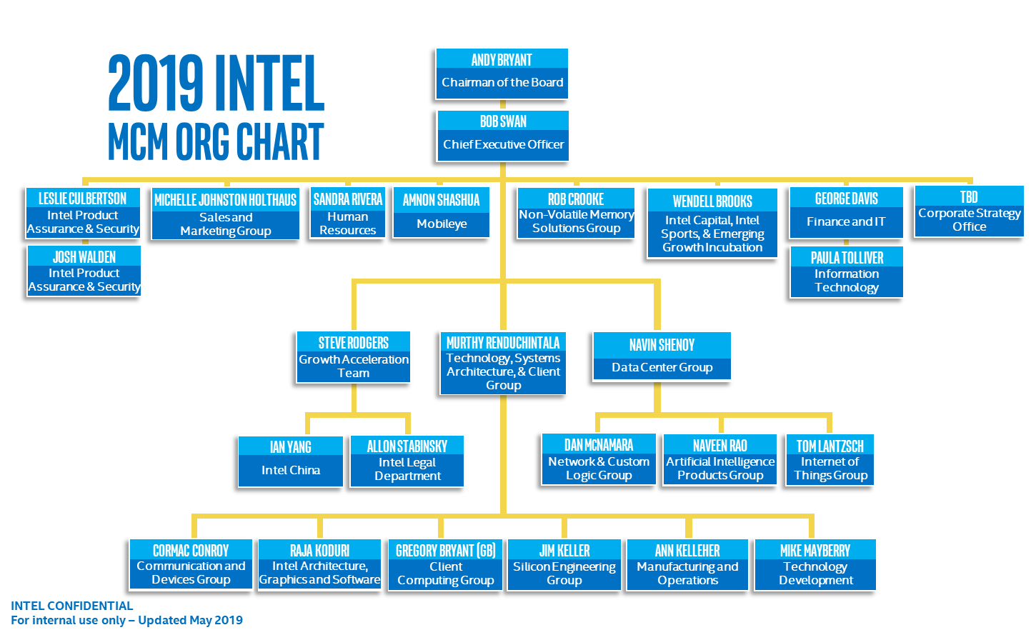
Org Chart shows MCM Members Only

