Slide 1
Hybrid Cloud: Best Practices for HPC Performance On Premise and On Cloud
Intel® Parallel Studio XE 2019
Jennifer DiMatteo, Technical Consulting Engineer, Intel Corporation

Slide 2
HPC Workloads in the Cloud
The top public cloud providers are investing more resources into providing a competitive environment for HPC workloads.
As with private servers, workloads on the cloud still need performance tuning to ensure they are taking advantage of the newer Intel® architectures.

Slide 3
Code Modernization Workflow
Stage 1: Use Optimized Libraries
Stage 2: Compile with Architecture-Specific Optimizations
Stage 3: Analyze and Tune
Stage 4: Check Correctness

Slide 4
Code Modernization Workflow
Stage 1: Use Optimized Libraries
Stage 2: Compile with Architecture-specific Optimizations
Stage 3: Analyze and Tune
Stage 4: Check Correctness
Notes:
Your customers can optimize their code for Skylake in four steps:
Stage 1: Use optimized libraries (MKL, Python)
Stage 2: use Intel compiler with architecture-specific optimizations (AVX-512)
Stage 3: Analysis and Tuning w/ VTune/Advisor/ITAC
Stage 4: Check correctness (Inspector, cluster checker)
In the next part of the presentation, we will get into the details of how Intel® Parallel Studio XE tool suite can help you go through those steps.

Slide 5
Profiling on the Cloud vs On-Premise
What’s the Difference?
Shared resources and provisioning may affect performance
Some profiler functionality may not be available on cloud VMs
Cloud VMs limit access to hardware counters
Accessibility
Installation of profilers and viewing results
Overall, there are few differences between cloud and on-premise profiling. However, profiling on the cloud ensures you are getting the performance you expect, or shows you how to improve it.

Slide 6
Effectively Profiling on the Cloud
Recommendations:
Start with Intel® Advisor for native (C/C++/Fortran) workloads
Advisor’s cache-aware Roofline feature will help identify whether your application is memory or CPU bound
Use Intel® VTune™ Amplifier to:
View overall hotspots with stacks
View thread concurrency
Profile managed code including Python* and Java*

Slide 7
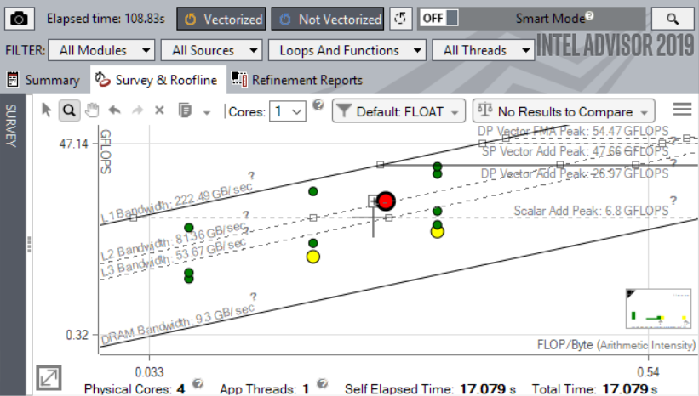
Find Effective Optimization Strategies with Intel® Advisor
Roofline Performance Insights
Quickly check the performance of your loops relative to your system’s capability
Cache-aware Roofline Analysis shows whether loops are memory- or CPU- bound
Shows performance ‘headroom’ for each loop
Which can be improved?
Which are worth improving?
Highlights poor performing loops
Suggests next optimization steps

Slide 8
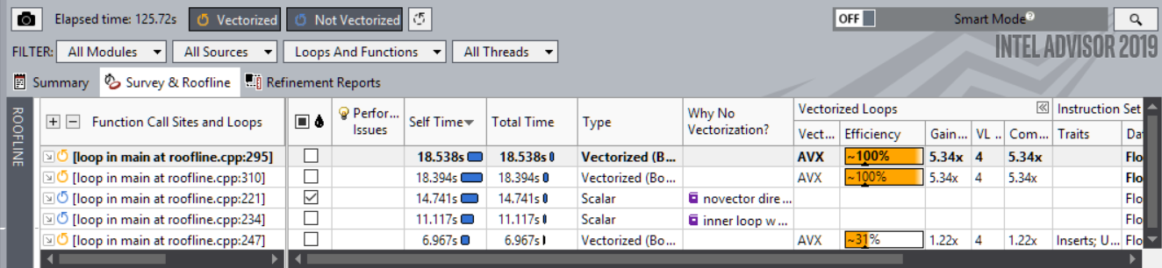
Get Breakthrough Vectorization Performance
Faster Vectorization Optimization
Vectorize where it will pay off most
Quickly ID what is blocking vectorization
Tips for effective vectorization
Safely force compiler vectorization
Optimize memory stride
Data & Guidance You Need
Compiler diagnostics + Performance Data + SIMD efficiency
Detect problems & recommend fixes
Loop-Carried Dependency Analysis
Memory Access Patterns Analysis
Optimize for Intel® AVX-512 with or without access to AVX-512 hardware

Slide 9
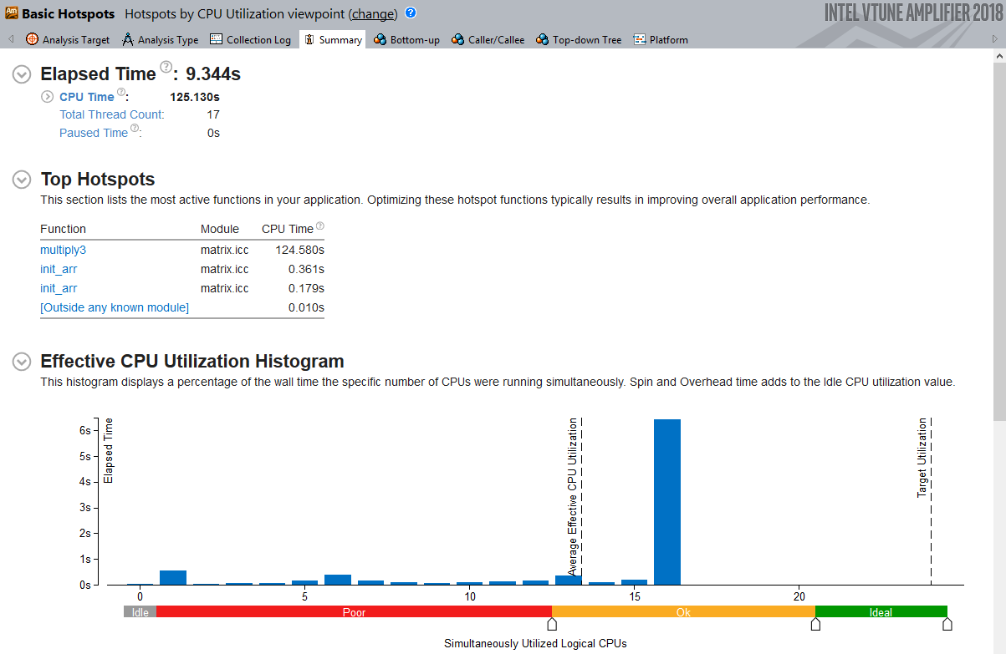
Analyze & Tune Application Performance with Intel® VTune™ Amplifier
Save Time Optimizing Code
Accurately profile C, C++, Fortran*, Python*, Go*, Java*, or any mix
Quickly find hotspots to focus on the right code
Optimize CPU, threading & more
Profile inside containers
Remote profiling for cloud VMs
Save time: rich analysis leads to insight
Hotspots show you which functions use the most CPU time
Visualize CPU utilization to see if threading is optimal

Slide 10
DEMo

Slide 11
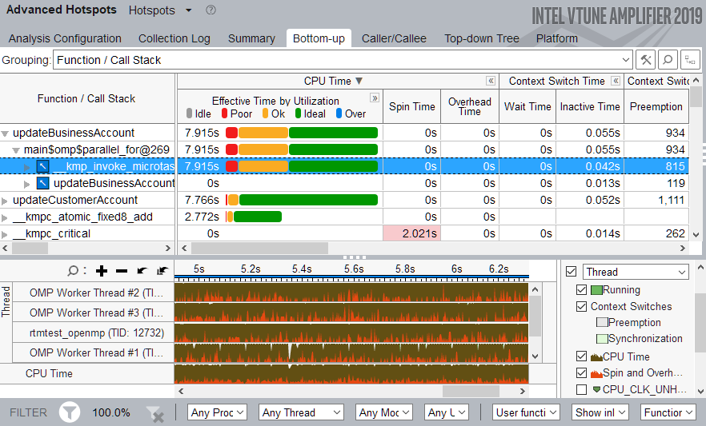
Summary and FREE Tools!
Use Intel® VTune™ Amplifier to identify hotspots and threading issues
Intel® VTune™ Amplifier and Inte l® Advisor are two great ways to get quick performance insights in or out of the cloud
Free download of latest versions with community support
Also available as part of Intel® Parallel Studio XE
Paid licenses include Priority Support
Use Intel® Advisor Roofline Analysis to quickly view memory and CPU utilization
https://software.intel.com/en-us/free-software

Slide 12
Legal Disclaimer & Optimization Notice
Software and workloads used in performance tests may have been optimized for performance only on Intel microprocessors. Performance tests, such as SYSmark and MobileMark, are measured using specific computer systems, components, software, operations and functions. Any change to any of those factors may cause the results to vary. You should consult other information and performance tests to assist you in fully evaluating your contemplated purchases, including the performance of that product when combined with other products. For more complete information visit www.intel.com/benchmarks.
INFORMATION IN THIS DOCUMENT IS PROVIDED “AS IS”. NO LICENSE, EXPRESS OR IMPLIED, BY ESTOPPEL OR OTHERWISE, TO ANY INTELLECTUAL PROPERTY RIGHTS IS GRANTED BY THIS DOCUMENT. INTEL ASSUMES NO LIABILITY WHATSOEVER AND INTEL DISCLAIMS ANY EXPRESS OR IMPLIED WARRANTY, RELATING TO THIS INFORMATION INCLUDING LIABILITY OR WARRANTIES RELATING TO FITNESS FOR A PARTICULAR PURPOSE, MERCHANTABILITY, OR INFRINGEMENT OF ANY PATENT, COPYRIGHT OR OTHER INTELLECTUAL PROPERTY RIGHT.
Copyright © 2018, Intel Corporation. All rights reserved. Intel, Pentium, Xeon, Xeon Phi, Core, VTune, Cilk, and the Intel logo are trademarks of Intel Corporation in the U.S. and other countries.
Optimization Notice
Intel’s compilers may or may not optimize to the same degree for non-Intel microprocessors for optimizations that are not unique to Intel microprocessors. These optimizations include SSE2, SSE3, and SSSE3 instruction sets and other optimizations. Intel does not guarantee the availability, functionality, or effectiveness of any optimization on microprocessors not manufactured by Intel. Microprocessor-dependent optimizations in this product are intended for use with Intel microprocessors. Certain optimizations not specific to Intel microarchitecture are reserved for Intel microprocessors. Please refer to the applicable product User and Reference Guides for more information regarding the specific instruction sets covered by this notice. Notice revision #20110804
12

