Slide 1
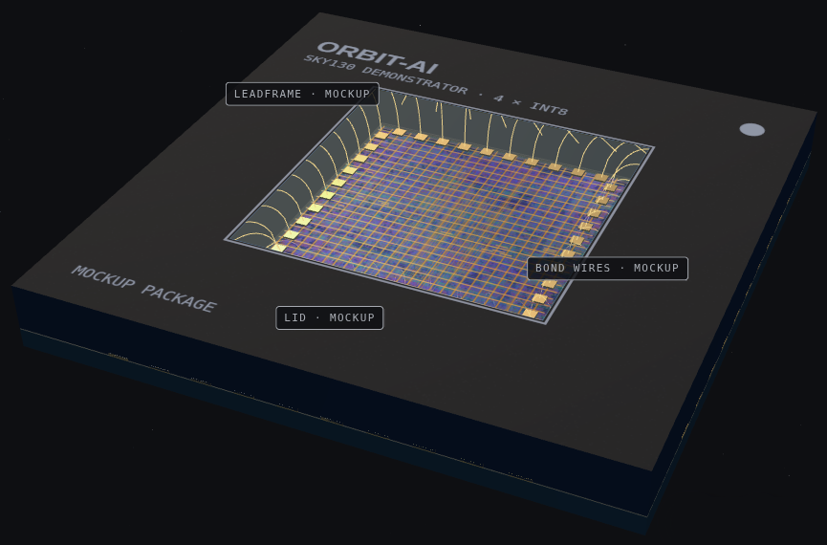
ORBIT-AI
VANTAGE · SPACE COMPUTE
An AI chip built for orbit.
It catches its own radiation errors before they become wrong answers.
Notes:
Open with the one-liner: an AI inference chip that refuses to give a wrong answer when radiation hits it.

Slide 2
Space breaks normal chips.
THE PROBLEM
ORBIT-AI · 02
Satellites need AI on board, but orbit is hostile to the silicon that runs it.
01
02
03
04
Radiation flips bits
No repair visits
Heat only radiates
Power is scarce
Whatever launches has to fix itself.
A single particle can silently change a result.
No air to cool. Hot spots must be managed.
Every watt comes from the solar array.
Notes:
Today the choice is slow rad-hard CPUs or fast commercial chips with no protection.

Slide 3
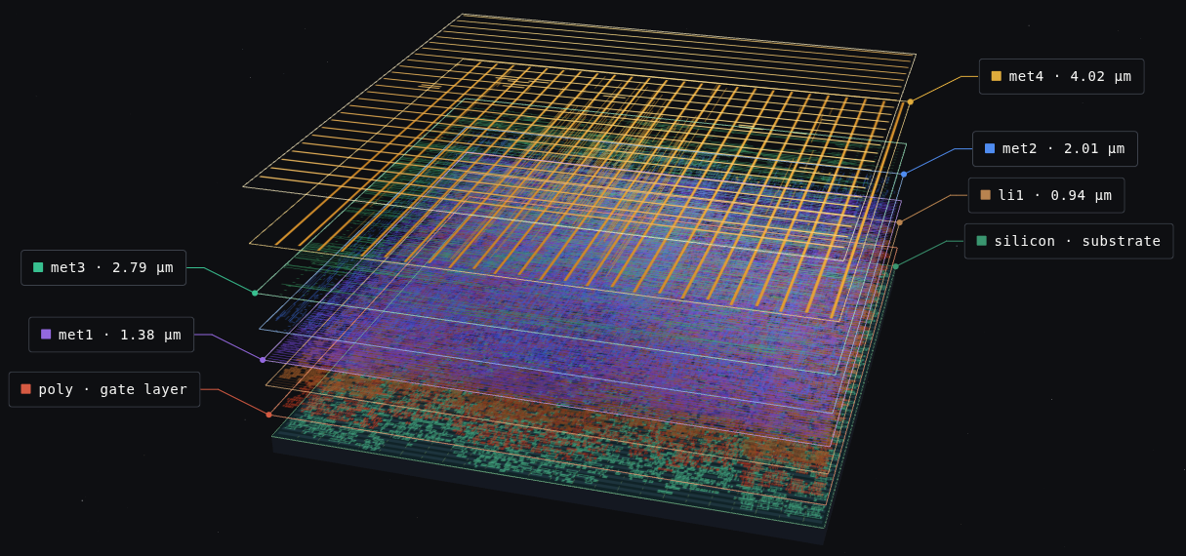
Built, laid out, and tested.
THE CHIP
ORBIT-AI · 03
A 4-lane INT8 AI demonstrator taken from RTL to a sign-off-clean layout with open-source tools on the SkyWater 130 nm process.
346 µm
139 MHz
1.1 GOPS
4
die edge
clock, timing met
INT8 throughput
AI lanes, fully protected
Notes:
Yosys, OpenROAD, sky130. Everything is in the open repo.

Slide 4
Every result is checked twice.
HOW IT PROTECTS ITSELF
ORBIT-AI · 04
01
02
03
04
Twin copies
Compare
Fault-stop
Triple vote
Each lane runs on two copies of the hardware.
The copies are compared every cycle.
A mismatch stops the output. No wrong answer leaves.
Thermal control runs in triplicate and votes 2 of 3.
Notes:
Duplicate plus compare on the datapath, TMR on the thermal state machine (80, 95, 70 C thresholds).

Slide 5
936 bit flips. Zero wrong answers.
FAULT INJECTION
ORBIT-AI · 05
Flips injected into the gate-level netlist over 30,000 cycles. Every one was caught.
936 / 936
702
234
0
flips stopped or repaired
caught by fault-stop
repaired by voting
wrong results out
Notes:
Gate-level simulation, not a beam test. Radiation testing is a next step.

Slide 6
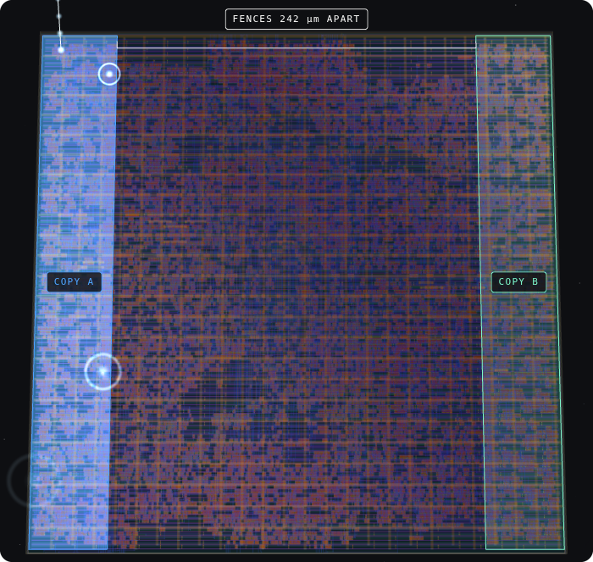
One particle can't hit both copies.
PHYSICAL LAYOUT
ORBIT-AI · 06
The twin copies sit in fenced regions on opposite sides of the die, so a single strike cannot corrupt both.
≥ 251 µm
242 µm
between twin copies
gap between fences
0 / 262
13 → 0
same-bit pairs touching
vs. unfenced layout
Notes:
Measured on the routed layout, not estimated.

Slide 7
Clean enough to tape out.
SIGN-OFF
ORBIT-AI · 07
0
Clean
+0.031 ns
DRC violations
LVS: layout matches netlist
timing slack at 7.2 ns
Notes:
OpenROAD flow scripts, sky130hd standard cells.

Slide 8
Only ORBIT-AI checks every box.
COMPETITIVE LANDSCAPE
ORBIT-AI · 08
ORBIT-AI
RAD750
GR740
XQR Versal
PIC64-HPSC
Jetson Orin NX
AI inference engine (INT8)
–
–
Hardware fault tolerance beyond memory ECC
–
Separated copies, measured in layout
–
–
–
–
–
Fault injection published bit by bit
–
–
–
–
–
No wrong result on a detected upset
–
–
–
–
–
Open design
–
–
–
–
–
6/6
1/6
1/6
2/6
2/6
1/6
Notes:
Ticks mean published capability. Competitor figures come from public sources and should be re-verified before external use.

Slide 9
From demonstrator to full-size chip.
ROADMAP
ORBIT-AI · 09
01
02
03
04
Built
Full-size design
Radiation test
Tapeout
4-lane demonstrator. Layout clean, faults proven in simulation.
Heavy-ion and proton beam testing of the protection scheme.
First silicon, then flight demonstration.
16 tiles, 6.55 to 26.21 INT8 TOPS. Designed on paper.
Notes:
Be explicit: only the demonstrator is built. No radiation or flight qualification yet.

Slide 10
Explore the real layout in 3D.
SEE IT
ORBIT-AI · 10
Every block, fence, and copy is labeled from the routed design data.
3D die explorer
Interactive story
Open source
vittesh12345.github.io/chip/
orbit-ai/explorer/
vittesh12345.github.io/chip/
orbit-ai/
github.com/vittesh12345/chip

Slide 11
AI that stays right in orbit.
VANTAGE
Let's talk.

