Slide 1
Natural Language Processing (NLP)
By Pankaj Soni

Slide 2
Agenda
Introduction of NLP
Why NLP ?
NLP Applications
Fundamental steps involved in NLP
Future of NLP
Supported Python libs for NLP
Hands On using python
Case study-1 : Spam detection (Using Naive Bayes Supervised ML algo)
Case study-2 : Human DNA classification
Creating word cloud
Q & A

Slide 3
Introduction of NLP
Natural Language Processing, usually shortened as NLP, is a branch of artificial intelligence that deals with the interaction between computers and humans using the natural language.
The ultimate objective of NLP is to read, decipher, understand, and make sense of the human languages in a manner that is valuable.
Most NLP techniques rely on machine learning to derive meaning from human languages.

Slide 4
Why NLP ?
Language translation applications such as Google Translate
Word Processors such as Microsoft Word and Grammarly that employ NLP to check grammatical accuracy of texts.
Interactive Voice Response (IVR) applications used in call centers to respond to certain users’ requests.
Personal assistant applications such as OK Google, Siri, Cortana, and Alexa.

Slide 5
NLP Applications
Text Classification
Language Modeling
Part-of-Speech Tagging
Speech Recognition
Caption Generation
Machine Translation
Document Summarization
Spell Checking
Question Answering

Slide 6
Fundamental steps involved in NLP
Remove numbers, punctuations, stopwords, whitespace
Word stemming
Morphological Analysis/ lexical Analysis
Syntax Analysis
Semantic Analysis
Discourse integration
Pragmatic Analysis

Slide 7
Fundamental steps involved in NLP cont..
Morphological Analysis/ lexical Analysis:
Here we separate the words as tokens like root words by removing all the suffix and prefix to make it easy
Example: John is eating an apple: [John, is, eating, an, apple]
Syntax Analysis:
After getting the root words we analyze that sentence is syntax wise correct or not, and check if it follows the basic grammar rules.
Example: Boy the goes t o store: this is syntax wise wrong as determiners can't come after a noun not, and check if it follows the basic grammar rules. this is syntax wise wrong as determiners can't come after a noun
Semantic Analysis:
If the sentence forms any meaning or not.
Example: She is wearing a colorless green dress: Syntax-wise it seems correct but how can a green dress be colorless therefore it is semantic wise wrong
Discourse integration:
In any language, we find dependencies like pronouns, its work is to identify and understand where the dependency is pointing to
Example: Ram is a boy, he goes to school : here “he” is a dependency pointing to Ram
Pragmatic Analysis:
It is said to be the toughest part in AI, pragmatic analysis deals with the context of a sentence.
Example: - John saw Mary in a garden with a cat: here we can't say that John is with cat or mary is with cat
Example: - Do you know what time is it??????

Slide 8
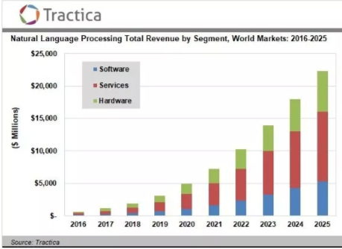
Future of NLP
The Bots
Invisible UI: Alexa! Is the best example
Smarter search
Ref

Slide 9
Supported Python libs for NLP (Ref)
Natural Language Toolkit (NLTK)
TextBlob
CoreNLP
Gensim
spaCy
polyglot

Slide 10
Hands On using python
Creating document (aka: list of sentences)
Creating sentence tokens
Creating word tokens
Getting frequency distribution of each word
Finding Stop words and removing them
Finding root words (aka: Stemming)
Part of Speech tagging (aka: POS)
Lemmatization
Difference between Stemming and Lemmatization
Text cleaning
Creating BoW (Bag of Words)
Training and Test dataset
Serializing/De-serializing machine learning models

Slide 11
Python Code in Jupyter notebook

Slide 12
Case study-1 : Spam detection (Using Naive Bayes Supervised ML algo)
Python Code in Jupyter notebook

Slide 13
Case study-2 : Human DNA classification (Using Naive Bayes Supervised ML algo)
Python Code in Jupyter notebook

Slide 14
Q & A

