Slide 1
Agenda
 Flow Controls
if .. else & ifelse
Loops ( For , while , repeat)
next and break

Slide 2
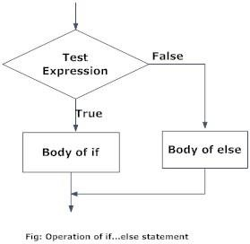
If .. else

Slide 3
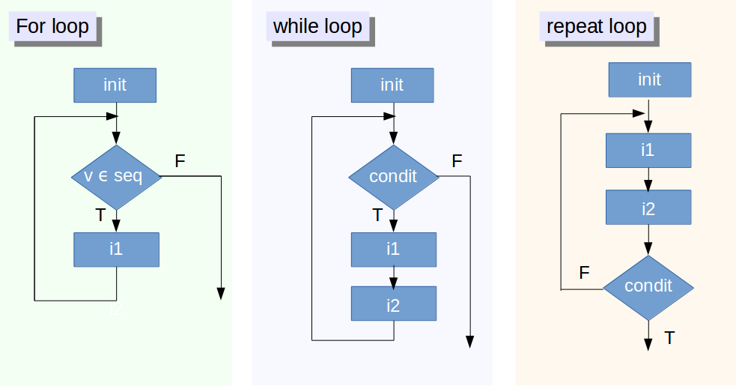
Loops in R

Slide 4
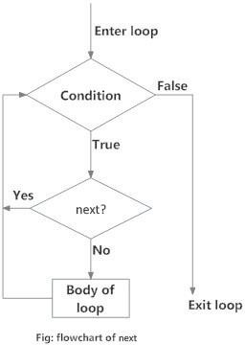
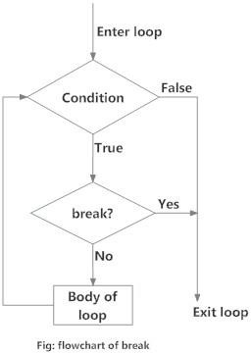
Next and break

