Slide 1
Agenda
Aggregation in R

Slide 2
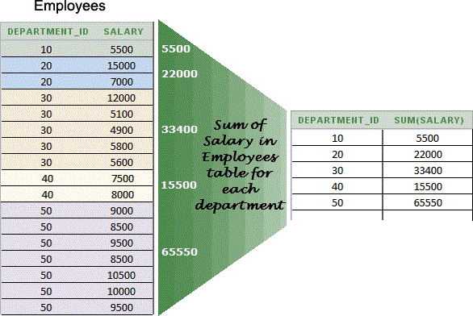
What is aggregation?
The process in which data is gathered and expressed in a summary form to extract
meaningful information and to perform statistical analysis
 In SQL, similar operation is achieved using the ‘group by’ operator
 Multiple functions can be used while aggregating – sum, min, max, median etc. You can even use function which have been defined by yourself (UDFs)
 In base R, we use the ‘aggregate’ syntax for this. We will also learn about the dplyr approach towards data manipulation

Slide 3
Data aggregation using aggregate()
 aggregate() - aggregate the inputted data.frame d.f by applying a function specified by the FUN
parameter to each column of sub-data.frames defined by the by input parameter
 Arguments commonly used in the aggregate() function:
x - an R object.
by - a list of grouping elements, each as long as the variables in the data frame x.
FUN - a function to compute the summary statistics which can be applied to all data subsets
formula - a formula, such as y ~ x or cbind(y1, y2) ~ x1 + x2, where the y variables are numeric data to be split into groups according to the grouping x variables (usually factors)
data - a data frame (or list) from which the variables in formula should be taken
 aggregate() always returns a data.frame as a result

Slide 4
Agenda
Merging in R

Slide 5
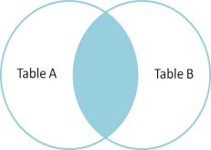
Inner join / Full Inner join in R & SQL
TABLE “A”
TABLE “B”
TABLE “A” INNER JOIN TABLE “B”
name | marks
Ashwin | 50
Saagar | 90
Anil | 80
Ankit | 40
name | section
Ashwin | A
Saagar | B
Anil | C
George | A
name | marks | section
Anil | 80 | C
Ashwin | 50 | A
Saagar | 90 | B
SQL Syntax
R Syntax
SELECT * FROM tableA INNER JOIN tableB ON tableA.name = tableB.name ;
innerJ <- merge(tableA, tableB, by.x ="name", by.y ="name", all= FALSE)

Slide 6
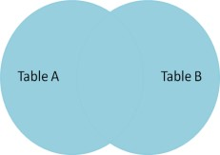
Outer join / Full Outer join in R & SQL
TABLE “A”
TABLE “B”
TABLE “A” OUTER JOIN TABLE “B”
name | marks
Ashwin | 50
Saagar | 90
Anil | 80
Ankit | 40
name | section
Ashwin | A
Saagar | B
Anil | C
George | A
name | marks | section
Anil | 80 | C
Ankit | 40 | (NULL)
Ashwin | 50 | A
Saagar | 90 | B
George | (NULL) | A
SQL Syntax
R Syntax
SELECT * FROM tableA OUTER JOIN tableB ON tableA.name = tableB.name ;
outerJ <- merge(tableA, tableB, by.x ="name", by.y ="name", all= TRUE)

Slide 7
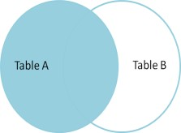
Left join / Left Outer join in R & SQL
TABLE “A”
TABLE “B”
TABLE “A” LEFT JOIN TABLE “B”
name | marks
Ashwin | 50
Saagar | 90
Anil | 80
Ankit | 40
name | section
Ashwin | A
Saagar | B
Anil | C
George | A
name | marks | section
Anil | 80 | C
Ankit | 40 | (NULL)
Ashwin | 50 | A
Saagar | 90 | B
SQL Syntax
R Syntax
SELECT * FROM tableA LEFT JOIN tableB ON tableA.name = tableB.name ;
leftJ <- merge(tableA, tableB, by.x ="name", by.y ="name", all.x= TRUE)

Slide 8
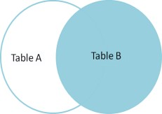
Right join / Right Outer join in R & SQL
TABLE “A”
TABLE “B”
TABLE “A” RIGHT JOIN TABLE “B”
name | marks
Ashwin | 50
Saagar | 90
Anil | 80
Ankit | 40
name | section
Ashwin | A
Saagar | B
Anil | C
George | A
name | marks | section
Anil | 80 | C
Ashwin | 50 | A
Saagar | 90 | B
George | (NULL) | A
SQL Syntax
R Syntax
SELECT * FROM tableA RIGHT JOIN tableB ON tableA.name = tableB.name ;
rightJ <- merge(tableA, tableB, by.x ="name", by.y ="name", all.y= TRUE)

