Slide 1
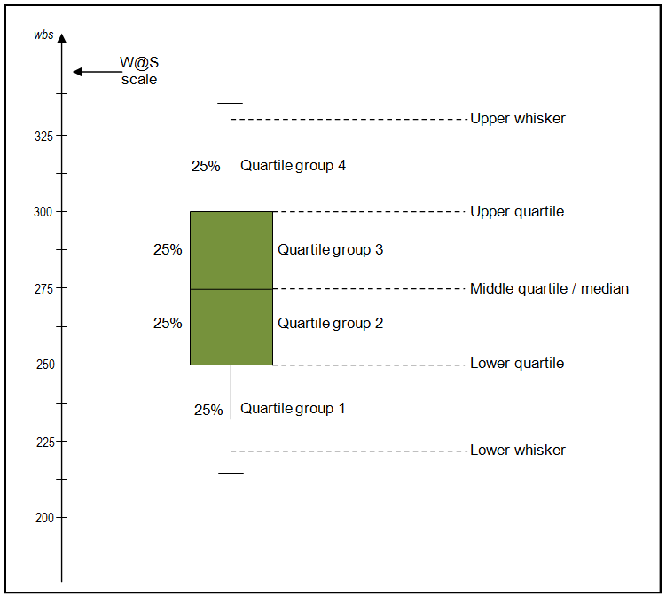

Slide 2
Understanding Box Plots
Median The median (middle quartile) marks the mid-point of the data and is shown by the line that divides the box into two parts. Half the scores are greater than or equal to this value and half are less.
Inter-quartile range The middle “box” represents the middle 50% of scores for the group. The range of scores from lower to upper quartile is referred to as the inter-quartile range. The middle 50% of scores fall within the inter-quartile range.
Upper quartile Seventy-five percent of the scores fall below the upper quartile.
Whiskers The upper and lower whiskers represent scores outside the middle 50%

Slide 3
1) What the key values are, such as: the average, median 25th percentile etc. 2) If there are any outliers and what their values are. 3) Is the data symmetrical 4) How tightly is the data grouped 5) If the data is skewed and if so, in what direction.
Interpreting Box Plots

