Slide 1


Quick game development with
C++11/C++14
Vittorio Romeo
http://vittorioromeo.info
vittorio.romeo@outlook.com
Notes:
* Greet
* Introduce myself with next slide

Slide 2
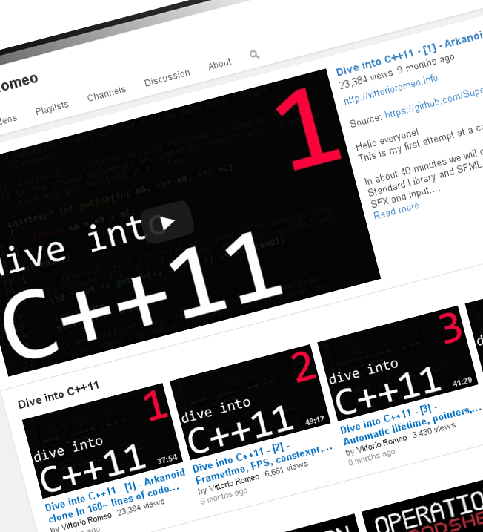
About myself
Computer Science student at the University of Messina
Autodidact programmer
Interests:
  Software development
  Gaming and game-development
  C++ and its evolution
  Open-source software
  Sharing my knowledge
Notes:
* Briefly talk about myself and my projects

Slide 3
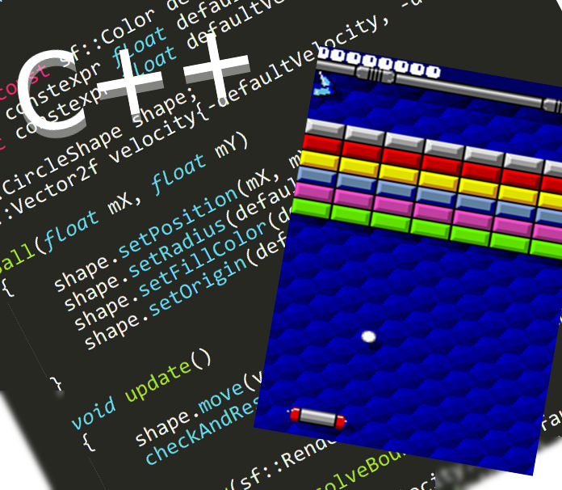
About this talk
Introductory part:
  Game development: why?
    Why C++?
    Why C++11/C++14?
Live coding part:
  Preparation: goals, compilers, resources
  Live coding: development analysis/walkthrough of a complete playable simple game
Notes:
* Very briefly outline the talk

Slide 4
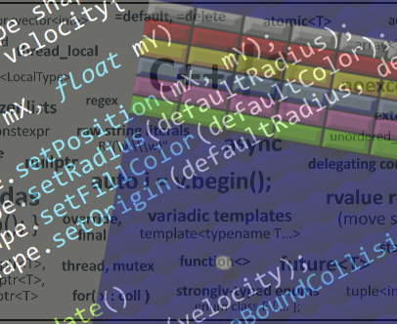
Goals of this talk
Encouraging everyone to try game development
Demonstrating how C++ and its newer standards make game development a breeze
Notes:
* Briefly explain what the goals are

Slide 5
Game development:
all-around development experience
Notes:
* Explain further in next slide

Slide 6
Game development: why?
Game development
  Requires knowledge and skills in multiple areas
  Involves the programmer with the community
  Touches a vast number of specific programming topics
Design
Mechanics
Style and feel
Story and concept
Implementation
Engine and
architecture
Game development
Scripting and
customization
Porting
and distribution
Resources
Graphics
Music
Sounds
Notes:
* Touches many programming subjects
* Involves the developer with non-programming subjects if solo
* Involves the developer with a team of non-programming content creators if in team
* Involves the programmer with community feedback and fanbases

Slide 7





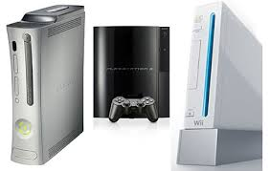

Game development: why C++?
Efficient: zero-cost abstractions and “low-level” code
Portable: standard-compliant code can target many architectures
Widespread: huge number of libraries and resources available
Notes:
* Most languages can be used, but C++ is the best one because...

Slide 8
Game development: why C++11/C++14?
Convenience, safety and expressiveness
  Initializer lists and uniform initialization
  auto, range-based for loops
  Lambdas, variadic templates, decltype
  override, final, enum class, explicit, nullptr
  default, delete
Memory management (!)
  std::unique_ptr, std::shared_ptr, offsetof
Possible performance improvements
  constexpr, std::move, noexcept
Other improvements/additions
  Multithreading library facilities
  std::tuple, variadic macros, <random>, <chrono>
  Generic lambdas, lambda capture expression
  auto functions, relaxed constexpr, std::tuple::get<...>
factory functions
entity management
game loop timing
Notes:
* Focus on real life game development examples
* All other features are still extremely useful but they've already been covered a lot

Slide 9
Let's get started, then!

Slide 10
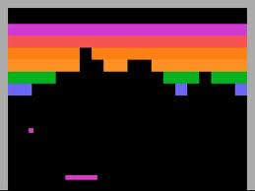
Live coding: what is our goal?
Our goal is creating an arkanoid/breakout clone almost from scratch.
Step by step, I'll demonstrate how easy it is to create a playable game, in around 200 lines of code.

Slide 11
Live coding: what compiler?
C++11 support is mandatory
  g++ 4.7.2 or clang++ 3.0 (or newer) fully support the
  C++11 standard
Some C++14 features will be used
  clang++ 3.4 fully supports the C++14 standard
  g++ 4.9 supports all the C++14 features we'll be using
Standard compliance information
  http://gcc.gnu.org/projects/cxx1y.html
  http://clang.llvm.org/cxx_status.html
Notes:
* C++14 compiler is required

Slide 12

Live coding: SFML library
To interface ourselves with the input, audio, graphics components of our computer and our operating system we'll use the SFML 2.1 open-source C++ library available at http://sfml-dev.org
Notes:
* Similar libraries: Cinder, SDL
* Just a step forward from lower-level libraries like OpenGL

Slide 13
Live coding: code and resources
You can download the code and the resources that are going to be used here:
  http://github.com/SuperV1234/cppcon2014
The SFML 2.1 library is available here:
  http://sfml-dev.org
Notes:
* SFML is also available in most package managers

Slide 14
Info: game loop
The game loop is a continuously running loop (until the end of the game)
  1. Get input
  2. Update game logic
  3. Draw game entities
Notes:
* This is the most basic game loop possible
* There are more complex loop architectures

Slide 15
Info: coordinate system
SFML's coordinate system sets the origin in the top-left corner of the window.
X
(0, 0)
(width, 0)
(0, height)
(width, height)
Notes:
* Other libraries such as OpenGL define other origins

Slide 16
Info: ball movement
By adding a velocity vector to the ball's position every frame, the ball appears to move.
velocity
velocity
velocity
update
update
update
time

Slide 17
Info: ball vs window collision
By checking if one of the ball's coordinates is greater or lower than the window's bounds, we can determine if the ball is outside the window.
X
ball.x + (ball.width / 2)
window.width

Slide 18
Info: AABB vs AABB collision
(top, left)
(top, right)
(top, left)
(top, right)
vertical overlap
(bottom - top)
(bottom, left)
(bottom, right)
(bottom, left)
(bottom, right)
horizontal overlap
(right - left)
Notes:
* Explain how to read the diagram
* Explain it step by step

Slide 19
Info: ball vs paddle collision
Depending on where the paddle was hit, we set the ball's X velocity towards the left or the right.
Notes:
* Arkanoid games usually also deflect the angle
* We're not doing it to keep things simple (no trigonometry)

Slide 20
Info: ball vs brick collision
We need to change the ball's velocity depending on the direction the brick was hit from.
Notes:
* Explain why it is from the right and not from the left

Slide 21
Info: class hierarchy
This is the final class hierarchy of our game objects.

Slide 22
Info: game architecture
This is the final code architecture of our game classes.
Game
Manager
Entities
Grouped entities

Slide 23
Thanks!
Vittorio Romeo
http://vittorioromeo.info
vittorio.romeo@outlook.com
Notes:
* Thank everyone
* Further questions?
* Goodbye

