Slide 1
SYOPI
An E-Commerce Web Service
G3T1

Slide 2
Solution Scoping
Our project, Syopi, aims to tackle how an e-commerce site with lots of moving components would work in a microservice architecture. The two main actors in an e-commerce system are customers and sellers. Our user scenarios revolve around these actors.
User Scenarios:
User successfully returns Order
User Opens Shop and Add Products
User reviews product after it arrives

Slide 3
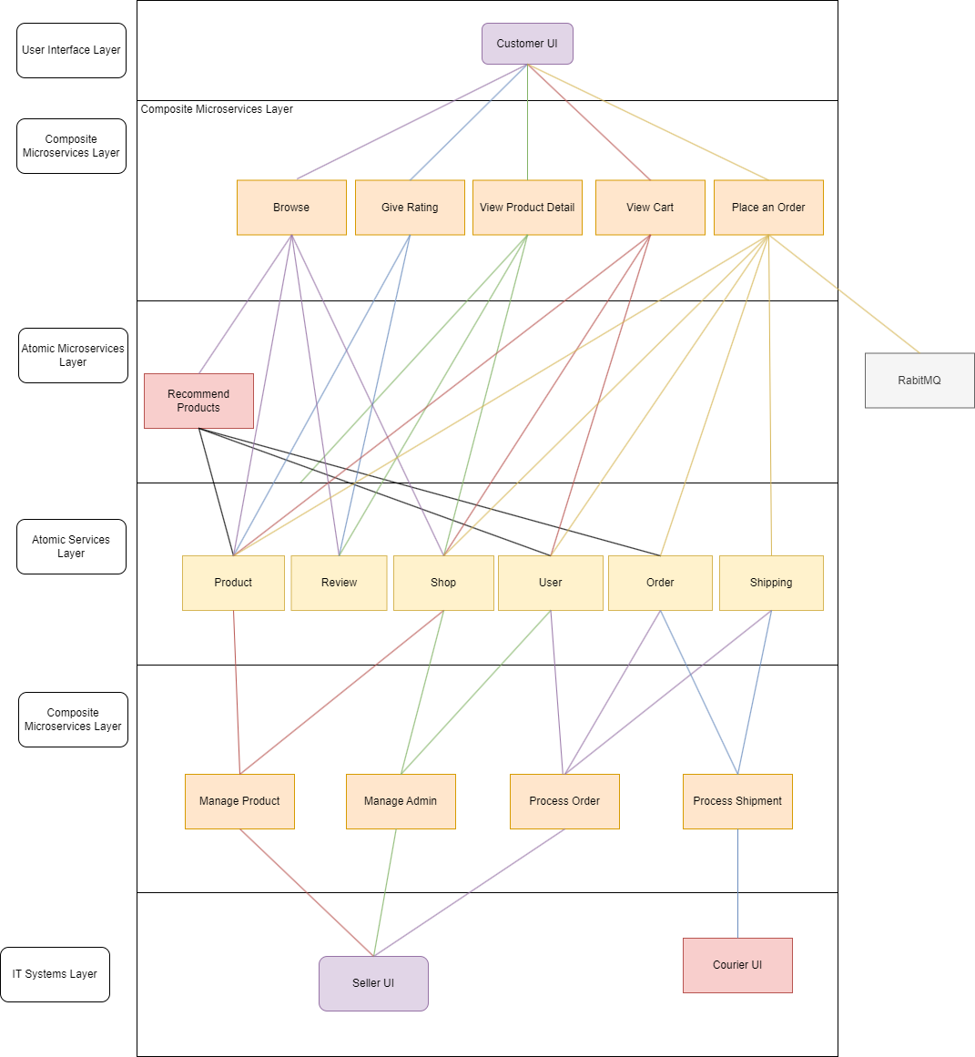
Solution Design

Slide 4
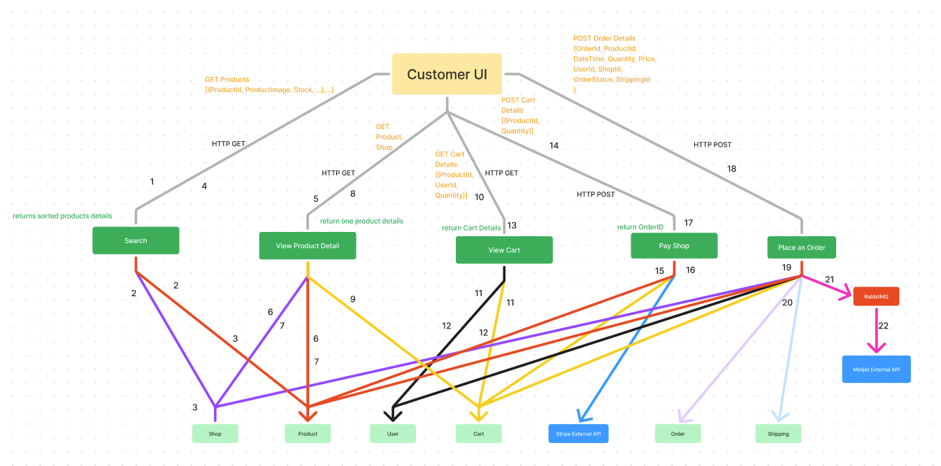
Microservice Interaction Diagram – User Buys A Product
Notes:
You may put more details about the communications (e.g., the URL for the (micro)services, the input parameters for the (micro)services along with the URLs), data stores used for the (micro)services, etc.) in the diagrams, as long as they are clean and easily readable.
This is a good place to consider what microservices should be built and what external services can be used to support the user scenario.
The process:
Passenger sends a booking request for a taxi through the UI by keying in destination of journey
UI invoke Pricing service, Get price operation to obtain the price for this journey
Pricing service calls the Google Distance Matrix API to obtain the distance for price calculation
Returns distance and other values to the Pricing service
Returns the price of trip based on the distance calculated
UI displays the price of trip and user clicks on Book, to initiate the booking request
UI invokes Booking service, New Booking operation to create a new booking with the status = open
Returns new booking created. At this point, booking is not confirmed as it is pending assignment of a driver, to complete this booking.
You may use double-headed arrows lines to represent request-reply communications.

Slide 5
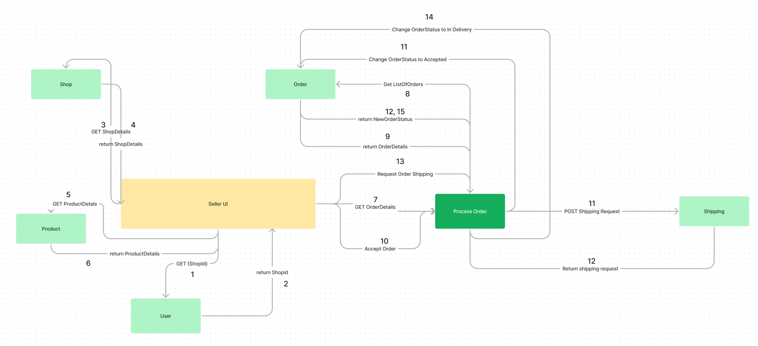
Microservice Interaction Diagram – Seller create store and add product
Notes:
You may put more details about the communications (e.g., the URLs, the AMQP binding/routing keys for the (micro)services, the input parameters, correlation ids, data stores, etc.) in the diagrams, as long as they are clean and easily readable.
Taxi driver uses UI to find a booking. The driver uses the UI to invoke the Booking service, via [GET] /booking/open to get all open bookings.
Return all bookings that are currently with the status = open. UI displays all bookings and driver selects a specific one
Triggers UI to invoke Accept Booking complex microservice, [POST] /acceptbooking/{bookingID}, to orchestrate the accept booking process.
The Accept Booking microservice invokes Booking microservice, [PUT] /booking/{bookingID}, to update the status of the booking
The Accept Booking microservice invokes Passenger microservice, [GET] /passenger/{passengerID}, to obtain Passenger information.
Passenger microservice returns the passenger information (e.g. contact details).
Accept Booking microservice sends a message {passengerID, driverID, phone} with routing key passenger.notify to a topic message exchange. SMS service will receive the message based on binding key *.notify and send a SMS to the passenger.
The Accept Booking service upon receiving passenger information returns the confirmation of the booking to the Taxi Driver UI.
You may use either double-headed arrows or 2 uni-direction arrows to depict request-reply.

Slide 6
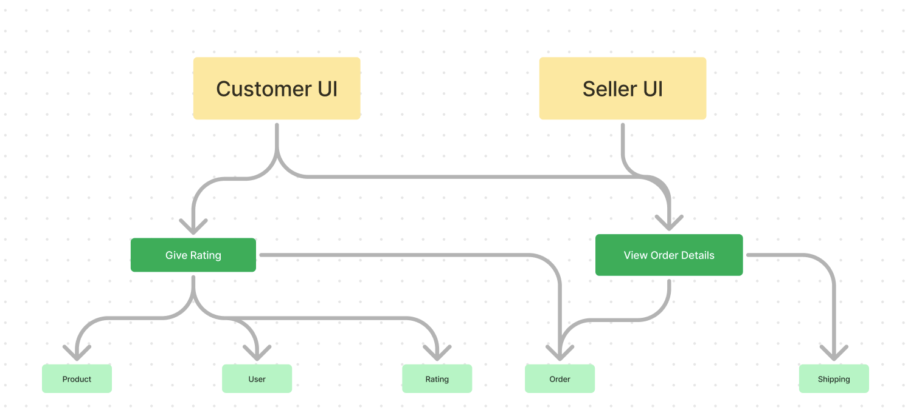
Microservice Interaction Diagram – User reviews product after it arrives
Notes:
You may put more details about the communications (e.g., the URLs, the AMQP binding/routing keys for the (micro)services, the input parameters, correlation ids, data stores, etc.) in the diagrams, as long as they are clean and easily readable.
Taxi driver uses UI to find a booking. The driver uses the UI to invoke the Booking service, via [GET] /booking/open to get all open bookings.
Return all bookings that are currently with the status = open. UI displays all bookings and driver selects a specific one
Triggers UI to invoke Accept Booking complex microservice, [POST] /acceptbooking/{bookingID}, to orchestrate the accept booking process.
The Accept Booking microservice invokes Booking microservice, [PUT] /booking/{bookingID}, to update the status of the booking
The Accept Booking microservice invokes Passenger microservice, [GET] /passenger/{passengerID}, to obtain Passenger information.
Passenger microservice returns the passenger information (e.g. contact details).
Accept Booking microservice sends a message {passengerID, driverID, phone} with routing key passenger.notify to a topic message exchange. SMS service will receive the message based on binding key *.notify and send a SMS to the passenger.
The Accept Booking service upon receiving passenger information returns the confirmation of the booking to the Taxi Driver UI.

Slide 7
Technical Overview Diagram/SOA Layer Diagram
Notes:
This is an overall Technical Overview Diagram showing the needed (micro)services in the scenario and possible implementation details.
It is good to fill this in with as many details as possible to plan your implementation, and observe the dependency between the UI to the (micro)services.

