Slide 1
«Assortative and preferential attachment leads to core periphery» Torres, L., Puggini, L., & Moreno, V. (2023)
Prof. Piccardi Carlo
Palladino Vittorio
Academic year 2024/25

Slide 2
Introduction and various definition of core-periphery
Borgatti and Everett:
Fully-connected core
Disconnected periphery
Indicate the core periphery as the correlation between the real adjacence matrix and the ideal one.
Gallagher
Introduce two type of core periphery models:
Hub and spoke as generalization of the Borgatti and Everett’ model
Layered network

Slide 3
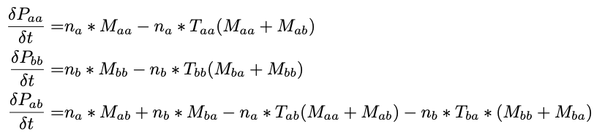
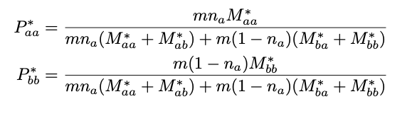
1 Models used
Rewiring Model
Focal node select randomly with p = nₐ
Choose Candidate
Given a uniform distribution if p < c
Preferential Attachment
Otherwise randomly
Link creation
If the nodes belongs to the same group
Create a link with p = Sa
Otherwise 1-Sa = Sab
Link deleted with a random neighbors
Growing Model
Focal node added with p = nₐ
Choose M candidates
Given a uniform distribution if p < c
Preferential Attachment
Otherwise randomly
Link creation
If the nodes belongs to the same group
Create a link with p = Sa
Otherwise 1-Sa = Sab
Repeated m times

Slide 4
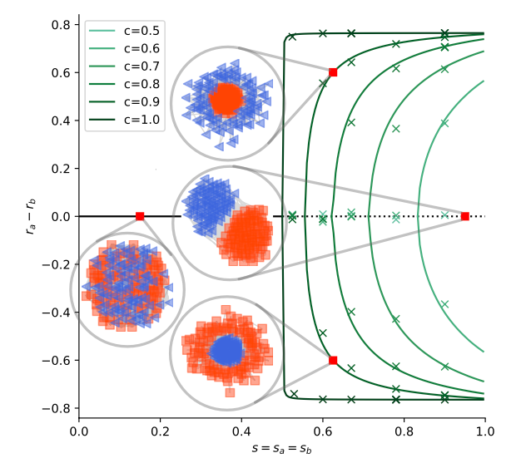

2.1 How much preferential attachment and assortative influenced the CP
For s <= 0.5 no detailed distinction between Core and periphery
Both group are disassortative
For s > 0.5 preferential attachment led the bifurcation between core and periphery
Two possible unstable solution (a (b) core if r_a – r_b > (<) 0)
The higher the c the more accentuated is the distinction
Core quality indicator
r_g = max r_g(alfa)

Slide 5
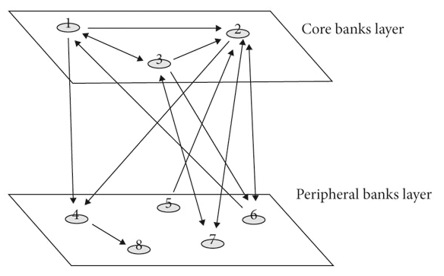
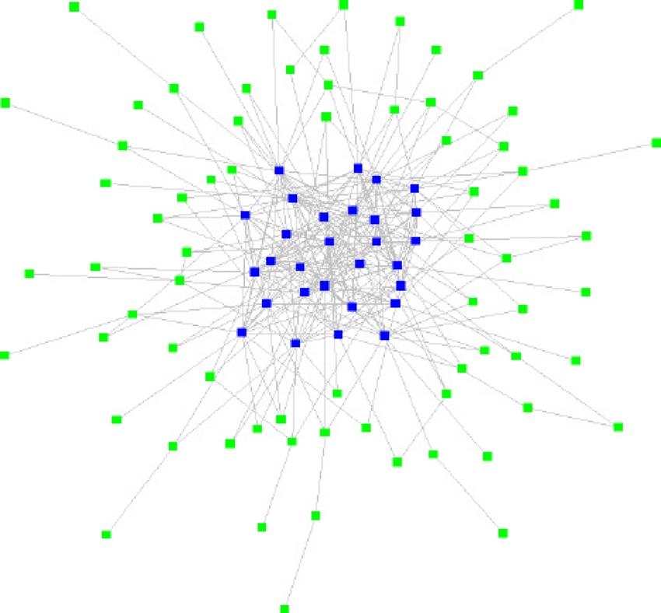



Where do the models evolve to?
Growing models tends to Layered Network
Rewiring models tends to Hub and Spoke
$Ωg ≈$ 0
$Ωg ≈$ 1

Slide 6
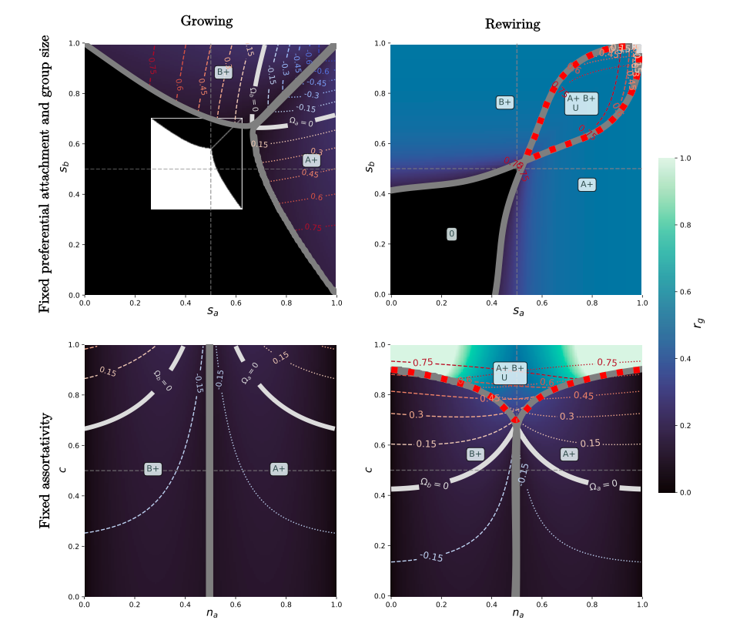
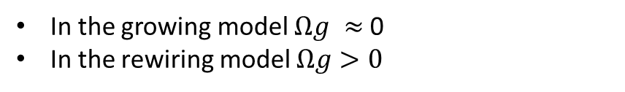
2.2 How much preferential attachment and assortative influenced the CP
Dotted red lines isolate place where a or b can become either core
Top:
Assortativity can improve core periphery distinction ( c = 0.95, na = Na/N = 0.5)
Bottom
Preferential attachment minority group to become core (rewiring model)
In the growing model $Ωg ≈$ 0
In the rewiring model $Ωg>0$

Slide 7
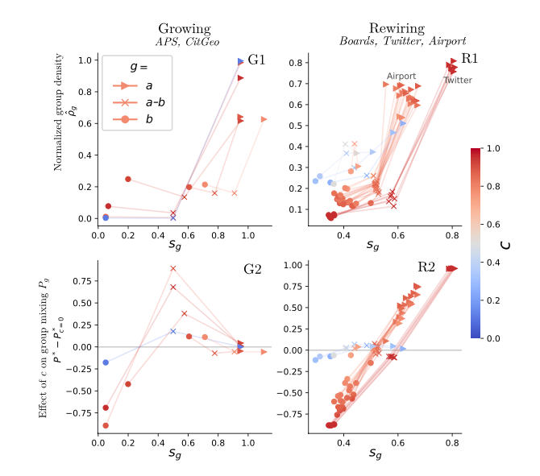
Pratical experiment on growing and rewiring model
LEFT: growing model, citation newtork based on geography and subfield within physics
0<Sg<0.5 preferential attachment leads to more intra-core links
Then increasing in the Sg leads to more inter group (tends to Layered network)
RIGHT: rewiring model, twitter discussion about climate change (core political actors)
Sg > 0 (core assortative despite the periphery tends to connect with core nodes)
Increase the number of links inside the core at the expense of the intra groups links. => hub and spoke => high GINI/CP coefficient
P* - P*c=0 > 0 LOSS of Link Intragroup
P* - P*c=0 < 0 GAIN of link
P* fixed point of P for fixed value
“Notably, for the rewiring model preferential attachment vastly increases the fraction of links within the core at the expense of links within the periphery”

Slide 8
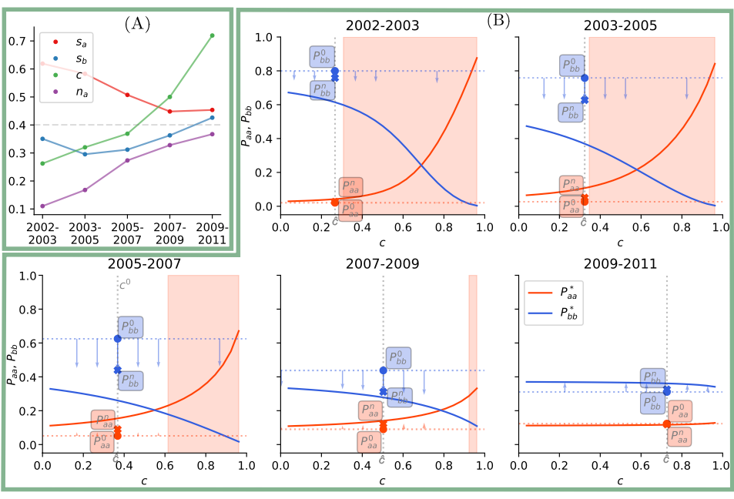
Variations of the parameters
Due to some constraints on the theoretical models (deletions might not follow creation, assortavity definition…) the result may deviate from the seen one.
Study case: Boards network, boards of director in Norway 2002-2011.
Link between two nodes => belongs to the same board
A: evolutions of the four fitted parameters.
B: evolution of Group mixing matrix
Policy applied: Increase of the minority group by the end of 2008 (starts in 2006)
The real policy tends to the fixed point of the rewiring model
Alternative policy applied by the author: leave other parameters untouched, and increase (decrease) preferential attachment. (Restricting the link between people). RED and BLUE arrow.

Slide 9
Conclusion
GROWING MODEL
Structure: Tends to Layered network
Effect of preferential attachment: High preferential attachment leads to more inter-group links at the expense of the intra-core ones.
Comparison with rewiring: Equal to the rewiring model but gain links over time and has no deletion step.
Influence on the CP-CNN maximizing the log likelihood over the preferential attachment leads the CP hidden layer to have some nodes(core) which extracts more features than peripheral nodes.
REWIRING MODEL
Structure: Tends to Hub and Spoke
Effect of preferential attachment: High preferential attachment boosts the intra-core links
Comparison with growing: high preferential attachment can lead minority group to became core
Link deletion «shifts» the links from one group to another over time.

Slide 10
References
Torres, L., Puggini, L., & Moreno, V. (2023). Assortative and preferential attachment lead to core-periphery networks. arXiv preprint arXiv:2305.15061. Available at: https://arxiv.org/abs/2305.15061
Zhao, L., Dai, H., Wu, Z., Zhu, D., & Liu, T. (2023). CP-CNN: Core-Periphery Principle Guided Convolutional Neural Network. ArXiv preprint arXiv:2304.10515.
Available at: https://arxiv.org/abs/2304.10515

