Slide 1
B3M38DIT1 Fault detection of sensors with machine learning using LSTM neural networks
Vít Zeman 09.01.2023

Slide 2
Task
Fault detection on temperature sensor
Long-term time series data from multiple sensors
Using Long short-term memory (LSTM) neural network

Slide 3
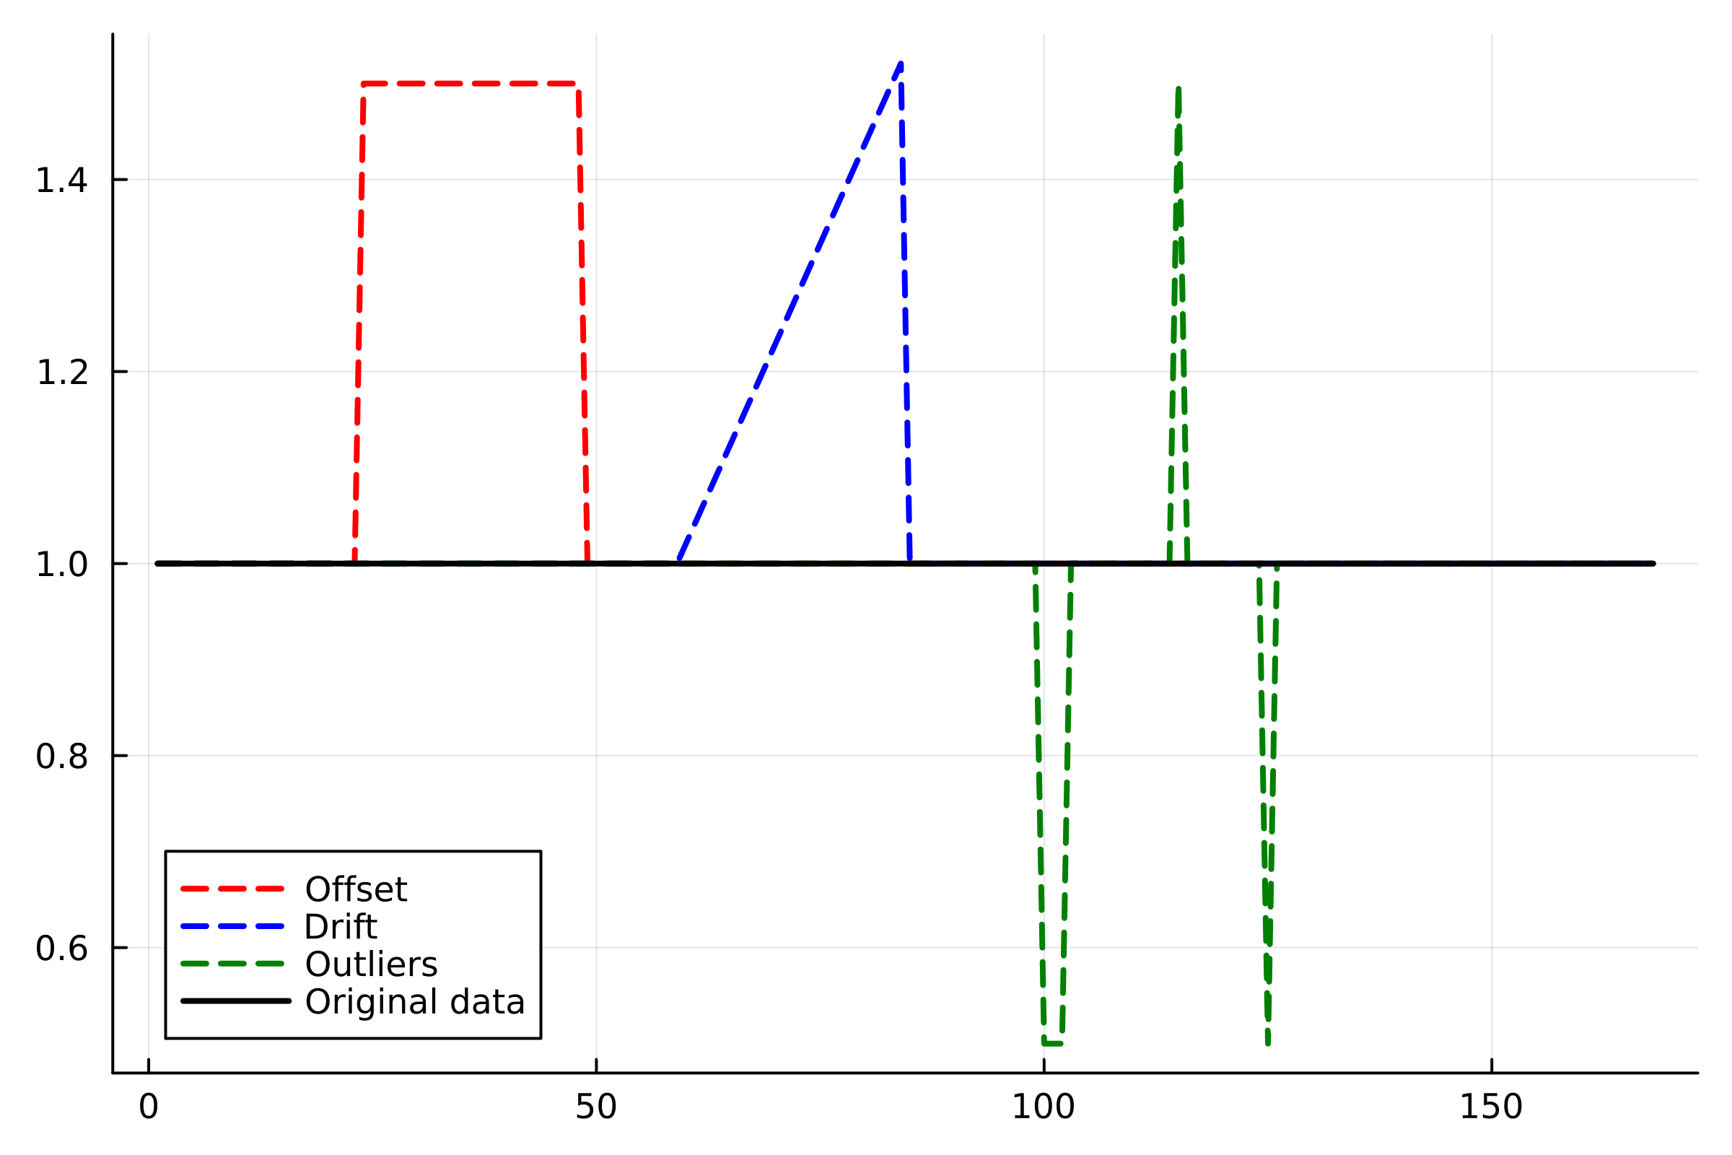
Faults
Three types of faults:
Drift:
Linear
± [0.75; 1.25] kelvins every 5 days
Offset:
Shift in temperature values
± [0.5; 5] Kelvin
Outliers:
Sudden big jump in value
± [10; 30] Kelvin from average

Slide 4
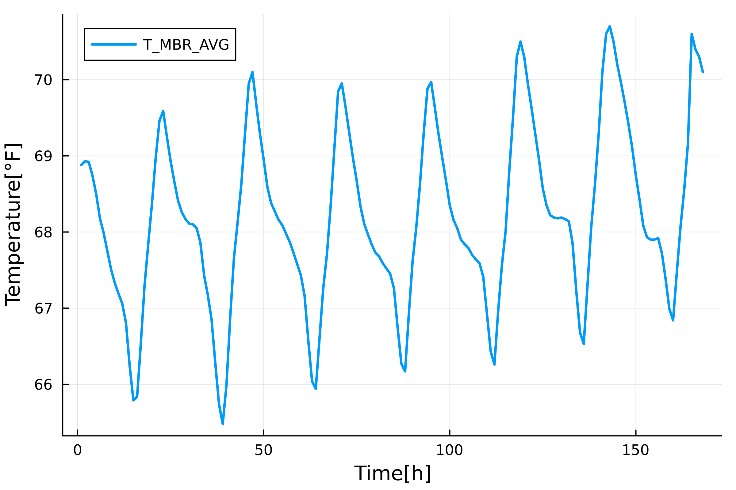
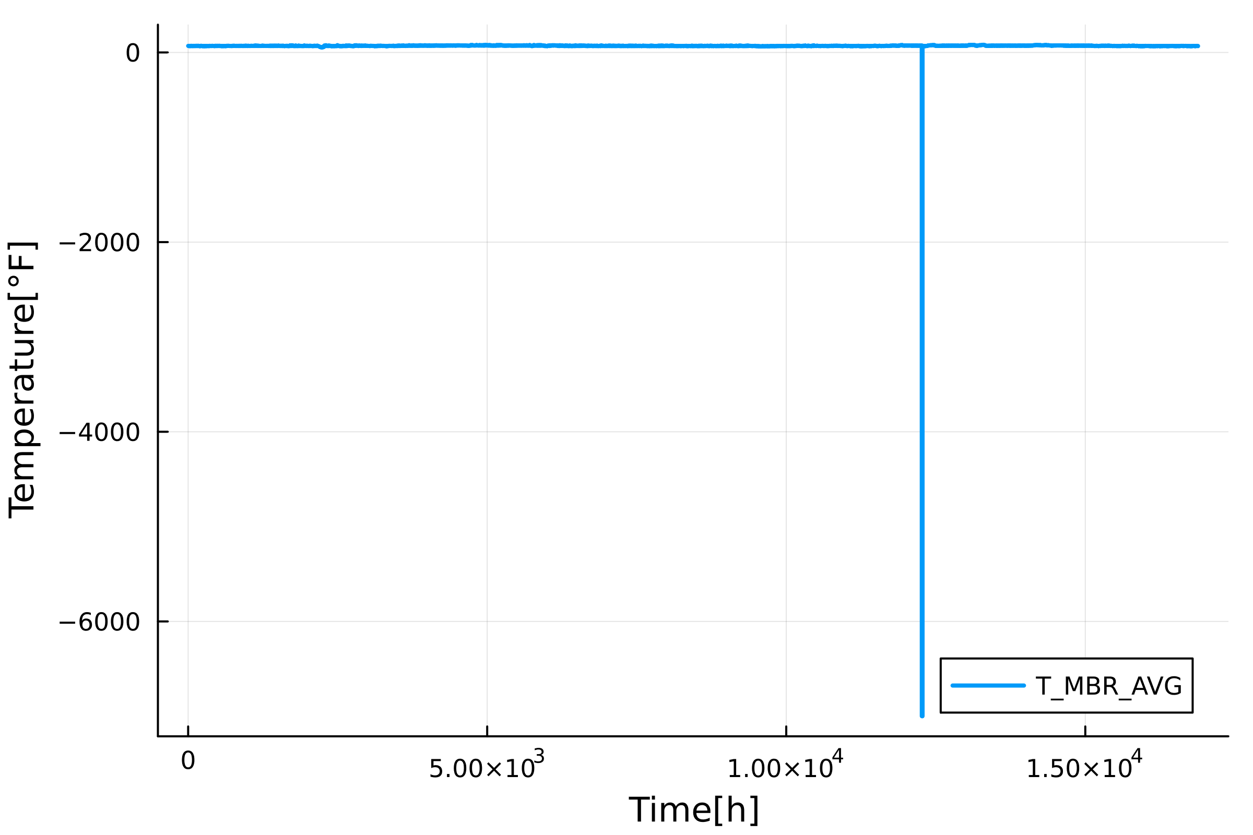
Data
Temperature, relative humidity, energy consumption and generation
Approx. 704 days of continuous measurements
Average over hour
Inconsistencies (-6999 °F, missing data)

Slide 5
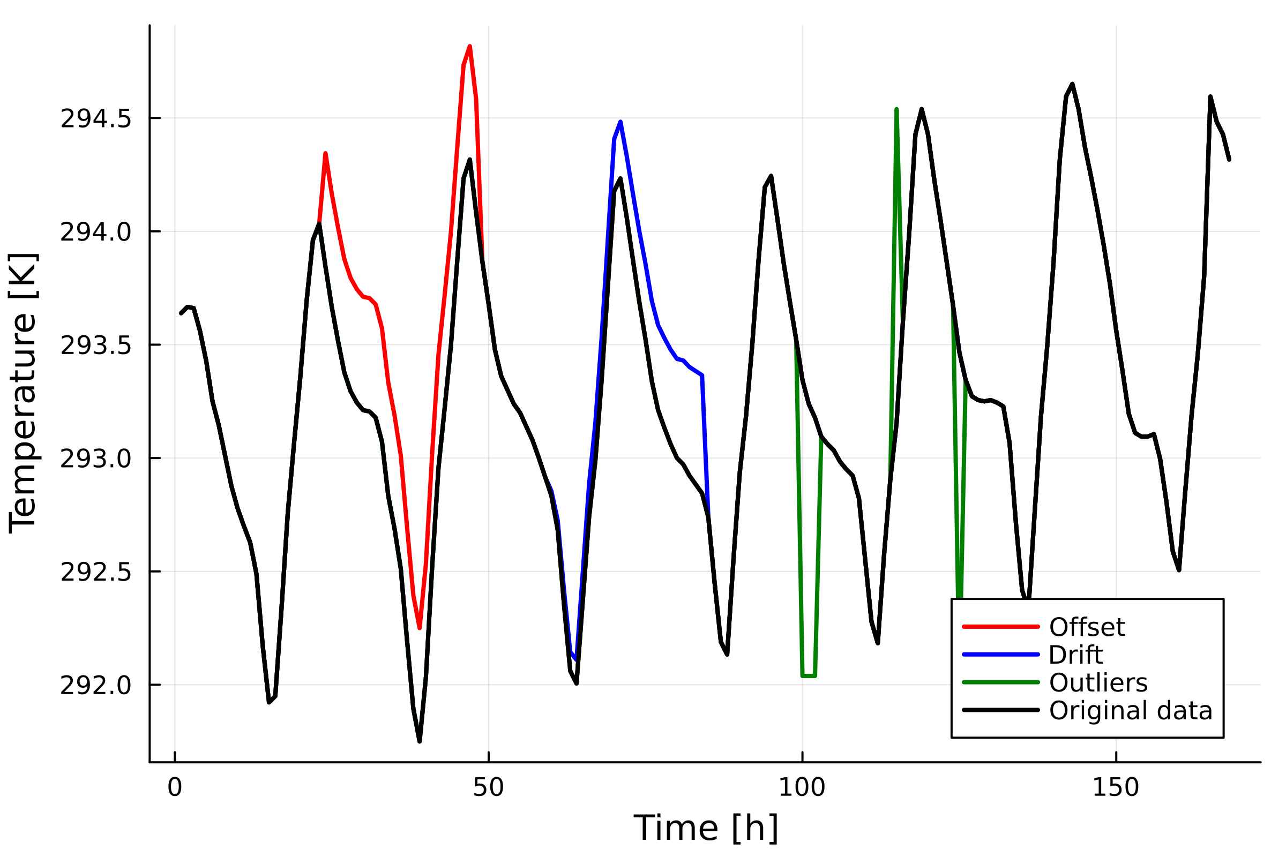
Dataset generation
Conversion to Kelvins
Random location and duration
4 classes
Faultless
Drift
Offset
Outlier
Distribution of [0.4, 0.2,0.2,0.2]

Slide 6
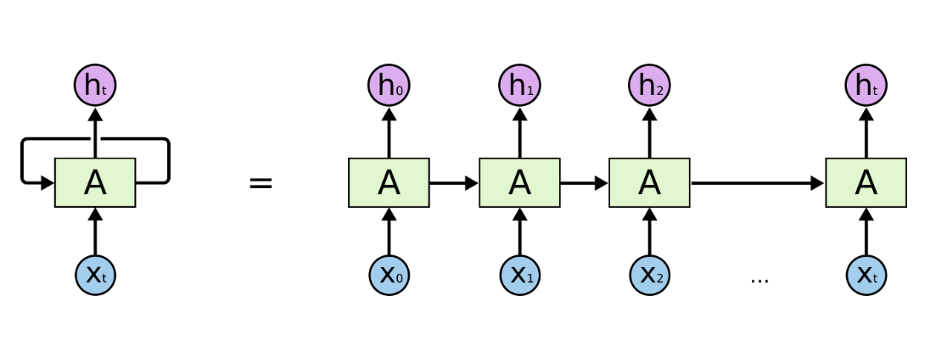
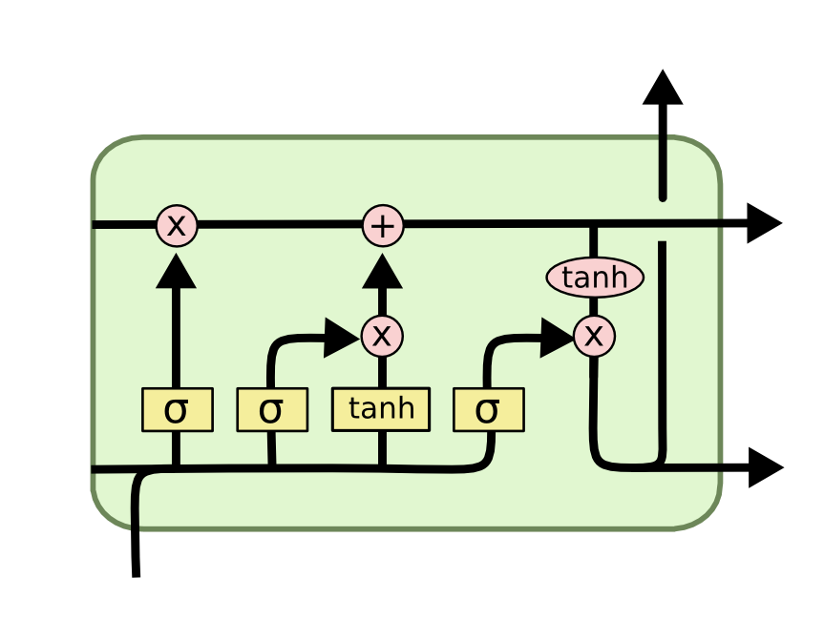
RNNs and LSTMs
Memory: Previous input/output impacts current case
RNNs
Only short memory
Vanishing or exploding gradient
LSTMs
Added long term memory
Used for classification and prediction
Images: https://colah.github.io/posts/2015-08-Understanding-LSTMs/

Slide 7
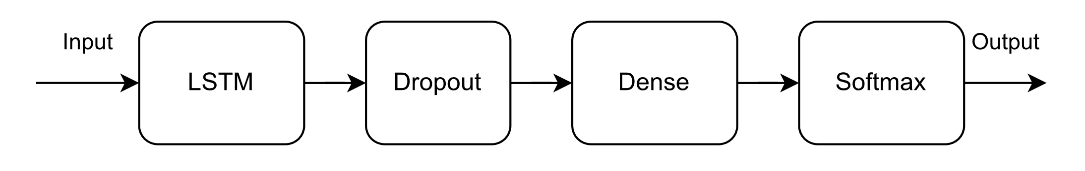
Proposed model
Idea use LSTM to extract features
Use Dense layers to classify outputs
Metrics
Accuracy
Confusion matrix

Slide 8
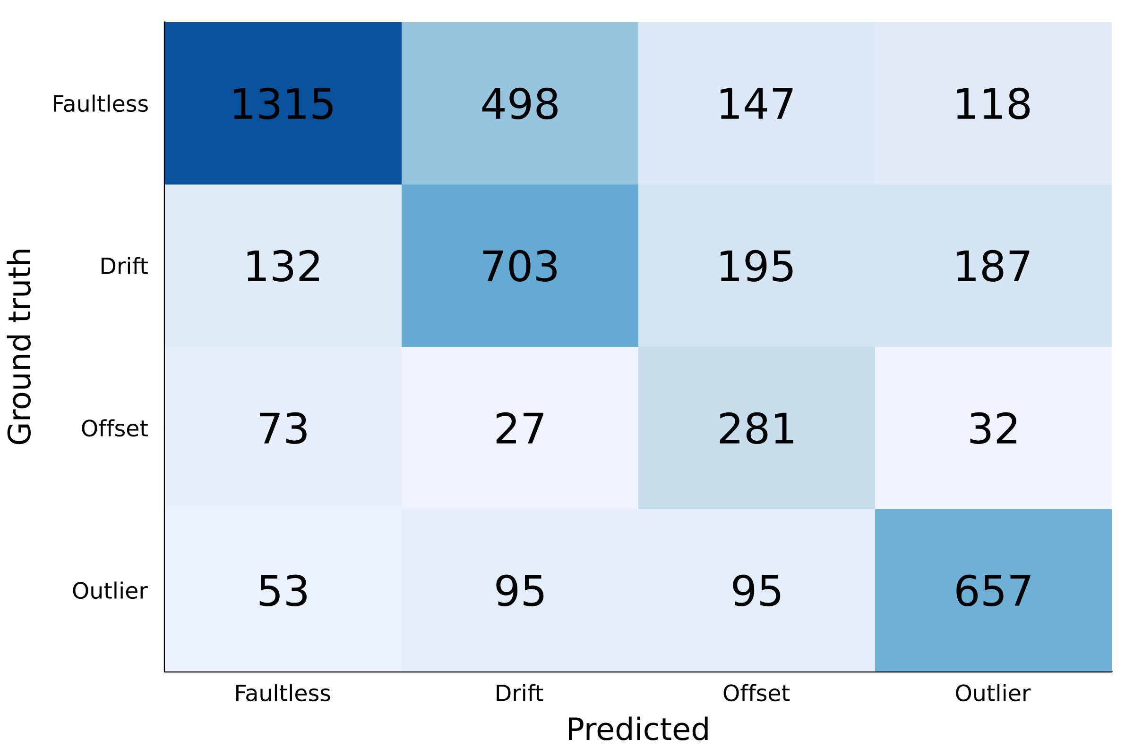
Results
Accuracy 64%

Slide 9
References
[1] S. Hochreiter and J. Schmidhuber. Long short-term memory. Neural computation, 9:1735–80, 12 1997.
[2] R. C. Staudemeyer and E. R. Morris. Understanding lstm-a tutorial into long short-term memory recurrent neural networks. 2019.

