Slide 1
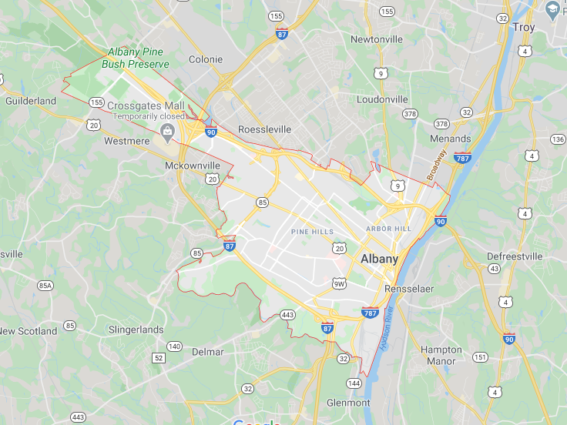
The City of Albany, NY
New York State capital city
Population: ~100,000
Economy: governmental centers,
academy, industry & high-tech

Slide 2
Goal:
Understanding the pricings of houses in various areas in the city

Slide 3
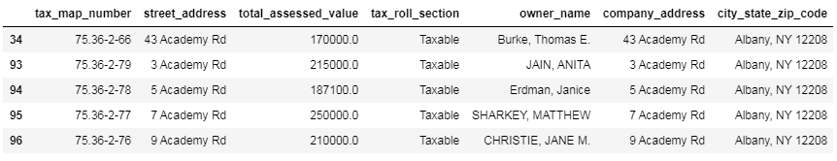
Database
Using the official database in the city website

Slide 4
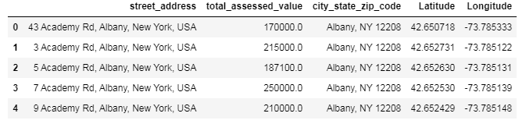
Data Cleaning
Attaching each address of private home a price and location in coordinates by using online services

Slide 5
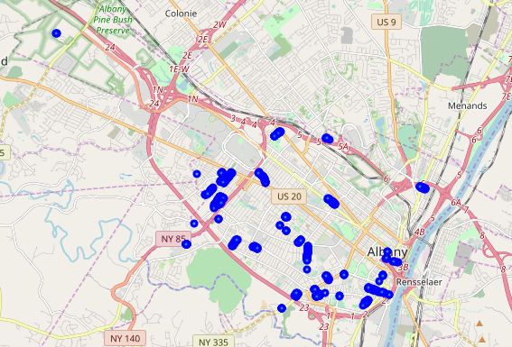
Data Cleaning
After locating the houses the data is presented using Folium package on the map

Slide 6
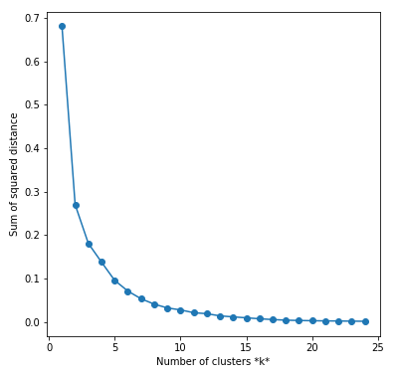
Clustering
Now I grouped the houses in the city by their location in order to understand how their location change their price.
In order to understand how many groups should be clustered I checked the accuracy by SSD algorithm
15 clusters is chosen as seen to be good enough

Slide 7
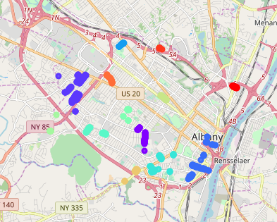
Clustering
Clusters presented on map by Folium

Slide 8
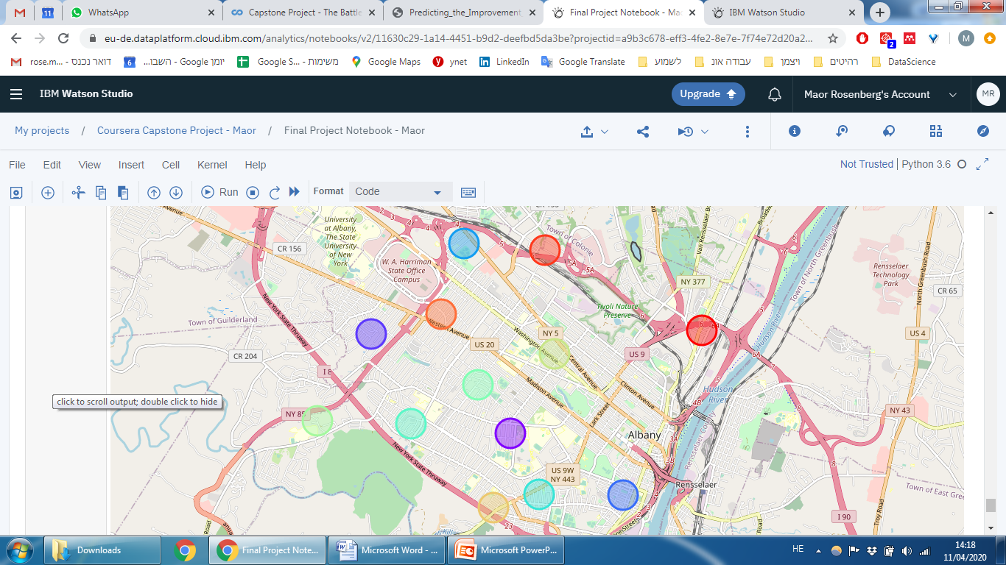
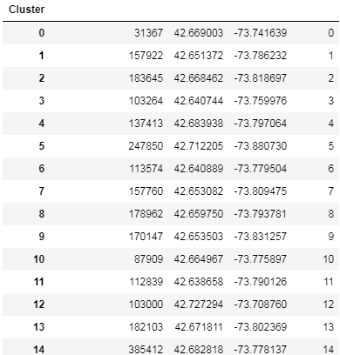
Clustering
Then for each cluster housing prices were averaged and put on map

Slide 9
Clustering
385,412$
137,413$
182,103$
31,367$
183,645$
87,909$
178,962$
170,147$
157,760$
157,922$
113,574$
103,264$
112,839$

Slide 10
Conclusions
Houses closer to city center have higher prices
Houses closer to highways have higher prices
The highest prices are at the northern side of the city

