Slide 1

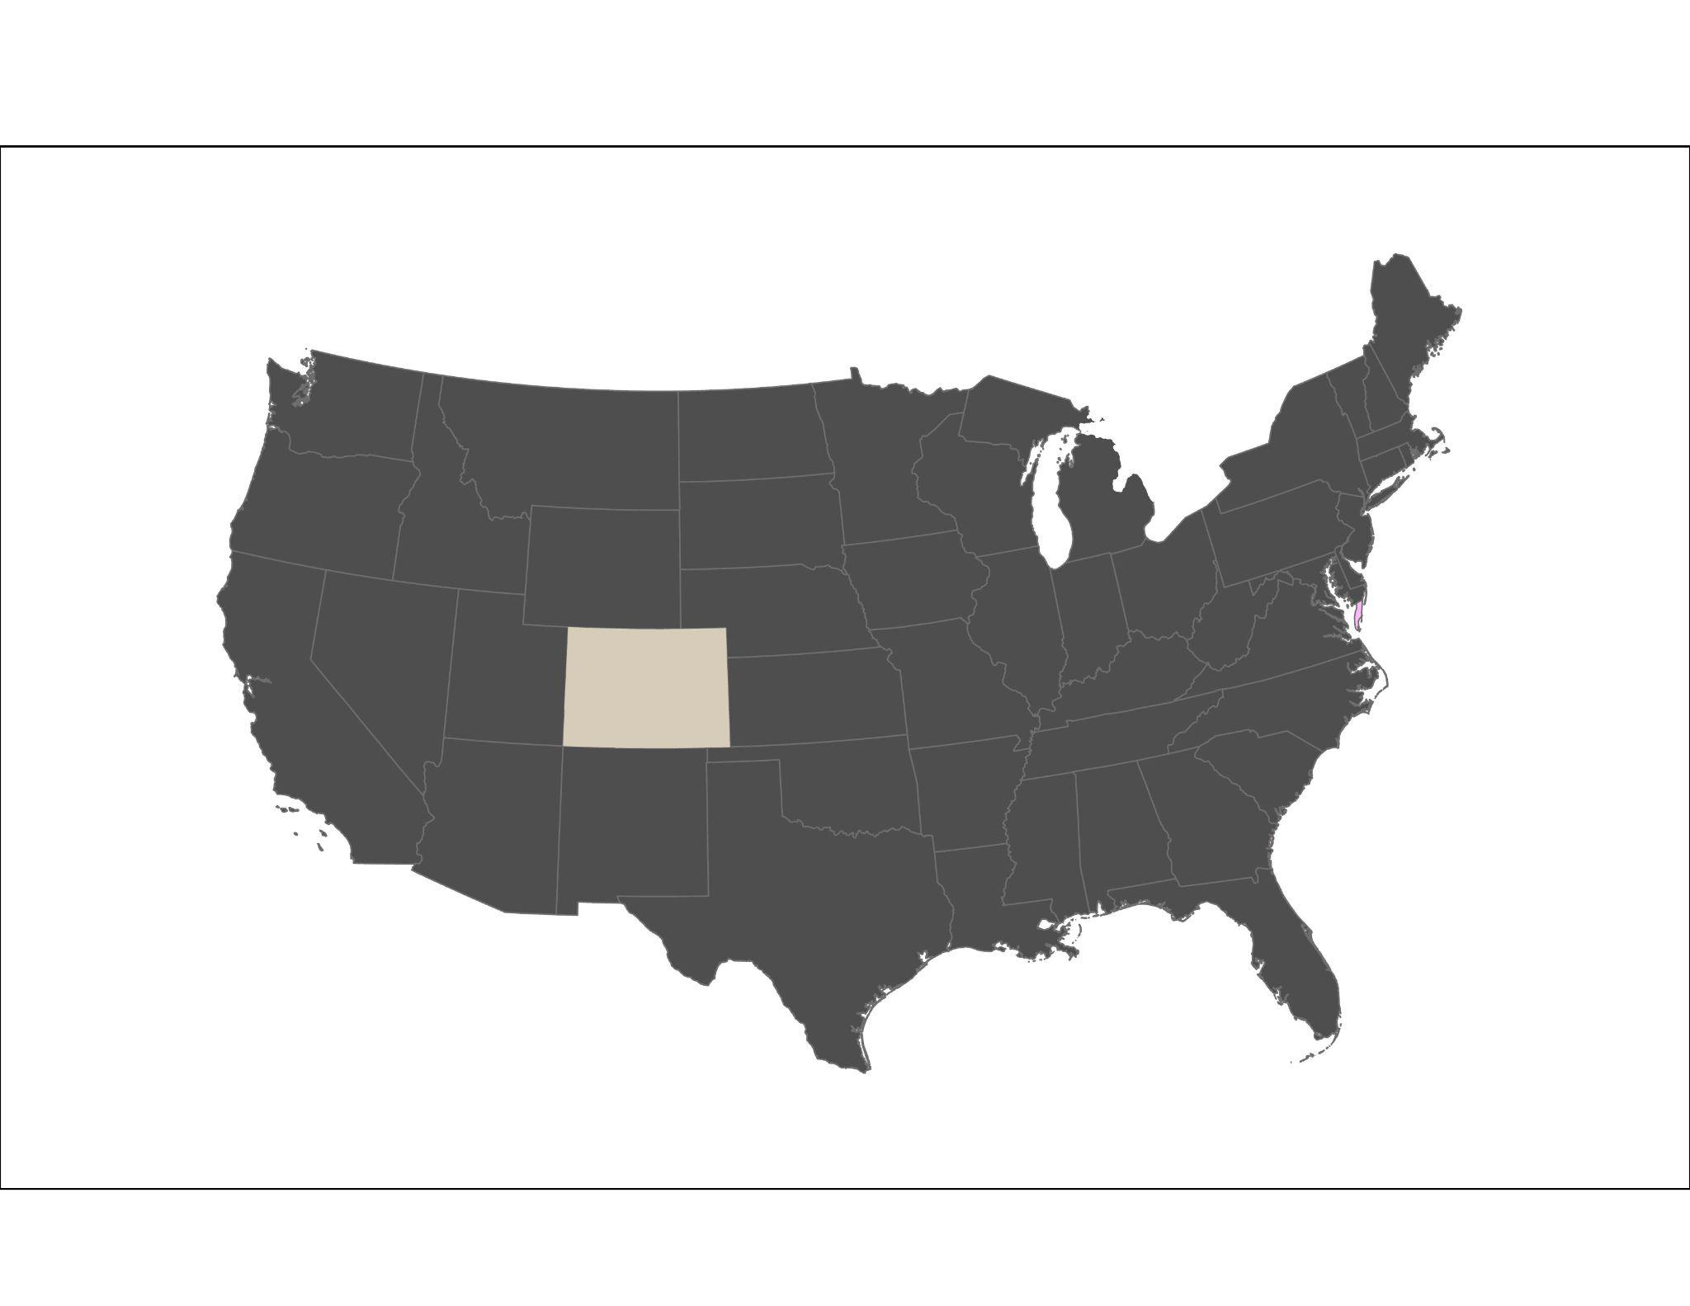
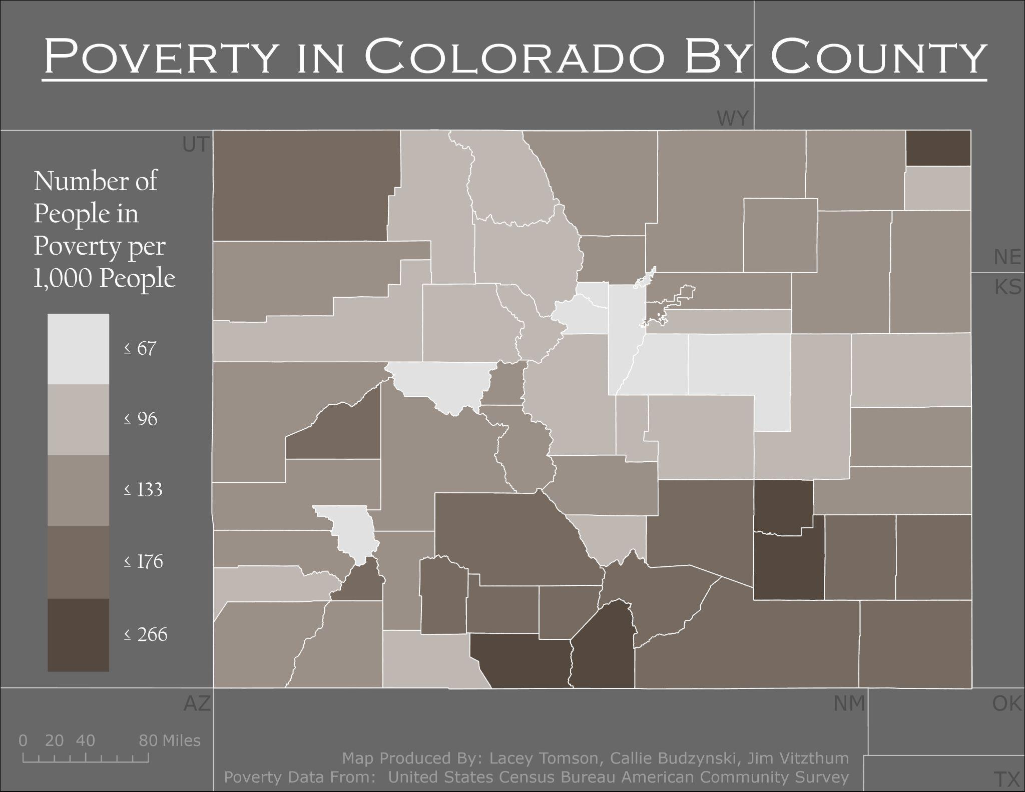
P o v e r t y
P o l l u t i o n
Callie Budzynski
Lacey Tomson,
Jim Vitzthum
and
Are Colorado Counties with Higher Rates of Poverty Experiencing More Sites of Pollution?
GEOG 5092
December, 2022
Introduction
Methods
Results and Conclusions
Colorado’s state history is intertwined with mining.The act of mining can create harsh environmental effects such as mountain-top removal and acid mine drainage.
Abandoned mines have the potential to evolve into Superfund sites, even making it to the Environmental Protection Agency’s National Priority List for cleaning efforts.
With over one thousand active mines and Superfund sites in the state of Colorado, the relationship of these sites to the poverty rates in each county were explored.
Identify the total number of mines and superfund sites (pollution sites) and the total area for the pollution sites in each county.
For each county, calculate the number of people in poverty per 1,000 people, calculate the number of pollution sites per 1,000 square miles, and calculate the area of pollution sites per 1,000 square miles.
Calculate a Linear Regression and Pearson’s R with both the pollution sites and pollution site areas as a function of poverty rates for each county.
There were weak negative relationships observed between poverty rate and, both, pollution sites and pollution site areas in each county.
Both linear regression R² values show that poverty can explain less than 5% of the variance in the pollution data and both P-Values are insignificant, as well.
Both the linear regression and Pearson’s R results do not conclude that counties in Colorado that are higher in their poverty rate are also experiencing statistically more sites of pollution than the counties in Colorado that are lower in their poverty rate.

Slide 2
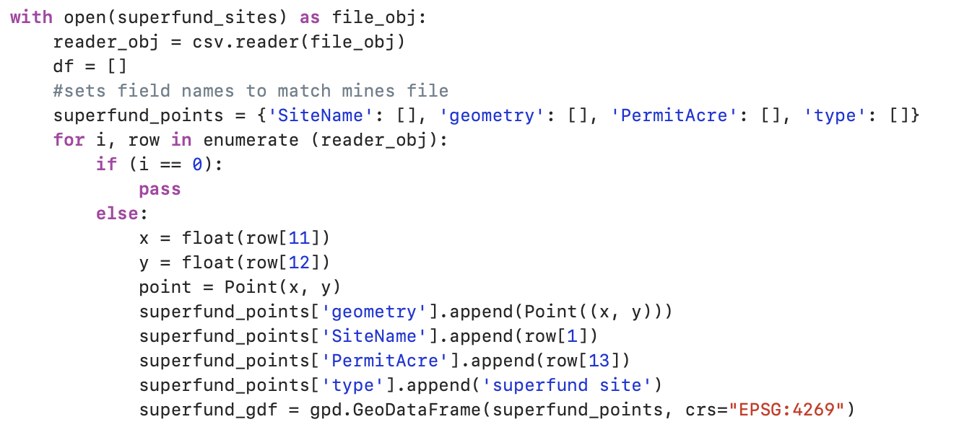

P o v e r t y
P o l l u t i o n
Callie Budzynski
Lacey Tomson,
Jim Vitzthum
and
Are Colorado Counties with Higher Rates of Poverty Experiencing More Sites of Pollution?
GEOG 5092
December, 2022
Code Methods: Pollution Sites per County
Code can go here

Slide 3
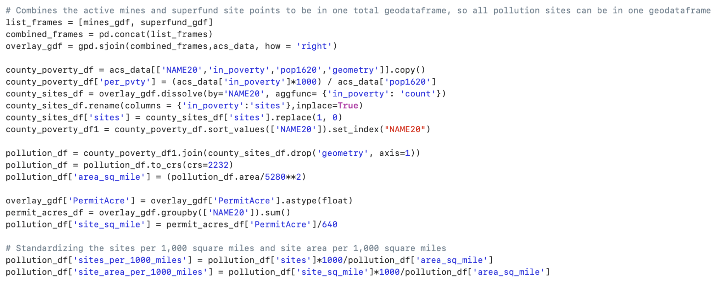
P o v e r t y
P o l l u t i o n
Callie Budzynski
Lacey Tomson,
Jim Vitzthum
and
Are Colorado Counties with Higher Rates of Poverty Experiencing More Sites of Pollution?
GEOG 5092
December, 2022
Code Methods: Standardizing Data
Code can go here

Slide 4
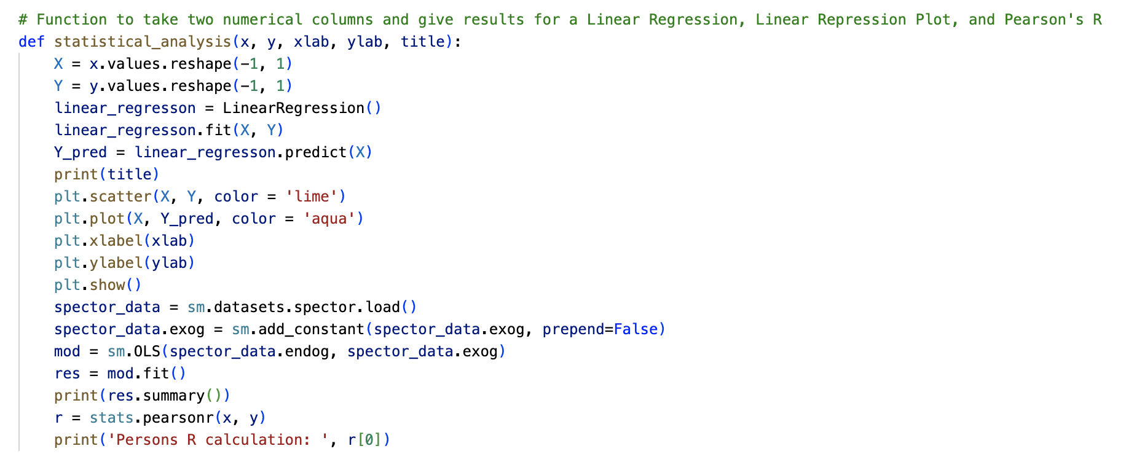
P o v e r t y
P o l l u t i o n
Callie Budzynski
Lacey Tomson,
Jim Vitzthum
and
Are Colorado Counties with Higher Rates of Poverty Experiencing More Sites of Pollution?
GEOG 5092
December, 2022
Code Methods: Statistical Tests

Slide 5
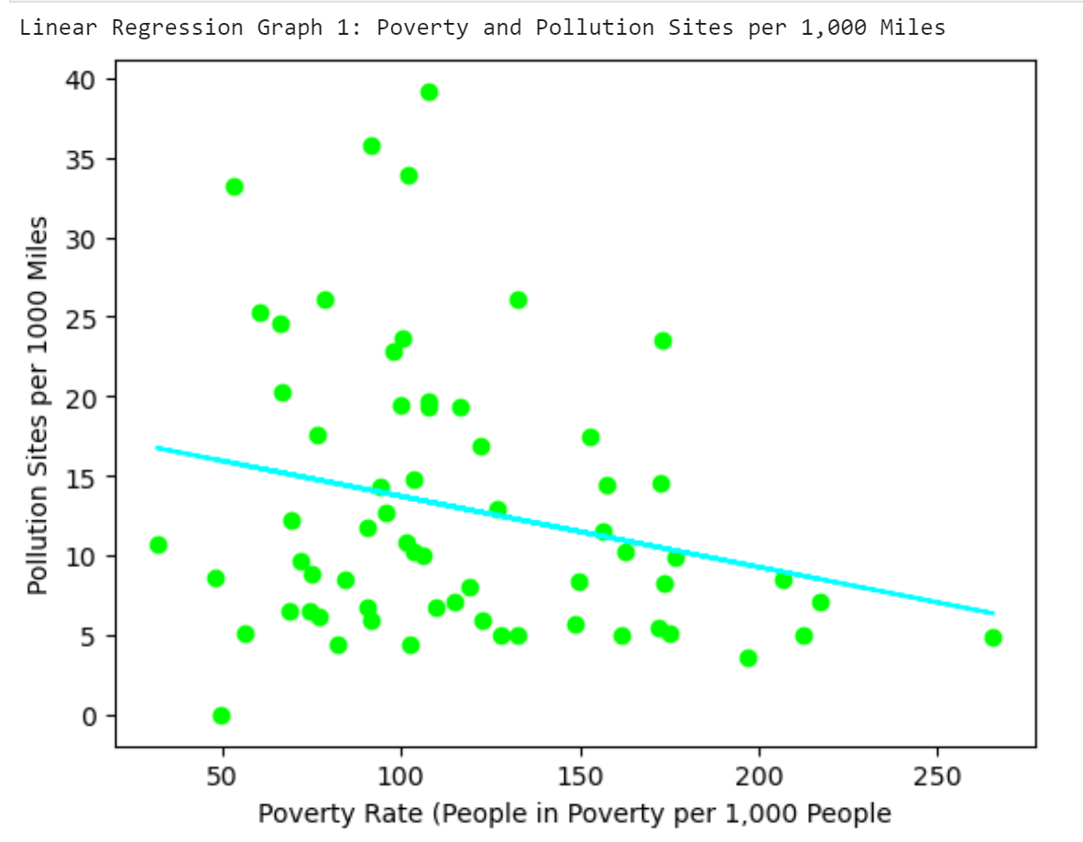
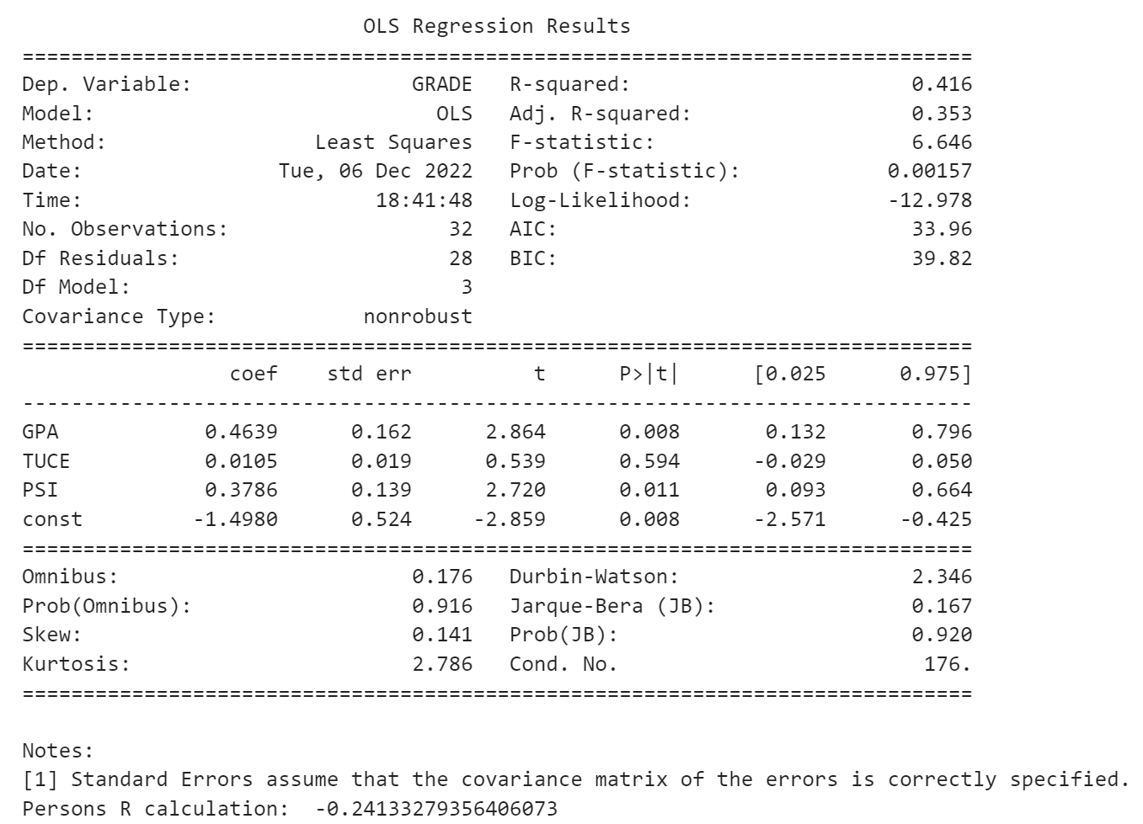
Statistical Output: Poverty Rate and Sites per 1,000 Square Miles
P o v e r t y
P o l l u t i o n
Callie Budzynski
Lacey Tomson,
Jim Vitzthum
and
Are Colorado Counties with Higher Rates of Poverty Experiencing More Sites of Pollution?
GEOG 5092
December, 2022

Slide 6
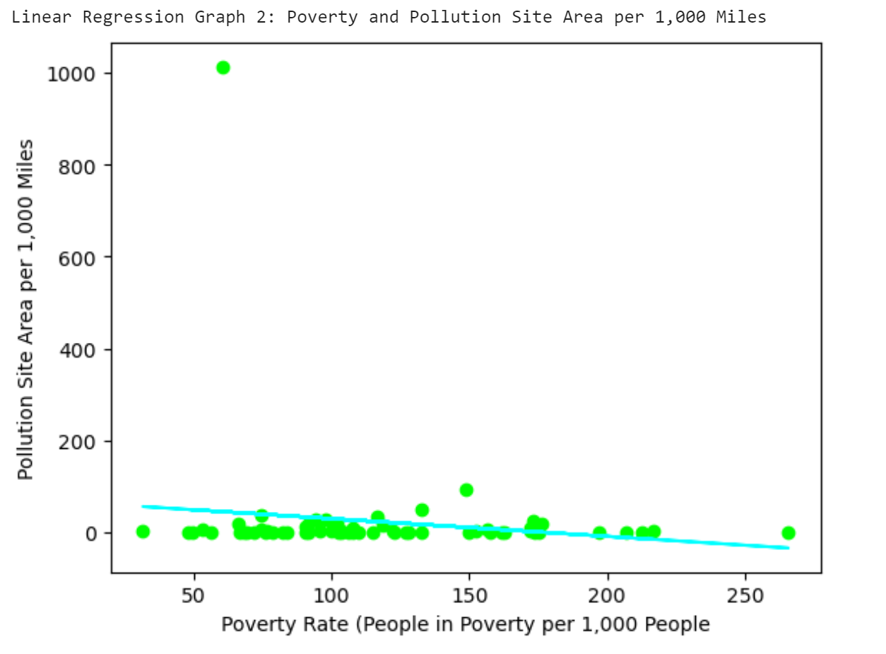
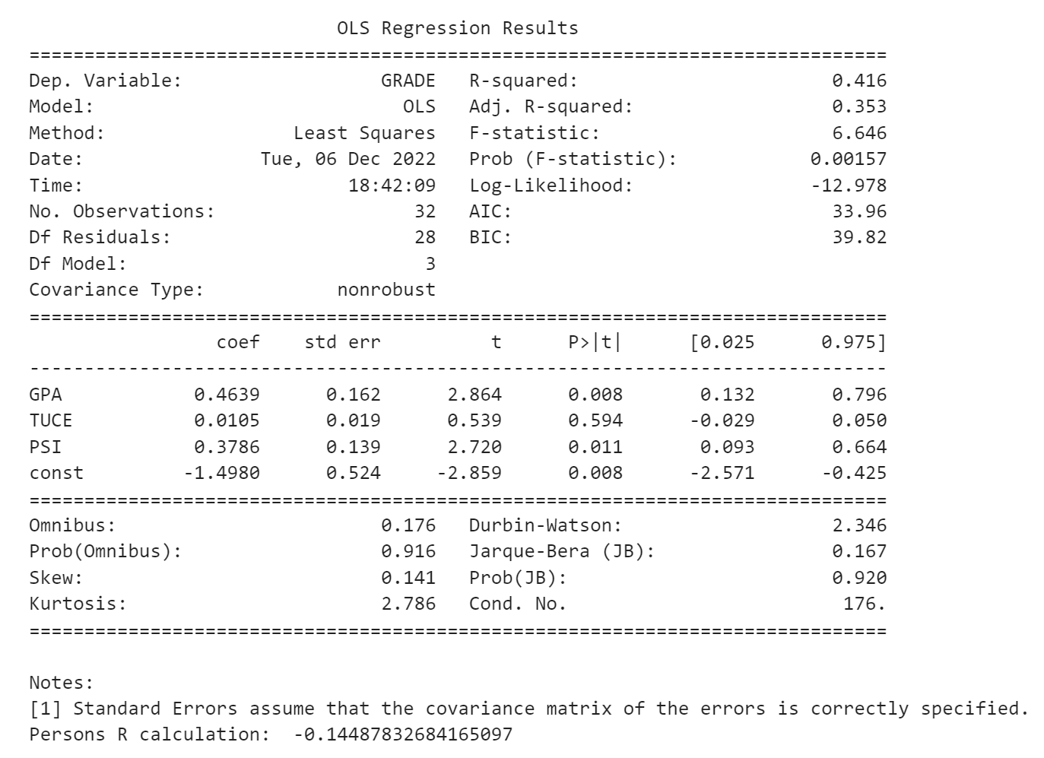
Statistical Output: Poverty Rate and Site Area per 1,000 Square Miles
P o v e r t y
P o l l u t i o n
Callie Budzynski
Lacey Tomson,
Jim Vitzthum
and
Are Colorado Counties with Higher Rates of Poverty Experiencing More Sites of Pollution?
GEOG 5092
December, 2022

Slide 7
P o v e r t y
P o l l u t i o n
Callie Budzynski
Lacey Tomson,
Jim Vitzthum
and
Are Colorado Counties with Higher Rates of Poverty Experiencing More Sites of Pollution?
GEOG 5092
December, 2022

Slide 8
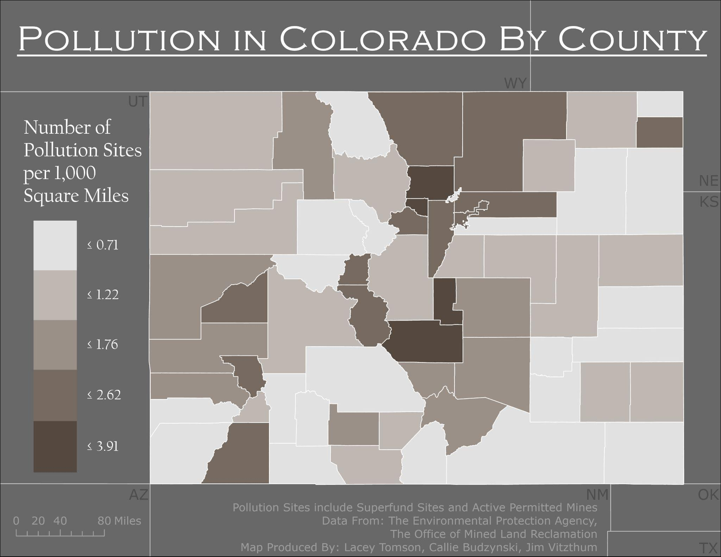
P o v e r t y
P o l l u t i o n
Callie Budzynski
Lacey Tomson,
Jim Vitzthum
and
Are Colorado Counties with Higher Rates of Poverty Experiencing More Sites of Pollution?
GEOG 5092
December, 2022

Slide 9
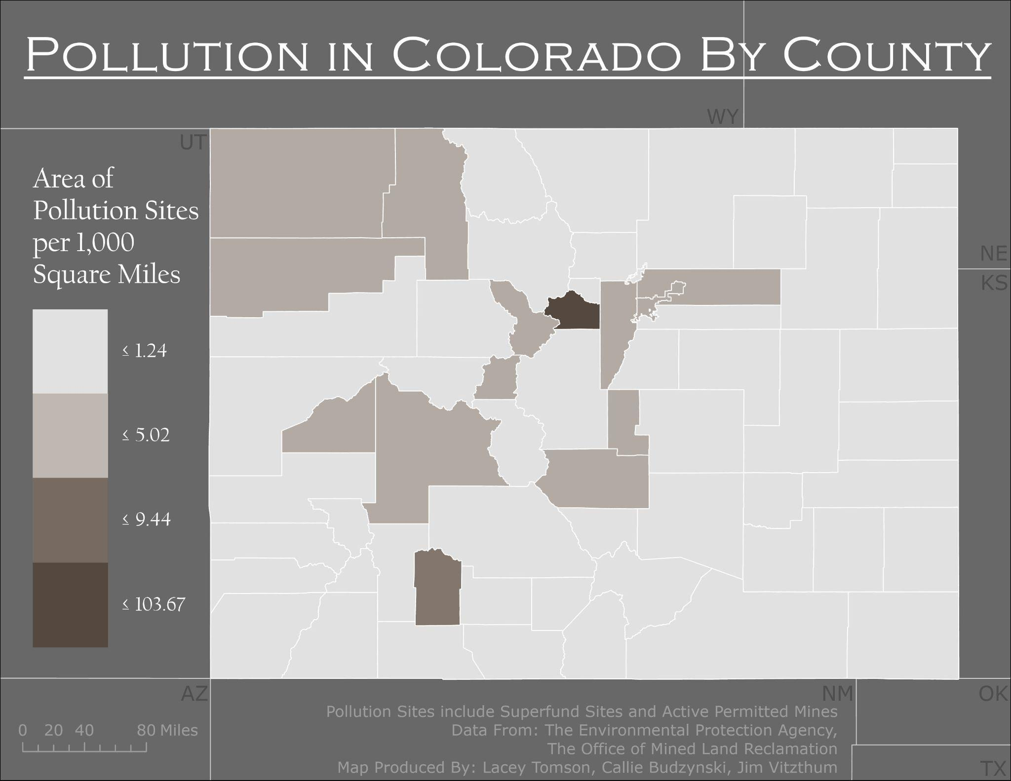
P o v e r t y
P o l l u t i o n
Callie Budzynski
Lacey Tomson,
Jim Vitzthum
and
Are Colorado Counties with Higher Rates of Poverty Experiencing More Sites of Pollution?
GEOG 5092
December, 2022

Slide 10
P o v e r t y
P o l l u t i o n
Callie Budzynski
Lacey Tomson,
Jim Vitzthum
and
Are Colorado Counties with Higher Rates of Poverty Experiencing More Sites of Pollution?
GEOG 5092
December, 2022
References
Superfund Site Information. EPA, Environmental Protection Agency, 20 Oct. 2017, https://cumulis.epa.gov/supercpad/cursites/srchrslt.cfm?start=1.
NVDataMiner. Arcgis.com, BLM, NDOM, USGS, FGDC Cadastral Subcommittee, BLM Colorado, BLM AZO Cadastral and GIS Staff, Oregon BLM, https://www.arcgis.com/home/item.html?id=c21b5d04d85943c58640a09bbfd366c5.
U.S. Census Bureau (2020). ACS1620, 2007-2011 American Community Survey 5-year estimates. Retrieved from https://data.census.gov/all?q=poverty+in+colorado+in+2020

