Slide 1
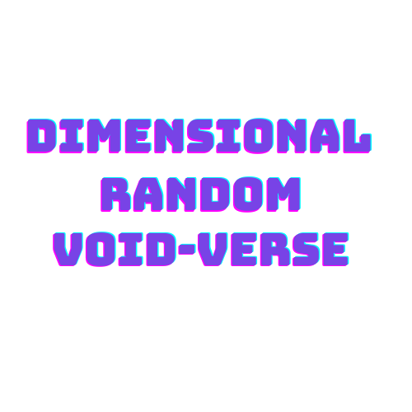



Slide 2
Creators:
Dev Mehta (19bca029)
Rahul Gosai (19bca013)
Vivek Malam (19bca056)

Slide 3
>> welcome to the dimensional random void verse…
>> status connected…
>> you are entering the void verse which will never be same everytime, you need to figure it out
how to survive and have a strategic tactics & gameplay to conquer the realm…
>> photosensitivity warning : read before playing…
>> A very small percentage of individuals may experience epileptic seizures when exposed to certain light patterns or
flashing lights. Exposure to certain patterns or backgrounds on a computer screen, or while playing video games,
may induce an epileptic seizure in these individuals. Certain conditions may induce previously undetected
epileptic symptoms even in persons who have no history of prior seizures or epilepsy.
If you, or anyone in your family, have an epileptic condition, consult your physician prior to playing. If you experience
any of the following symptoms while playing a video or computer game -- dizziness, altered vision, eye or muscle
twitches, loss of awareness, disorientation, any involuntary movement, or convulsions -- IMMEDIATELY discontinue
use and consult your physician before resuming play…

Slide 4


PLAY

Slide 5








FRONT-END TOOLS

Slide 6




MORE TOOLS
:- Used to create simulated UI & its elements.
:- Used to create 3D Models & Animations.
:- Used to create sounds to the game assets.
:- Used as an code editor with the C# extention.

Slide 7




BACK-END TOOLS

Slide 8

NETWORKING TOOLS
:- Unity Networking framework for real time
multiplayer games and application.

Slide 9

PROJECT DESCRIPTION
Dimensional Random Void-Verse (DRV) is an Action, Adventure Online Multiplayer Strategic game having three different game modes like Adventure, Survival, Battle Royale. It also contains Voice Over Internet Protocol (VoIP), Chat -Messaging.
The purpose of making our game is to experience the world in a fully different aspect as it’s not possible in real world. Like playing on virtual procedural generated environment which never be same as before!
Our game stand out of other games by the feature of Terraforming. In which player can manipulate the terrain like making caves or ridge to survive & to explore the game in their own way.

Slide 10
PROJECT DESCRIPTION
This game includes Procedural generated world, Armory & Tactics with the ability of Terraforming, Customizable Settings & Inventory. Compatible with Windows 10 64 bit & higher.
Game insures Strategic environment which helps in increase hand-to-eye coordination, Greater multi-tasking ability, Faster and more accurate decision-making, Enhanced prosocial behaviors.

Slide 11

FEATURES & SCOPE
FEATURES
3 Different modes(Battle Royale, Adventure, Survival).
Procedural Generated World.
Terraforming.
Armory, Abilities, Inventory, Vehicles.
Chat Messaging, Quick chat.
Voice Over Internet Protocol(VoIP)
AI enemies & Interactive companion.

Slide 12
FEATURES & SCOPE
SCOPE
Our game is presently developed for Windows Systems.
Limit to 60 players per session by 3 player per lobby equals
to 20 trios a match.
Game will not be launched for general public for now but will
may launch it in future.
Priority to build for android in next updates.
System requirements are to be decided after execution.
Game is not featured for Controllers & VR headsets.

Slide 13

STAKEHOLDERS
Gamers
&
Developer
Community
Organizations
Positive
&
Negative
Interests
Affected by
Execution
&
Compilation

Slide 14
Thank You!

