Slide 1
Random Acts of Pizza
VIVSWAT SHRIVASTAVA
TERM PROJECT – TECH. FUNDAMENTALS FOR BUSINESS ANALYTICS (MGMT 6560)
FALL 2018

Slide 2
Introduction
Predicting altruism through free pizza is a challenge launched by Tim Althoff et all. on Kaggle
Random Acts of Pizza - It is a Reddit forum community, where users can make requests for free pizza
For example: ”I’ll write a poem, sing a song, do a dance, play an instrument, whatever! I just want a pizza”
If someone buys a pizza to the requester, the request would be considered successful, if not that would be unsuccessful.
Input- The competition contains a dataset of textual requests for pizza from the Reddit community ‘Random Act Of Pizza’
Goal- Given a post (or request), the goal is to predict if it will be successful or unsuccessful

Slide 3
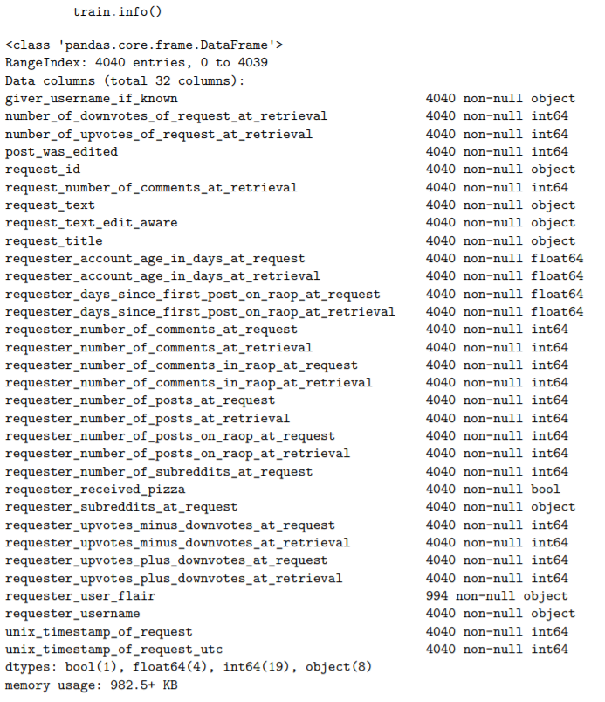
Data Description & EDA
The train dataset has 32 variables and 4040 observations
The test dataset has 17 variables and 1631 observations.
Success rate in our data is 24.6% -> make sure model is not biased
Attributes are a mix of binary (1), numerical (23) and text (8) types
Additional columns in train dataset:
request_text/post_was_edited: Since posts are often edited after a successful request, this request_text column is not the most accurate. Instead, request_text_edit_aware, which is available in both the train and test sets, will be used.
*_at_retrieval: For our purposes of real-time prediction, *_at_request columns are more relevant.
requester_user_flair: This is a post-receipt of pizza feature with a lot of null values and thus will not be a useful indicator of results.
requester_received_pizza: Target variable for our model.

Slide 4
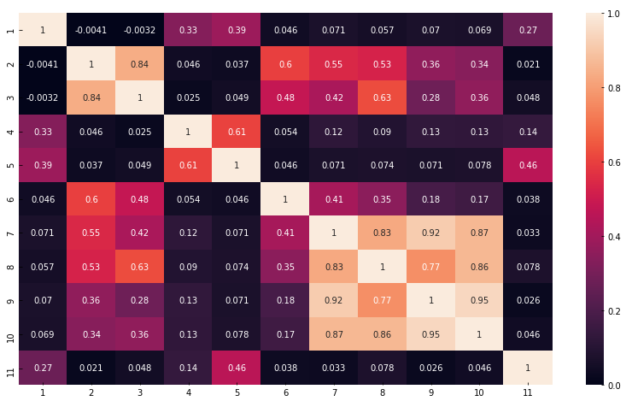
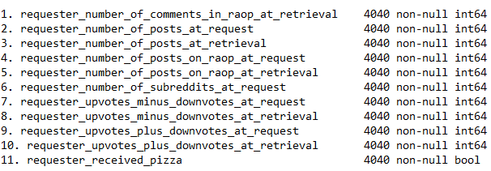
Data Description & EDA
The corresponding labels to the column name in the heatmap is listed below:

Slide 5
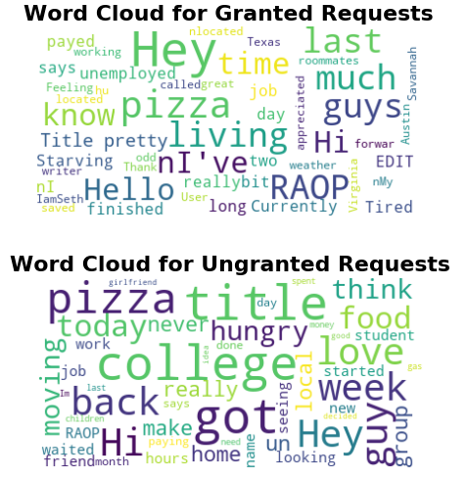
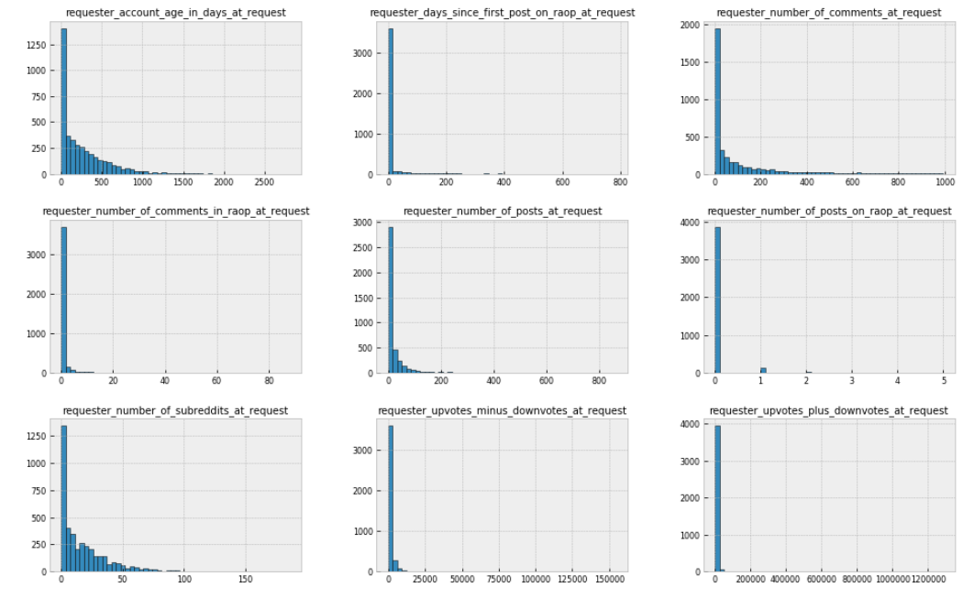
Data Description & EDA

Slide 6
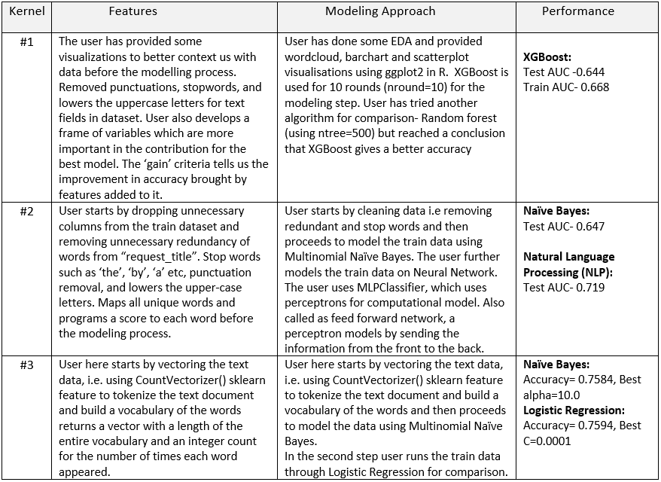
Evaluation of 3 other solutions
*Kernel 1: https://www.kaggle.com/jatinraina/random-acts-of-pizza-xgboost
Kernel 2: https://www.kaggle.com/mbp14mtp/raopizza
Kernel 3: https://www.kaggle.com/heyheyivan/random-pizza

Slide 7
Modeling
RAOP train dataset
Feature Extraction
Feature Selection
Train model
Test
Results
train[‘request_title’]+ train[‘request_text’]
Stop words + punctuation removal
TFIDF Vectorizer
K-means clustering

Slide 8
Modeling
I have used Logistic Regression with cross validation as the data model. Overfitting is prevented by using cross validation. The best parameters for cross validation are found by using grid search method.
Model #0- Naïve Model- No One Gets a Pizza ☹
AUC: 75.4%
Model #1- Select TFIDF features that are part of vocab found using k-means clustering.
AUC: 56.4%, Computation Time: 2.2 secs
Model #2- Add two highly correlated continuous features (['requester_number_of_comments_in_raop_at_retrieval',
'requester_number_of_posts_on_raop_at_retrieval’]) to the feature set.
AUC: 79.3%, Computation Time: 3.4 secs
Model #3- Add all other continuous features to the feature list.
AUC: 82.2%, Computation Time: 16.3 secs

Slide 9
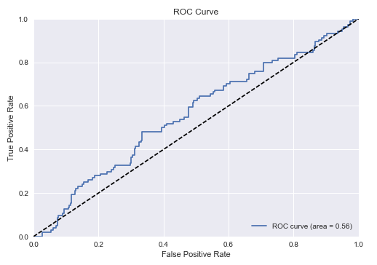
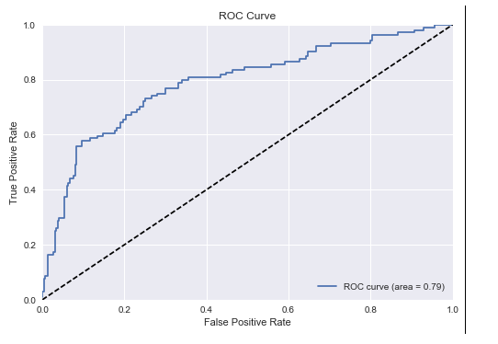
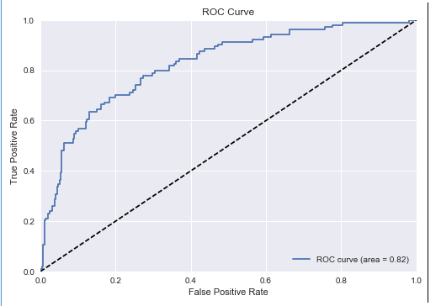
Modeling
Model #1
Model #2
Model #3
Model | Computation Time | AUC
Model #1 | 2.2 secs | 56.4%
Model #2 | 3.4 secs | 79.3%
Model #3 | 16.3 secs | 82.2%

Slide 10
Conclusion
Following is the summary of the 3 models discussed above. We note down the computation time and the AUC values for comparison.
Model | Computation Time | AUC
Model #1 | 2.2 secs | 56.4%
Model #2 | 3.4 secs | 79.3%
Model #3 | 16.3 secs | 82.2%
We observe from the above table that the increase in AUC from model 1 to model 2 is significant with slight increase in the computation time. However, from model 2 to model 3, the computation time increases significantly, but the increase in AUC is not significant. Hence, we conclude that model 2 is the best-fit model.

