Slide 1
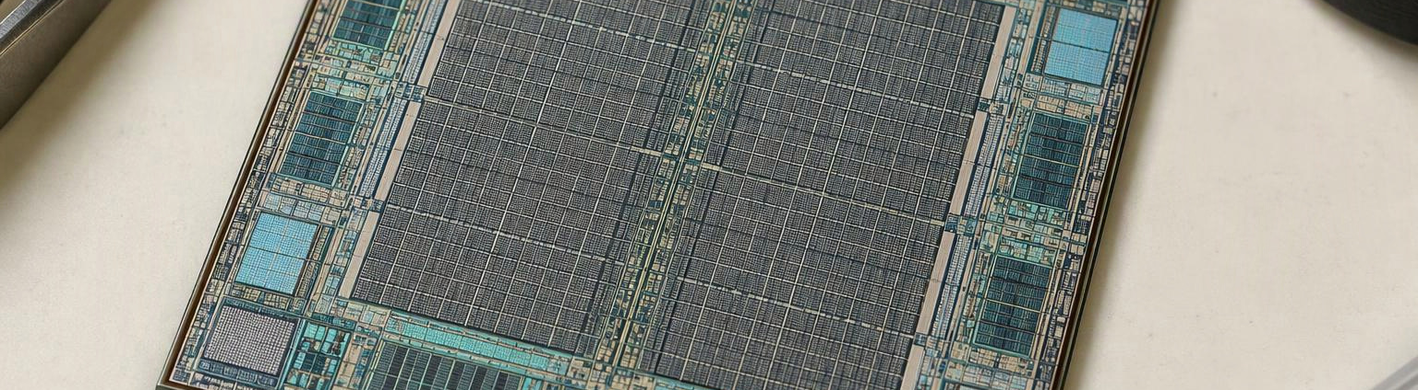
FPGA Multi-Programmer
A Novel Architecture for Dynamic FPGA Programming
Vivaan Tasker · Rajas Wagle · Dhruv Warik · Soham Shah · Kaustubh Vekhande
01

Slide 2
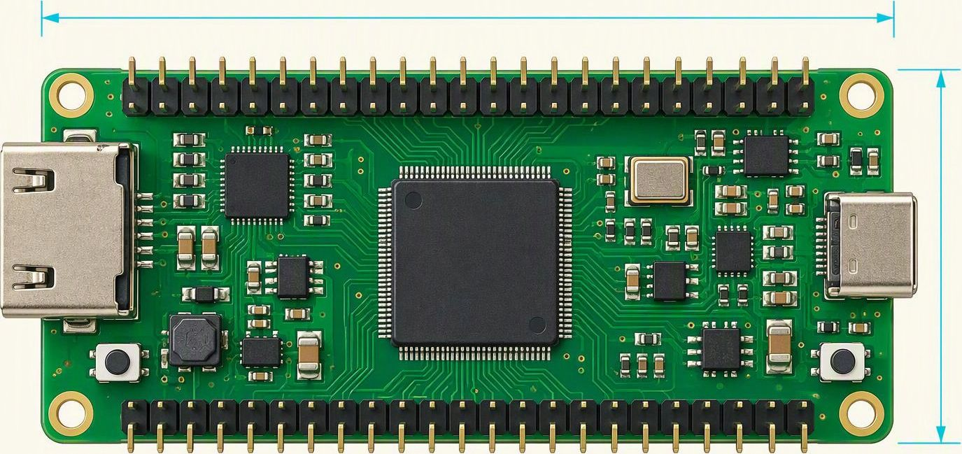
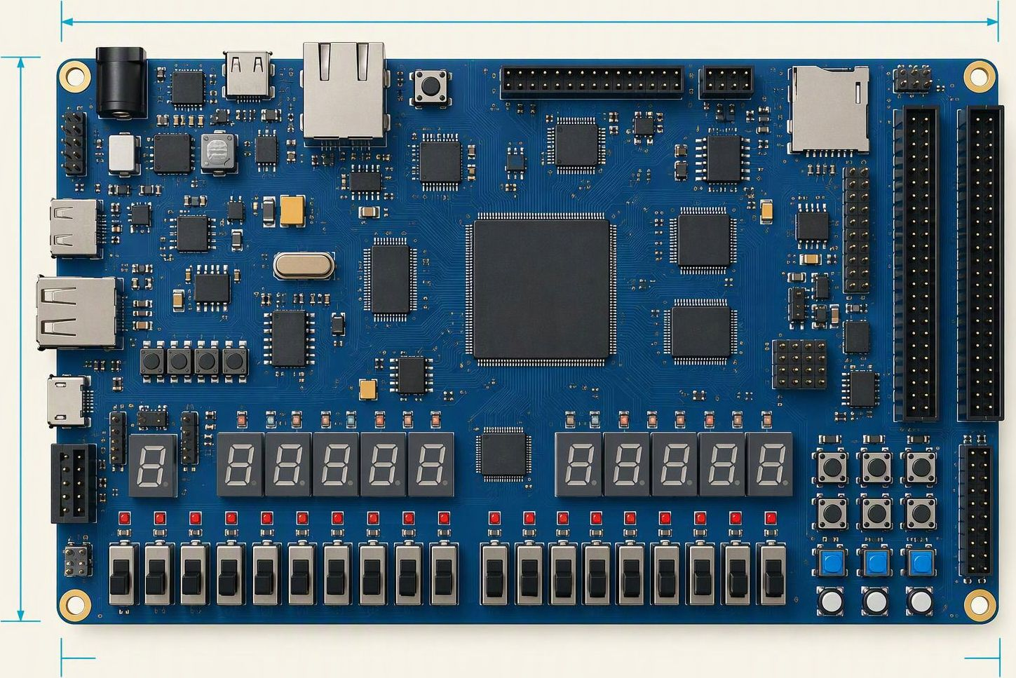
02 / THE NEED
Big ideas.
Cheap, limiting hardware.
TANG NANO 9K
EDGE ARTIX-7 · XC7A35T
RESOURCE | VALUE
LUTs | 8,640 LUT4
Flip-flops | 6,480
Block RAM | 468 Kbit
DSP | 20 × 18×18
SPI flash | 32 Mbit
RESOURCE | VALUE
LUTs | 20,800
Flip-flops | 41,600
Block RAM | 50 × 36 Kb
DSP slices | 90
SDRAM / flash | 32 MB / 8 MB
Resource limits shape how much of the DUT can run at once.
Sources: Sipeed Tang Nano 9K Wiki · FPGA Board Repository (EDGE Artix-7)
02

Slide 3
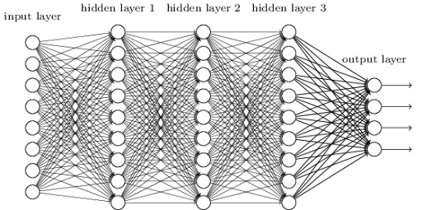

03 / USE CASE
Dynamic reconfiguration makes one FPGA serve multiple roles
NATIVE MULTIBOOT BASELINE
APPLICATIONS
Nexys A7-100T · Artix-7
$349
1 · TIME-MULTIPLEX LARGE ML MODELS
DEV BOARD LIST PRICE · 1 NOV 2026
Partition a network into layer groups and load only the accelerator needed for the next stage. Intermediate activations stay in external memory, allowing a model larger than one FPGA image to execute sequentially.
FPGA FABRIC | 15,850 slices · 240 DSP · 4,860 Kbit BRAM
MEMORY | 128 MiB DDR2 · onboard configuration flash
I/O | Ethernet · USB/UART · VGA · 5 Pmod ports
PROGRAMMING | USB-JTAG · flash configuration
BOOT BEHAVIOR | 2+ images · application-triggered switch · fallback
2 · ADAPT HARDWARE TO THE SITUATION
Switch complete logic images as conditions change: high-throughput processing when demand is high, low-power monitoring while idle, or a known-good recovery design after a detected fault.
The Nexys A7 combines onboard configuration flash with 7-series MultiBoot and fallback support for multiple FPGA images.
A native MultiBoot development board costs $349—before any deployment-specific hardware.
Sources: Digilent Nexys A7 product page · AMD XAPP1247 MultiBoot with 7 Series FPGAs and SPI
03

Slide 4
04 / OUR SOLUTION
A streamed path from memory to any target FPGA
ASIC
External
AXI4-STREAM
AXI4-STREAM
External
MEMORY
CHIP
SPI MEMORY
INTERFACE
DMA
JTAG FLASH
TARGET
FPGA
SPI
JTAG
AXI4-LITE
AXI4-LITE
AXI4-LITE
INTERRUPT 1
CONTROLLER
INTERRUPT 2
PARAMETERS
INTERRUPT 3
⋮
INTERRUPT 16
04

Slide 5
06 / COMPONENT VERIFICATION
Memory Manager Architecture: Multi-Protocol Serial Flash Controller & Functional Verification Summary
DUT ARCHITECTURE
memory_manager
FUNCTIONAL COVERAGE
Vivado XSim XCRG · transaction_cg
Top-level request decoder and protocol arbiter for SPI 1-1-1, QSPI 1-4-4, and OSPI 8-8-8 reads.
100%
METRIC | COVERED | TOTAL | RESULT
Coverpoints | 22 | 22 | 100%
Cross bins | 55 | 55 | 100%
Uncovered bins | 0 | 77 | 0
Fabric control
read_req · abort · addr[23:0] · length[31:0] · memory_type[2:0]
GROUP SCORE
┌────────────────────── MEMORY_MANAGER ──────────────────────┐
│ UPSTREAM FABRIC │
│ read_req/abort · addr[23:0] · length[31:0] · memory_type │
│ │ │
│ ┌──────▼─────────────┐ │
│ │ VALIDATE + SELECT │ reject: zero / unaligned / │
│ └───┬──────┬──────┬─┘ invalid protocol │
│ │ │ │ │
│ ┌───────▼─┐ ┌──▼──────┐ ┌▼─────────┐ │
│ │ SPI 1-1-1│ │QSPI 1-4-4│ │OSPI 8-8-8│ │
│ │ ENGINE L1│ │ ENGINE L4│ │ ENGINE L8│ │
│ └────┬─────┘ └────┬────┘ └────┬────┘ │
│ sclk/cs/mosi qspi_io[3:0] ospi_io[7:0] │
│ └────────────┼────────────┘ │
│ ┌───────▼────────┐ │
│ │ AXI4-STREAM BUS │ │
│ └───────┬────────┘ │
│ m_axis_tdata[31:0] · tkeep[3:0] · tvalid/tlast │
│ m_axis_tready → backpressure busy/done/error │
└────────────────────────────────────────────────────────────┘
COVERPOINT SUMMARY
CROSS COVERAGE
COVERPOINT | BINS | COVERAGE
memory_type | 4 / 4 | 100%
length | 6 / 6 | 100%
outcome | 3 / 3 | 100%
stall | 3 / 3 | 100%
address | 3 / 3 | 100%
beats | 3 / 3 | 100%
CROSS | BINS | COV.
type × length × outcome | 36 / 36 | 100%
type × stall | 10 / 10 | 100%
type × beats | 9 / 9 | 100%
SCENARIO EVIDENCE
ENGINE FSM
DIMENSION | OBSERVED HITS
Protocol | SPI 39 · QSPI 36 · OSPI 41 · invalid 6
Outcome | completed 78 · aborted 32 · rejected 12
Backpressure | no stall 20 · medium 41 · heavy 61
Length | zero 4 · non-byte 4 · tiny 23 · short 24 · medium 51 · long 16
AXIS beats | one 57 · two 25 · many 40
IDLE → COMMAND → ADDRESS → DUMMY → DATA → STREAM_WAIT
Dedicated PHY pins
SPI: sclk/cs_n/mosi/miso · QSPI: qspi_sclk/cs_n/io[3:0] · OSPI: ospi_sclk/cs_n/io[7:0]
KEY ARCHITECTURAL HIGHLIGHTS
• Reusable serial_flash_read_engine parameterizes lanes, clock divider, dummy cycles, and opcode.
• ST_STREAM_WAIT halts SCLK while TREADY is low—preserving data under downstream backpressure.
• One-cycle error response traps zero length, length[2:0] ≠ 0, and invalid protocol selections.
VERIFICATION READOUT All 77 functional bins covered; protocol, error, abort, and backpressure spaces are closed.
Source: Vivado XSim XCRG report · tb_memory_manager::transaction_cg · functional coverage only
06

Slide 6
07 / COMPONENT VERIFICATION
JTAG Controller Architecture: Scan Engine, TAP Sequencer & Functional Verification Summary
DUT ARCHITECTURE
jtag_controller
XCRG FUNCTIONAL COVERAGE
Source group: jtag_tb_pkg::jtag_coverage::cg_jtag
Top-level JTAG transaction controller: command decode, TAP-state sequencing, IR/DR scan execution, clock generation, and IDCODE/error checking.
100%
45 / 45
27 / 27
18 / 18
System I/O
clk 100 MHz · rst_n · transaction kind · scan mode · bit length · frequency · payload valid/ready · abort
GROUP SCORE
BINS COVERED
VARIABLE BINS
CROSS BINS
┌────────────────────── JTAG_CONTROLLER ─────────────────────┐
│ HOST: transaction kind · scan mode · bit length · frequency│
│ │ │
│ ┌─────────▼──────────┐ │
│ │ DECODE + VALIDATE │ bad freq/length/ID/abort │
│ └─────────┬──────────┘ │
│ │ │
│ ┌─────────────▼─────────────┐ │
│ │ COMMAND / SCAN SCHEDULER │ │
│ └──────┬───────────┬────────┘ │
│ │ │ │
│ ┌──────▼─────┐ ┌───▼──────────┐ │
│ │ IR SCAN │ │ DR / IDCODE │ │
│ │ LOAD + SHIFT│ │ CAPTURE/VERIFY│ │
│ └──────┬─────┘ └───┬──────────┘ │
│ └──────┬────┘ │
│ ┌─────────▼──────────┐ │
│ │ TAP FSM + TCK DIV │ │
│ └─────────┬──────────┘ │
│ JTAG PHY: TCK · TMS · TDI → DUT · TDO ← DUT │
└────────────────────────────────────────────────────────────┘
COVERPOINT BREAKDOWN
COVERPOINT | COV./EXP. | % | REPORT EVIDENCE
cp_kind | 4 / 4 | 100 | Check ID 11 · Load IR 17 · Stream 16 · Abort 1
cp_scan_mode | 2 / 2 | 100 | IR 17 · DR 28
cp_bit_length | 6 / 6 | 100 | 1b 2 · byte 4 · 32b 13 · unaligned 5 · med 7 · large 2
cp_frequency | 4 / 4 | 100 | low 10 · med 18 · high 7 · Nyquist 9
cp_handshake_stalls | 3 / 3 | 100 | none 15 · short 12 · long 18
cp_idcode_verify | 3 / 3 | 100 | bypass 32 · capture 1 · full 10
cp_errors | 5 / 5 | 100 | ok 33 · bad freq 1 · bad len 1 · bad ID 9 · abort 1
TAP / SCAN FLOW
IDLE → SELECT → CAPTURE → SHIFT → EXIT → UPDATE → COMPLETE
JTAG pins
TCK: programmable frequency · TMS: TAP state control · TDI: serial stimulus · TDO: captured response
CROSS-COVERAGE MATRIX
ARCHITECTURAL HIGHLIGHTS
CROSS | COV./EXP. | % | STATUS
cross_flash: mode × length | 10 / 10 | 100 | IR: 4 legal bins · DR: 6 length bins
cross_freq: frequency × mode | 8 / 8 | 100 | All 4 frequencies closed in IR and DR
• Unified sequencer executes CHECK_ID, LOAD_IR, STREAM_DATA, and FLASH_ABORT transactions.
• Valid/ready handshaking tolerates zero, short, and long payload gaps without losing scan position.
• Fault detection traps invalid frequency/length, IDCODE mismatch, and hardware abort conditions.
REGRESSION HARDENING Repeat low-hit bins: FLASH_ABORT, capture-only ID, bad frequency, bad length, and hardware abort.
Report note: XCRG shows 100% functional coverage; SVA results are not contained in the supplied report.
07

Slide 7
08 / COMPONENT VERIFICATION
DMA Stream Bridge Controller: Architecture & Functional Verification Summary
DUT ARCHITECTURE
dma_controller
VERIFICATION RESULTS
XCRG · tb_dma_controller::cg_dma_controller
Single-entry, backpressure-aware AXI4-Stream bridge. Validates declared bit length, byte alignment, contiguous TKEEP and TLAST framing; one elastic register retains data losslessly through downstream stalls.
97.78%
100%
19 / 23
4
CONTROL
clk · rst_n · start · abort · source_address[31:0] · transfer_length[31:0] bits
XCRG GROUP
CP BINS
CROSS BINS
UNCOVERED
AXIS I/O
S: tdata[31:0] · tkeep[3:0] · valid/ready · last → M: same signals
XCRG COVERAGE BREAKDOWN
┌─────────────────── DMA_CONTROLLER ───────────────────┐
│ CTRL: start · abort · address · length(bits) │
│ │ │
│ ┌────────────▼────────────┐ │
│ │ PARAMETER + LENGTH │── reject / error │
│ │ VALIDATOR │ │
│ └────────────┬────────────┘ │
│ ▼ │
│ ┌──────────────────────────────────┐ │
│ │ TRACKER + PROTOCOL CHECKER │ │
│ │ expected_bits / bits_seen │ │
│ │ contiguous TKEEP / expected_keep │ │
│ │ early + late TLAST │ │
│ └─────────────────┬────────────────┘ │
│ ▼ │
│ S_AXIS ───────▶ [ ELASTIC REGISTER ] ───────▶ M_AXIS │
│ valid/ready push-pop / freeze valid/ready│
│ │ │
│ └────▶ done · error · busy │
└───────────────────────────────────────────────────────┘
METRIC | COV / EXP | RESULT
All 8 coverpoints | 28 / 28 | 100%
length × m_stall | 14 / 18 | 77.78%
scenario × error | 5 / 5 | 100%
Total represented bins | 47 / 51 | 92.16%
Four uncovered cross bins are zero-length / unaligned classes × output-stall state.
SUPPLIED REGRESSION SUMMARY
CHECK | VALUE | STATUS / SOURCE
Runs | 120 random + 27 directed | PASSED
Stream beats | 1,850 in / 1,850 out | 0 mismatches
Pulse samples | done 107 · error 8 | XCRG evidence
Assertions | 7 properties | 0 violations
ARCHITECTURAL HIGHLIGHTS
• Cycle-0 trap for zero or non-byte-aligned length; no stream beat is accepted.
• Dynamic expected_keep rejects zero/non-contiguous masks plus early or late TLAST.
• Ready gating (!m_valid || m_ready) freezes registered output without losing beats.
• abort or double-start immediately flushes the pipeline and returns to safe idle.
SVA: done/error mutex · exact one-cycle done/error pulses · output stable under stall · busy clears at termination · valid/ready suppressed while idle.
Coverage note: 100% applies to coverpoint bins; the complete XCRG group score is 97.7778%.
08

Slide 8
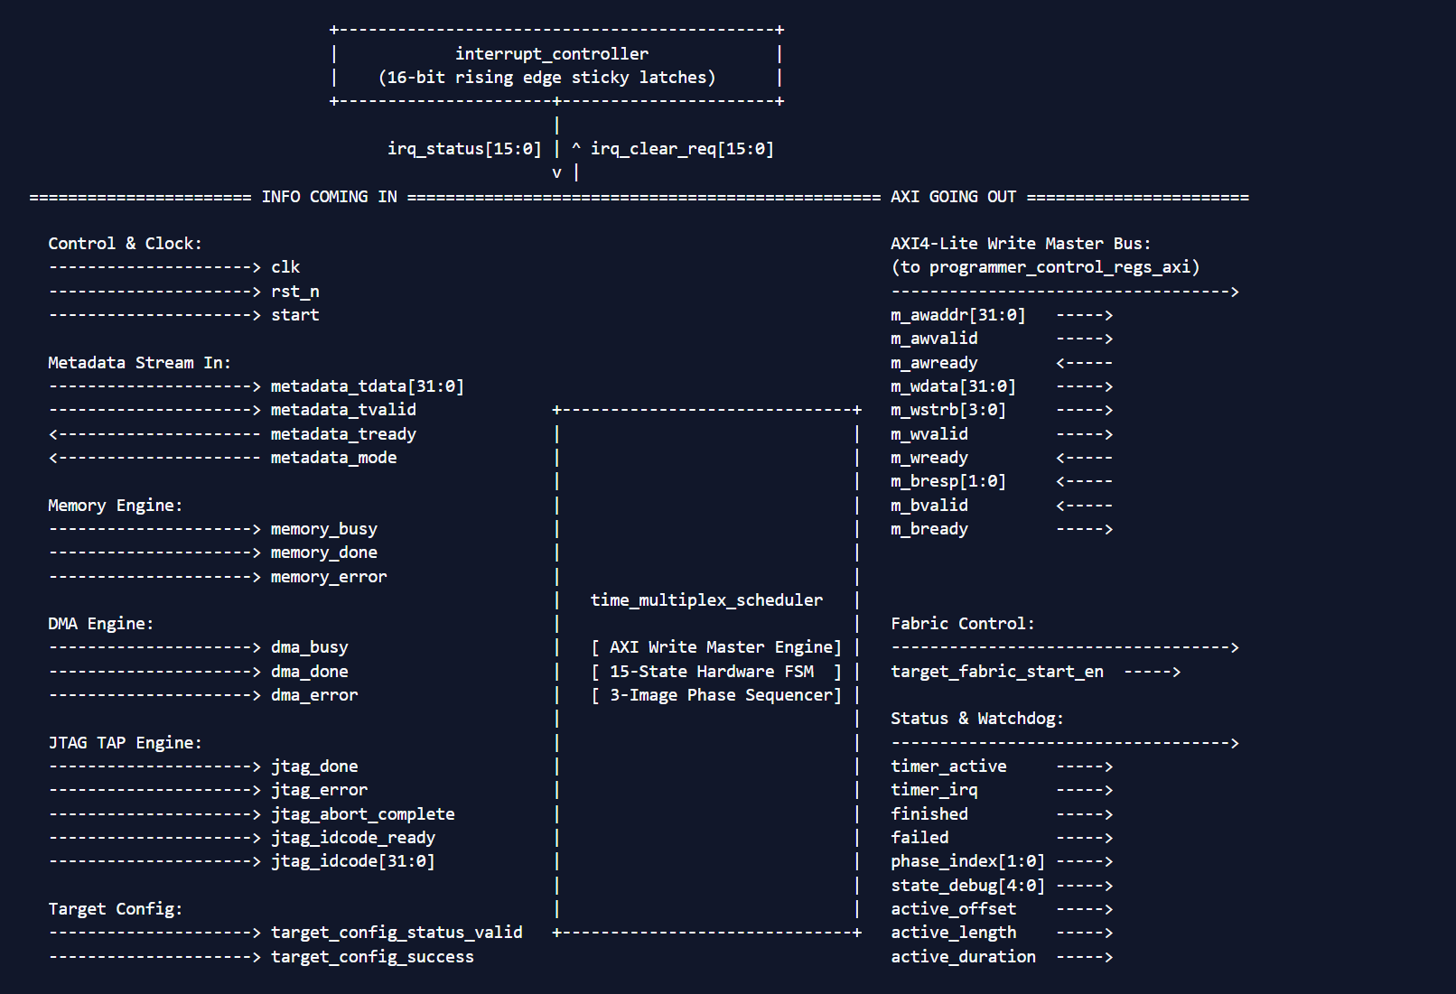
10 / RTL VERIFICATION
Detailed Coverage Evidence & Programmer RTL Architecture
GRP0 · PROGRAMMER_PKG
pkg_coverage_group / pkg_cov
INTERRUPT CONTROLLER + TIME-MULTIPLEX SCHEDULER
verified DUT interface view
100%
12 / 12
0
GROUP SCORE
BINS COVERED
UNCOVERED
XCRG REPORT CONFIGURATION
source: tb_rtl_coverage.sv
FIELD
VALUE
GOAL
AT LEAST
WT
Group
pkg_coverage_group
100
—
1
Instance
pkg_cov
100
1
1
Coverpoint
cp_package_category
100
1
1
COVERPOINT & BIN EVIDENCE
Auto Bin Max 64 · Print Missing 0
BIN SET
EXPECTED
COVERED
HITS
category_1 – category_11
11
11
1 each
category_12
1
1
2
User-defined bins total
12
12
13 hits
DIRECTED PACKAGE EVIDENCE
94 checked cases — separate from XCRG %
•
Parameter and enum encodings exercised across the package categories.
•
Shared constants and common type definitions checked for expected values.
•
CRC helper behavior checked for deterministic outputs and edge cases.
•
100% applies only to the 12 reported functional bins; no code-coverage claim.
10

Slide 9
11 / RTL VERIFICATION
Detailed XCRG Evidence: Interrupt Controller & Scheduler
GRP1 · INTERRUPT_CONTROLLER
irq_coverage_group / irq_cov
GRP2 · TIME_MULTIPLEX_SCHEDULER
scheduler_coverage_group / scheduler_cov
100%
12 / 12
0
100%
3 / 3
0
GROUP SCORE
BINS COVERED
UNCOVERED
GROUP SCORE
BINS COVERED
UNCOVERED
REPORT CONFIGURATION
Goal 100 · Weight 1 · At least 1 · Auto Bin Max 64
REPORT CONFIGURATION
Goal 100 · Weight 1 · At least 1 · Auto Bin Max 64
ITEM
REPORT VALUE
RESULT
ITEM
REPORT VALUE
RESULT
Group
irq_coverage_group
100%
Group
scheduler_coverage_group
100%
Instance
irq_cov
100%
Instance
scheduler_cov
100%
Coverpoint
cp_interrupt_scenario
12 / 12
Coverpoint
cp_scheduler_scenario
3 / 3
COVERED BINS
scenario_1 – scenario_12
COVERED BINS
all bins met at-least-1
scenario_1
1×
scenario_2
1×
scenario_3
1×
scenario_4
1×
BIN
HIT COUNT
AT LEAST
STATUS
scenario_5
1×
scenario_6
1×
scenario_7
1×
scenario_8
1×
scenario_1
1
1
Covered
scenario_9
1×
scenario_10
1×
scenario_11
1×
scenario_12
1×
scenario_2
1
1
Covered
DIRECTED BEHAVIOR EVIDENCE
scenario_3
1
1
Covered
semantics are separate from bin naming
DIRECTED PATH EVIDENCE
•
Reset and registered interrupt-enable behavior
3 checked scheduler scenarios
•
Rising-edge capture and sticky status retention
•
Reset behavior and return to the scheduler idle path
•
Masking, software clearing and held-high source behavior
•
Nominal schedule progression across image/phase processing
•
Simultaneous sources and clear-priority handling
•
AXI write-error response handled through abort and failure paths
•
All 12 reported scenario bins reached their at-least-1 target
•
Coverage percentage reflects only cp_scheduler_scenario bins
•
Directed scenarios do not establish RTL code-coverage completeness
XCRG scope: one coverpoint, 12 user-defined bins, zero uncovered.
XCRG scope: one coverpoint, 3 user-defined bins, zero uncovered.
11

Slide 10
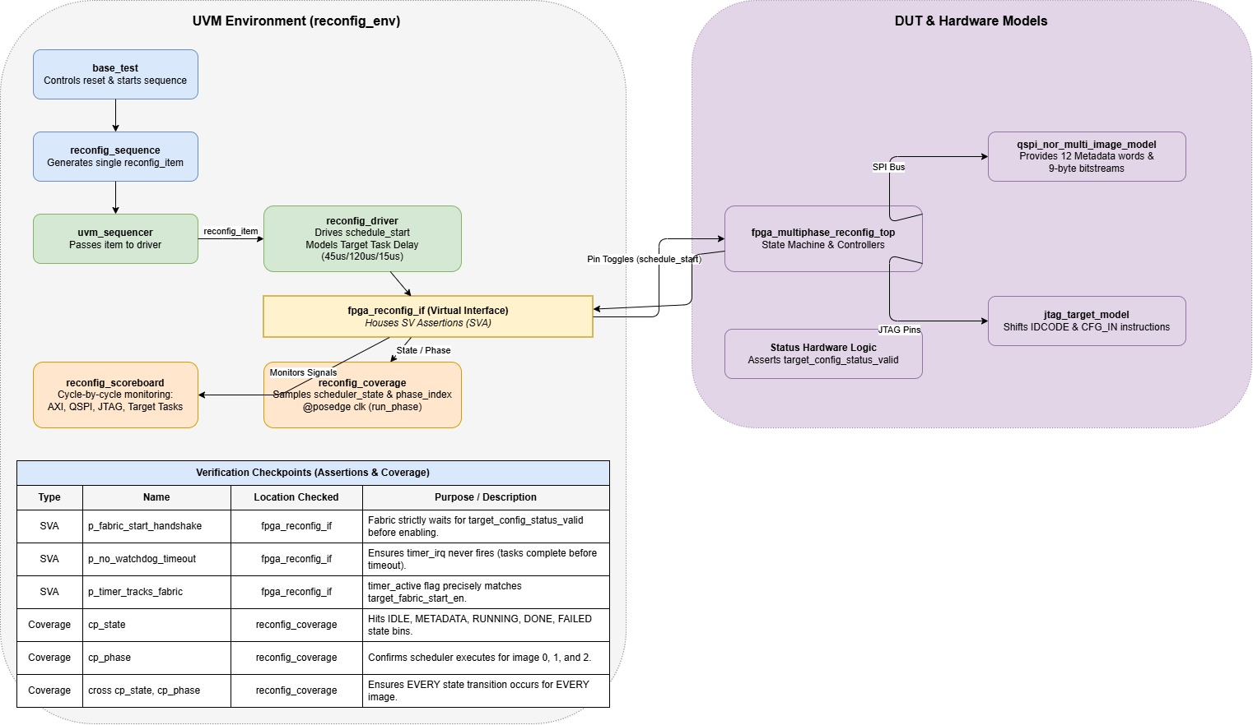
Multi-Image Scheduler Architecture & Testbench Execution
ARCHITECTURE / WAVEFORM REGION
reserved for QSPI → DMA → JTAG sequencing + FSM transitions
VERIFICATION SCOPE & TEST TARGET
•
Testbench: tb_multi_image_schedule.sv
•
Model: pin-level SDR Quad-SPI NOR (qspi_nor_multi_image_model)
•
0xEB Fast Read Quad I/O · 24-bit address · 2 dummy cycles · low nibble then high nibble
MULTI-IMAGE FLASH ALLOCATION
DIAGRAM / WAVEFORM PLACEHOLDER
•
Flash: 256 KB (FLASH_BYTES = 262144)
•
Metadata @ 0x0000_0000 · 4-word fpga_schedule_entry_t: offset, size, IDCODE, duration
Recommended content: QSPI metadata fetch → AXI-Stream payload delivery → JTAG IR/DR scan → TARGET_RUNNING, aligned to phase_index 0 / 1 / 2.
IMAGE 0
0x0000_1000 · 72 bits / 9 bytes
11 22 33 44 55 66 77 88 99
ID 0x1234_5678 · 100 ms
IMAGE 1
0x0001_0000 · 72 bits / 9 bytes
AA BB CC DD EE 12 34 56 78
ID 0x1234_5678 · 100 ms
IMAGE 2
0x0002_0000 · 72 bits / 9 bytes
DE AD BE EF CA FE 00 01 02
ID 0x1234_5678 · 100 ms
EXECUTION & SCHEDULING FLOW
•
JTAG delivery is streamed LSB-first.
•
Phases execute image_0 → image_1 → image_2.
•
INVALID_METADATA hook supports zero-length bitstream error injection.
D1

Slide 11
Functional Coverage Analysis & Gap Breakdown: Basic Functionality Test
COVERGROUP SUMMARY
$unit_axi_lite_write_master_sv_357825715::reconfig_coverage::cg_scheduler_states
Instance: this.cg_scheduler_states
Source: C:/ASIC_Verification_Lab_Exps/fpga_programme/tb/tb_multi_image_schedule.sv
73.33%
100%
64
1
GROUP SCORE
TARGET GOAL
AUTO BIN MAX
AT LEAST
1 · INSTANCE CATEGORY SUMMARY
2 · COVER POINT EXECUTION DETAILS
CATEGORY
CP / X
EXP
UNCOV
COV
AVG
COVER POINT
EXP
UNCOV
COV
HIT %
WT
GOAL
Variables
2
8
1
7
90.00%
cp_state
5
1
4
80.00%
1
100%
Crosses
1
15
9
6
40.00%
cp_phase
3
0
3
100.00%
1
100%
Overall
3
23
10
13
73.33%
cp_state×cp_phase
15
9
6
40.00%
1
100%
3 · BIN HIT COUNTS
4 · CROSS COVERAGE MATRIX · CP_STATE × CP_PHASE
6 covered · 9 uncovered
POINT
BIN
STATUS
HITS
MIN
STATE
PHASE
STATUS
HITS
cp_state
IDLE
Covered
6
1
IDLE
image_0
Covered
6
cp_state
WAIT_FLASH_METADATA
Covered
237
1
WAIT_FLASH_METADATA
image_0
Covered
237
cp_state
TARGET_RUNNING
Covered
1,812
1
TARGET_RUNNING
image_0
Covered
454
cp_state
DONE
Covered
4
1
TARGET_RUNNING
image_1
Covered
1,204
cp_state
FAILED
Uncovered
0
1
TARGET_RUNNING
image_2
Covered
154
cp_phase
image_0
Covered
2,236
1
DONE
image_2
Covered
4
cp_phase
image_1
Covered
2,677
1
UNCOVERED COMBINATIONS · 0 HITS
STATE
PHASE
STATUS
cp_phase
image_2
Covered
1,631
1
IDLE
image_1 · image_2
Uncovered
WAIT_FLASH_METADATA
image_1 · image_2
Uncovered
DONE
image_0 · image_1
Uncovered
FAILED
image_0 · image_1 · image_2
Uncovered
cp_state hole: FAILED = 0 because only clean paths ran. Set INVALID_METADATA = 1’b1 to exercise error handling.
Cross gaps are structural: initialization occurs under image_0 and DONE under image_2. Filter unreachable pairs or add mid-sequence abort/reset tests.
D2

Slide 12
13 / SYSTEM VERIFICATION
System-Level UVM Verification: High-Priority Fault Injection & Safety Interlocks
1 · UVM ARCHITECTURE & RECOVERY COVERAGE
2 · HIGH-PRIORITY FAULT INJECTION & RECOVERY MATRIX
15 / 15
9 / 9
100%
TEST CASE | FAULT INJECTED | HARDWARE ACTION | TIME | STATUS
base_test | None (Golden flow) | All 3 images execute | 655.75 us | PASSED
test_idcode_mismatch | TDO=0 (ID: 0x00 != expected) | SEQ_ABORT -> ST_FAILED | 88.25 us | PASSED
test_config_failure | target_config_success=0 | MEM/DMA abort writes | 180.85 us | PASSED
test_task_error | Pulse target_task_error=1 | IRQ 13, fabric shutdown | 191.35 us | PASSED
FSM STATES (100%)
AXI SEQUENCES
SVA PASS RATE
VERIFICATION COMPONENT | IMPLEMENTATION & HARDWARE SCOPE
UVM Testbench Top | tb_multi_image_schedule (driver, scbd, cov, sequencer)
FSM Coverpoint (cp_state) | All 15 states binned (IDLE, TRANSFER, ABORT, FAILED, etc.)
Sequencer (cp_sequence) | All 9 sequences (SEQ_META_CFG through SEQ_ABORT)
SVA: p_fabric_start | $rose(target_fabric_start_en) |-> config_handshake_ok
SVA: p_no_fabric_fail | failed |-> !target_fabric_start_en (safety interlock)
SVA: p_timer_sync | timer_active == target_fabric_start_en (lockstep)
FAULT INJECTION & RECOVERY TIMING FLOW
===================================================================
1. test_idcode_mismatch [t = 88.25 us]
ST_IDCODE_WAIT -> Sample TDO -> Mismatch (0x00000000 != 0x12345678)
-> failed=1, sequence_kind = SEQ_ABORT
-> AXI Abort: MEM (0x02), DMA (0x02), JTAG (0x10 + 5-clock TLR)
-> ST_ABORT_WAIT -> ST_FAILED | target_fabric_start_en = 0
2. test_config_failure [t = 180.85 us]
ST_TARGET_STATUS_WAIT -> status_valid=1 & status_success=0 (CRC fail)
-> failed=1, sequence_kind = SEQ_ABORT -> ST_FAILED
3. test_task_error [t = 189.00 us -> 191.35 us]
ST_TARGET_RUN -> target_task_error=1 -> irq_status[13] asserted
-> target_fabric_start_en <= 0, timer_active <= 0 (Immediate halt)
-> irq_clear_req[13] <= 1 -> SEQ_ABORT -> ST_FAILED
HARDWARE SAFETY INTERLOCK PRINCIPLE
• In VLSI verification, testing nominal paths alone leaves abort routines unexercised.
• Hardware safety rule: If silicon ID or bitstream integrity fails, target_fabric_start_en MUST remain strictly 0 to protect connected external hardware and power rails.
• All abort paths trigger 3 peripheral abort writes and 5-cycle JTAG TLR TAP recovery.
13

Slide 13
14 / SYSTEM VERIFICATION
System-Level UVM Verification: Medium & Low Priority Scenarios
1 · MEDIUM PRIORITY: BOUNDARY PARSING & FLOW CONTROL
2 · LOW PRIORITY: WATCHDOGS & ASYNC RESET RECOVERY
test_metadata_zero_len · BITSTREAM ZERO-LENGTH REJECTION
• Injected: Metadata word 4 (bitstream length) set to 0 in flash.
• Hardware Reaction: Combinational check evaluates metadata_valid=0 in ST_META_WAIT.
• Aborts immediately at 26.75 us. Prevents DMA hang / zero-length descriptor stall.
test_watchdog_timeout · APPLICATION RUNTIME WATCHDOG EXPIRY
• Injected: Target task duration set to 1 ms; target_task_done suppressed.
• Hardware Reaction: task_watchdog_count reaches limit in ST_TARGET_RUN.
• timer_irq pulses, fabric drops, enters SEQ_ABORT -> ST_FAILED (220.15 us).
test_metadata_unaligned · BYTE-ALIGNMENT ENFORCEMENT
• Injected: Length set to 73 bits (73 % 8 != 0, unaligned bitstream boundary).
• Hardware Reaction: Detected by metadata_words[1][2:0] != 0. Rejected in ST_META_WAIT.
• Aborts at 26.75 us. Guarantees byte packing integrity into DMA/JTAG shift register.
test_config_timeout · DISCONNECTED TARGET STATUS TIMEOUT
• Injected: Target status valid handshake suppressed after JTAG bitstream shift.
• Hardware Reaction: State watchdog count reaches WATCHDOG_CYCLES (2000 cycles).
• Escapes permanent deadlock in ST_TARGET_STATUS_WAIT -> aborts at 378.85 us.
Protocol Flow Control · AXI-STREAM BACKPRESSURE & TCK STABILITY
• Cross: memory_tvalid x memory_tready and awvalid x awready.
• Verified serial flash engine holds in ST_STREAM_WAIT without losing bytes or dropping SCLK.
• SVA p_tck_stable_when_idle verifies JTAG TCK never glitches during pauses.
test_mid_op_reset · ASYNCHRONOUS RESET & RESTART RECOVERY
• Injected: 10-cycle asynchronous rst_n=0 asserted in ST_TRANSFER_WAIT (state 6).
• Hardware Reaction: All outputs drop in 1 cycle; returns cleanly to ST_IDLE.
• Re-pulsing schedule_start rebooted and completed all 3 images (757.25 us).
14

Slide 14
15 / RTL & SYSTEM VERIFICATION
AMD Vivado XCRG Unified Coverage Report & Regression Sign-Off
1 · XCRG UNIFIED COVERAGE SCORES (Vivado 2025.2)
2 · AUTOMATED REGRESSION SUITE SIGN-OFF (scripts/run_regression.sh)
84.73%
80.51%
TESTCASE NAME | PRIORITY | TARGET VERIFIED | RESULT
base_test | Nominal | End-to-end 3-image flow | PASSED
test_idcode_mismatch | High Priority | Silicon ID protection | PASSED
test_config_failure | High Priority | Target CRC rejection | PASSED
test_task_error | High Priority | Task crash error IRQ | PASSED
test_metadata_zero_len | Medium Priority | Zero length rejection | PASSED
test_metadata_unaligned | Medium Priority | 73-bit unaligned reject | PASSED
test_watchdog_timeout | Low Priority | Task runtime watchdog | PASSED
test_config_timeout | Low Priority | Status disconnect timeout | PASSED
test_mid_op_reset | Low Priority | Mid-transfer reset recovery | PASSED
FUNCTIONAL (cg_scheduler)
STATEMENT COVERAGE
57.24%
58.74%
BRANCH COVERAGE
CONDITION COVERAGE
MODULE NAME | STMT | BRANCH | COND
time_multiplex_scheduler | 70.43% | 70.27% | 67.57%
programmer_control_regs_axi | 88.64% | 83.33% | 80.00%
dma_controller (fixed) | 92.11% | 75.00% | 72.22%
TOTAL DESIGN (19 files) | 80.51% | 57.24% | 58.74%
OFFICIAL AMD VIVADO HTML COVERAGE REPORTS
• Functional Report: coverage_report/functionalCoverageReport/dashboard.html
• Code Coverage Report: coverage_report/codeCoverageReport/dashboard.html
• Unified across 9 regression runs with zero exclusions and zero waivers.
REGRESSION SIGN-OFF: 9 PASSED · 0 FAILED (100% PASS RATE)
Zero UVM Errors · Zero UVM Fatals · Zero Assertion Violations
Automated execution via ./scripts/run_regression.sh (compile + elaborate + 9 tests + xcrg)
15

Slide 15
BENCHMARKING / SCALE TEST
Testing the system at scale
HARDWARE COARSE-GRAINED RECONFIGURATION BENCHMARK PERFORMANCE
QSPI → AXI4-STREAM → JTAG · 1 MHz TCK
PARAMETER | PHASE 0 · PRE-FILTER | PHASE 1 · 2D-FFT | PHASE 2 · CLASSIFIER
CONFIGURATION PAYLOAD
Input Bitstream Payload Size | 1,024 Bytes (8,192 b) | 2,048 B (16,384 b) | 512 Bytes (4,096 b)
Flash Image Offset (QSPI) | 0x001000 | 0x003000 | 0x006000
Target JTAG Instruction Code | 0x1 (CFG_IN) | 0x1 (CFG_IN) | 0x1 (CFG_IN)
AXI4-Stream Beats Transferred | 256 Words (32-bit) | 512 Words (32-bit) | 128 Words (32-bit)
MEASURED PERFORMANCE
Measured Reconfiguration Overhead | 8.27 ms | 16.47 ms | 4.17 ms
Active Compute Window (Execution) | 43.0 us | 89.0 us | 24.0 us
Target Task Interrupt Latency | 150 ns | 150 ns | 150 ns
Effective JTAG Serialization Rate | 0.990 Mbps | 0.995 Mbps | 0.982 Mbps
Theoretical JTAG Limit (1 MHz TCK) | 1.000 Mbps | 1.000 Mbps | 1.000 Mbps
Link Efficiency | 99.0% | 99.5% | 98.2%
INTEGRITY & RESOURCE OUTCOME
Bitstream Bit-Slip / Data Error | 0 Bits (0.00%) | 0 Bits (0.00%) | 0 Bits (0.00%)
Functional Code Coverage | 100.0% | 100.0% | 100.0%
Physical Silicon LUT Savings | ~60% Area Reduction through Time-Shared Fabric
Scale result: zero data errors, ≥98.2% link efficiency and 100% functional code coverage across all three workload phases.
B1

Slide 16
05 / PUBLICATION STRATEGY
Package the architecture as a reproducible reconfiguration method
WORKING PAPER TITLE
JOURNAL / CONFERENCE | TARGET ISSUE / TRACK | SUBMISSION WINDOW
A Novel External Dynamic FPGA Reconfiguration Strategy for Resource-Constrained Applications
Novelty claim
Externalized, controller-managed programming across resource-limited FPGA targets
05

