Slide 1
My Favorite Things

Slide 2
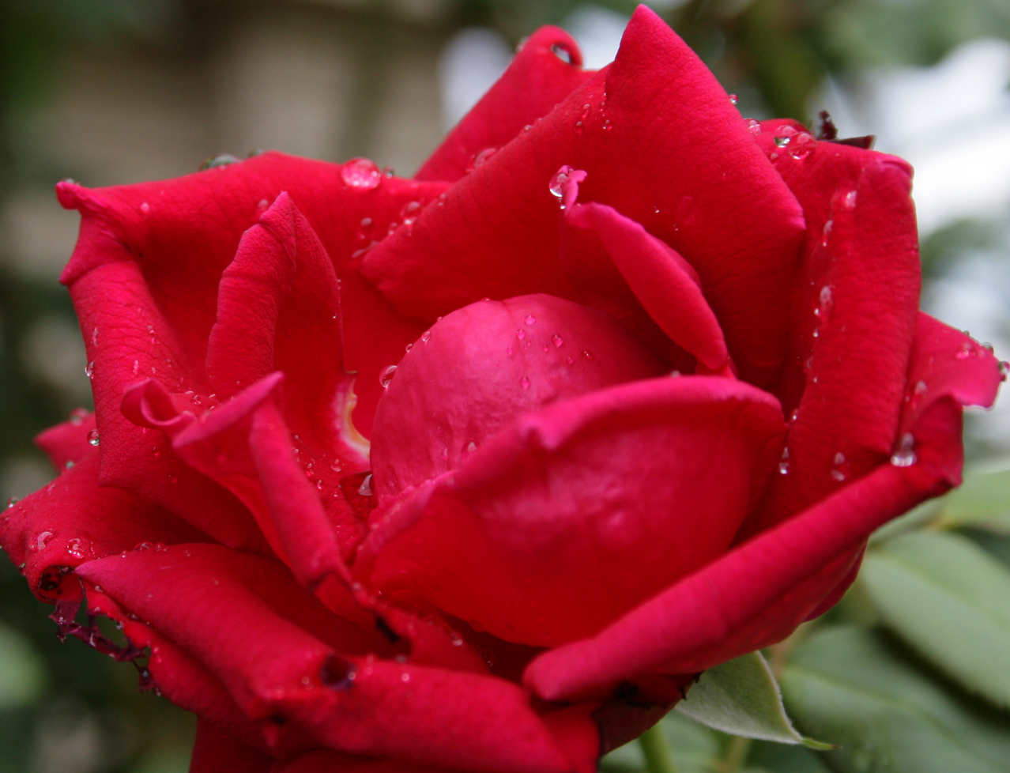
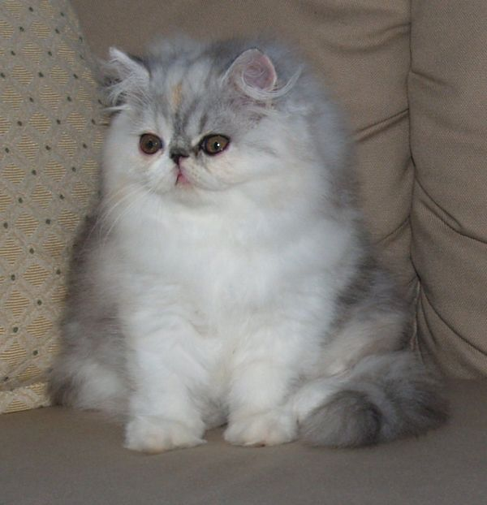
A Few of My Favorites
Raindrops Here
Whiskers Here

Slide 3
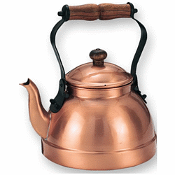
Preferred Kettle Types
Bright
Copper

Slide 4
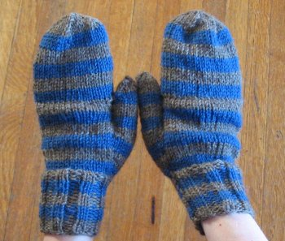
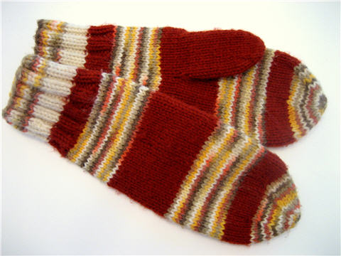
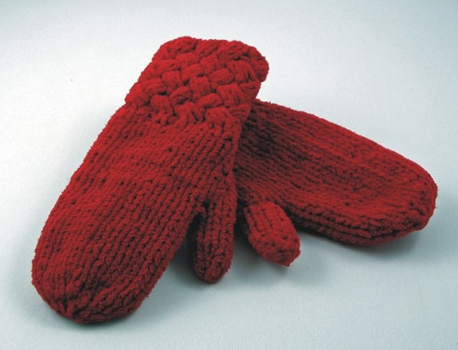
Mitten Preference
Warm
Woolen

Slide 5
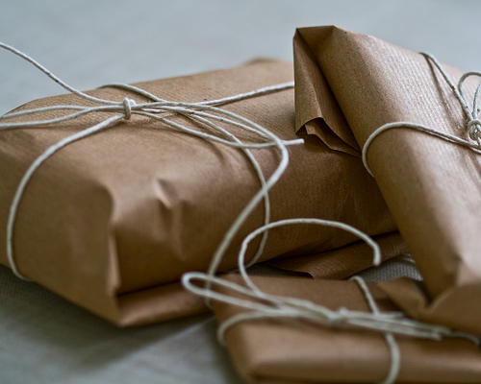
Feelings Toward Packages

Slide 6
Recap

Slide 7
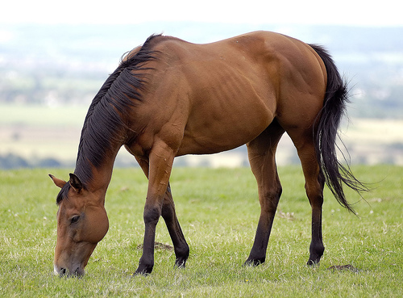
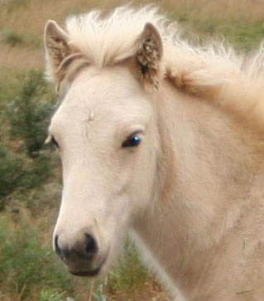

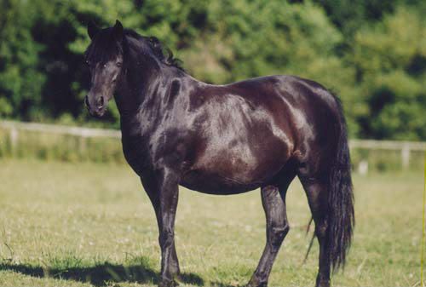
Optimum Pony Color

Slide 8
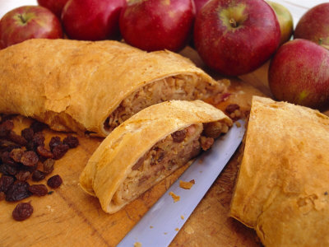
Conditions under which streudels become my favorite
Texture
Crisp
Flavor
Apple

Slide 9
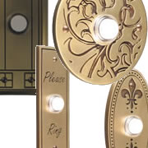
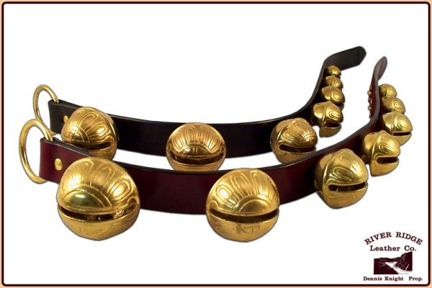
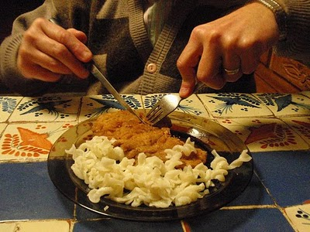
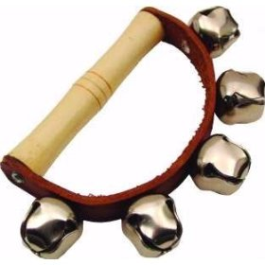
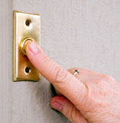
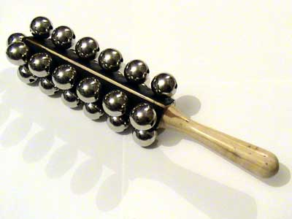
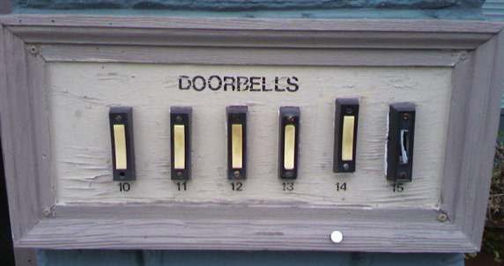
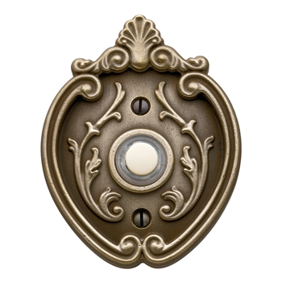
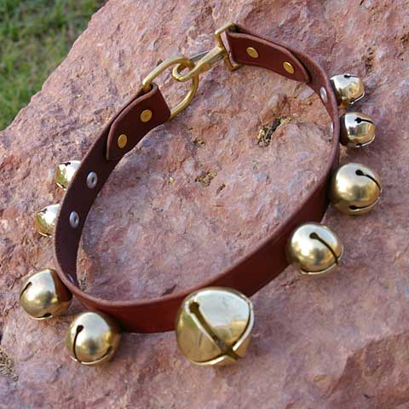
Musical and Culinary Favorites

Slide 10
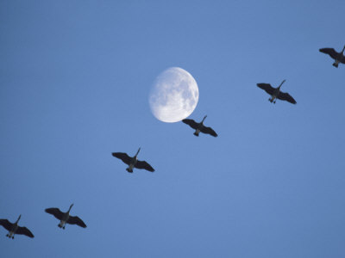
Wild Geese Theory
If geese = wild and in flight
+ moon on wings
Then geese = my favorite

Slide 11
What We’ve Learned So Far:
These are few of my favorite things:
Cream colored ponies
Crisp apple streudels
Doorbells
Sleigh bells
Schnitzel with noodles
Wild geese that fly with the moon on their wings

Slide 12
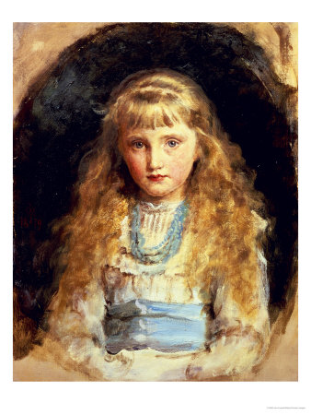
Thoughts On Style
My Favorite

Slide 13
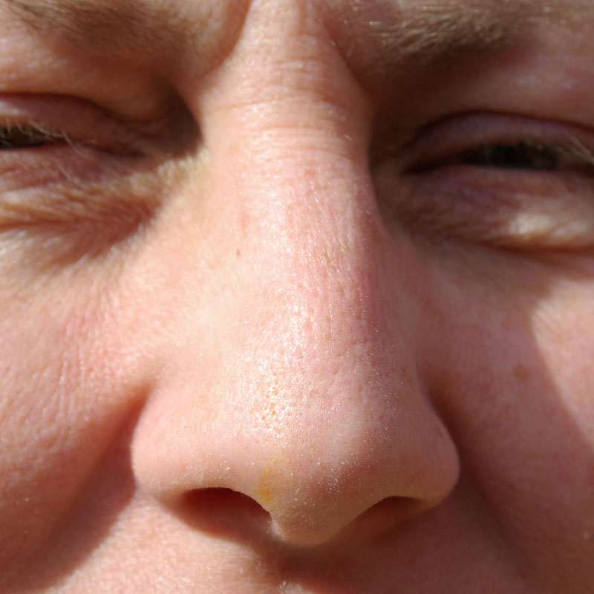
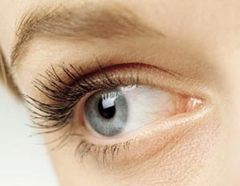
Ideal Snowflake Resting Spots
Nose (See Figure 1)
Eyelashes (See Figure 2)
Fig.1
Fig.2

Slide 14


Slide 15


Slide 16
What are a few of my favorite things?
These

Slide 17
How to React in the Following Situations:

Slide 18
In Conclusion:
So Bad
Not So Bad

Slide 19
Thank you!

