Slide 1
Mobx with angular
Efficient state management
Ville M. Vainio, Computer Programmer, Basware
@vivainio

Slide 2
Problem: state management
{
stuff: [{
name: "foo",
age: 65
}, ...]
}
Trivial, right?

Slide 3
Trivial state management
<p>Hello {{firstname}} {{lastname}}</p>
When does this dirty check the expressions?

Slide 4
Faster alternative: onpush change detection
changeDetection: ChangeDetectionStrategy.OnPush
@Input() user: User;
<p>Hello {{user.firstname}} {{user.lastname}}</p>
When does this dirty check the expressions?

Slide 5
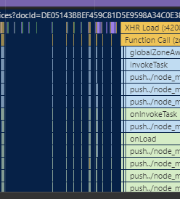
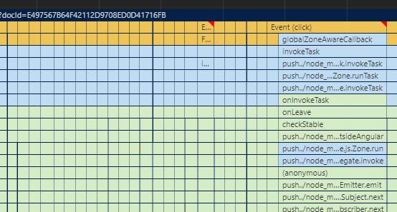
What do you mean faster?
OnPush
Default change detection strategy (w/ heavy bindings)

Slide 6
you want onpush

Slide 7
Passing down props
<app-top-pane [foo]="..." [bar]="..." [user]="userData" (userChange)="changeUser($event)">
So much busywork

Slide 8

In search of global alternatives

Slide 9
Global state management take #0
Injectable service:
class CurrentUserService {
user: User = undefined;
}
- Problem: you have to poll it

Slide 10
Global state management take #1
Use Observable stream:
class CurrentUserService {
user = new Subject<User>();
}
Problem: now you have to subscribe to it, merge streams etc
Rx becomes tangled in all your your logic
Fad-ish?

Slide 11
Global state management take #2 - redux
“Getting Started with Redux is a video course consisting of 30 videos narrated by Dan Abramov, author of Redux.”

Slide 12
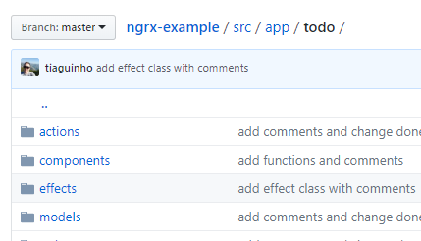

Global state management take #3 – ngrx

Slide 13
mobx
Global state (injected stores)
Not just for React
Reactive, i.e. PUSH based
Something happens, reactions are immediately run
”Reaction”: render UI, patch data to grid etc
Change detector run by reassign prop, or manually
Vs. PULL (poll for things to happen, a’la Change Detectors)
Transparent reactivity

Slide 14
basics
class UserStore {
@observable u: User;
@computed get name() {
return `${u.firstname + “ “ + u.lastname}`
}
// everyone observing 'name' gets run
@action setUser(u: User) {
this.u = u;
}
}
// runs once, + every time setUser is run
autorun(() => {
console.log('Hello', userstore.name);
})

Slide 15
Observables vs computeds
Autorun1
O1
C1
C3
O2
C2
O3
Autorun2
O3 changes. Only C2 and C3 are recalculated, memoized value used for C1.
R/W

Slide 16
Angular usage
@Component({...})
class MyComponent {
editing = false;
otherData: string[] = [];
constructor(private store: DocStore, private otherStore: SomeStore) {}
ngOnInit() {
autorun(() => {
this.editing = this.store.docIsInEdit(this.docId);
});
autorun(() => {
this.otherData = this.otherStore.otherData;
});
}
}

Slide 17
Lifecycle
autorun() returns disposer function
dispose on unmount or bad things will happen!
ngOnInit() {
this.autorun1 = autorun(() => ...)
this.autorun2 = autorun(() => ...)
}
ngOnDestroy() {
// yuck
this.autorun1();
this.autorun2();
}

Slide 18
Lifecycle helpers
ngOnInit() {
const d = startObservers(this.cdr, "My component stuff", [
["edit state", () => this.editing = this.store.docIsInEdit(this.docId)],
["other stuff", () => this.otherData = this.otherStore.otherdata],
]);
addComponentDisposer(this, d);
}
ngOnDestroy() {
stopObserving(this);
}

Slide 19
layering
docs.service.ts (“public api” for feature, uses .store and .api, lots of .store.ts forwarding here)
docs.store.ts (@observables and @actions)
docs.api.ts (http calls)

Slide 20
Word on debuggability
Everything is synchronous so call stacks are nice
... If not short! See pages andpages of Observable stack frames coming from Angular
Example: call @action, you break on autorun() while calling the @action
MobX devtools (Chrome plugin) works most of the time
Inspecting data is faster if you toJS() it

Slide 21
Practical learnings
Autoruns („observevers“) should:
...have limited deps (more autoruns is better)
See also reaction()
...be runnable „any time“ safely (idemponent)
...not return early if (!non_observable_var)
toJS() is sometimes necessary with sloppy libs (_.flatMap())

Slide 22
More stuff
medium.com/vivainio

