Slide 1
Trilogue Tables Editor
Steering Committee meeting
15-11-2016
CONCEPT Unit, PROJECTS Project Management Service

Slide 2
Agenda
Approval of the 30/09 Coordination meeting minutes
Follow up of 30/09 Coordination meeting actions
  Consensus to the structure of the SC (participants)
  Joint analysis report
  Shape of the project
  Draft roadmap
  Draft joint Note to the SGs
AOB
Next SC meetings scheduling

Slide 3
Follow up of the actions and status
Steering Committee Structure – pending (decision needed)
Joint Analysis report – completed
Project set up options – pending
Preparation of roadmap – pending
Draft joint Note to the SGs – pending (previous points are preconditions)

Slide 4
Steering Committee composition
Name |  | Organisation | Role | Presence
ROBSON | Ellen | Dir DLA | Decision maker | Required
EILERTSEN | Steen | Dir ITEC | Decision maker | Required
BLAU | Sarah | HoU CODE | Decision maker | Required
GENSON | Roland | Dir DGF2 | Decision maker | Required
LERNHART | Andreas | Dir DQL | Decision maker | Required
SCHILDERS | Dirk | Dir DGA CIS | Decision maker | Required
TANCA | Antonio | HoU GIP | Decision maker | Required
LEBOEUF | Olivier | HoD Projects | Information provider – Alternate to ALARI | Optional
ALARI | Gianluigi | IT PM | Information provider | Optional
KOUKLAKIS | Georgios | IT DM | Information provider | Optional
FEHERPATAKY | Michal | IT Business Analyst | Information provider | Optional
DITTHARD | Jürgen | CODE Administrator | Information provider | Optional
KATHARIOS | Georgios | HoU Legislative planning | Information provider | Optional
EMMES | Oliver | CODE Administrator | Information provider – Alternate to DITTHARD | -
SYKORA | Juraj | HoU DGF2C | Information provider – Alternate to GENSON | Optional
LEJASISAKA | Ieva | HoU DQL | Information provider – Alternate to LERNHART | Optional
VLEMINCKX | Philippe | HoU DGA CIS | Information provider – Alternate to SCHILDERS | Optional
GUICHARD | Jérôme | GIP senior administrator | Information provider – Alternate to TANCA | Optional
DEKEYSER | Wout | HoS DGA CIS | Information provider | Optional
DUDÁS | Elõd | DGG2C PM | Information provider | Optional
FEYAERTS | Guido | DGA CIS | Information provider | Optional
SIX | Luc | DGA CIS business liaison officer | Information provider | Optional
GIANNOPOULOS | Nikos | HoUe DGA CIS | Information provider | Optional
KAMUZINZI | Richard | DGF2C Business Architect | Information provider | Optional
MORRIS | Ian | DGA3 coordinator | Information provider | Optional

Slide 5
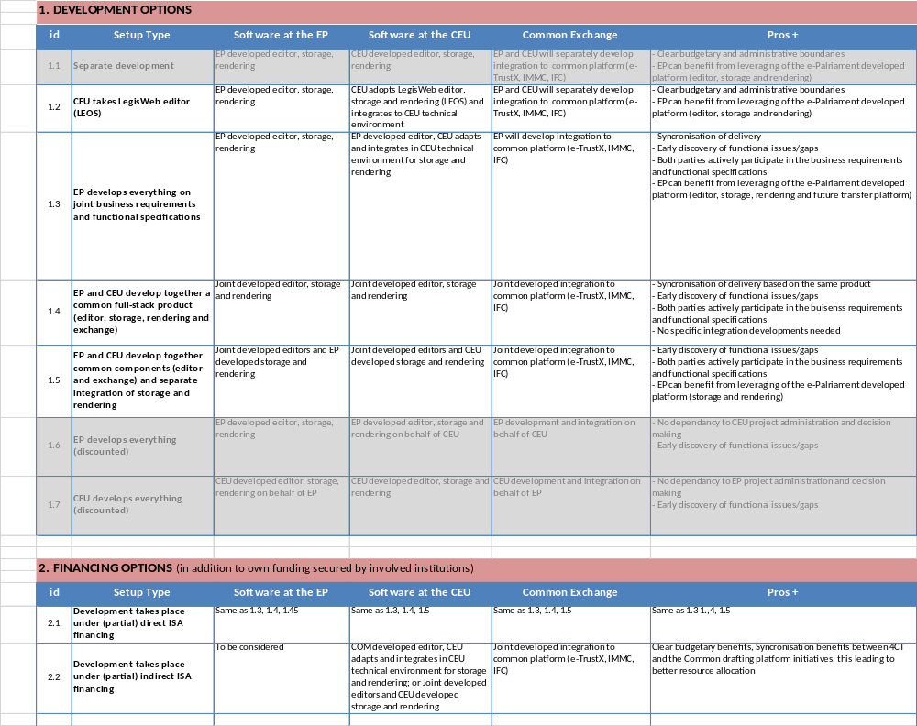
Shape of the project

Slide 6
AOB

Slide 7
Next SC meetings scheduling
Regular SC meetings, bi-monthly (following session week)
  2017, January 23-27
  2017, March 20-24
  2017, May 22-24 (holiday 25-26) or
  2017, May 29-June 2 (mini-session 31/5 & 1/6)
  2017, July 10-14
  2017, September 18-22
  2017, November 20-24
Extraordinary SC meetings
  When deemed necessary

