Slide 1
🅿️ Astana Central Parking
Stage 4 — Unified LangGraph Orchestration
One graph: user interaction → administrator approval (human-in-the-loop) → data recording (MCP).
LangGraph · LangChain · MCP (FastMCP) · FastAPI · Streamlit · SQLite · Milvus Lite

Slide 2
RECAP
From four stages to one pipeline
▸ Stage 1 — RAG chatbot answers questions & collects reservations
▸ Stage 2 — a second agent escalates to a human admin (approve / reject)
▸ Stage 3 — an MCP server records approved reservations to a file
▸ Stage 4 — orchestrate all of it with ONE LangGraph graph
• user_interaction → admin_approval (human-in-the-loop) → record
• Seamless integration, stable operation, tested end-to-end

Slide 3
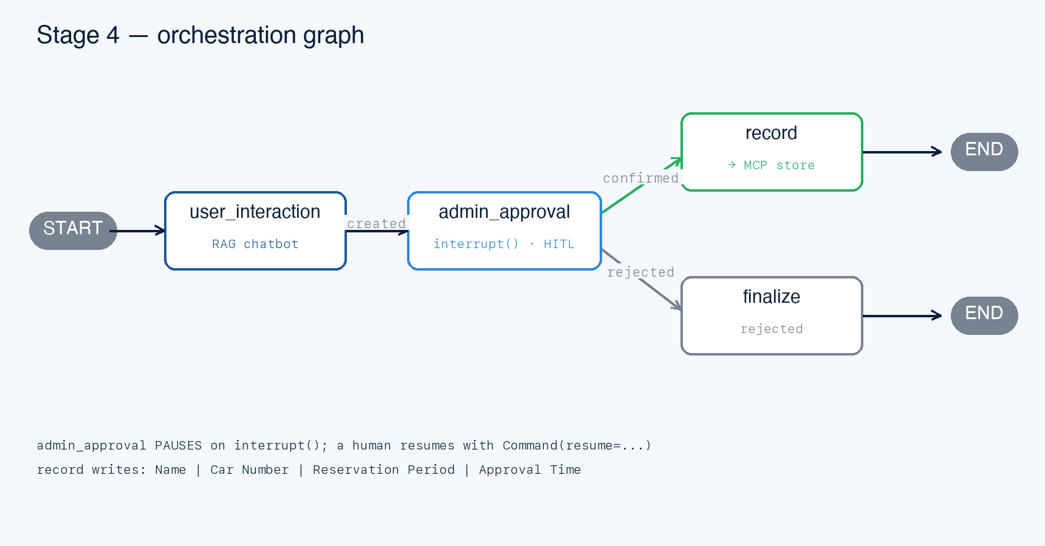
STAGE 4 · LANGGRAPH
The orchestration graph
One StateGraph, three core nodes — the exact structure the brief asks for.

Slide 4
ADMIN_APPROVAL NODE
Human-in-the-loop, done properly
▸ The graph literally pauses for the administrator
• admin_approval calls LangGraph interrupt(payload)
• invoke() returns with __interrupt__ — the reservation awaits a decision
▸ A human decides via the admin UI (or API / test)
• resume with Command(resume={'decision': 'approve'|'reject'})
• interrupt() returns that value; the node applies status + notifies
▸ Backed by a checkpointer
• In-memory by default; a persistent saver lets another process resume
start_pipeline(request) → pause · resume_pipeline(thread_id, decision) → record / finalize

Slide 5
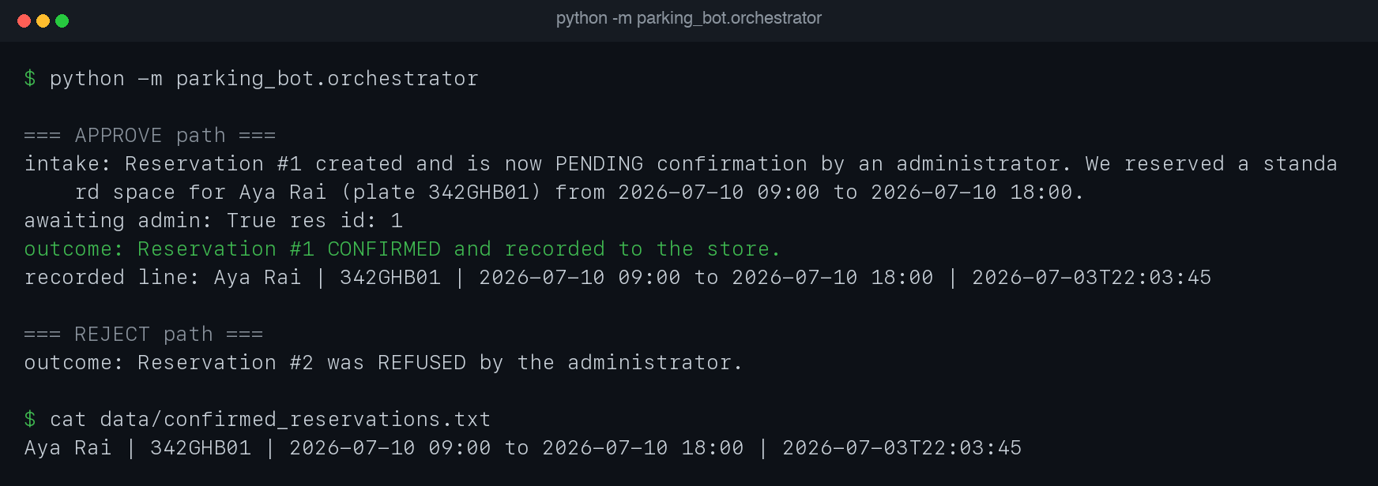
LIVE RUN
The pipeline in action
python -m parking_bot.orchestrator — approve records the line; reject is refused.

Slide 6
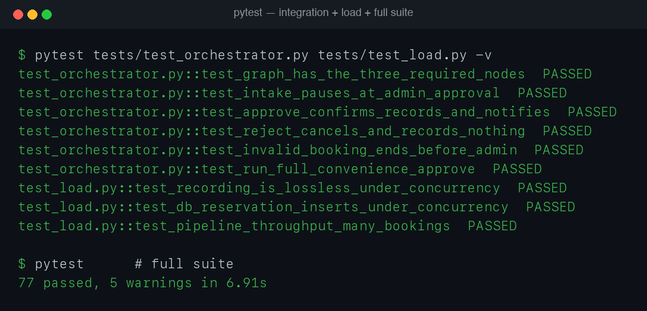
VERIFICATION
Integration & load tests pass
Whole-graph integration tests + concurrency load tests — 77 passed.

Slide 7
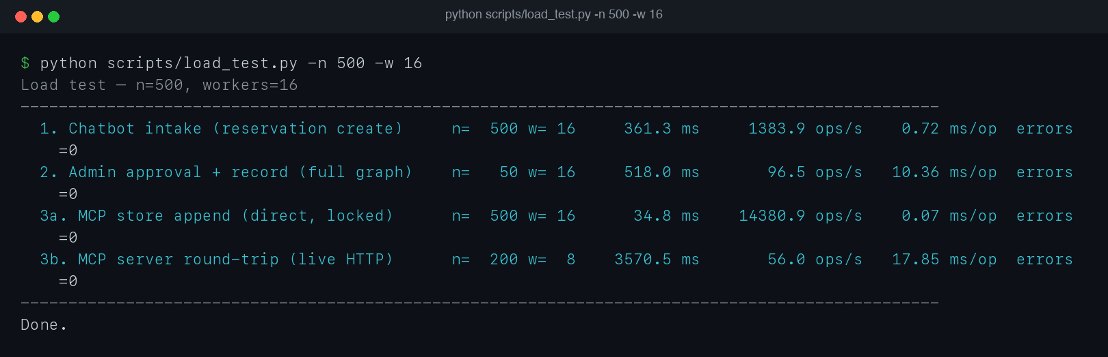
PERFORMANCE
Load testing — per component
scripts/load_test.py — throughput & latency per component, zero errors under load.

Slide 8
TESTING · CI/CD
Engineering quality
▸ 77 pytest tests — ≥ 2 per module, fully offline
• Integration: the whole graph (nodes, interrupt, approve, reject, invalid)
• Load/concurrency: lossless store appends, concurrent DB inserts
• Live MCP client↔server round-trip; fail-closed auth
▸ Reliability hardening
• SQLite busy_timeout; MCP direct-write fallback; MCP off in tests
▸ CI/CD — GitHub Actions, Python 3.11 & 3.12, every push/PR

Slide 9
SUMMARY
Outcome
▸ A unified system where all components interact seamlessly
• One LangGraph pipeline: interaction → approval (HITL) → recording
▸ Stable operation of the entire pipeline
• Load-tested per component; integration-tested end-to-end
▸ Documented (README + ARCHITECTURE.md), tested (77), CI on every push
Demo: python -m parking_bot.orchestrator · Services: mcp_server + admin_server + streamlit

