Slide 1


SAPTHAGIRI COLLEGE OF ENGINEERING
(Affiliated to Visvesvaraya Technological University, Belagavi
& Approved by AICTE, New Delhi)
Department of Computer Science & Engineering
Technical Seminar
Presentation
on
“Practical Algorithm Substitution Attacks on Real-World Public-Key Cryptosystems”
PRESENTED BY:
SHRAVAN L
Under the guidance of :
Prof. Kokila
Assistant Professor
Dept of CSE SCE
2023-2024

Slide 2
CONTENTS
Introduction
Literature Survey
Methodologies
Conclusion and Future Enhancements
References

Slide 3
INTRODUCTION
Substitution attacks are a type of cryptanalytic attack where an attacker tries to recover the plaintext or the secret key by systematically substituting different values (such as the public key, ciphertext, or other parameters) and analyzing the output.
In the context of public-key cryptosystems, substitution attacks can be practical in certain scenarios, particularly when the underlying cryptosystem or its implementation has vulnerabilities or weaknesses.

Slide 4
SIGNIFICANCE OF THE TOPIC
They expose vulnerabilities and weaknesses in the implementation or design of widely-used cryptographic algorithms, potentially compromising the security of critical systems and data.

Slide 5
SCOPE OF THE TOPIC
The scope of the topic, "Practical Algorithm Substitution Attacks on Real-World Public-Key Cryptosystems," encompasses a comprehensive examination of algorithm substitution attacks within the context of real-world public-key cryptosystems.

Slide 6
LITERATURE SURVEY
Sl No | Title | Author | Year | Contributions and drawbacks.
1. | Homomorphic Encryption-Based Secure Data Sharing and Processing in Mobile Cloud Computing | H. Zhang et al. | 2016 | Contributions: By leveraging homomorphic encryption, the proposed approach allows computations to be performed directly on encrypted data, thus preserving privacy. Drawbacks: Scalability issues , computational overhead , key management.
2. | Attribute-Based Encryption for Secure Data Sharing in Mobile Cloud Computing. | J. Wang et al | 2017 | Contributions: Secure Enclaves Implementation: The paper contributes to the field by implementing secure enclaves for privacy-preserving data encryption in mobile cloud computing environments. Drawbacks: Complexity of Attribute Management , Key Management Overhead , Potential for Attribute Inference

Slide 7
Sl No | Title | Author | Year | Contributions and drawbacks.
3. | Privacy-Preserving Data Encryption Techniques for Big Data in Mobile Cloud Computing | X. Liu et al. | 2018 | Contributions: By covering a wide range of encryption methods, including homomorphic encryption, attribute-based encryption, proxy re-encryption, and secure multi-party computation, it offers a valuable resource for researchers and practitioners. Drawbacks: Limited Depth , Lack of Real-World Case Studies , Future Directions.
4. | A Secure and Privacy-Preserving Data Encryption Scheme for Mobile Cloud Computing" | Y. Zhang, W. Liu, and Y. Chen | 2018 | Contributions: The proposed encryption scheme aims to provide robust security measures to protect data in mobile cloud computing environments. By employing advanced encryption algorithms and secure key management mechanisms, it addresses the security challenges associated with data transmission and processing in the cloud. Drawbacks: Limited Evaluation , Complexity , Resource Overhead.

Slide 8
Sl No | Title | Author | Year | Contributions and drawbacks.
5. | Privacy-Preserving Data Encryption for Big Data in Mobile Cloud Computing using Proxy Re-Encryption and Secure Multi-Party Computation | Y. Zhang, W. Liu, and Y. Chen | 2020 | Contributions: A novel privacy-preserving data encryption strategy for big data in mobile cloud computing by combining Proxy Re-Encryption (PRE) and Secure Multi-Party Computation (SMPC) techniques. This approach offers a unique solution to address privacy concerns in mobile cloud environments. Drawbacks: Complexity , Implementation Challenges , Security Considerations.
6. | Privacy-Preserving Data Encryption using Secure Enclaves in Mobile Cloud Computing | Z. Wang et al | 2021 | Contributions: The paper contributes to the field by implementing secure enclaves for privacy-preserving data encryption in mobile cloud computing environments. Secure enclaves offer hardware-based security mechanisms to protect sensitive computations and data. Drawbacks: Hardware Dependency , Performance Overhead , Limited Scope.

Slide 9
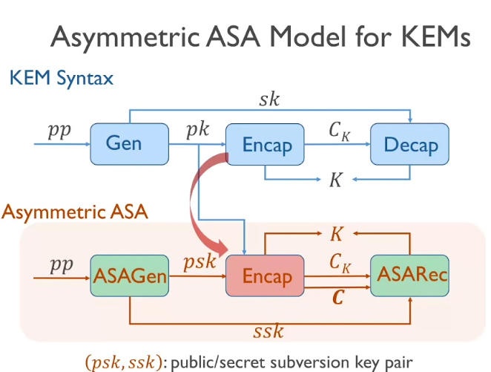
METHODOLOGY
Key Generation
Encapsulation
Encryption
Signing

Slide 10
KEY GENERATION
Key generation method involves utilizing cryptographic algorithms to generate random or pseudorandom values of specific lengths, adhering to established cryptographic standards and ensuring sufficient entropy for robust security.

Slide 11
ENCAPSULATION
Encapsulation in cryptographic algorithms involves combining plaintext data with a cryptographic key through an encryption process to produce ciphertext, ensuring confidentiality and integrity of the information while protecting against unauthorized access or tampering.

Slide 12
ENCRYPTION
Encryption involves transforming plaintext data into ciphertext using cryptographic algorithms and a secret key, rendering the original information unreadable to unauthorized parties while maintaining confidentiality and integrity.

Slide 13
SIGNING
Signing involves generating a digital signature using a private key to authenticate the origin and integrity of a message or document, providing assurance of non-repudiation and preventing tampering or forgery.

Slide 14
ASA ON RSA
Algorithm :
1. Obtain the public key (e, n) used in the RSA cryptosystem.
2. Substitute different public key values (e', n') by modifying the public exponent e or modulus n.
3. Encrypt a known plaintext message m with the substituted public key (e', n') to obtain a ciphertext c’.
4. Decrypt the ciphertext c' using the original private key (d, n) to obtain the plaintext m’.
5. Check if the decrypted plaintext m' matches the known plaintext m.
6. If a match is found, analyze the substituted public key (e', n') to deduce information about the private key or factorization of n.

Slide 15
ASA ON RSA
Given:- Public key: (e = 5, n = 33)
Private key: (d = 17, n = 33)
1. Obtain the public key (e, n) used in the RSA cryptosystem. Public key: (e = 5, n = 33)
2. Substitute different public key values (e', n') by modifying the public exponent e or modulus n. Let's substitute a smaller value for n, say n' = 21.
3. Encrypt a known plaintext message m with the substituted public key (e', n') to obtain a ciphertext c'. Let's choose the plaintext message m = 5. To encrypt m = 5 using the substituted public key (e = 5, n' = 21), we calculate: c' = m^e mod n' = 5^5 mod 21 = 5

Slide 16
ASA ON RSA
4. Decrypt the ciphertext c' using the original private key (d, n) to obtain the plaintext m'. Using the original private key (d = 17, n = 33), we calculate: m' = c'^d mod n = 5^17 mod 33 = 5
5. Check if the decrypted plaintext m' matches the known plaintext m. In this case, m' = 5 matches the original plaintext m = 5.
6. Since a match is found, analyze the substituted public key (e', n') to deduce information about the private key or factorization of n.

Slide 17
ASA ON RSA
Since n' = 21 is a smaller value than the original n = 33, it may be easier to factor n' and potentially recover the private key or factors of n.
In this example, we can easily factor n' = 21 = 3 × 7. Knowing the factors of n', we can use techniques like the Euclidean algorithm or continued fractions to recover the private key d corresponding to the original n = 33.
It's important to note that this attack relies on the key generation process being flawed and generating public keys with small prime factors.

Slide 18
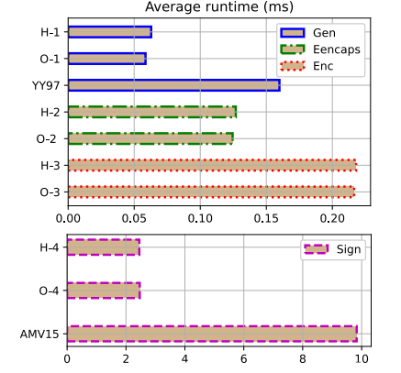
EXPERIMENTAL EVALUATION
Average runtime comparisions between modules.

Slide 19
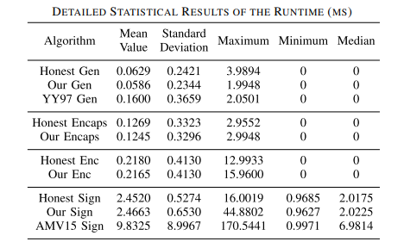
EXPERIMENTAL EVALUATION
Statistical results of the runtime of the modules.

Slide 20
CONCLUSION
A universal subversion framework, and then instantiate this framework to a series of practical ASAs on essential public-key cryptographic algorithms including key generation, encapsulation, encryption, and signature, which are much more effective than existing ones.
In particular, our ASAs can be applied to various widely deployed (and ongoing) cryptographic standards.

Slide 21
FUTURE ENCHANCEMENTS
Implementing advanced security measures to fortify the project against evolving cyber threats. This may involve exploring and integrating the latest encryption standards, authentication protocols, and anomaly detection mechanisms to enhance the overall security posture of the system.
Adapting the project for mobile platforms to cater to the growing number of users accessing applications through smartphones and tablets.

Slide 22
REFERENCES
[1] N. Perlroth, J. Larson, and S. Shane. (2013). N.S.A. Able toFoil Basic Safeguards of Privacy on Web. The New York Times.[Online]. Available: https://www.nytimes.com/2013/09/06/us/nsa-foils much-internet-encryption.html
[2] M. Bellare, K. G. Paterson, and P. Rogaway, “Security of symmetric encryption against mass surveillance,” in Advances in Cryptology—CRYPTO 2014, vol. 8616, J. A. Garay and R. Gennaro,Eds. Berlin, Germany: Springer, 2014, pp. 1–19, doi: 10.1007/978-3-662-44371-2_1.
[3] S. Berndt and M. Liskiewicz, “Algorithm substitution attacks from a steganographic perspective,” in Proc. ACM SIGSAC Conf. Comput.Commun. Secur., B. M. Thuraisingham, D. Evans, T. Malkin, and D. Xu,Eds., Oct. 2017, pp. 1649–1660, doi: 10.1145/3133956.3133981.
[4] I. C. Card. (2019). IBM Systems Cryptographic Hardware Products. [Online]. Available: https://www.ibm.com/security/cryptocards/pciecc4/overview
[5] A. Young and M. Yung, “The dark side of ‘black-box’ cryptography, or:Should we trust capstone?” in Advances in Cryptology—CRYPTO 1996,vol. 1109, N. Koblitz,Ed. Heidelberg, Germany: Springer, Aug. 1996,pp. 89–103, doi: 10.1007/3-540-68697-5_8.

Slide 23
THANK YOU

